Slide 1
HLTAID011
Provide First Aid

Slide 2
Teacher Note
As first aid is a sensitive topic and you know your students best, this presentation does not include any video footage. This has been extracted to allow you the opportunity to place appropriate videos for your audience.
If you would like any assistance with video ideas please feel free to contact info@savilerto.com.au

Slide 3
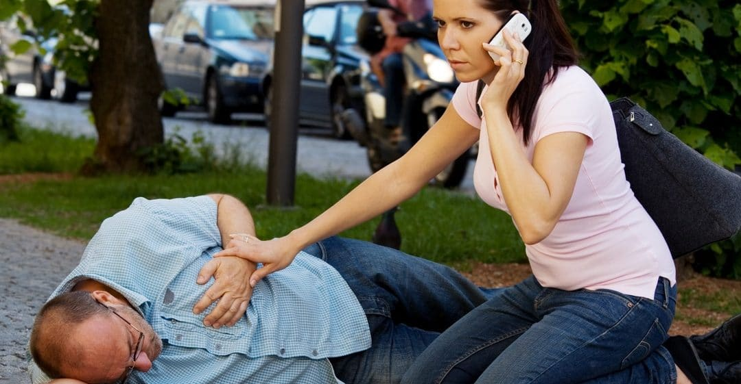
The Four P’s of First Aid Response
Preserve Life
Prevent Further Injury
Protect the Casualty
Promote Recovery Until Help Arrives

Slide 4
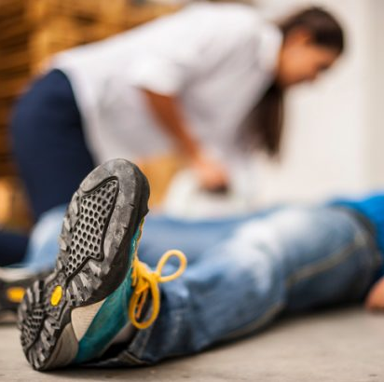
The Good Samaritan Act
This act ensures that a first aider cannot be found negligent for helping a casualty in a first aid scenario, as long as:
• their intentions were good
• they stayed within their level of training
• they didn’t make the situation any worse

Slide 5
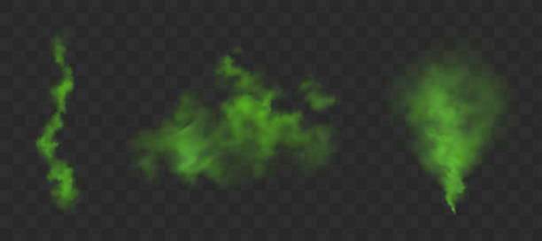
Recognising an Emergency Situation
Hear Something Unusual
See something out of the ordinary
Smell something that is stronger than normal
Note an immediate change in someone’s behaviour or signs that something might be wrong

Slide 6

Identifying and Preparing for Hazards
Common workplace hazards may include
Physical Hazards
Biological Hazards
Chemical Hazards
Manual Handling Hazards

Slide 7
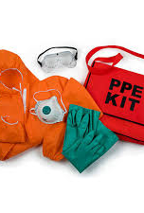
Protecting Yourself and Others
Never Put Yourself at Risk
Wear Protective Gear to avoid infection
Assess and manage risk

Slide 8
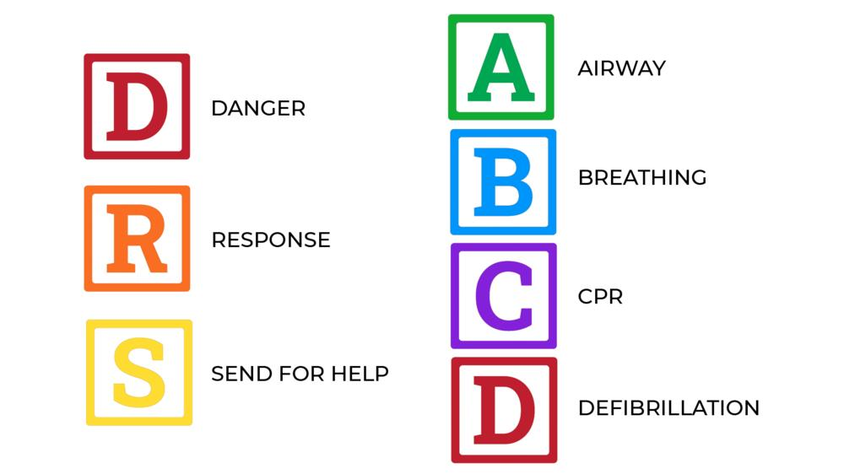
DRSABCD

Slide 9
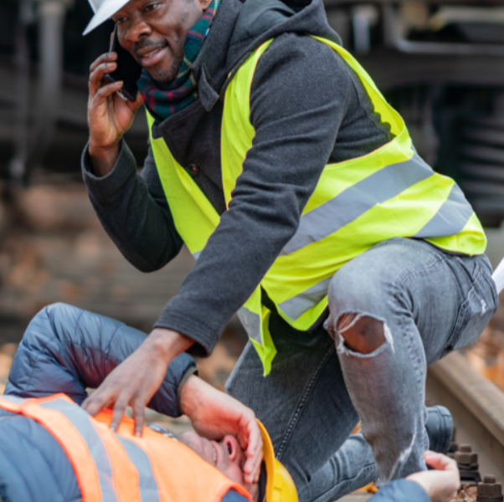
Dangers
Assess the situation
Does the threat still exist?
Can you safely remove the potential hazards?
What are the risks for you? The Casualty? Bystanders?
Do you have any protective equipment ?
How many casualties are there?
Who is at most risk?

Slide 10
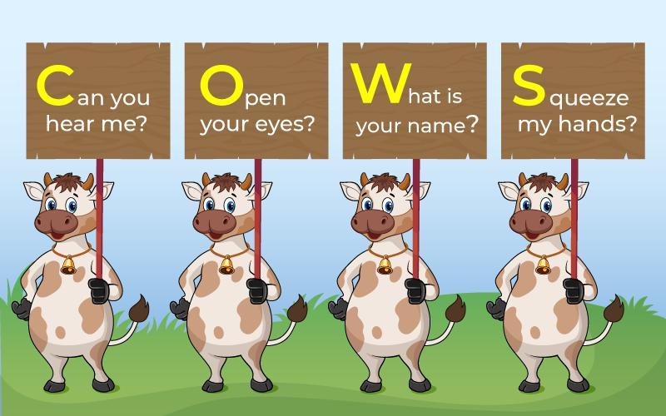
Responsive
COWS
Can you hear me
Open your eyes
Whats your name
Squeeze my hands

Slide 11

Send for Help 000 or 112

Slide 12
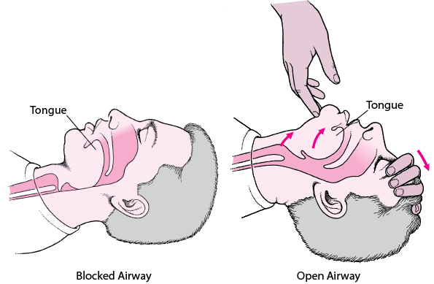
Open Airway

Slide 13
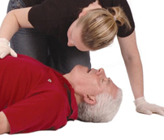
Normal Breathing
Recovery Position
Look, Listen, Feel

Slide 14
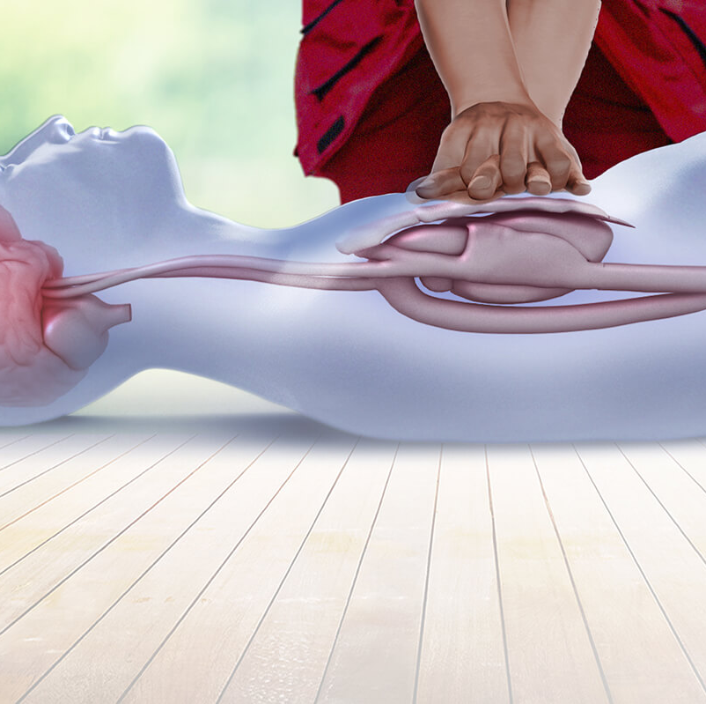
Start CPR
30 compressions 2 Breaths
100-120 beats per minute
1/3 of total chest depth

Slide 15
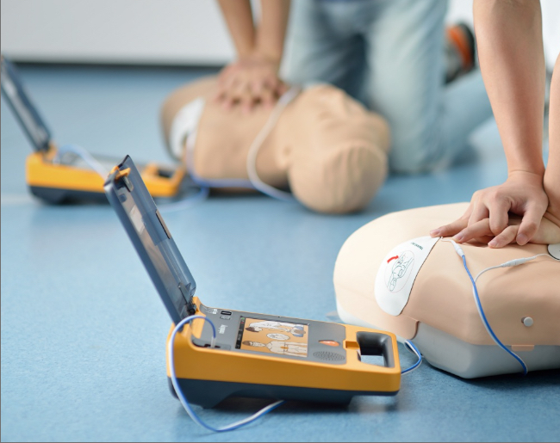
Attach Defibrillator
Find the nearest Defibrillator
Defibs can be found in shopping centers, sporting clubs, gyms, airports, local shops, nursing homes etc
Turn the Defib on and listen carefully to the instructions

Slide 16
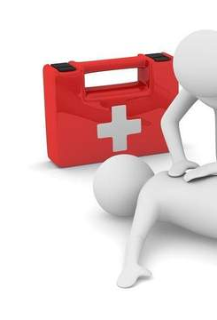
Conditions that will require first aid management
Abdominal injuries
Allergic reactions
Wound care and bleeding control
Nose bleeds
Burns
Cardiac conditions
Choking and airway obstructions
Crush injuries
Diabetes - hypoglycaemia and hyperglycaemia
Drowning
Envenomation
Hypothermia
Hyperthermia

Slide 17

Conditions that will require first aid management
Dehydration
Stroke
Shock
Eye and ear injuries
Dislocations
Fractures
Febrile convulsions
Seizures and epilepsy
Head neck and spinal injuries
Needle stick injuries
Poisoning and toxic substances
Asthma
Soft tissue injuries PLEASE NOTE – It is important to regularly check the Australia

Slide 18
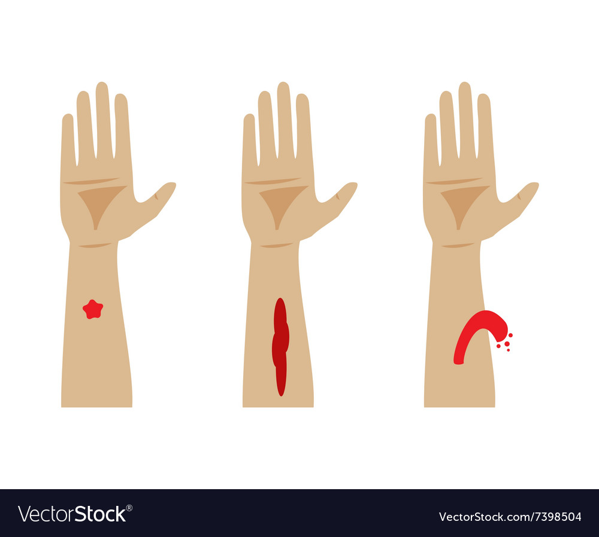
Bleeding
Types of Wounds
Lacerations
Punctures
Incisions
Abrasions
Avulsions

Slide 19

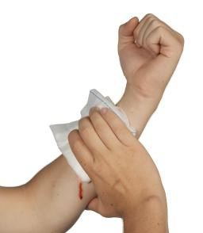
Managing a Bleed
Control the bleed, apply pressure
Prevent infection
Seek medical attention if required
https://youtu.be/ABxICAdQ3M8

Slide 20
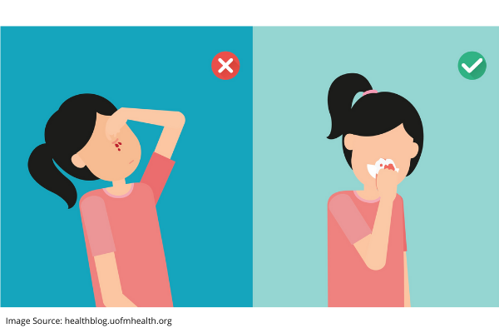
Management of Nose Bleeds
Keep the patient calm
Sit the patient down and have them lean their head down and forward
Patient pinches fleshy part of nose
Apply ice pack to the back of the neck
After 10 minutes check if patient is still bleeding

Slide 21
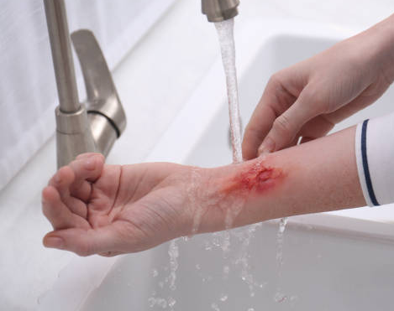
Burn Wounds
Remove the source of the burn
Cool the burnt area with cool flowing water for up to 20 minutes
Cover the burn with a non adhesive dressing
Seek further medical aid

Slide 22
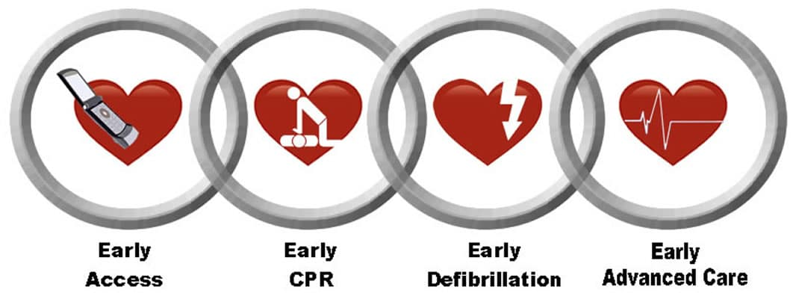
Cardiac Conditions & Chain of Survival
Heart Attack
Angina
Cardiac arrest

Slide 23
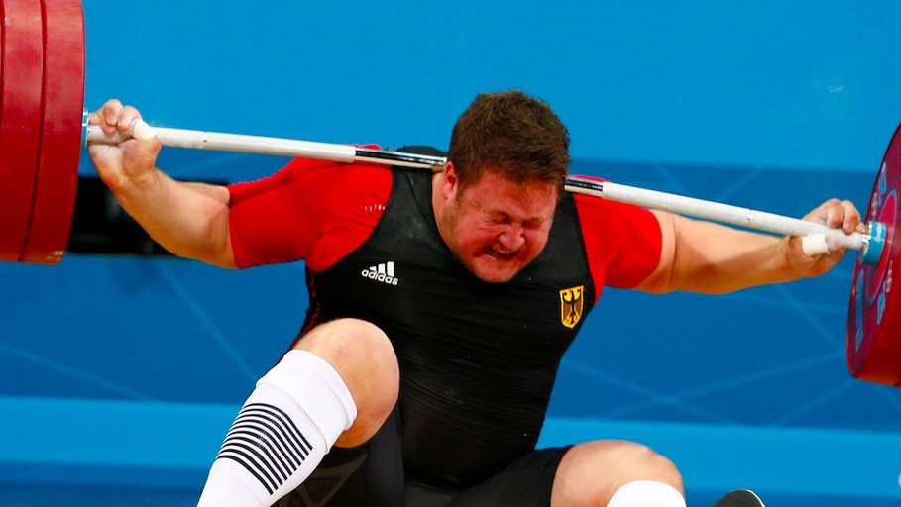
Crush Injuries
Common injuries caused by someone being crushed include:
Internal and external bleeding
Bruising
Broken bones and fractures
Compartment syndrome (where extreme pressure on limbs causes serious muscle, nerve, blood vessel and tissue damage
Treatment includes
Call 000 for help
Remove the crushing force, if possible and it is safe to do so
Assess the casualty’s injuries
Control any bleeding
Support and immobilise any suspected broken bones, fractures and/or dislocations
If the casualty becomes unresponsive follow DRSABCD

Slide 24

Diabetes
Type 1 vs Type 2 Big difference
Hyperglycemia – glucose levels too high – need insulin
Hypoglycemia – glucose levels too low – need glucose

Slide 25
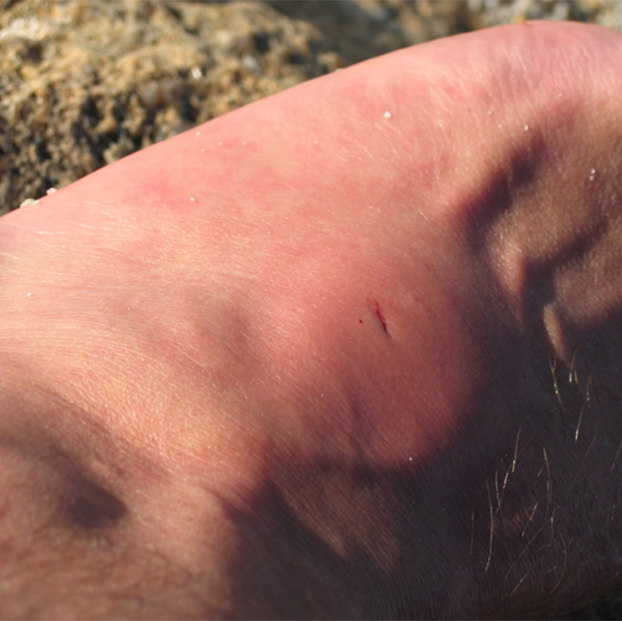
Envenomation
It is important to choose the right treatment based on the specific animal or insect that inflicted the injury.
Ice management - bees, mosquitos, wasps and bull ants
Pressure Immobilization- venomous snake in Australia, funnel web spider, blue ringed octopus or cone shell
Hot water immersion or hot pack – jelly fish
Vinegar – jelly fish

Slide 26
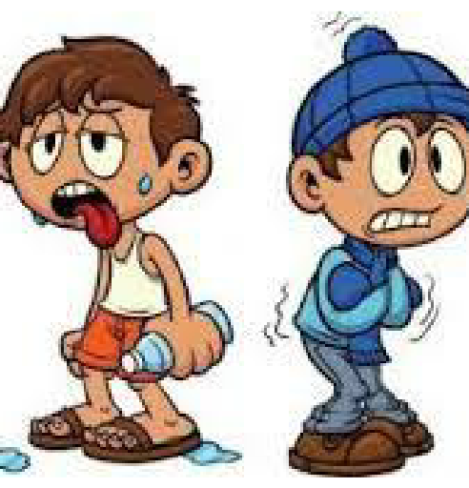
Hypothermia and Hyperthermia
Hypothermia – remove any wet clothing, warm with blankets and give a warm drink
Hyperthermia – Find shade, remove excess clothing, give cool drinks, apply ice packs to groin, neck and armpits

Slide 27
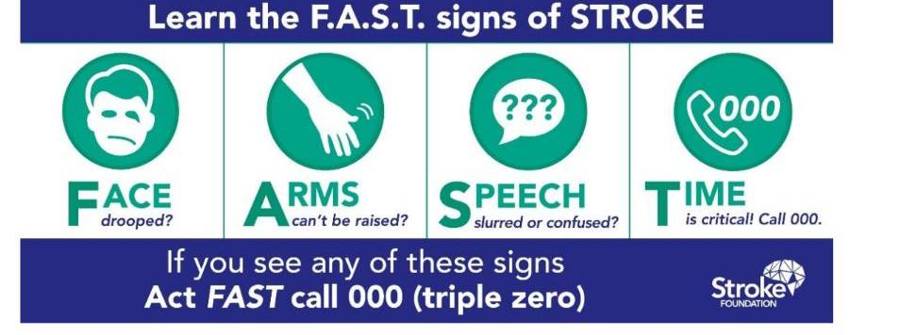
STROKE
A stroke occurs when the blood supply to the brain is blocked or disrupted, and oxygen cannot reach the brain

Slide 28
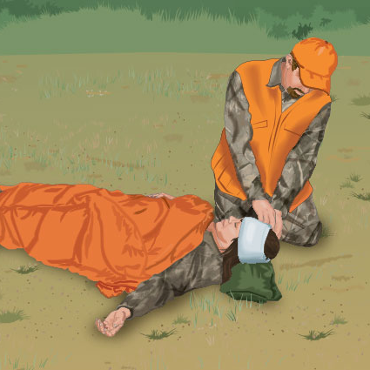
SHOCK
Shock often occurs when a person experiences a trauma or life threatening situation. Inadequate blood flow reaches the body tissues and the organs do not receive the amount of oxygen needed.
Treatment includes calling 000, laying the patient down, and keeping them warm while reassuring them

Slide 29
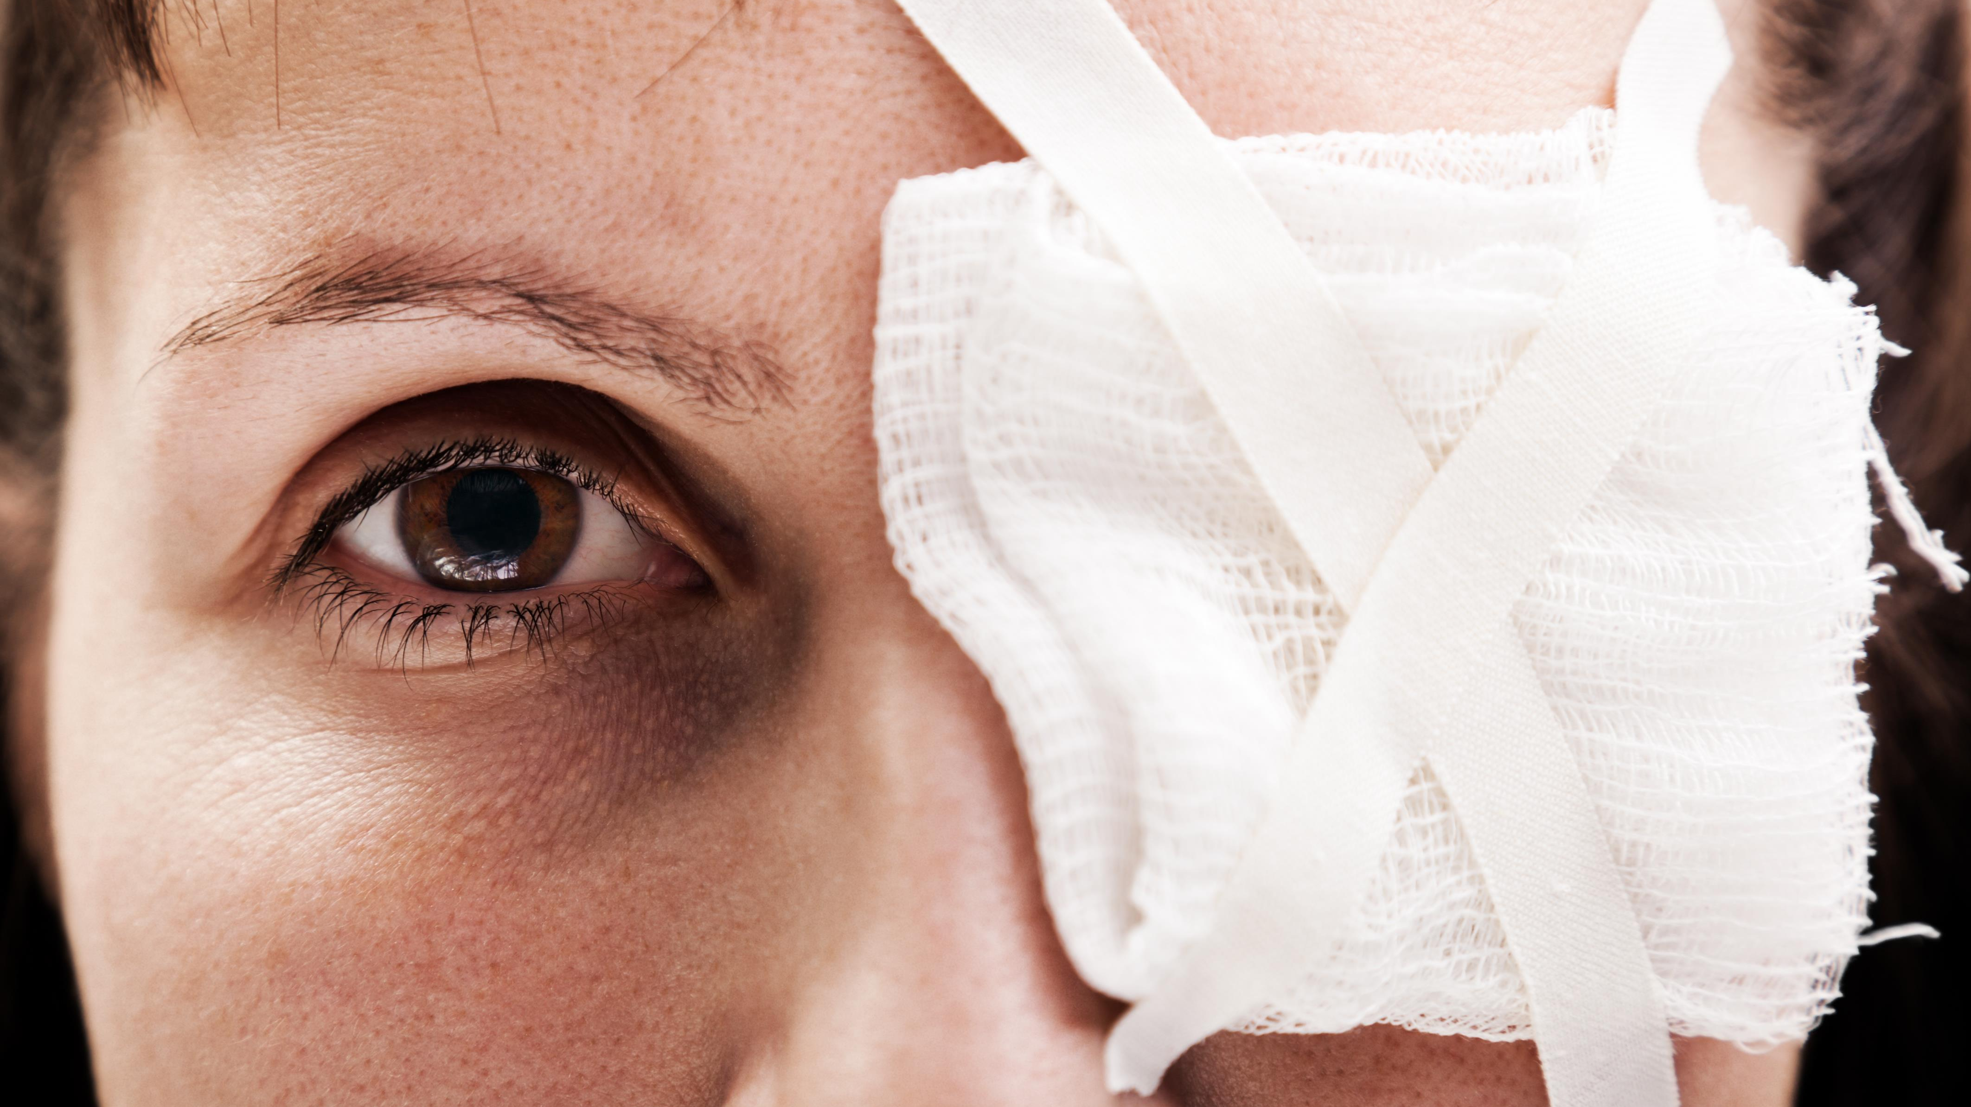
Treating Eye Injuries
1. Use saline solution (or water) to irrigate (rinse) the eye. DO NOT use eye drops.
2. Where a person feels that their vision is affected, you should seek medical assistance. For eye injuries, it is best to attend the Eye and Ear Hospital.
3. Cover the eye with an eye patch to reduce its use

Slide 30
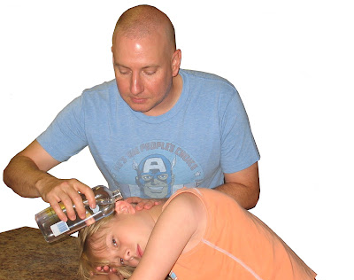
Ear Injuries
Insect in the ear - It is common also for insects to enter a person’s ear. If this happens you should use warm water to attempt to remove/’float’ the insect out.
A foreign object is lodged - Seek medical attention. You should never attempt to dig it out by poking anything into the ear as you could accidently push it further down the ear canal and cause more problems.
Eardrum rupture –Where a person’s eardrum has ruptured you should cover the person’s ear and seek medical attention

Slide 31
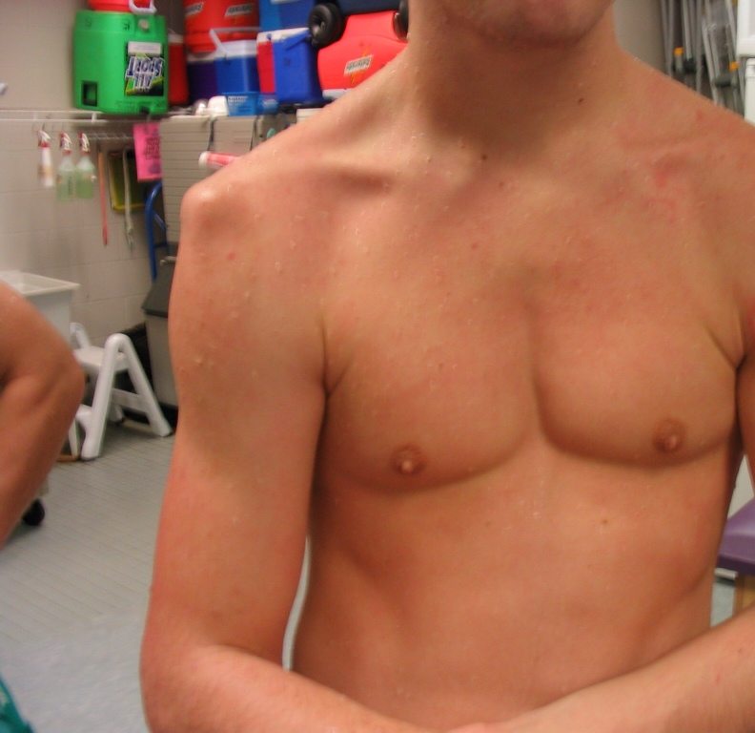
Dislocations
IMPORTANT: A first aider should never attempt to replace a dislocated bone
Treatment: Immobilise,support the joint and seek medical assistance

Slide 32
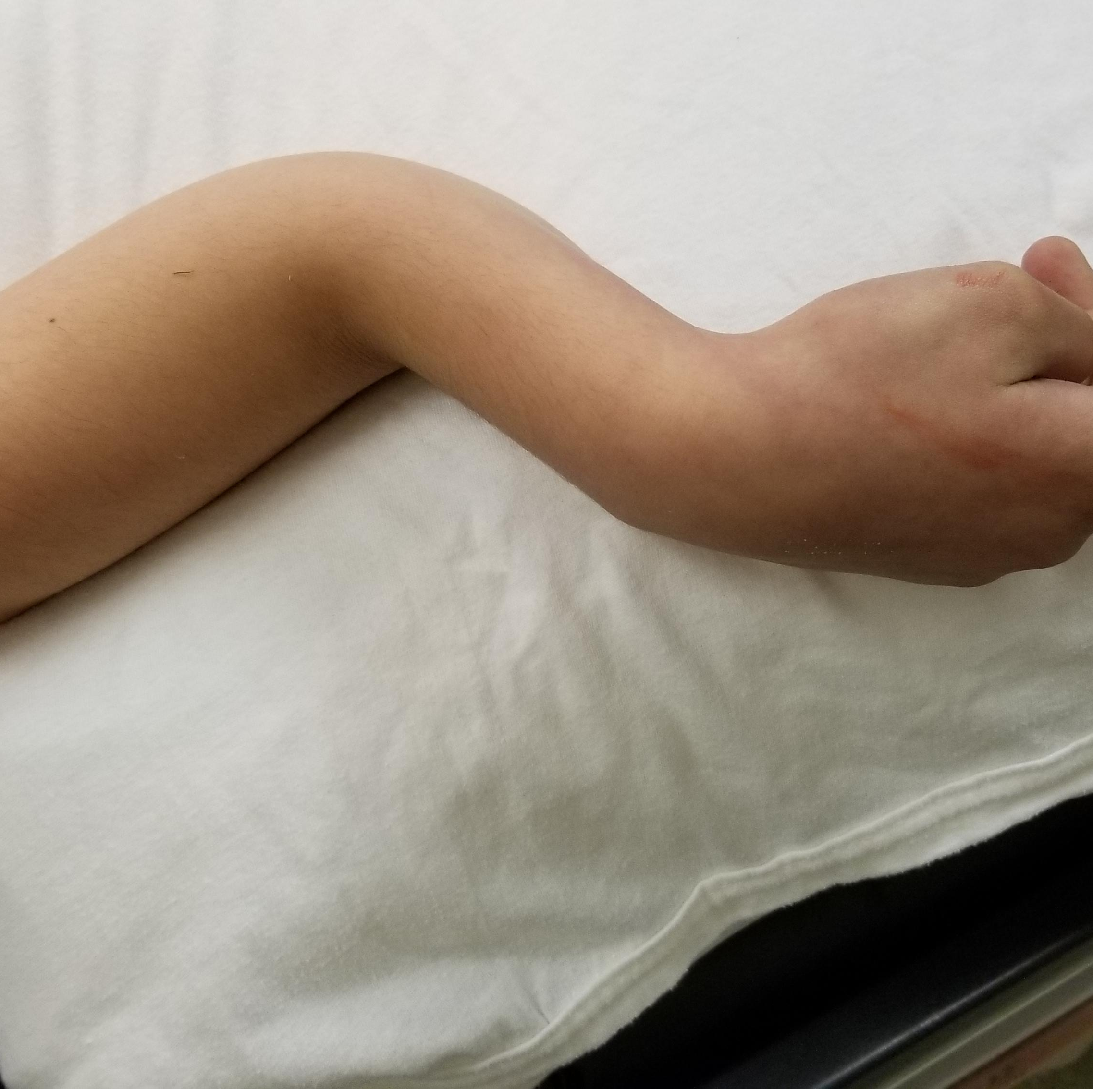
Fractures
The initial treatment for a first aider is the same; immobilise and seek medical attention.
To immobilise a limb, you need to create a splint or sling. Every first aid kit has a triangular bandage that can be used to create a range of different slings to support various fractures.

Slide 33
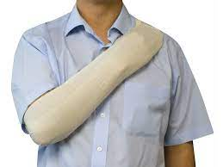
Elevation Sling

Slide 34
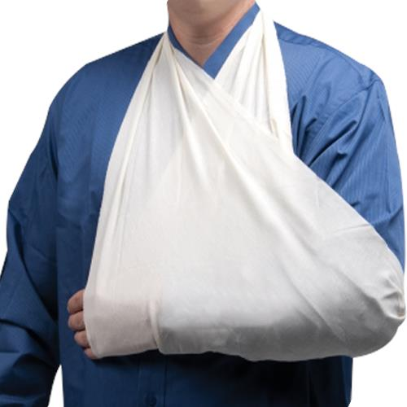
Arm Sling

Slide 35
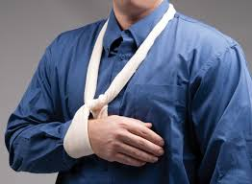
Collar and Cuff Sling

Slide 36
Seizures and Epilepsy
Seizures occur when there is abnormal electrical activity in the brain. There are a range of different conditions or incidents that cause seizures, some of which cause convulsions
Treatment includes removing dangers, putting casualty in recovery position if they were eating, and timing the seizure
Additional informational videos can be found here

Slide 37
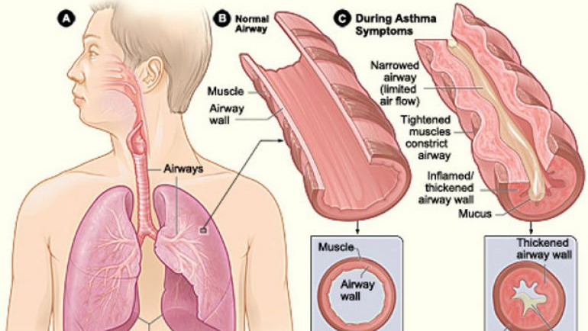
Asthma
Asthma is a condition that causes a person’s airways to narrow when exposed to a ‘trigger’. This causes the person to have difficulty breathing
Common triggers for asthmatics include: • Exposure to allergens such as dust mites, animal hair and mould • Excessive exercise • Exposure to irritants such as cigarette smoke • Food such as nuts • Changes in weather • Respiratory infections • Emotions, stress and anxiety

Slide 38
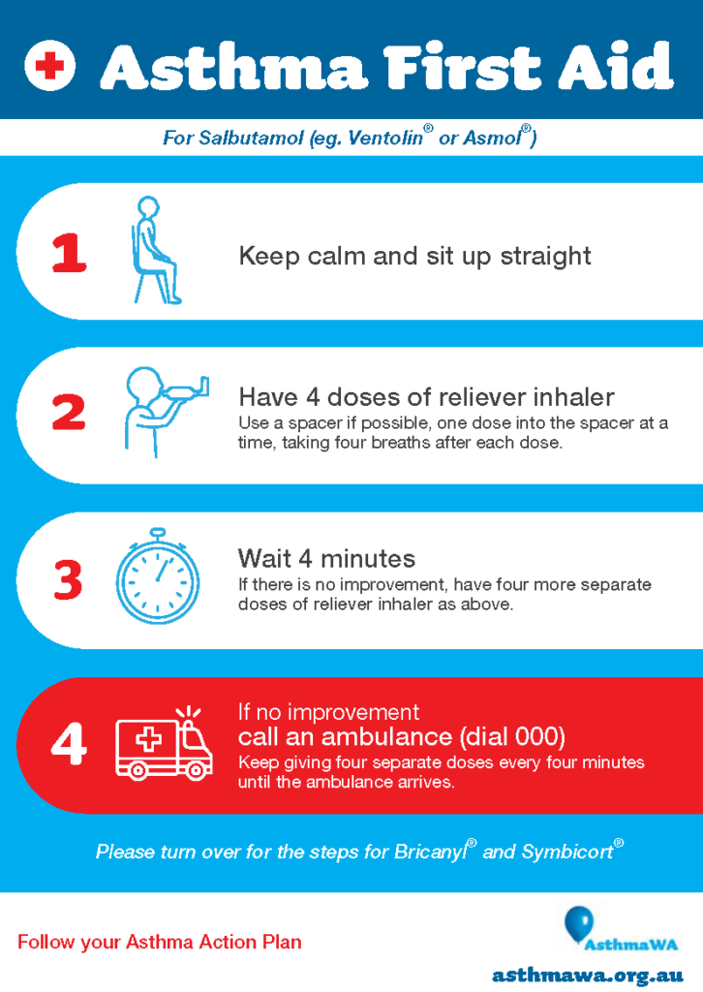
Asthma Treatment
4 x 4 x 4 Method

Slide 39
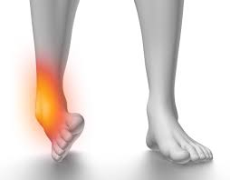
Sprains and Strains
RICER
Rest
Ice
Compression
Elevation
Referal

Slide 40
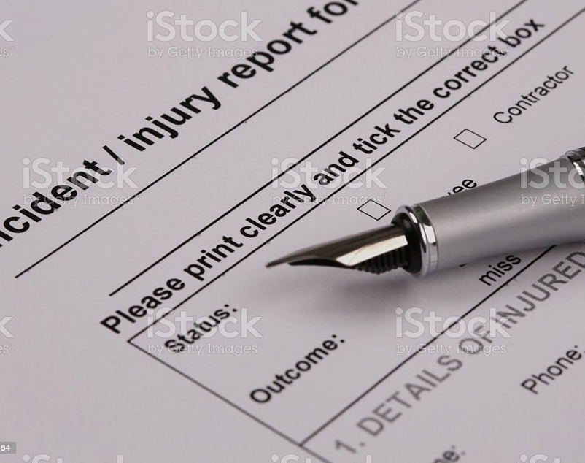
Communicate Details of Incident
Incident report forms must include the following
Date and time of incident
Casualty details
Contact details
Location of the incident
Description of the injury
Vital signs
Fluid output
Treatment
Referral
Witness
Signatures

Slide 41

Debriefing
Debriefing is about discussing the incident and working to put the abnormal event into perspective to enable a person to recover and move on from the incident.
Debriefing aims to:
Lessen the impact of the trauma
Assist those involved in the incident to recover
Identify those who may require additional assistance
Make improvements to systems and processes to avoid or be prepared for similar incidents in the future (most applicable for workplace-related

