Slide 1





Breaking
DOWN
the
EXAM
2024 exam & looking ahead to what is to come

Slide 2





Test your knowledge
Key Terminology
Data comparison
2025 potential strategies
Question Breakdown
Terms
Activities
Agenda

Slide 3



Test your knowledge
You have 2 minutes to answer this slide

Slide 4
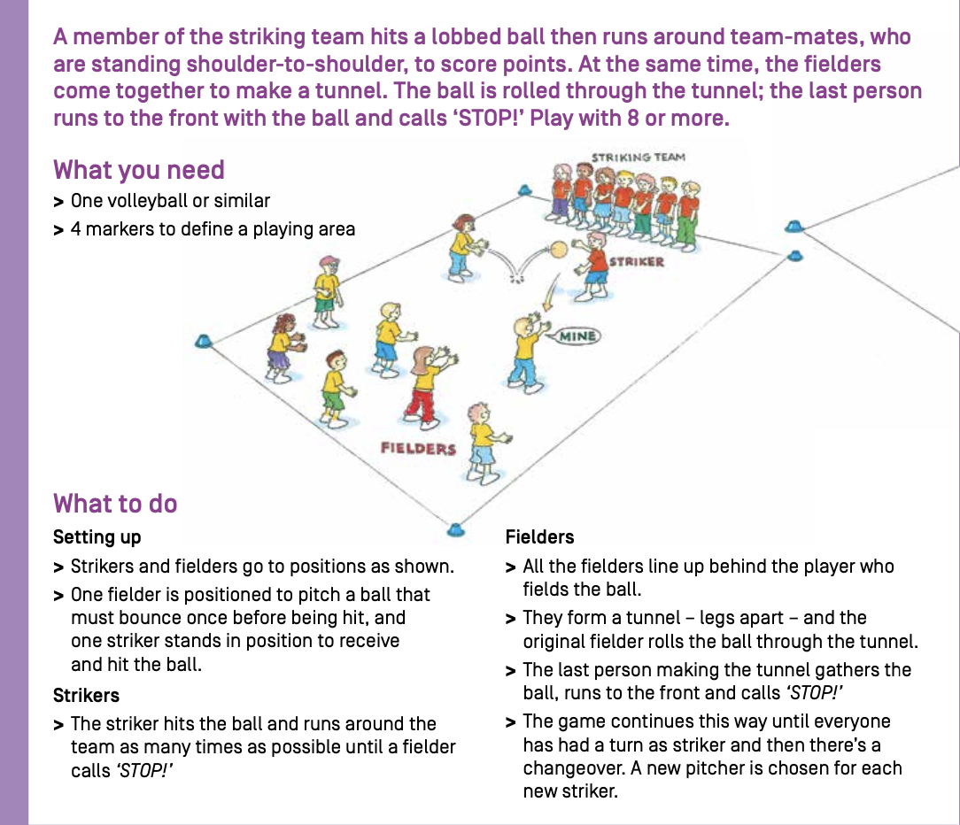
Alter this predesigned session plan
You notice that your children in the session after 20 minutes are becoming disinterested due to the ease of the game and their advanced ability.
On the next slide you are required to list and explain 2 adaptations to the session you can make to match the characteristics of your participants.

Slide 5
Adaptation 1:
Explanation:
Adaptation 2:
Explanation:

Slide 6
Exam terminology 101

Slide 7
Why do students need to know these?
Difference
Identify and explain how two or more items are not the same, focusing on distinct characteristics or outcomes.
Objective
State a goal or aim that is clear and measurable, without being influenced by personal feelings or opinions.
Rationale
Provide reasons or justification for a decision, action, or belief, explaining the underlying logic or reasoning.
Compare
Identify similarities and differences between two or more items, providing points for and/or against each.

Slide 8
Clarify
Compare
Define
Demonstrate
Describe
Discuss
Explain
Identify/Indicate/What
List
Outline
State
Why
Make clear or plain
Show how things are similar and different
State meaning and identify essential qualities
Show by example
Provide characteristics and features
Identify issues and provide points for and/or against
Relate cause and effect; make the relationships between things evident; provide why and/or how
Recognise and name
Provide a series of related words, names, numbers or items that are arranged in order, one after the other
Sketch in general terms; indicate the main features of
Express the main points of an idea or topic
Looking for the reason or cause of example

Slide 9




What was number one in 2024?
Identify - 11
Describe - 6
List - 5
Used 5 times as a secondary trigger word
Used once as a secondary trigger word

Slide 10
What about the rest of them?
Explain – 4 times (1 secondary)
Yellow is a big jump from previous years
Justify – 4 times (3 secondary)
Suggest – 4 times
Explain – 4 times (1 secondary)
Outline – 3 times (1 secondary)
Define – 2 times
Discuss – 2 times (2 secondary)
White is a new trigger from past exams
How – 1 time
Provide – 1 time secondary
Evaluate – 1 time

Slide 11

Trigger word | 2023 exam | 2022 exam | 2021 exam | 2020 exam | 2019 exam
Identify | 7 | 10 | 8 | 2 | 16
State | 6 | 9 | 7 | 7 | 9
Describe | 5 | 7 | 7 | 6 | 2
List | 0 | 2 | 6 | 10 | 4
What | 0 | 4 | 4 | 4 | 6
Explain | 1 | 2 | 3 | 3 | 4
Provide | 0 | 4 | 1 | 1 | 1
Define | 2 | 4 | 1 | 3 | 0
Give | 0 | 4 | 1 | 0 | 0
Indicate | 0 | 0 | 2 | 2 | 2
Select | 0 | 1 | 0 | 0 | 2
Why | 0 | 1 | 0 | 1 | 0
Outline | 3 | 1 | 3 | 0 | 3
Justify | 1 | 1 | 1 | 0 | 2
HOW DOES THIS COMPARE?

Slide 12



2025
EXAM
What does this mean for this year?
Look for higher order stem words:
illustrate, evaluate, discuss etc
Learn your knowledge evidence criteria and be particular about wording
Illustrate - Similar to 'explain', but requires the quoting of specific examples or statistics or possibly the drawing of maps, graphs, sketches, etc.
WHS protocols: Including risk identification and control measures.
Practical Scenarios: Real-world applications of sport and recreation management, with an increasing focus on inclusion and risk management for diverse populations.
Coaching Techniques: Particularly for different age groups, requiring detailed knowledge of communication methods and participant engagement.
Evaluate - To ascertain the value or amount of; appraise carefully.
Discuss - Identify issues and provide points for and/or against.

Slide 13

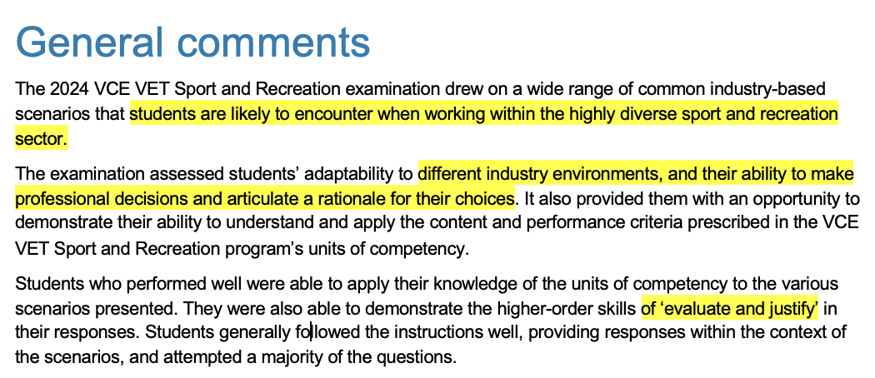


Slide 14
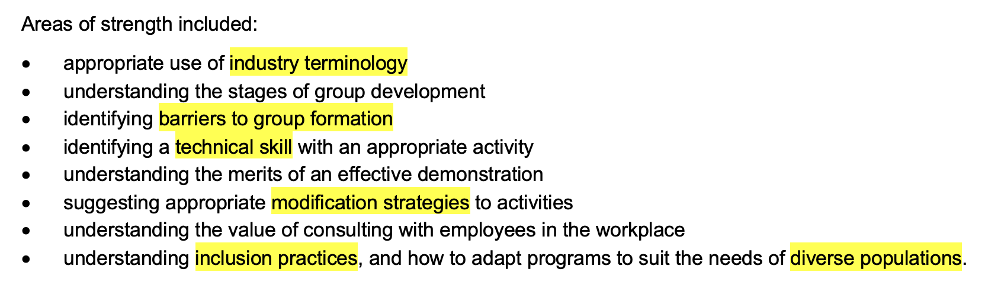

Slide 15

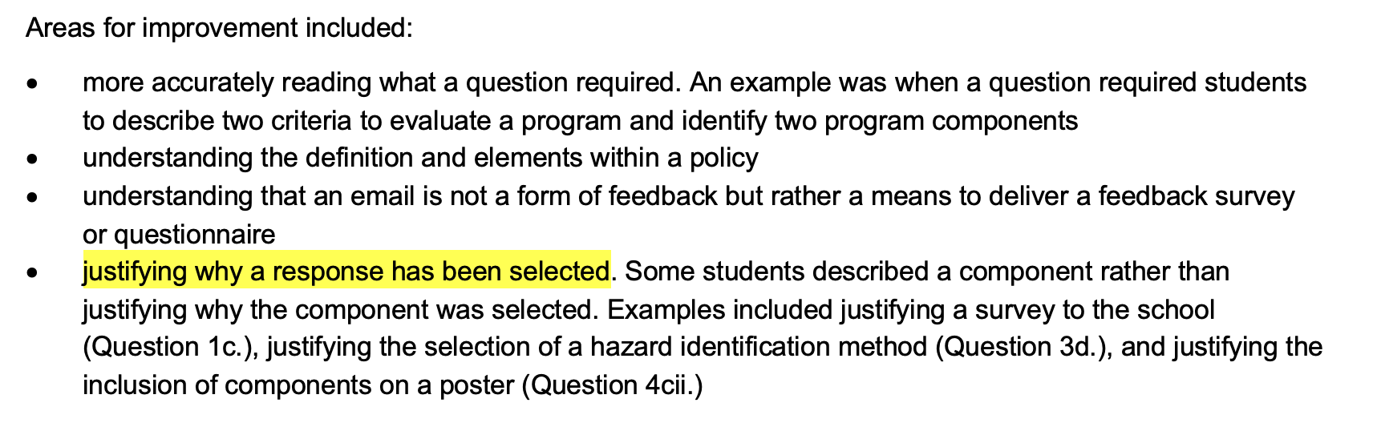
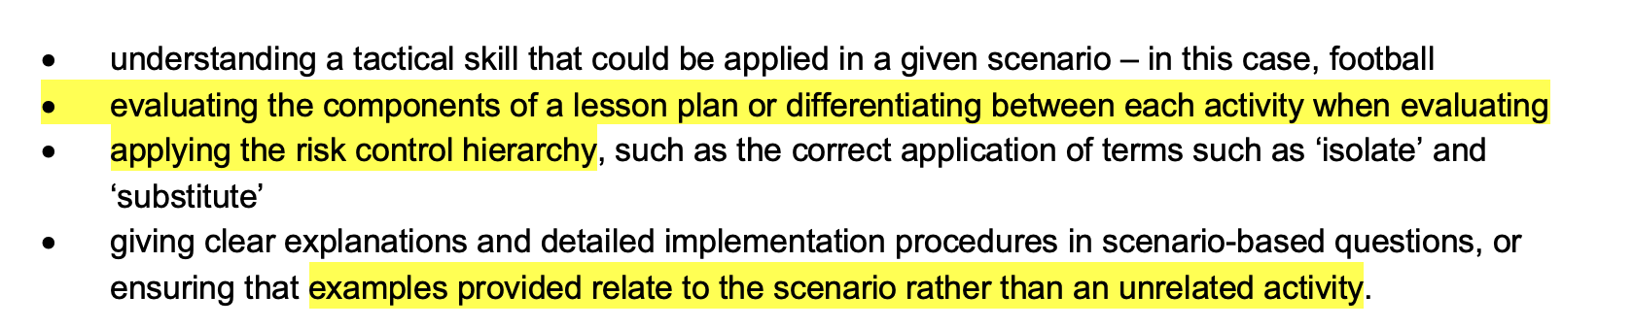

Slide 16
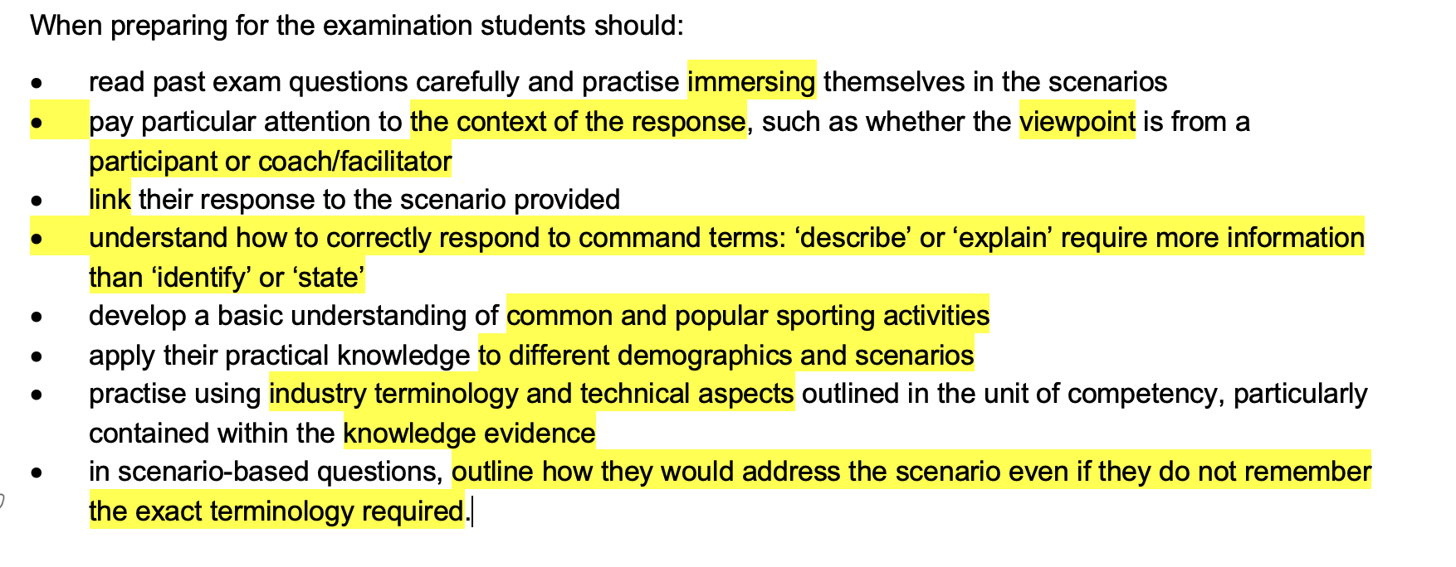

Slide 17
Review the examiners report
Look at the knowledge evidence
After today have a look at the report, break down the questions which were poorly answered and think about why?
Clearly telling you to find technical aspects and industry terminology
What does this
MEAN
UOC’s - where and how?
Common Sports
Have your students break down the UOC’s to work out where the answers are coming from.
Ensure that students are exposed to multiple sports in question types as well as general application of them.

Slide 18
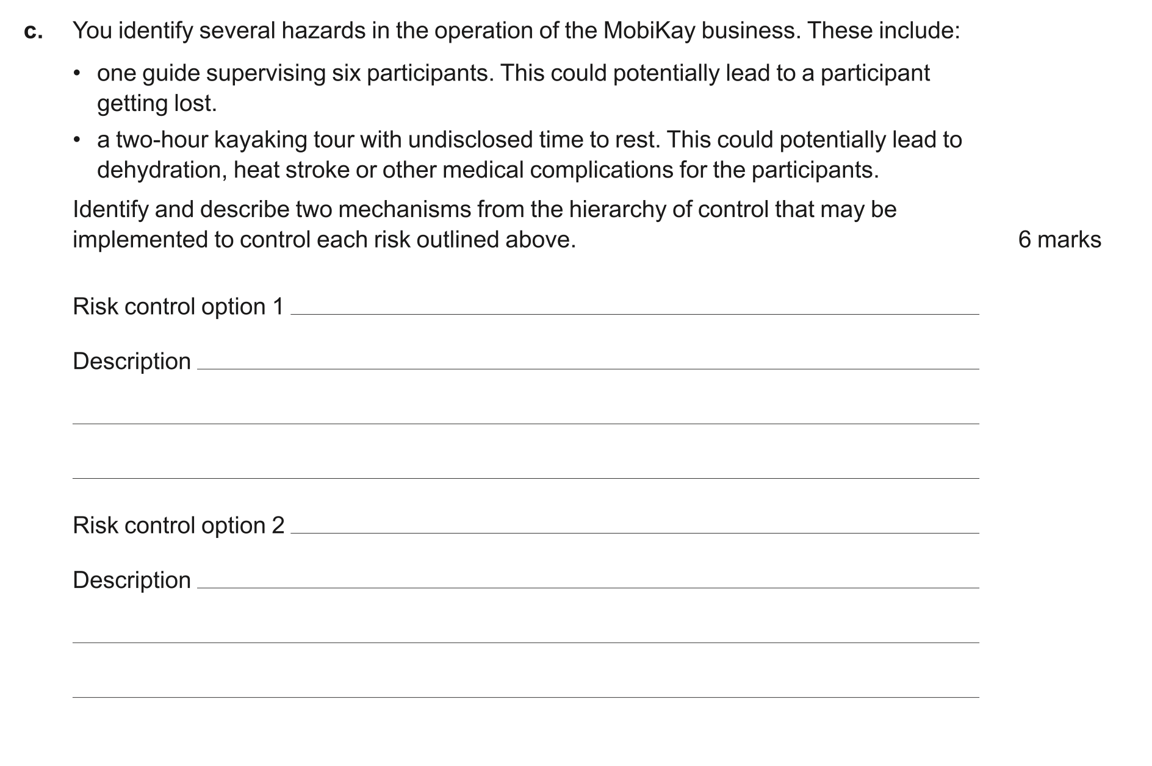
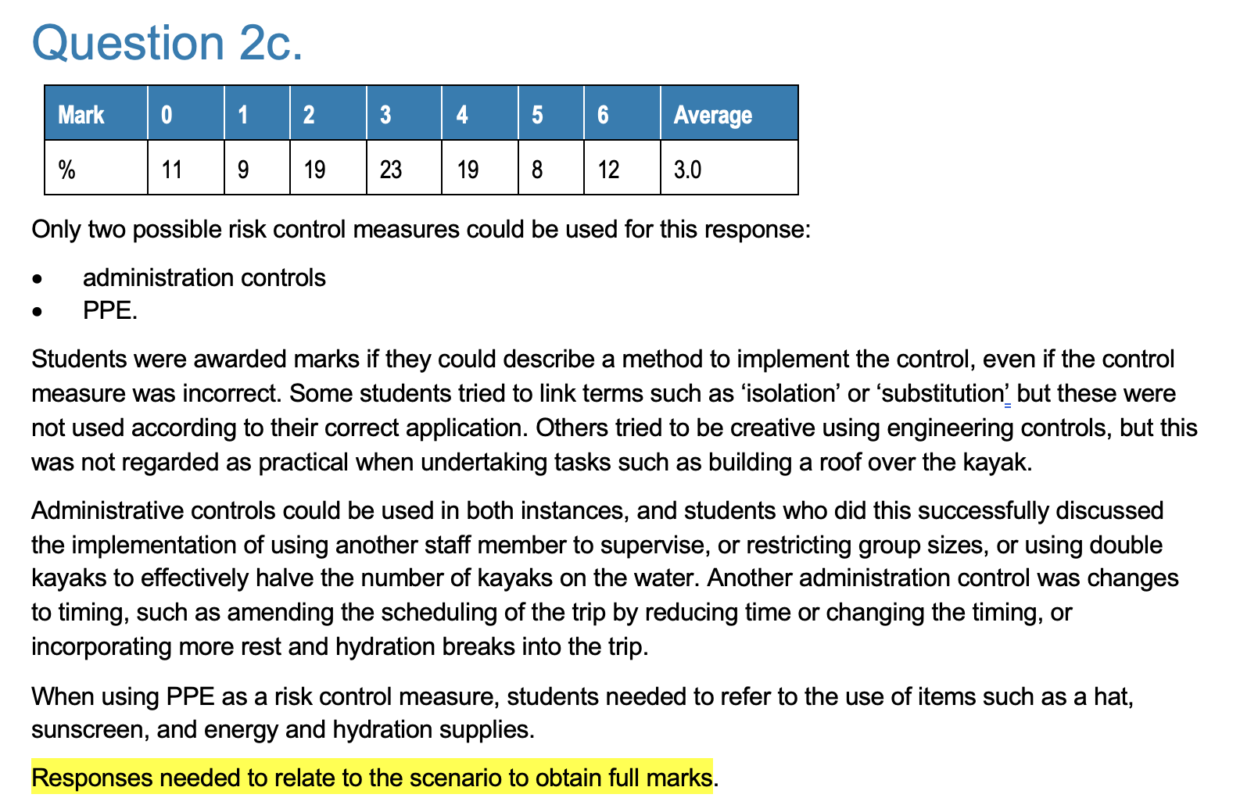

Slide 19
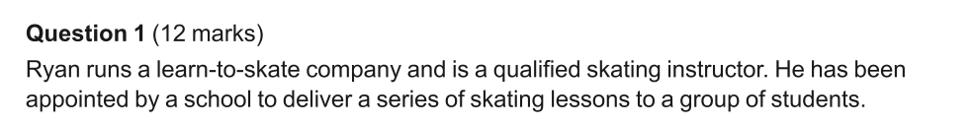
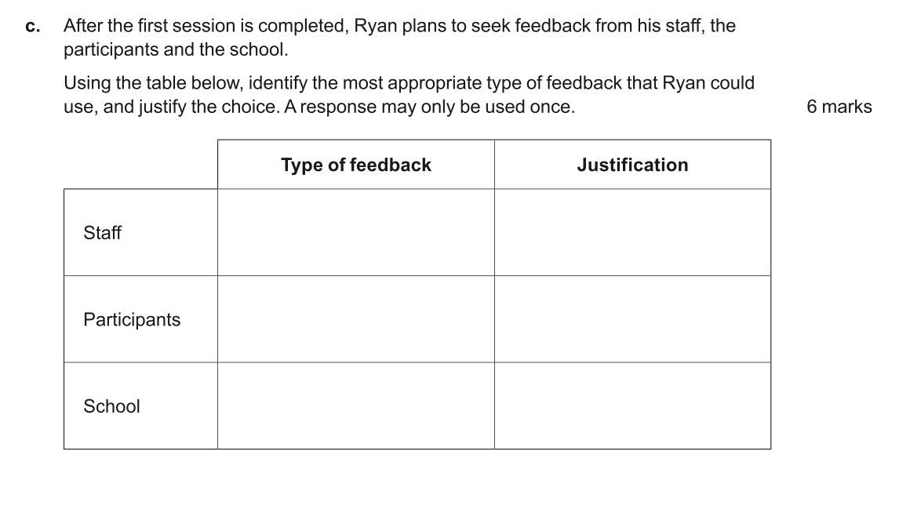
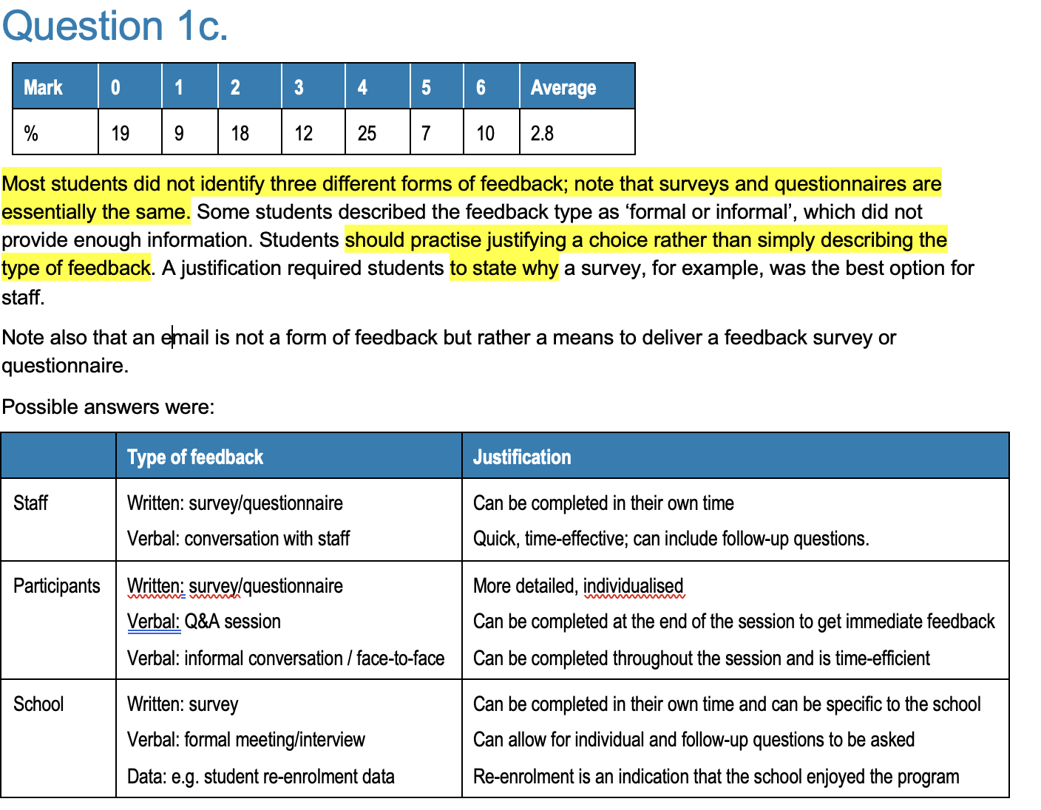

Slide 20
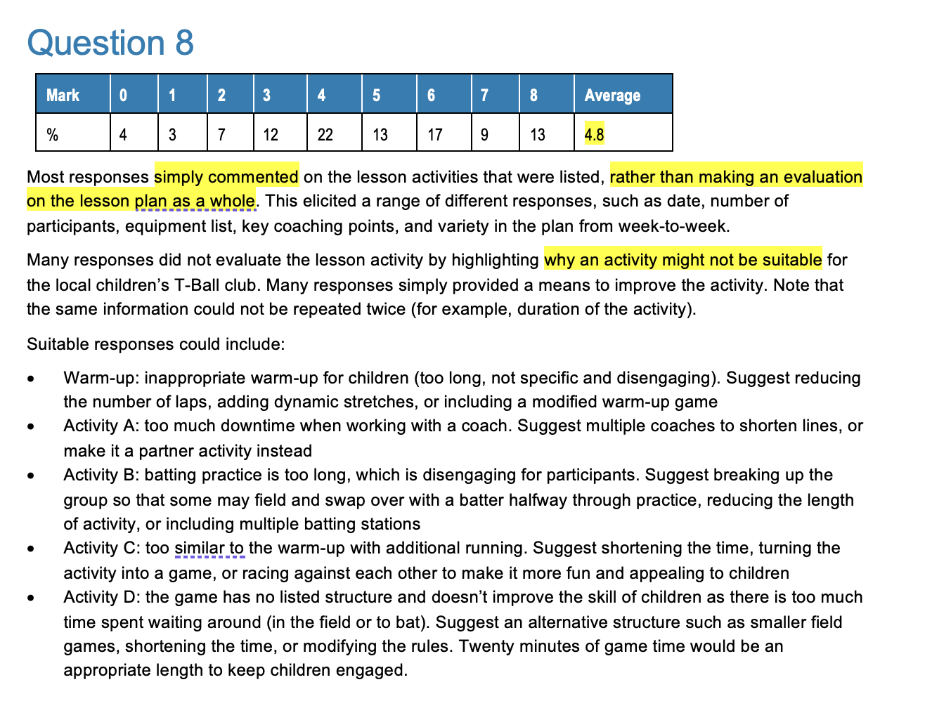
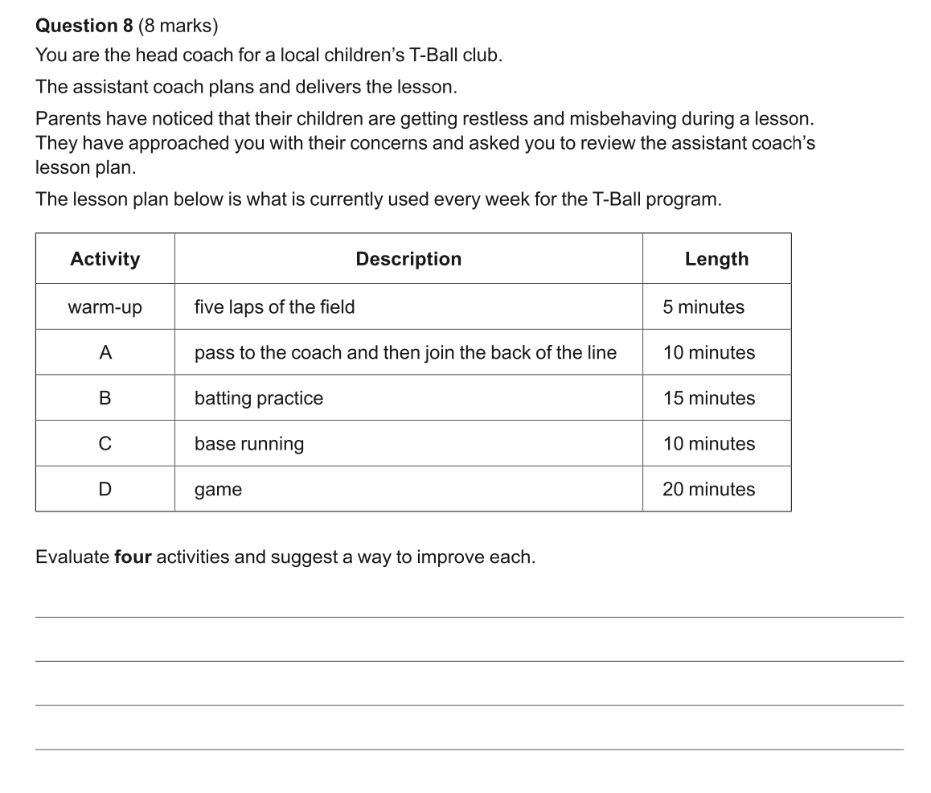

Slide 21
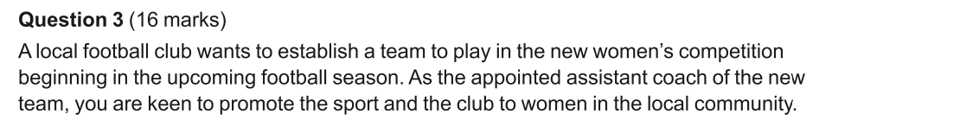
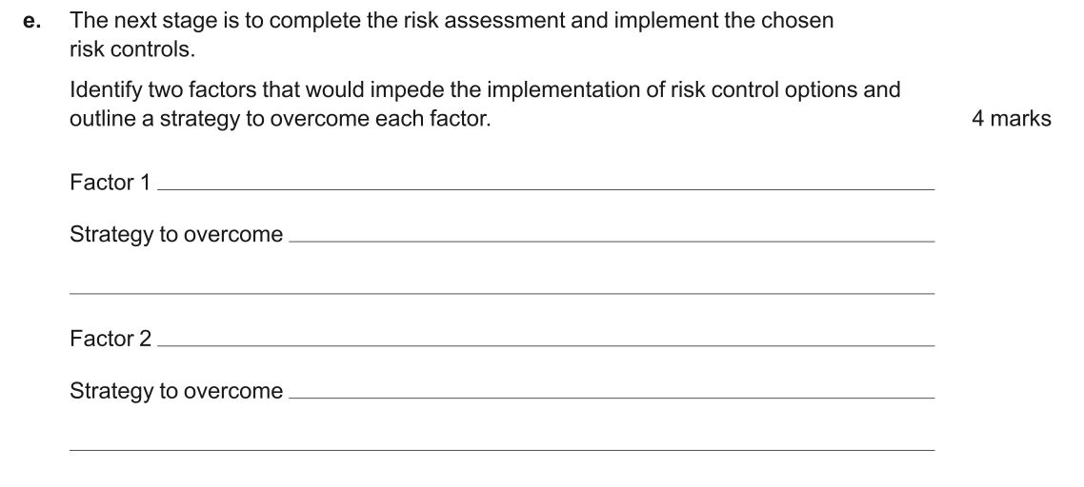
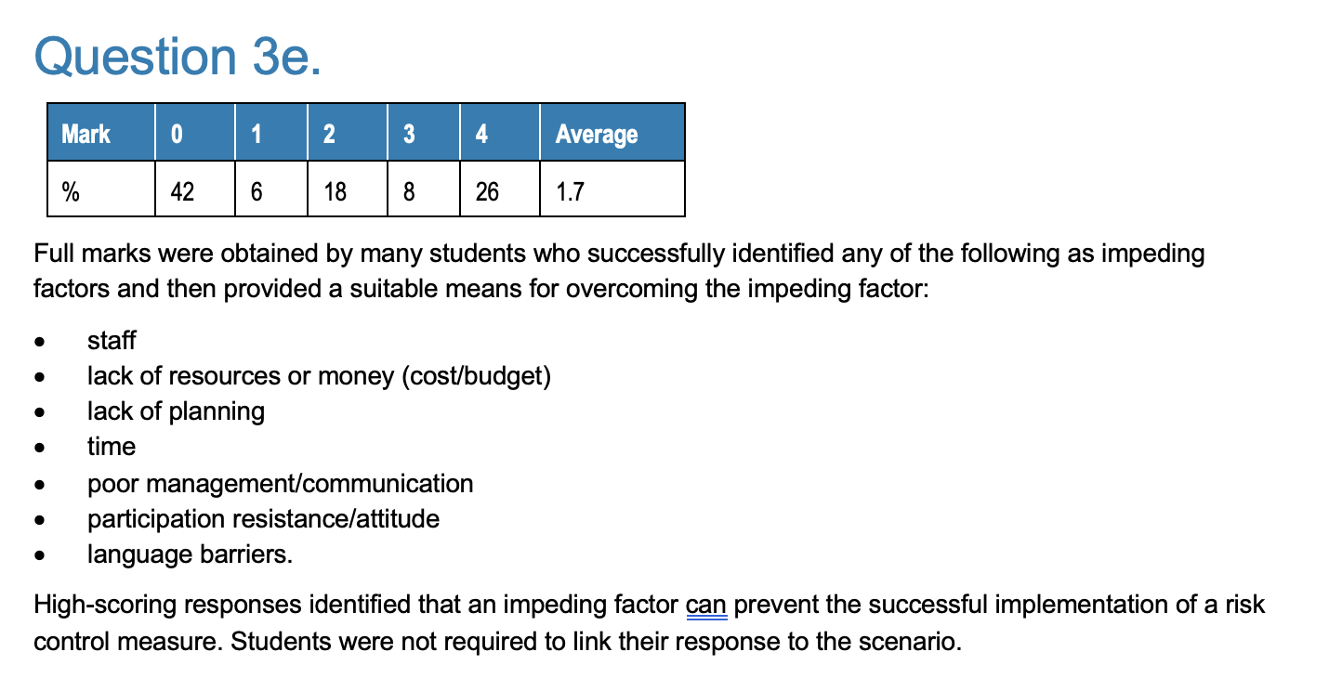

Slide 22
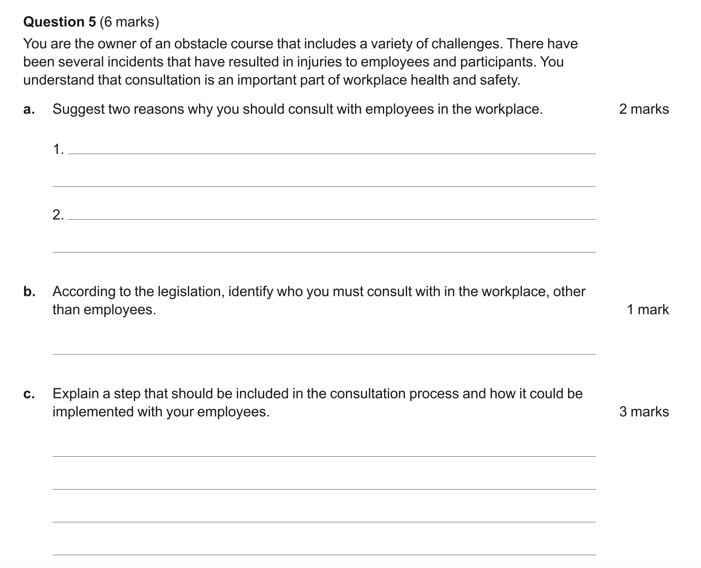
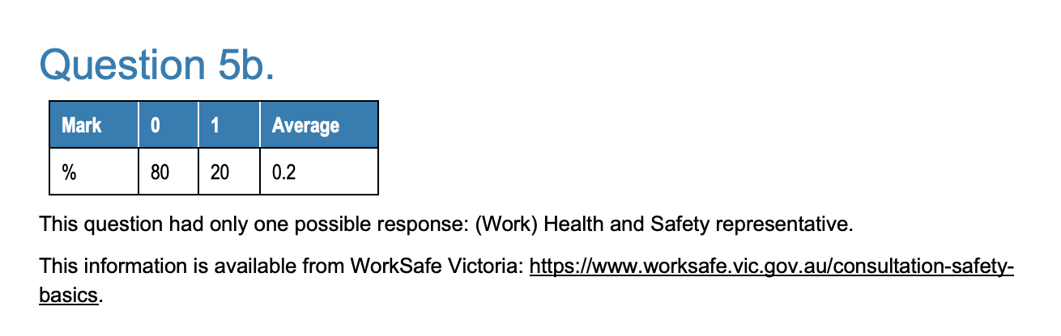

Slide 23
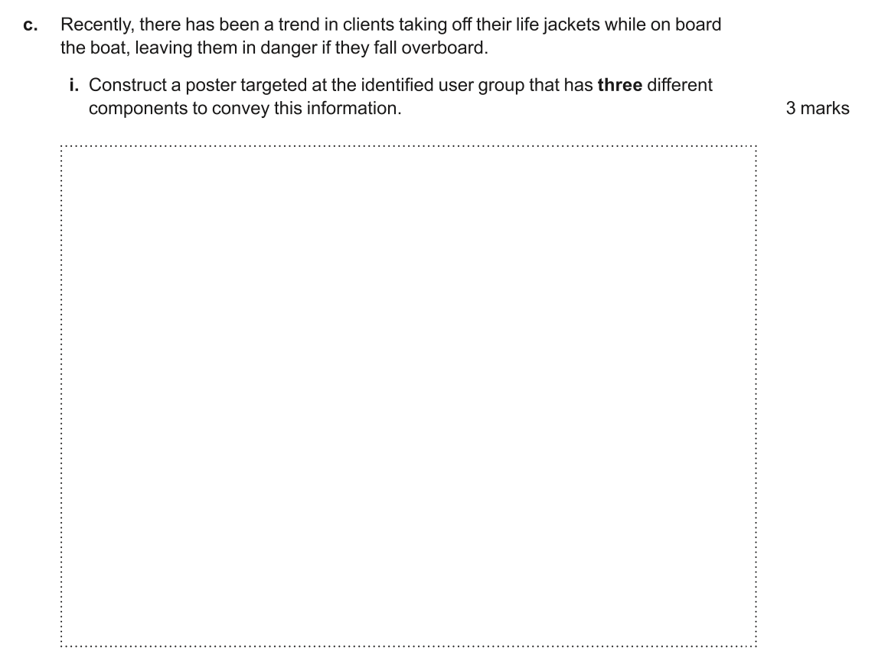
Something like this will be in the 2025 exam.
This will be based on a lesson plan and how to adjust the session based on your identified participant needs in the STEM question.

Slide 24
WHAT ELSE?
Appropriate resources to manage the identification and rectification of breaches in compliance requirements
Effective conflict resolution techniques
Facilitate
Groups
WHS
Workplace documents:
Program plans
Program and equipment checklists
Participant feedback or evaluation forms
Internal
External
Forms
Data
Drinking water
First Aid Kit
Deliver programs
Coaching
Organisational safety, emergency response and first aid procedures for the specific sport
Anaphylaxis
Asthma
CPR

Slide 25


LOOK AT THE EXAMINERS REPORT IN MORE DETAIL FOR THESE:
3D
7c
Compare and contrast
6c
Leadership Styles v Coaching communication

Slide 26


BSBWHS308
INDUSTRY TERMS
SOP -Standard Operating Procedure
PIN – Provisional Improvement Notice
HSR – Health and safety representative
PCBU - Persons Conducting Businesses or Undertakings (These are the duty holders)
Duty holder
Recordkeeping
SISXPLD004
What can be coming?
Leadership skills
Verbal and nonverbal communication
Consensus
Building trust and respect
SISXPLD002
Predesigned session plan
Participant characteristics and capabilities
Resource checklist
Self reflection
Evaluation reports
SISSSCO001
Code of conduct
NSO – National Sporting Organisation
Assistant coach/ head coach / supervisor

Slide 27
This is extremely relevant now when we are looking at the following Units of competency:
Language to be aware of:
SISSSCO001: You are an assistant coach / Communication styles
SISXPLD002: As a recreation leader you have, In your role as an assistant recreation leader/ activity leader / Communication techniques
SISXPLD004: You are facilitating a meeting, throughout the session you notice that members are becoming disengaged from the tasks at hand and are confused with their roles and responsibilities / Facilitation techniques
Language examples

Slide 28
Policies can be:
WHS (if it fits, use this one)
Anti-discrimination
Equal opportunity
Privacy and confidentiality
Records keeping
Budgets
Codes of conduct, including safe environments and equipment, session planning, player welfare, supervision/monitoring, first aid requirements, general conduct.
Working with Children's checks
Risk analysis
Reporting channels
Roles and responsibilities
Scope and frequency of equipment checks
Communication protocols
Workplace security
Anti-drug policy
Anti-harassment
Policy and Procedures

Slide 29
Procedures can be:
Pre-game ground inspections
Complaints procedures
Equipment checklists
PAR-Q questionnaire
Induction procedures
Hydration procedures
Confidential storage of information procedures.
Session planning checklist
Inclusive practices
Policy and Procedures

Slide 30
Documentation can be:
Budget
Proof of vaccination certificate
Program schedule/timetable
Session details – maps, parking, contact
Evidence of insurance
Site inspection / WHS checklist
Risk analysis
Equipment list
Equipment/facility hire confirmation conducting
Score sheets
Observation checklists
Fixtures
Equipment forms (borrow/return)
Session plan
Assessment forms
Accident injury form
Physical ability test concluding
Equipment return form
Feedback/evaluation forms
Self-reflection journal
Information on follow-up programs
Records (accident injury)
Documentation

Slide 31

Revision 1
Revision 2
Revision 3
Revision 4
Online revision testing
4 UOCs
3 x 15 question M/C
We can place into your portal
Industry Specific Terms
Found in your teacher toolbox
Reading Time Activity
VCAA Practice Exam
40 seconds per Question
40 seconds to write answer
Dice roll
Example provided for SISXPLD002

Slide 32
Insights 😉

Slide 33
BSBWHS308
Look at the assessment conditions – Standard Operating Procedures are listed.
This could be in the exam then.
What WHS Laws are relevant to hazard identification, risk assessment and risk control?
Occupational Health and Safety Act 2004
https://www.worksafe.vic.gov.au/resources/how-worksafe-applies-law-relation-identifying-and-understanding-hazards-and-risks
Suitable risk assessment methods
Qualitive – Subjective – High or low % - Likelihood etc
Quantitative – Objective – Based on data – Incident reports, near misses, statistics

Slide 34
SISXPLD004
Signs, stages and levels of conflict and TECHNNIQUES used to resolve EACH!!!!
This could be in the exam then.
Look at the sub points inside the knowledge evidence
Encouraging optimum interaction between group members by:
Rotating partners and sub-groups for different activities
Allocating tasks to group participants and rotating tasks
Appropriate to sport, fitness, aquatic and recreation activity situations

Slide 35
SISXPLD002
Assessment conditions state that the following must be available to replicate industry conditions of operation:
First Aid equipment
Communication equipment for response
Template evaluation forms
Organisational record keeping procedures for session delivery and evaluation
Look at the sub points inside the knowledge evidence
Too many to list
Roles and responsibilities of different activity leaders and support staff
Know all 3 participant groups
Children – Older people – People with disability *
*not defined – please note this and teach a wide range and not a narrow focus.

Slide 36
SISSSCO001
Assessment conditions state that:
Sport specific rules, regulations and policies
Coaching communication styles
Know the difference between this UOC and SISXPLD002
Communication techniques used for……
Establishing rapport with the group
etc

Slide 37
QUESTIONS

