Slide 1

SISXFAC006
Maintain activity equipment
Through this unit you will develop the skills and knowledge required to complete routine maintenance and minor repairs on sport, fitness, aquatic or recreation activity equipment, and to appropriately store equipment.

Slide 2
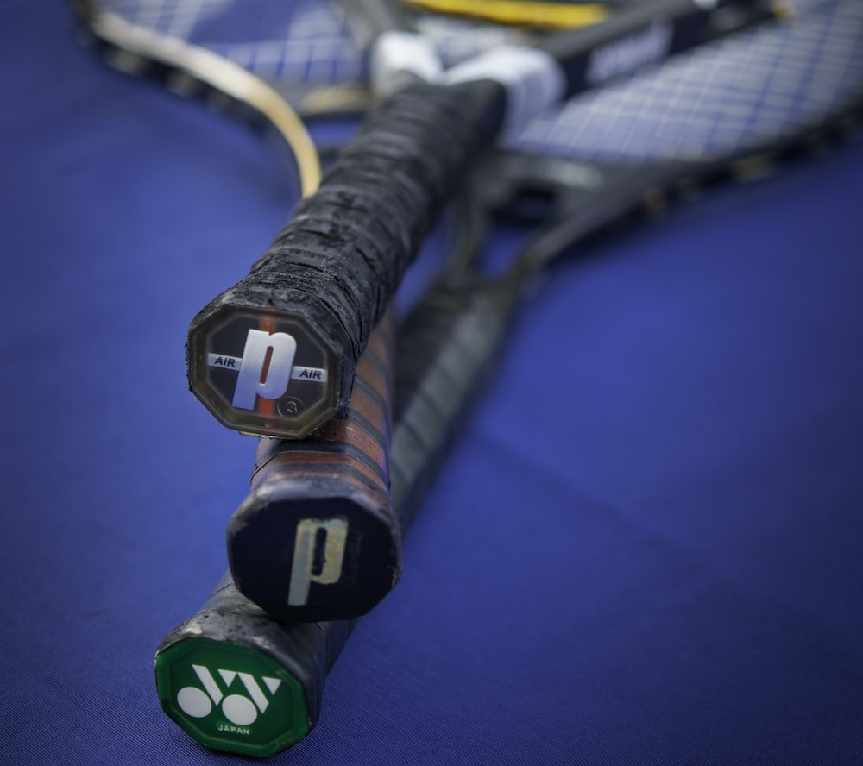
Maintain activity equipment
It is important to understand the significance of equipment maintenance in your chosen sport or field.
Proper equipment maintenance helps prevent injuries and accidents, which can be costly and time-consuming for businesses and organisations.
Businesses can build good or bad reputations based on how their equipment looks and works.
Available equipment contributes to positive or negative experiences for the user – essential tools who’s maintenance and care cannot be ignored, otherwise causing frustration, or risk of injury.

Slide 3
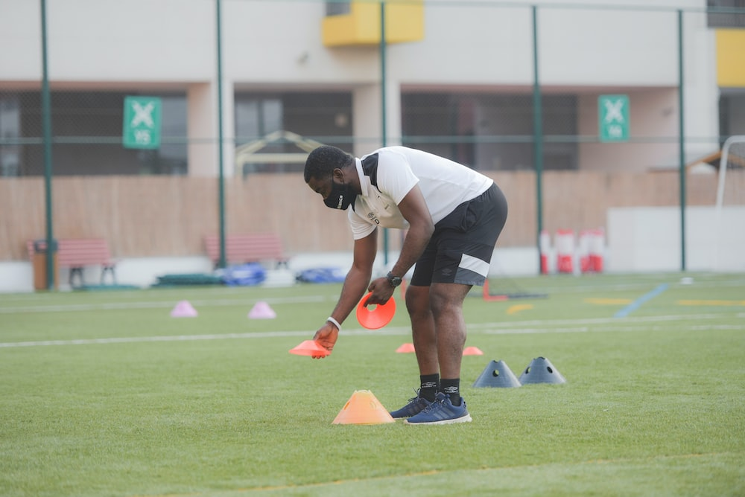
Trainers and Coaches role in maintenance
Trainers and Coaches are responsible for ensuring equipment is safe and reliable.
Highlighting the importance of care and maintenance encourages participants to respect equipment, and will also make them feel confident and prepared when using it.
Equipment use falls under a trainer or coaches ‘duty of care’ towards participants – identifying potential for failure or harm, and making prompt changes helps to create a safe environment

Slide 4
Duty of Care
A coach or trainer has an important responsibility to keep their athletes or participants safe and well-cared for. This means they must create a safe environment, watch over everyone, and make sure they follow the rules.
Coaches and trainers also need to teach proper techniques and make sure everyone understands how to stay safe. If someone gets hurt, they should know what to do and be able to help.
Good communication is also important, so everyone knows what's happening and can ask questions.
Coaches and trainers are always learning and improving their skills to keep everyone protected. Their main job is to make sure everyone enjoys the activity while staying safe and healthy

Slide 5
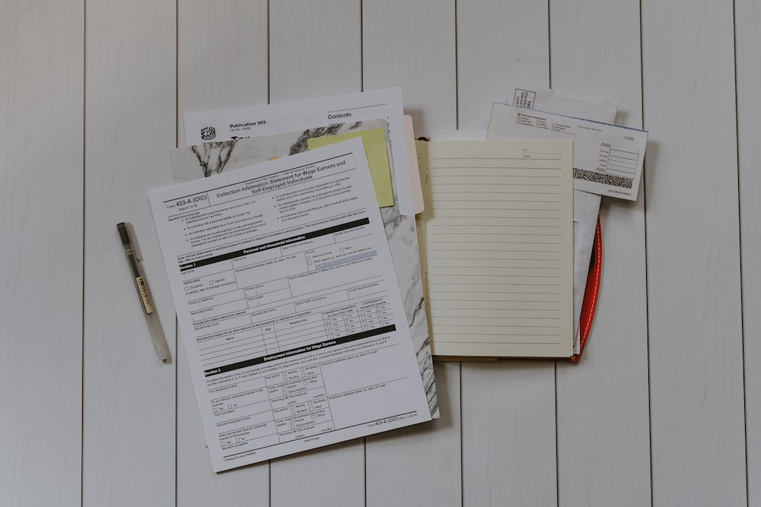
Organisational Procedures
To ensure that participants have a safe and enjoyable experience, it is crucial for organisations in this industry to implement proper organisational procedures for maintaining, repairing, storing, and securing activity equipment.
Without proper maintenance and care, equipment can become unsafe and lead to accidents, injuries, and potential liability issues for organisations and businesses.
It is essential for organisations in the sport and recreation industry to ensure that the proper maintenance, repair, storage, and security of activity equipment is being carried out to protect the safety and wellbeing of all participants.

Slide 6
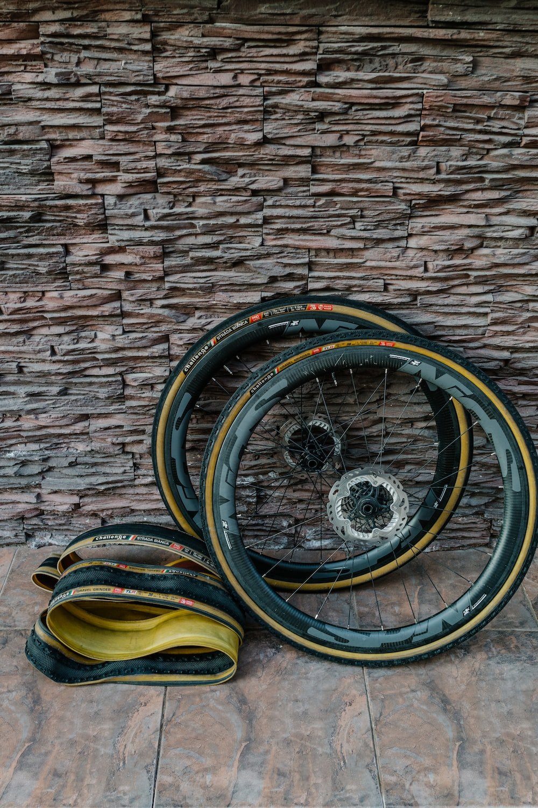
Maintenance Procedure
A maintenance schedule that includes regular and routine inspections of equipment will allow organisations to identify any issues early and prevent them from developing into more significant problems.
Regular cleaning and repairs of equipment should also be carried out to keep them in good working condition and this should always be done according to the manufacturer’s instructions.
A maintenance schedule should list all of the routine services, checks and inspections that a piece of equipment requires. Regular maintenance of equipment is crucial as it eliminates unexpected breakdowns and replacements, leading to accidents and injury.

Slide 7
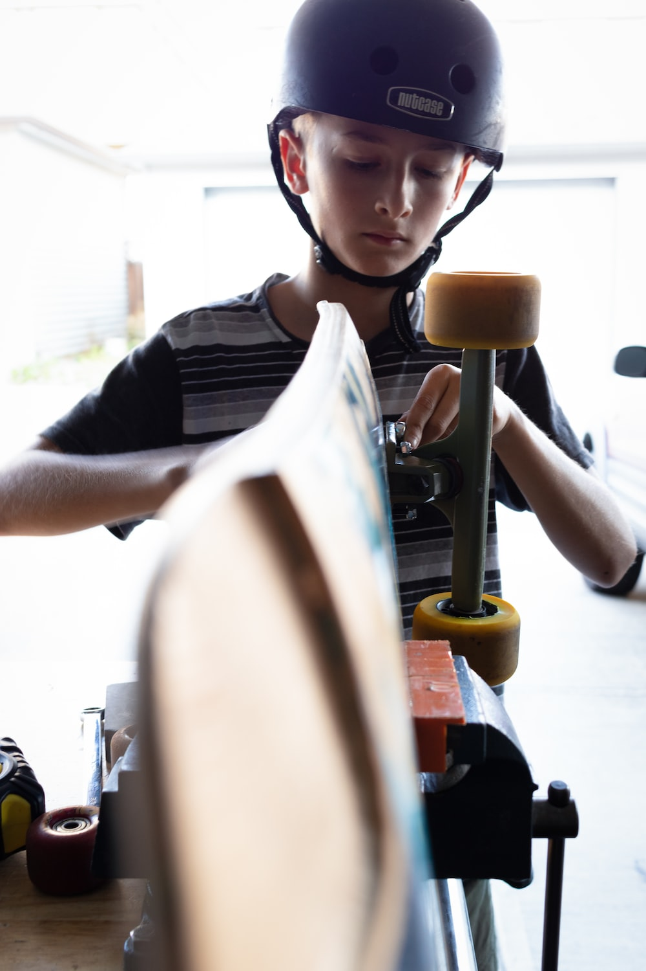
Repair Procedure
Required repairs should be carried out as soon as possible to avoid further damage to the equipment.
Organisations should ensure that they have a qualified technician to carry out repairs and that they have the necessary tools and equipment to do so.
It is also important that staff members are able to carry out minor non-specialist repairs on equipment, when necessary, in order to keep the equipment safe and functional for users.

Slide 8
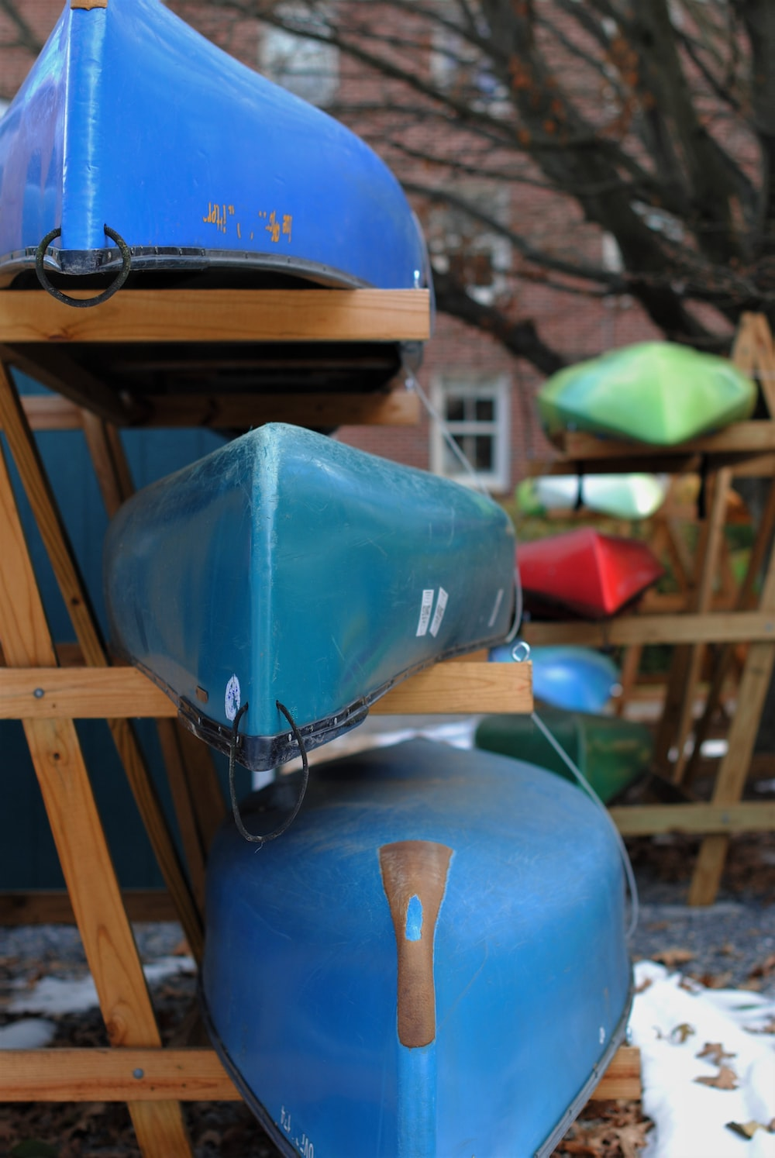
Storage
Equipment should be stored properly when it is not being used to prevent damage or theft.
This includes storing equipment in a dry, neat, clean, and secure location and avoiding exposure to extreme temperatures or weather conditions.

Slide 9
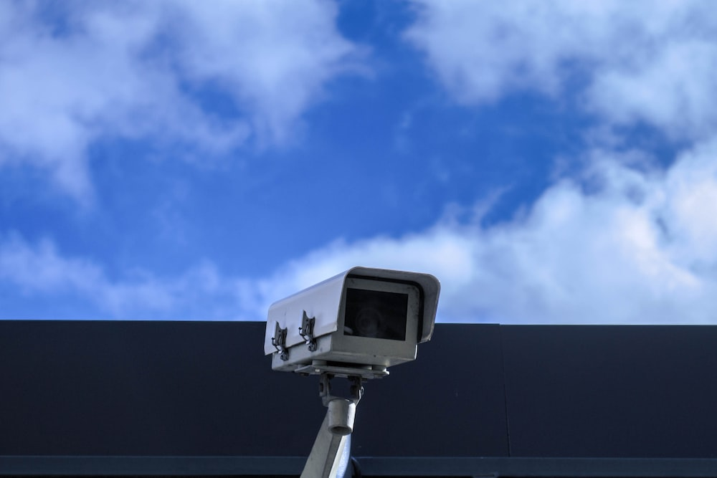
Security Procedure
Organisations should have proper security measures in place to prevent theft or damage to equipment. This includes locking equipment storage areas and using security systems such as alarms or CCTV cameras.

Slide 10

Documentation
Organisations should keep records of all inspections, repairs, and replacements of equipment.
This helps to track the lifespan of the equipment and ensure it is replaced when needed. We will explore this topic in more detail later in the chapter.

Slide 11

Training and Education Procedure
Organisations should provide training and education to staff members responsible for maintaining, storing, and completing minor repairs equipment to ensure they have the necessary skills and knowledge to identify and fix any issues and store equipment in the correct way.

Slide 12
Compliance with Standards
Organisations should ensure that their equipment meets industry safety standards and regulations. Regular audits carried out by qualified safety technicians should be conducted on all pieces of equipment within an organisation.
The organisational procedures for maintaining, repairing, storing, and securing activity equipment in the sport and recreation industry play a vital role in ensuring the safety and effectiveness of equipment for participants.
Maintaining, repairing, and storing equipment correctly, organisations can extend the lifespan of equipment, reduce the need for costly replacements, and ultimately provide a safe and enjoyable experience for all.

Slide 13
Role responsibilities, boundaries and reporting lines for repair and maintenance activities
It is crucial to establish clear organisational roles, responsibilities, boundaries, and reporting lines.
This helps prevent misunderstandings and conflict among team members, ensures that repairs are completed efficiently, and maintains the overall safety and enjoyment of participants.
Different organisational may include:

Slide 14

Equipment manager
Ensures that the organisation's equipment is properly stored, maintained, repaired, and replaced when necessary
They may work closely with manufacturers to ensure that equipment is serviced according to their specifications and to obtain replacement parts when necessary.
They create and implement maintenance schedules, as well as inspection, maintenance, removal and replacement, while also managing the equipment budget for the club.

Slide 15
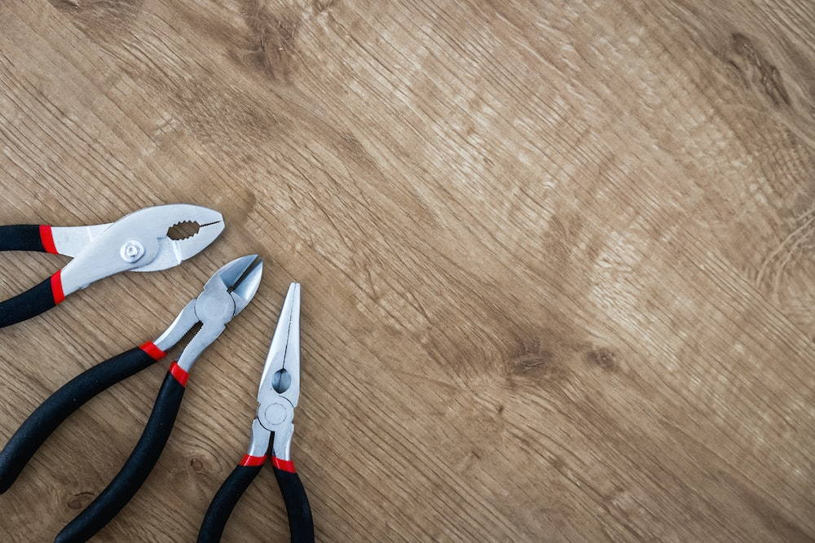
Maintenance technicians
They are responsible for carrying out routine maintenance, repairs, and troubleshooting of equipment to make sure that it is safe and reliable for everyone to use.
Maintenance technicians may work on a variety of equipment, including athletic gear, fitness equipment and sports facilities.
They are qualified in many maintenance and repair techniques and may have specialised knowledge in certain areas, such as electronics or mechanics.

Slide 16
Employees
Within your role, you may need check equipment once it has been used for an activity.
You will need to check the work environment and equipment for damage or deterioration and report any issues as required.
Where possible, you should carry out minor repairs as directed within your own role and responsibility.

Slide 17

Responsibilities
The responsibilities of individuals involved in repair and maintenance of activities will be dependent on your role within your organisation.
They may include inspecting equipment, identifying issues, scheduling repairs, conducting repairs, and testing equipment.
It is important to ensure that responsibilities are clearly outlined and communicated to everyone involved

Slide 18
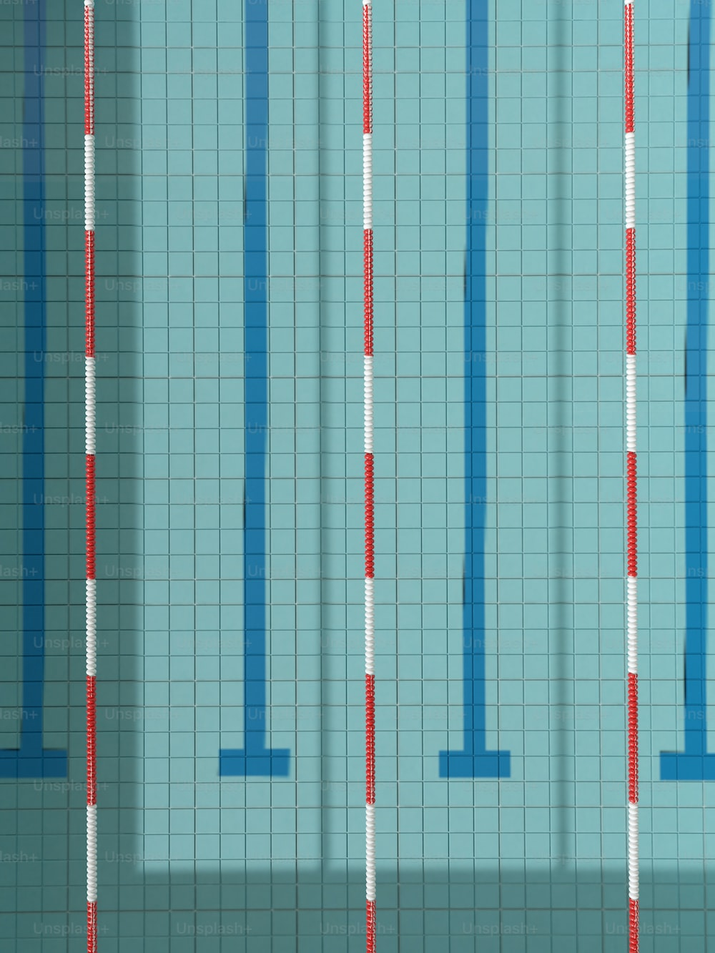
Boundaries
Boundaries are very important as they make sure that people do not go outside of their roles and responsibilities. Boundaries can include budget constraints, time constraints, and scope of work limitations
Establishing clear boundaries can also help prevent misunderstandings and conflicts among team members and ensure that the repair and maintenance process runs smoothly and promotes accountability

Slide 19

Reporting Lines
Participants should report equipment failure or damage to their coach, teacher or supervisor as soon as a possible
They then report it to the equipment manager.
The equipment manager will assess the issue, and seek help from appropriate maintenance techs.
Maintenance will complete required repairs, or if unable to do so, report back to the equipment manager.
If the issue cannot be resolved, specialists may need to be contacted, or the item replaced.

Slide 20
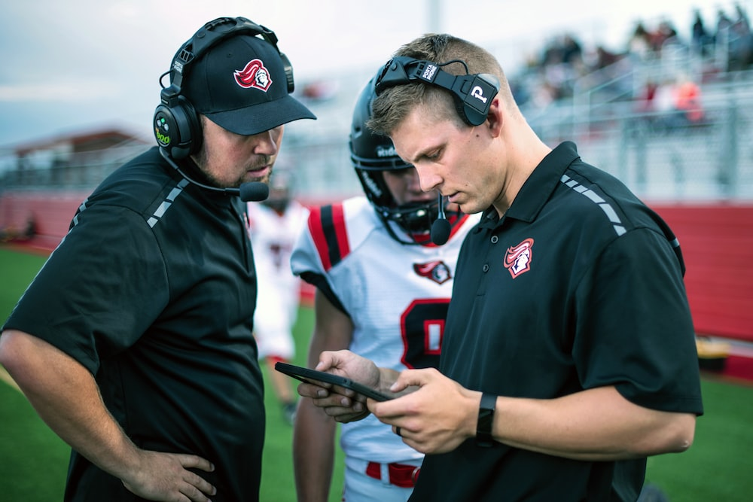

Reporting as a coach, trainer, or instructor
As a coach, trainer, or instructor your role in reporting equipment repairs and maintenance may vary depending on the policies and procedures of your organisation, however, below is a guide to follow when you need to report any issues with a piece of activity equipment.
Complete Inquiry task A

Slide 21
Complete the routine maintenance
Completing routine maintenance, such as cleaning, inspecting for problems, doing non specialised repairs and making adjustments will keep equipment in good working order for a long time.
It helps you catch issues early before problems become expensive or hazardous and can keep equipment working effectively . Maintenance should include
Reading manufacturers instructions
Inspect equipment
Prepare tools and materials
Clean equipment
Check for proper function
Replace worn or damaged parts
Document maintenance and follow schedule

Slide 22
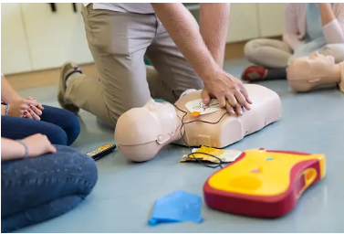
Emergency Equipment
Emergency equipment such as the contents of first aid kits and fire safety equipment should be routinely inspected, to ensure serviceability, that it is within use-by date and everything is where it should be.
Automatic External Defibrillators (AEDs) should also be inspected according to manufacturers instructions to ensure battery is working and there are no signs of wear or damage.

Slide 23
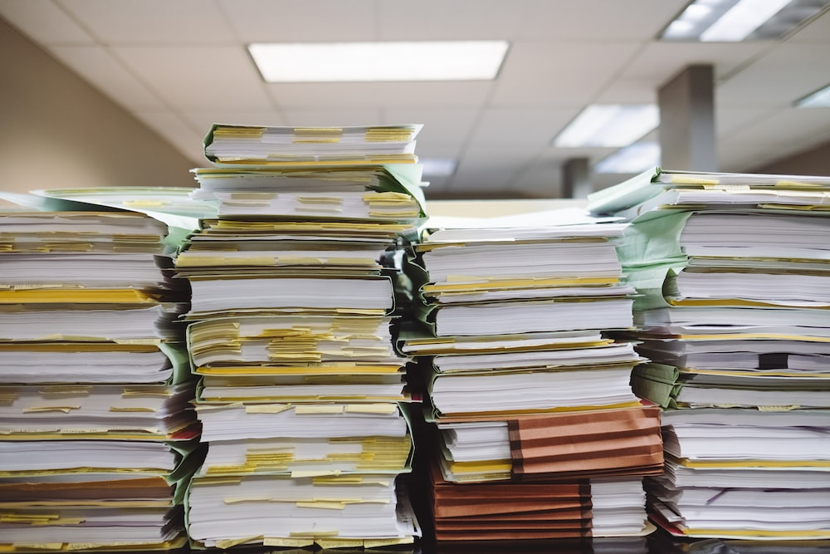
Maintenance Documentation
Keeping a record of all the information about the maintenance work done on equipment helps keep track of tasks completed, when, and who completed them.
Important documents may include:
Maintenance logs
Work Orders
Inspection Checklists
Repair Reports
Service Contracts
Equipment Manuals
Calibration Certificates
Complete Inquiry task B

Slide 24
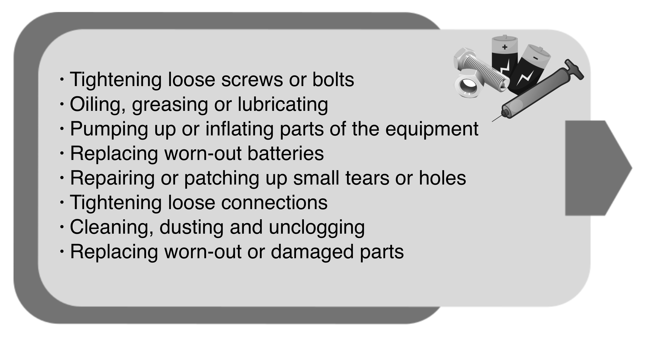
Complete minor equipment repairs on activity equipment
Minor repairs that you may need to carry out within your role can include:

Slide 25
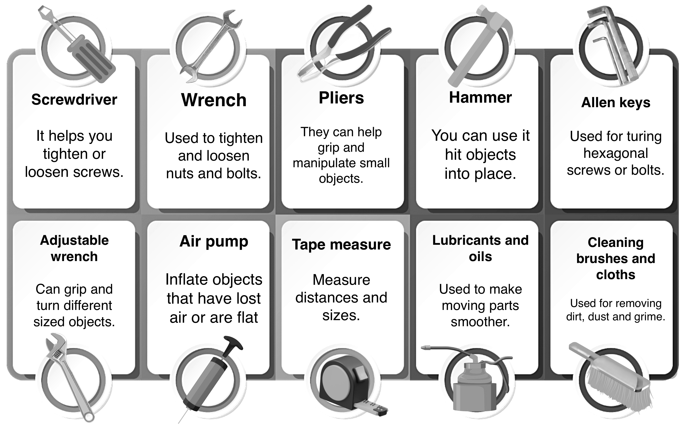
Tools for minor repairs and maintenance
It is important to have the right tools to perform maintenance tasks on hand - as well as keeping your tool box tidy and organised to remain efficient.
Useful tools will include:

Slide 26
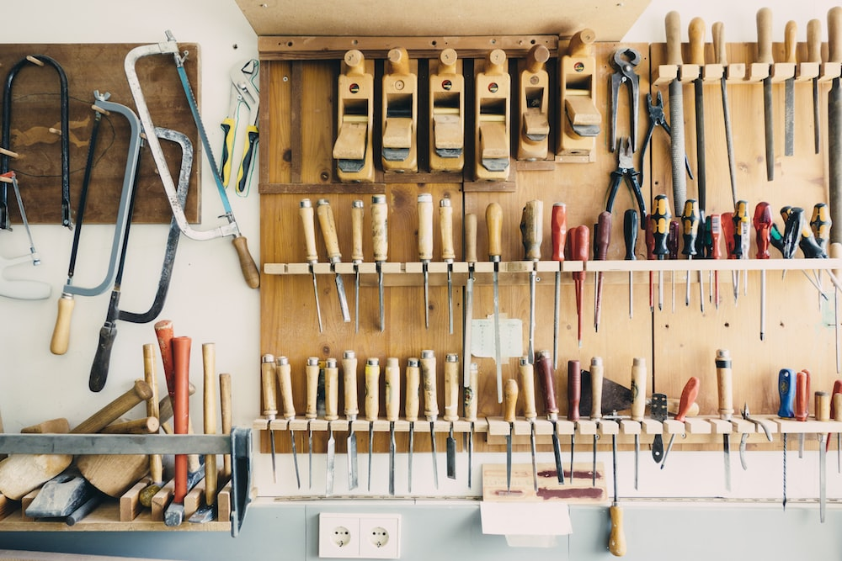
Taking care of tools
Regular maintenance means cleaning and checking your tools to make sure they are in good shape. This helps you do your work faster and more efficiently.
When you take care of your tools, you can prevent accidents and injuries that could happen if they are not working properly.
Maintaining your tools also makes them last longer, so you don't have to buy new ones as often

Slide 27
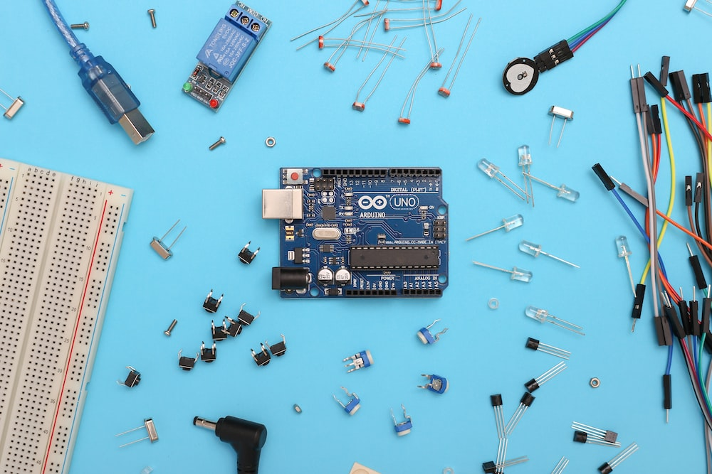
Outside your scope of skills
Trying to fix something you don't have the knowledge or training for can be risky and very dangerous.
By reporting the issue to someone with the right skills, such as a supervisor or maintenance person, you ensure that the repair is handled by someone who knows what they're doing.
This helps prevent further damage to the equipment and reduces the chance of accidents or injuries.

Slide 28
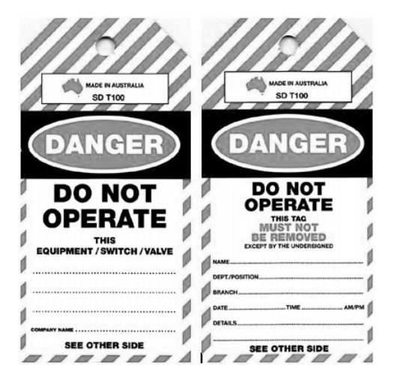
Faulty Equipment
A faulty piece of activity equipment in the sport and recreation industry is something used for games, sports, or physical activities that isn't working properly
If you come across faulty equipment, you should:
Tag the equipment using the appropriate equipment tag.
Isolate the equipment so that it is not easily reached
Report the fault to someone who can assist

Slide 29
Specialist Repairs
Some repairs are best left to the professionals.
Complex repairs may require fixing electrical problems, repairing big structural damage, dealing with complex mechanical issues, or working on delicate parts and mechanisms – any of which could cause damage or injury in the wrong hands.
If you’re not sure, or the repair seems too complicated, it’s better to check
Complete Inquiry task C

Slide 30
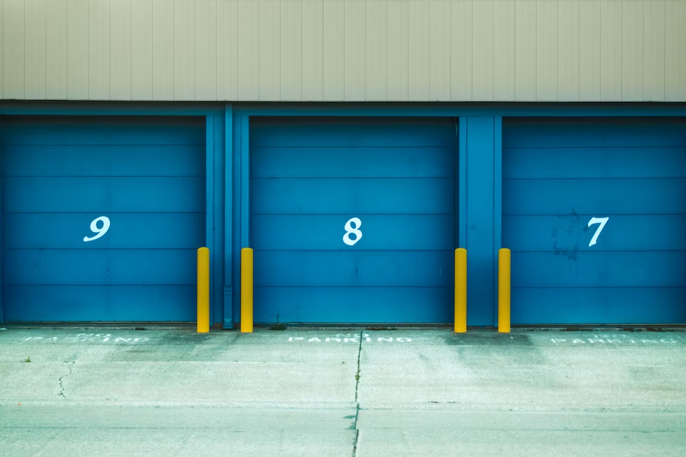
Store activity equipment to maintain serviceable condition
When you have finished with a piece of equipment and want to store it, it's important to ensure that it is packed up properly.
In order to pack up safely and efficiently you should:
Be calm, organised and take your time.
Disassemble any detachable parts of the equipment
Get help for heavy and awkward pieces of equipment
Ensure that you have a clear run to the storage area and that there are no obvious hazards that could cause a potential problem.
Stack items safely
Always store and handle equipment according to the manufacturer instructions.

Slide 31

Work Health and safety practices
It's important for organisations in the sport and recreation industry to have proper work health and safety practices in place for maintaining and storing equipment.
When preparing to lift or move activity equipment, you should consider:
How heavy is the equipment?
Is a manual handling aid available?
Have you surveyed the area?
Have you considered you strength and ability?
Are you lifting, pushing or pulling?

Slide 32
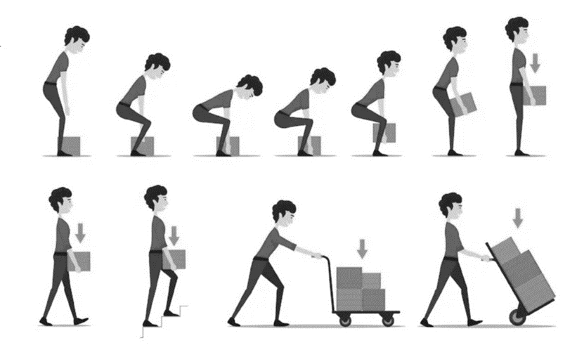
Use the correct technique
When preparing to lift a piece of equipment, you should:
Adopt a stable position, with feet shoulder-width apart with one leg slightly forward.
Grip the equipment securely. Hug it as close to your body as you can. The heavier side should be closest to your body.
As you start to lift the equipment, you will need to bend your knees and hips to squat down.
When carrying the equipment, try and keep it as close to your waist as you can.
Walk with your head up so you can see where you are going.
If your grip slips or you are having trouble, stop and re-set before
attempting to lift and carry the equipment again.
Complete Inquiry task D

Slide 33
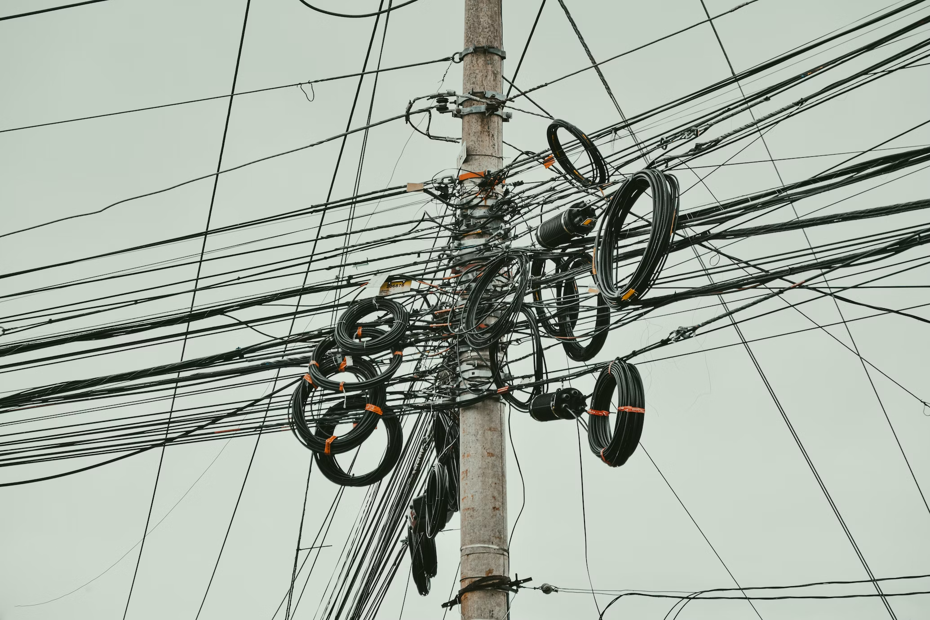
Maintain storage areas
Storage areas that are cluttered and disorganised can be dangerous. Maintaining storage areas is just as important as maintaining equipment
Poorly stored equipment can become damaged, broken, and lost, leading to costly repairs and replacements.
Equipment in each area should be clearly labelled and grouped with similar equipment to make it easy to access.
Records of equipment being hired out, checked, and stored should be completed and kept

Slide 34

Security
You need to make sure that equipment is stored in a locked and safe place where only the right people can get to it.
If anything does go missing, you should report it immediately
Putting labels or marks on the equipment can help identify it if it gets lost or stolen.
You should always be aware of anything suspicious and tell someone if you see something strange happening.
Lastly, you should also keep any important information about the equipment safe and protected.

Slide 35

Complete Inquiry task E
Complete the Reflection Bank

