Slide 1
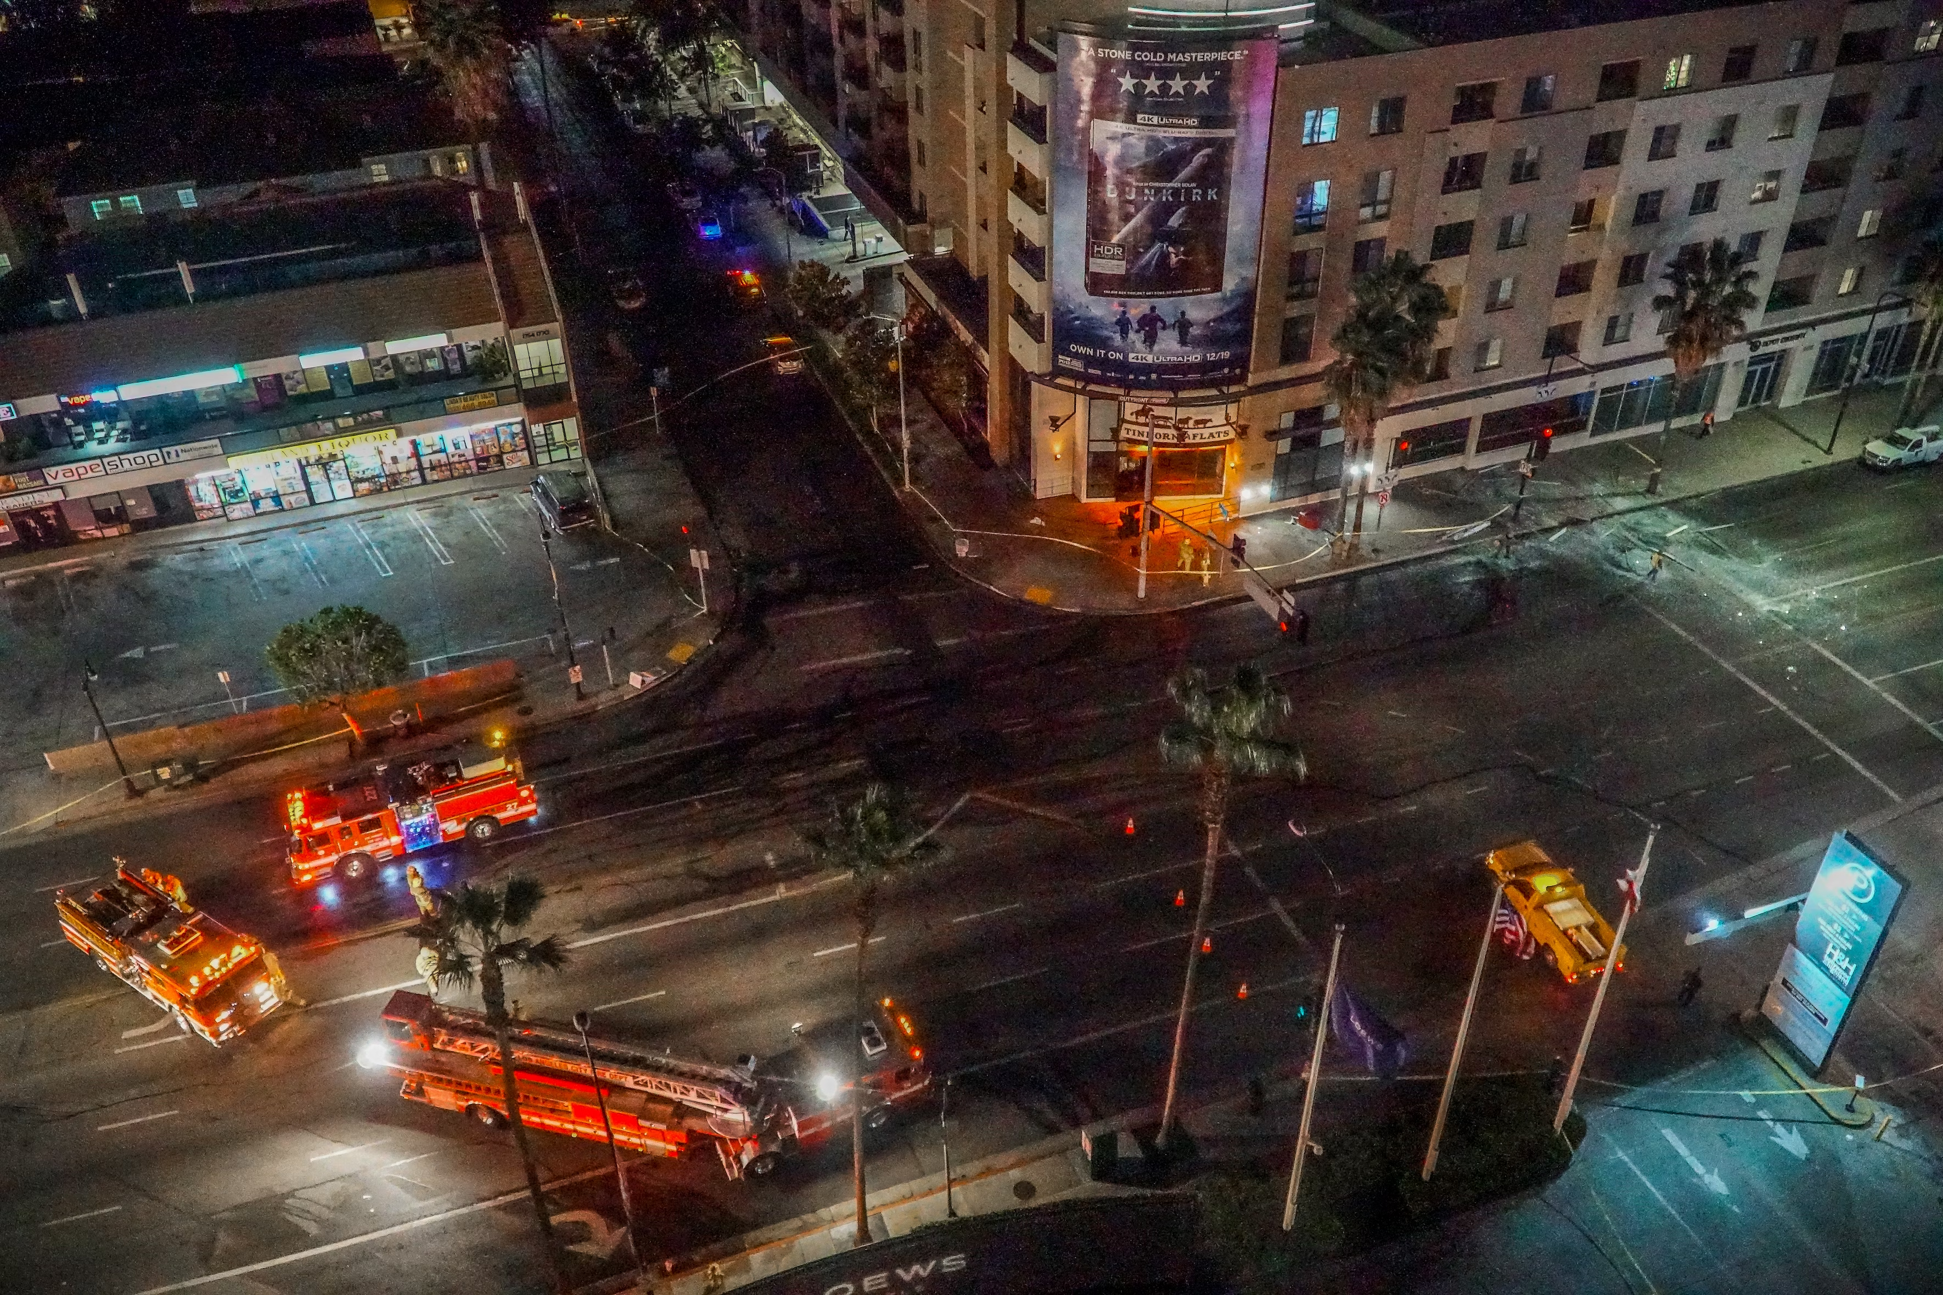
SISXEMR003
Respond to emergency situations.
Part 2
Emergencies can happen anytime, anywhere. They don't care where you are or what you're doing. That's why it's so important to have the right skills and know-how to deal with them, whether it's a fire, an accident, or bad weather.
When there's an emergency, the most important thing is to keep everyone safe – whether they're participants, clients, or visitors.

Slide 2

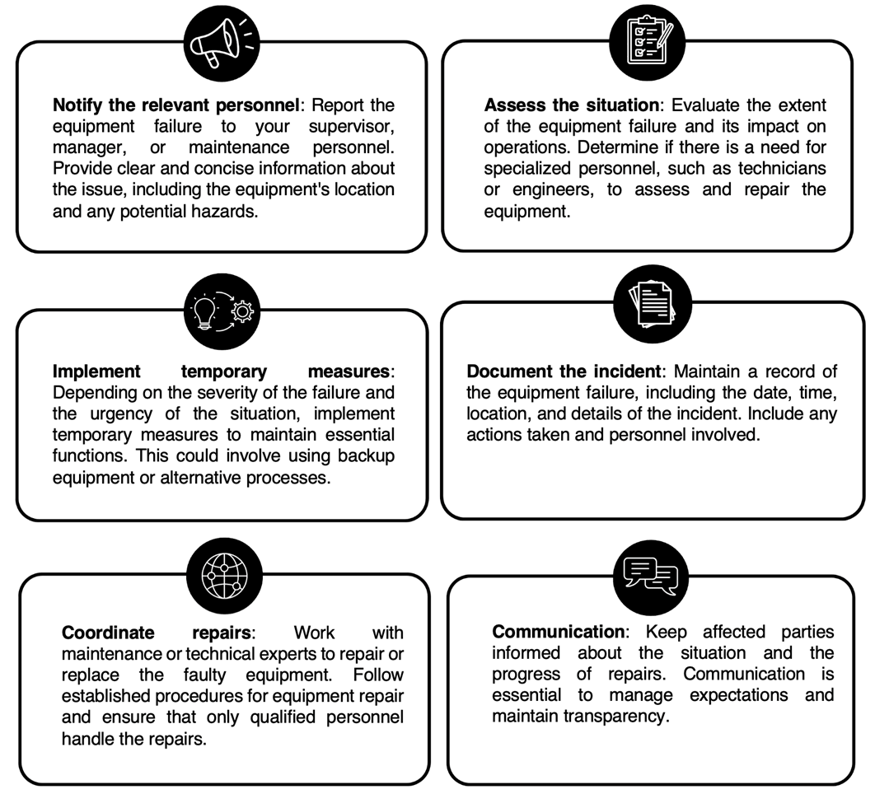
Equipment Failure
To effectively respond to equipment failure will depend on the type of equipment and its function.
However here are some general steps you can take when equipment fails:

Slide 3

Participant response and panic
Maintaining composure and taking swift, organised action is crucial. Beginning by assessing the situation – understanding whether it’s a medical issue, a fear-driven reaction, or some other concern.
Keeping participants informed about the situation and the actions being taken can help lessen anxiety. Delegation of responsibilities within your team, if available, helps with tasks like calling for assistance and providing first aid
Post-incident, conducting a debrief with your team helps in learning from the experience and identifying areas for improvement

Slide 4
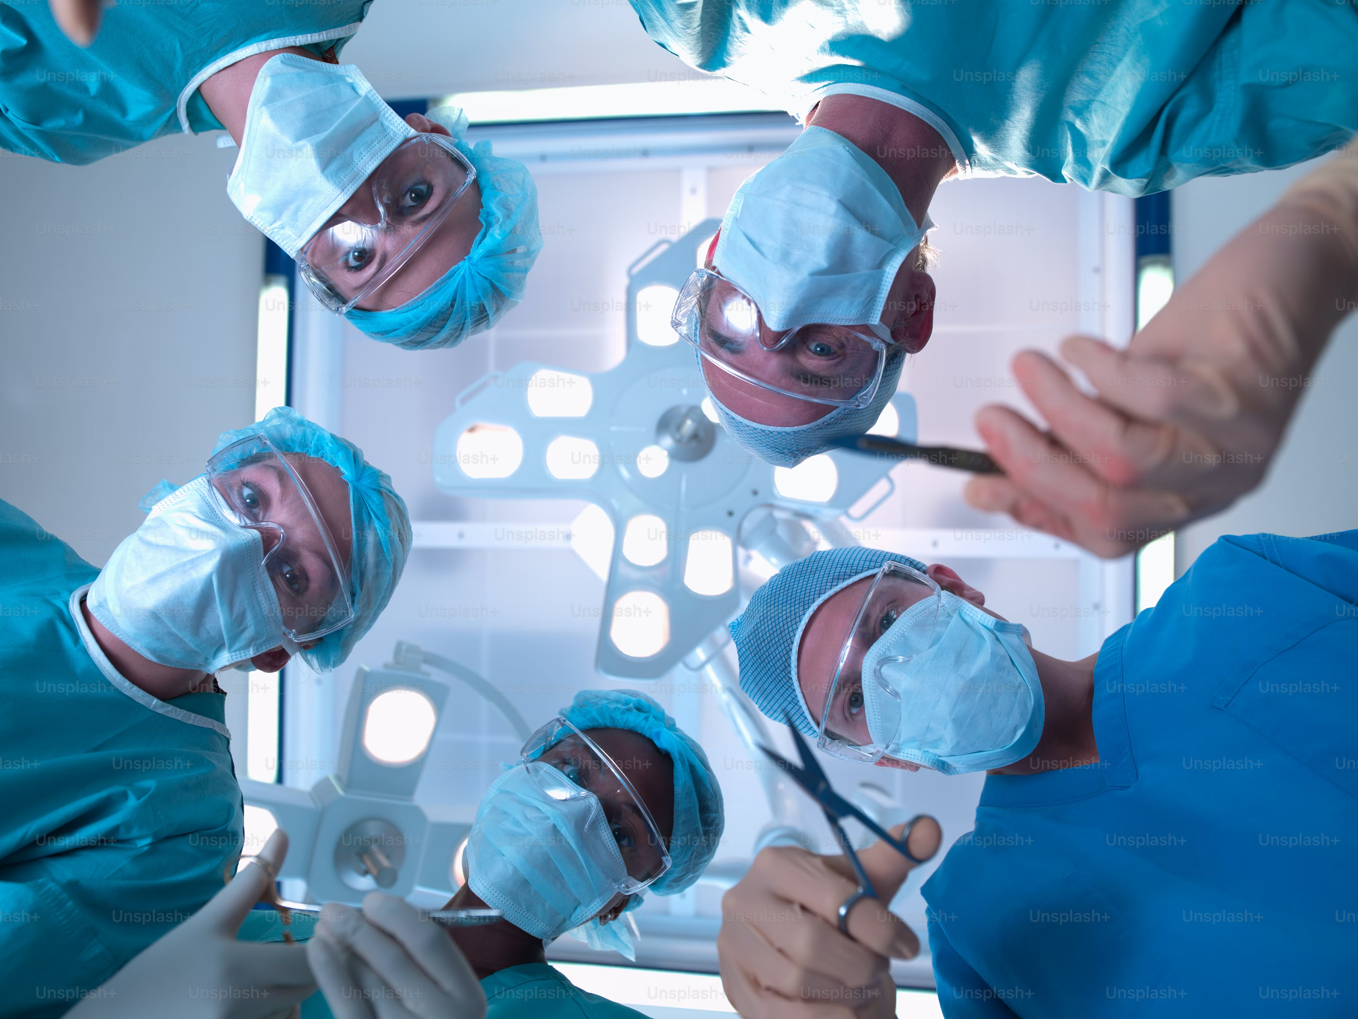
Medical and accident events
Here are steps to take when faced with these types of medical and accident situations:
Assess the situation
Ensure safety
Call for help
Provide first aid
Gather information
Communicate
Prevent further injury
Document the incident
Reassure and support
Follow organisational protocols
Preventative measures

Slide 5

Violent and threatening behaviour
Stay Calm
Assess the threat
Ensure personal safety
Avoid aggravation
Call for help
Maintain distance
Engage and actively listen
Use verbal de-escalation
Involve authorities
Document Incident
Follow organisational protocols
Support and reassurance

Slide 6
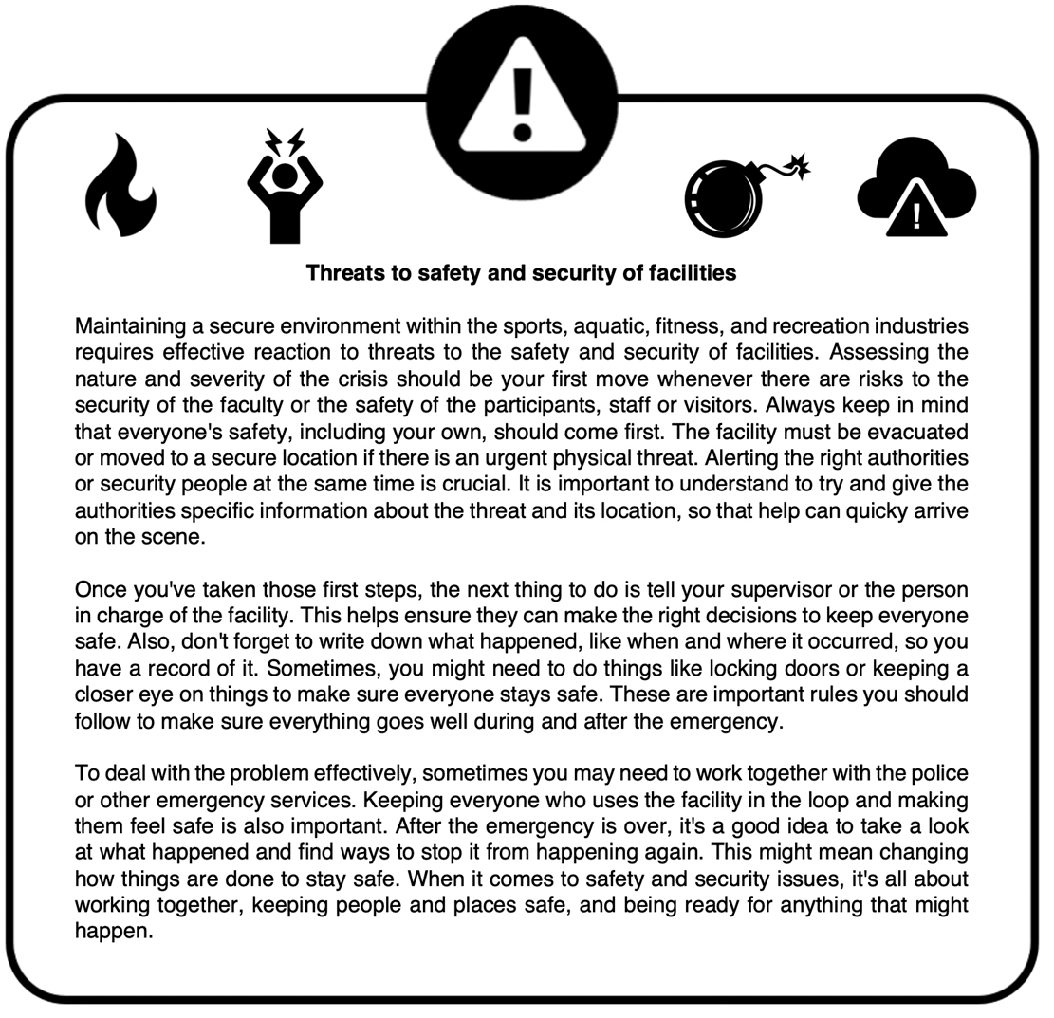

Threats to safety and security of facilities
Complete Inquiry task 5D

Slide 7
Emergency equipment
Fire Extinguishers
Fire Blankets
AEDs (automated external defibrillators)
Emergency Lighting
First Aid Kits
Emergency Signalling Devices
Thermal Blankets
Life Jackets
Emergency Communication Devices
Specialised tools and resources are carefully selected and maintained to respond effectively to a wide range of emergencies.
Fires, power outages, or hazardous material incidents - emergency equipment ensures that the right resources are readily available to address the situation and protect participants, staff and visitors
Complete Inquiry task 5E

Slide 8
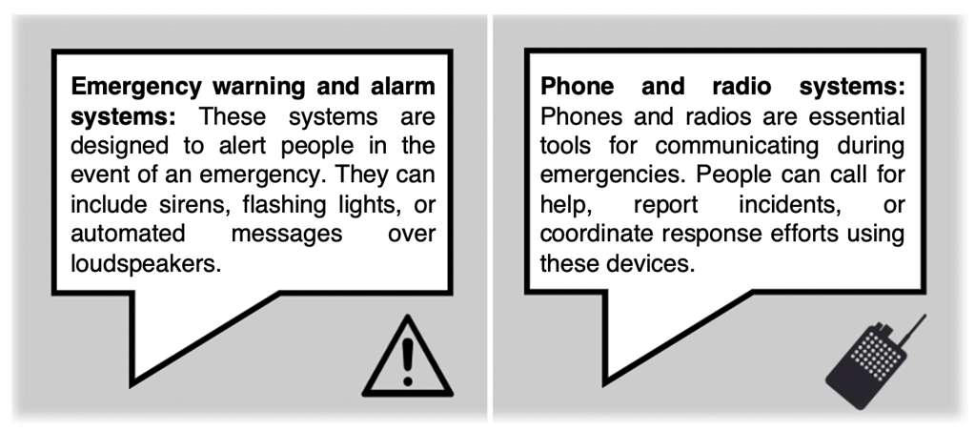
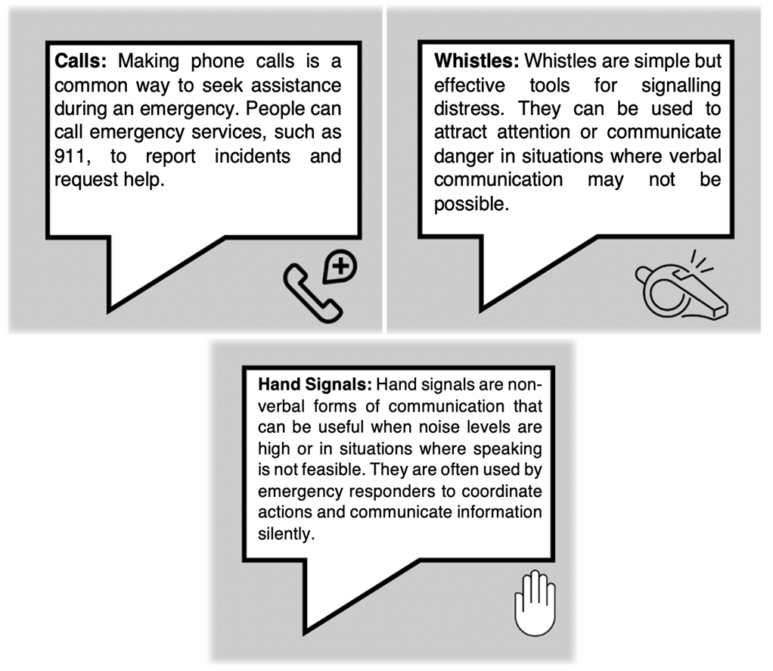
Communication Systems
When there's an emergency, it's really important to let the right people know as quickly as possible. Sometimes, you'll have to use different communication systems, like phones or radios to talk to others and emergency service.
Complete Inquiry task 5F&G

Slide 9

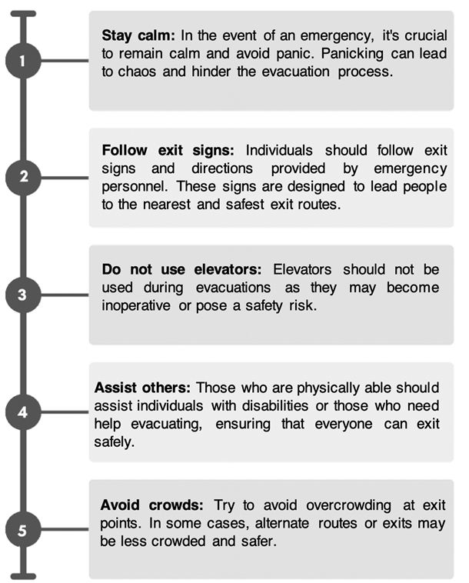
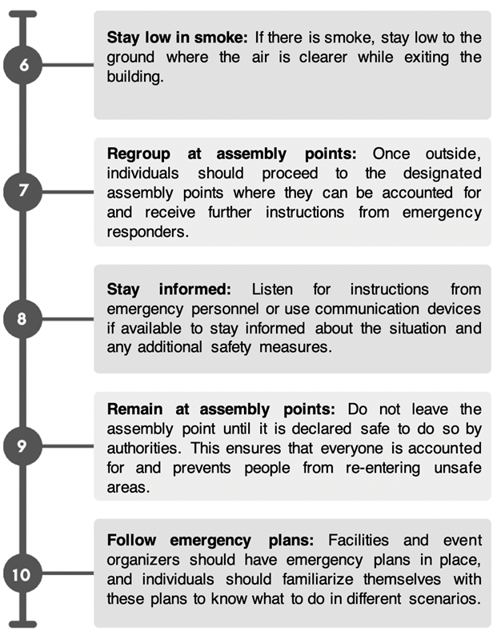
Exits and assembly points

Slide 10
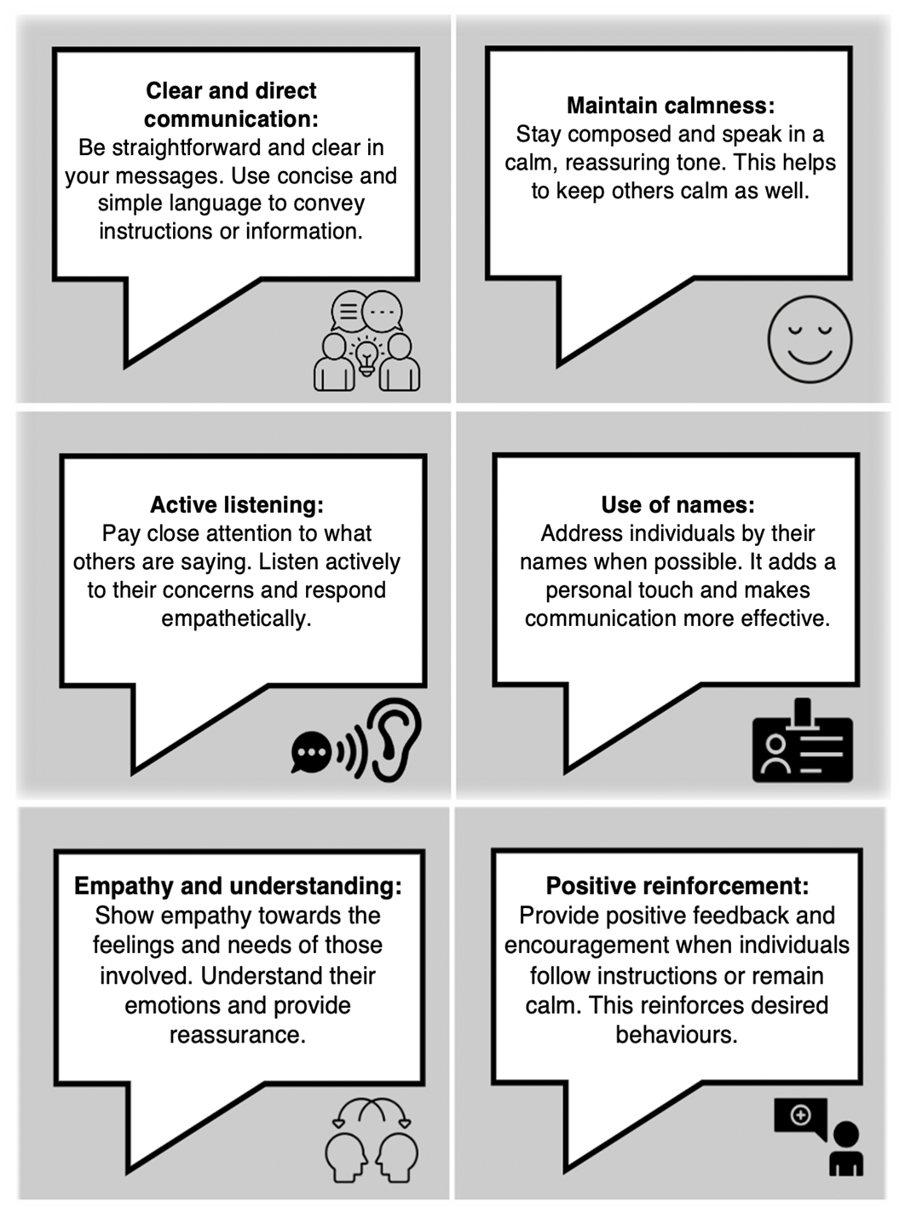
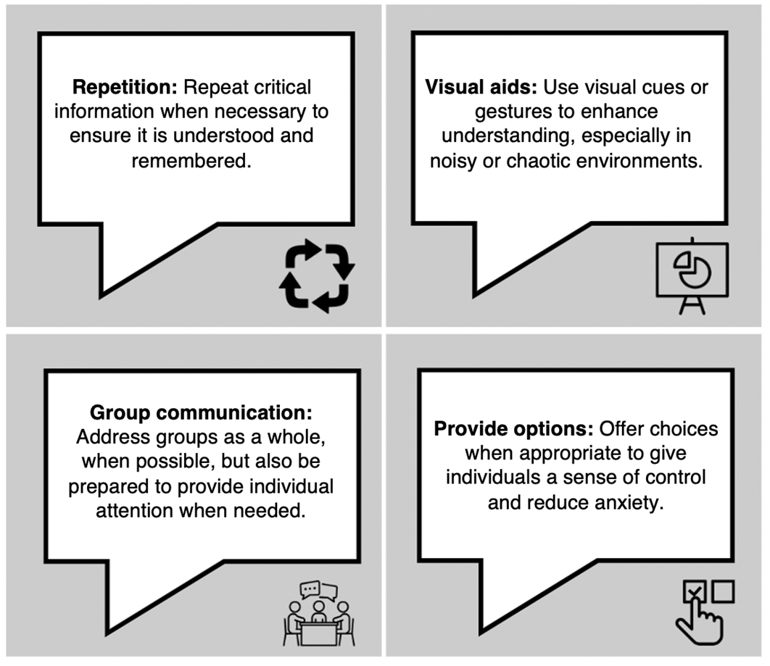
Communication during an emergency

Slide 11

Support and reassurance
Staying calm and composed is crucial. This helps people feel safe and reduces panic.
Use simple and clear language.
Avoid using complicated words or phrases that may confuse.
Pay close attention to what people are saying and show empathy.
Providing regular updates keeps everyone informed and reduces anxiety.
Non-verbal signals like hand gestures and maintaining eye contact convey reassurance.
Showing understanding of people's emotions and concerns creates a more caring environment.
Being honest and open builds trust during emergencies.

Slide 12
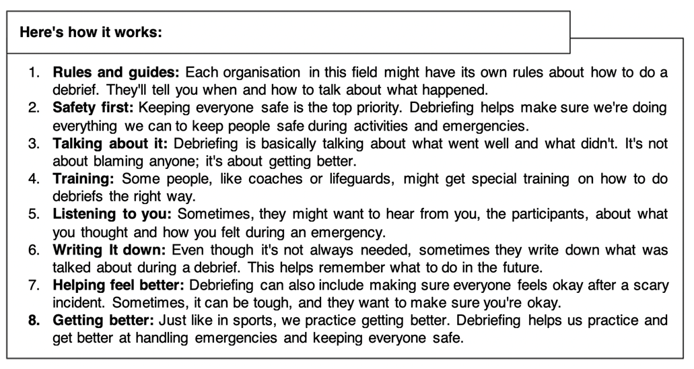
Debriefing and reporting
Debriefing is an in-depth discussion of what happened during an incident. Encouraging reflection and learning from experience, so things can be done better in the future.

Slide 13
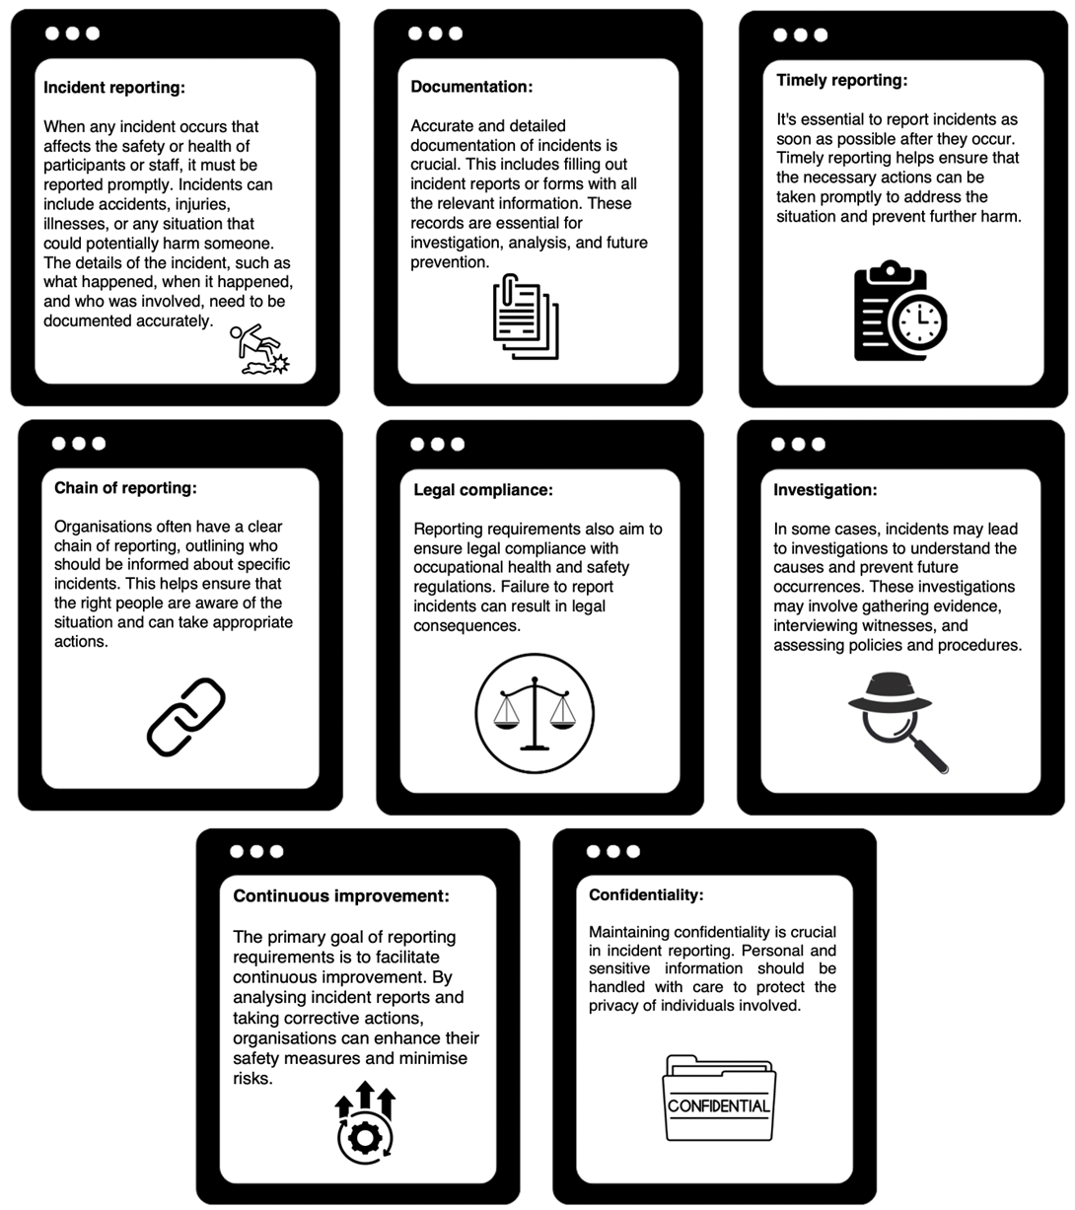

Reporting Requirements

Slide 14
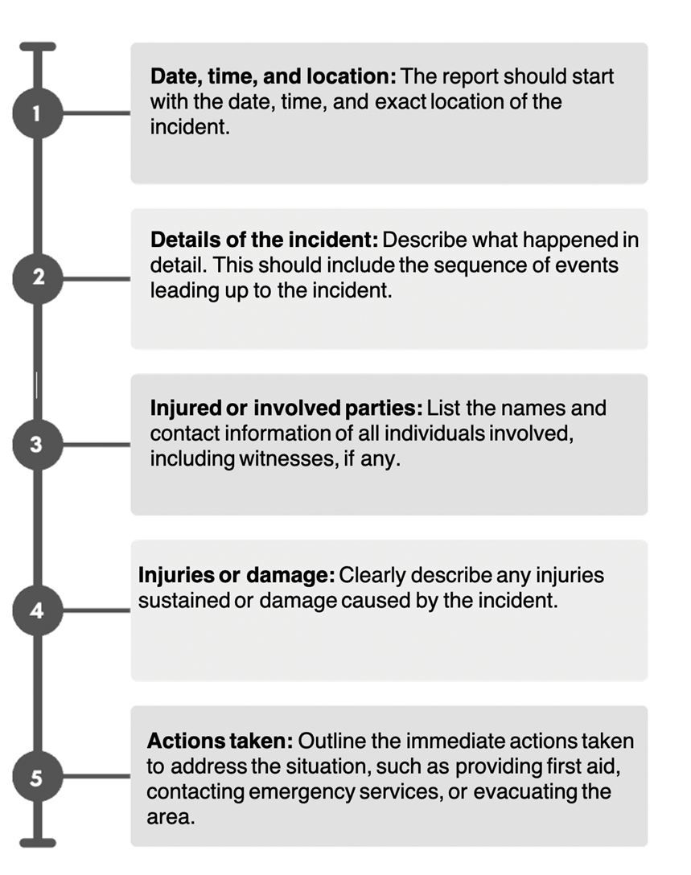
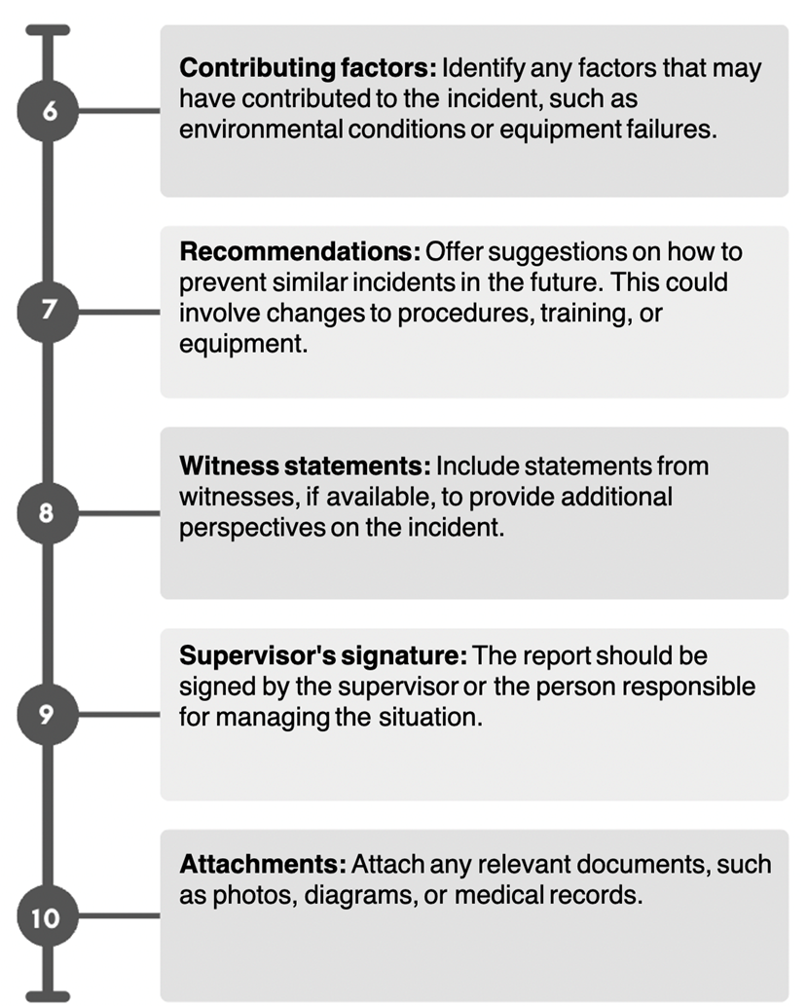
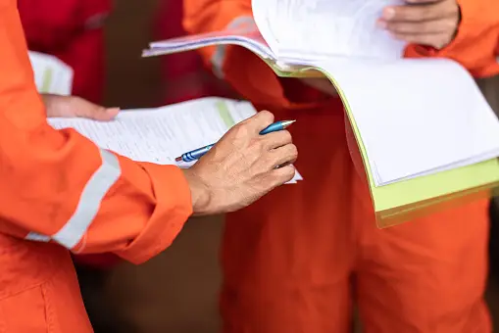
Incident Reports
In Australia, written incident reports typically follow a specific format to ensure all essential information is included. The key inclusions in these reports are:
Complete Reflection Bank Set B

