Slide 1
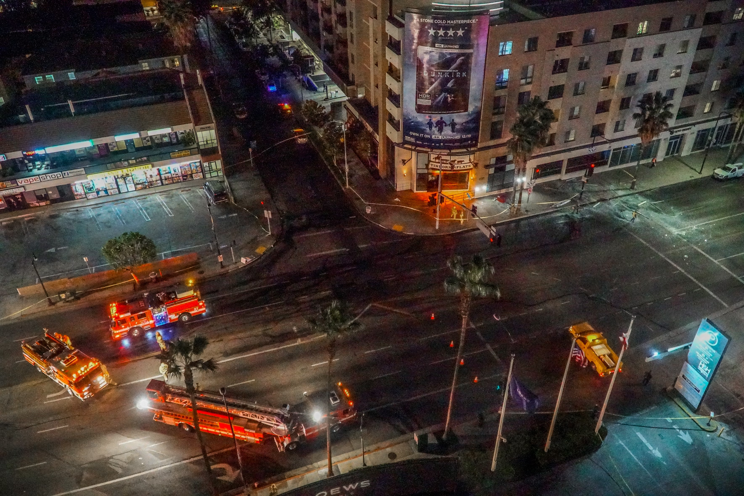
SISXEMR003
Respond to emergency situations.
Part 1
Emergencies can happen anytime, anywhere. They don't care where you are or what you're doing. That's why it's so important to have the right skills and know-how to deal with them, whether it's a fire, an accident, or bad weather.
When there's an emergency, the most important thing is to keep everyone safe – whether they're participants, clients, or visitors.

Slide 2

Types of Emergencies
Medical Emergencies – Heart attacks, strokes, seizures, burns etc
Weather and Water – Lightning, extreme winds, floods, drownings etc.
Fire – Indoor or bushfires, smoke inhalation
Environmental – Animal encounters, hypo/hyperthermia, dehydration, exposure to poisonous plants
Facility Specific – equipment malfunction or misuse, spills, structural failures
Person and activity specific – Lost or missing persons, activity specific injuries, panic
Security and Safety threats – security breaches, threats, assaults, altercations etc
Communication – Loss of reception, language barriers

Slide 3
Prepare in advance for emergencies
Emergency procedures provide an orderly and coordinated approach to managing emergencies, minimising risks, and try to reduce the impact of any adverse events. It's extremely important to understand and be aware of the emergency response procedures in your specific sport and recreation environment
It's also your duty of care to be safe and responsible and it's the law to be ready for emergencies
Organisational emergency response procedures in the sport, fitness, aquatic, and recreation industry include a range of specific actions and protocols suited to various types of emergencies.

Slide 4
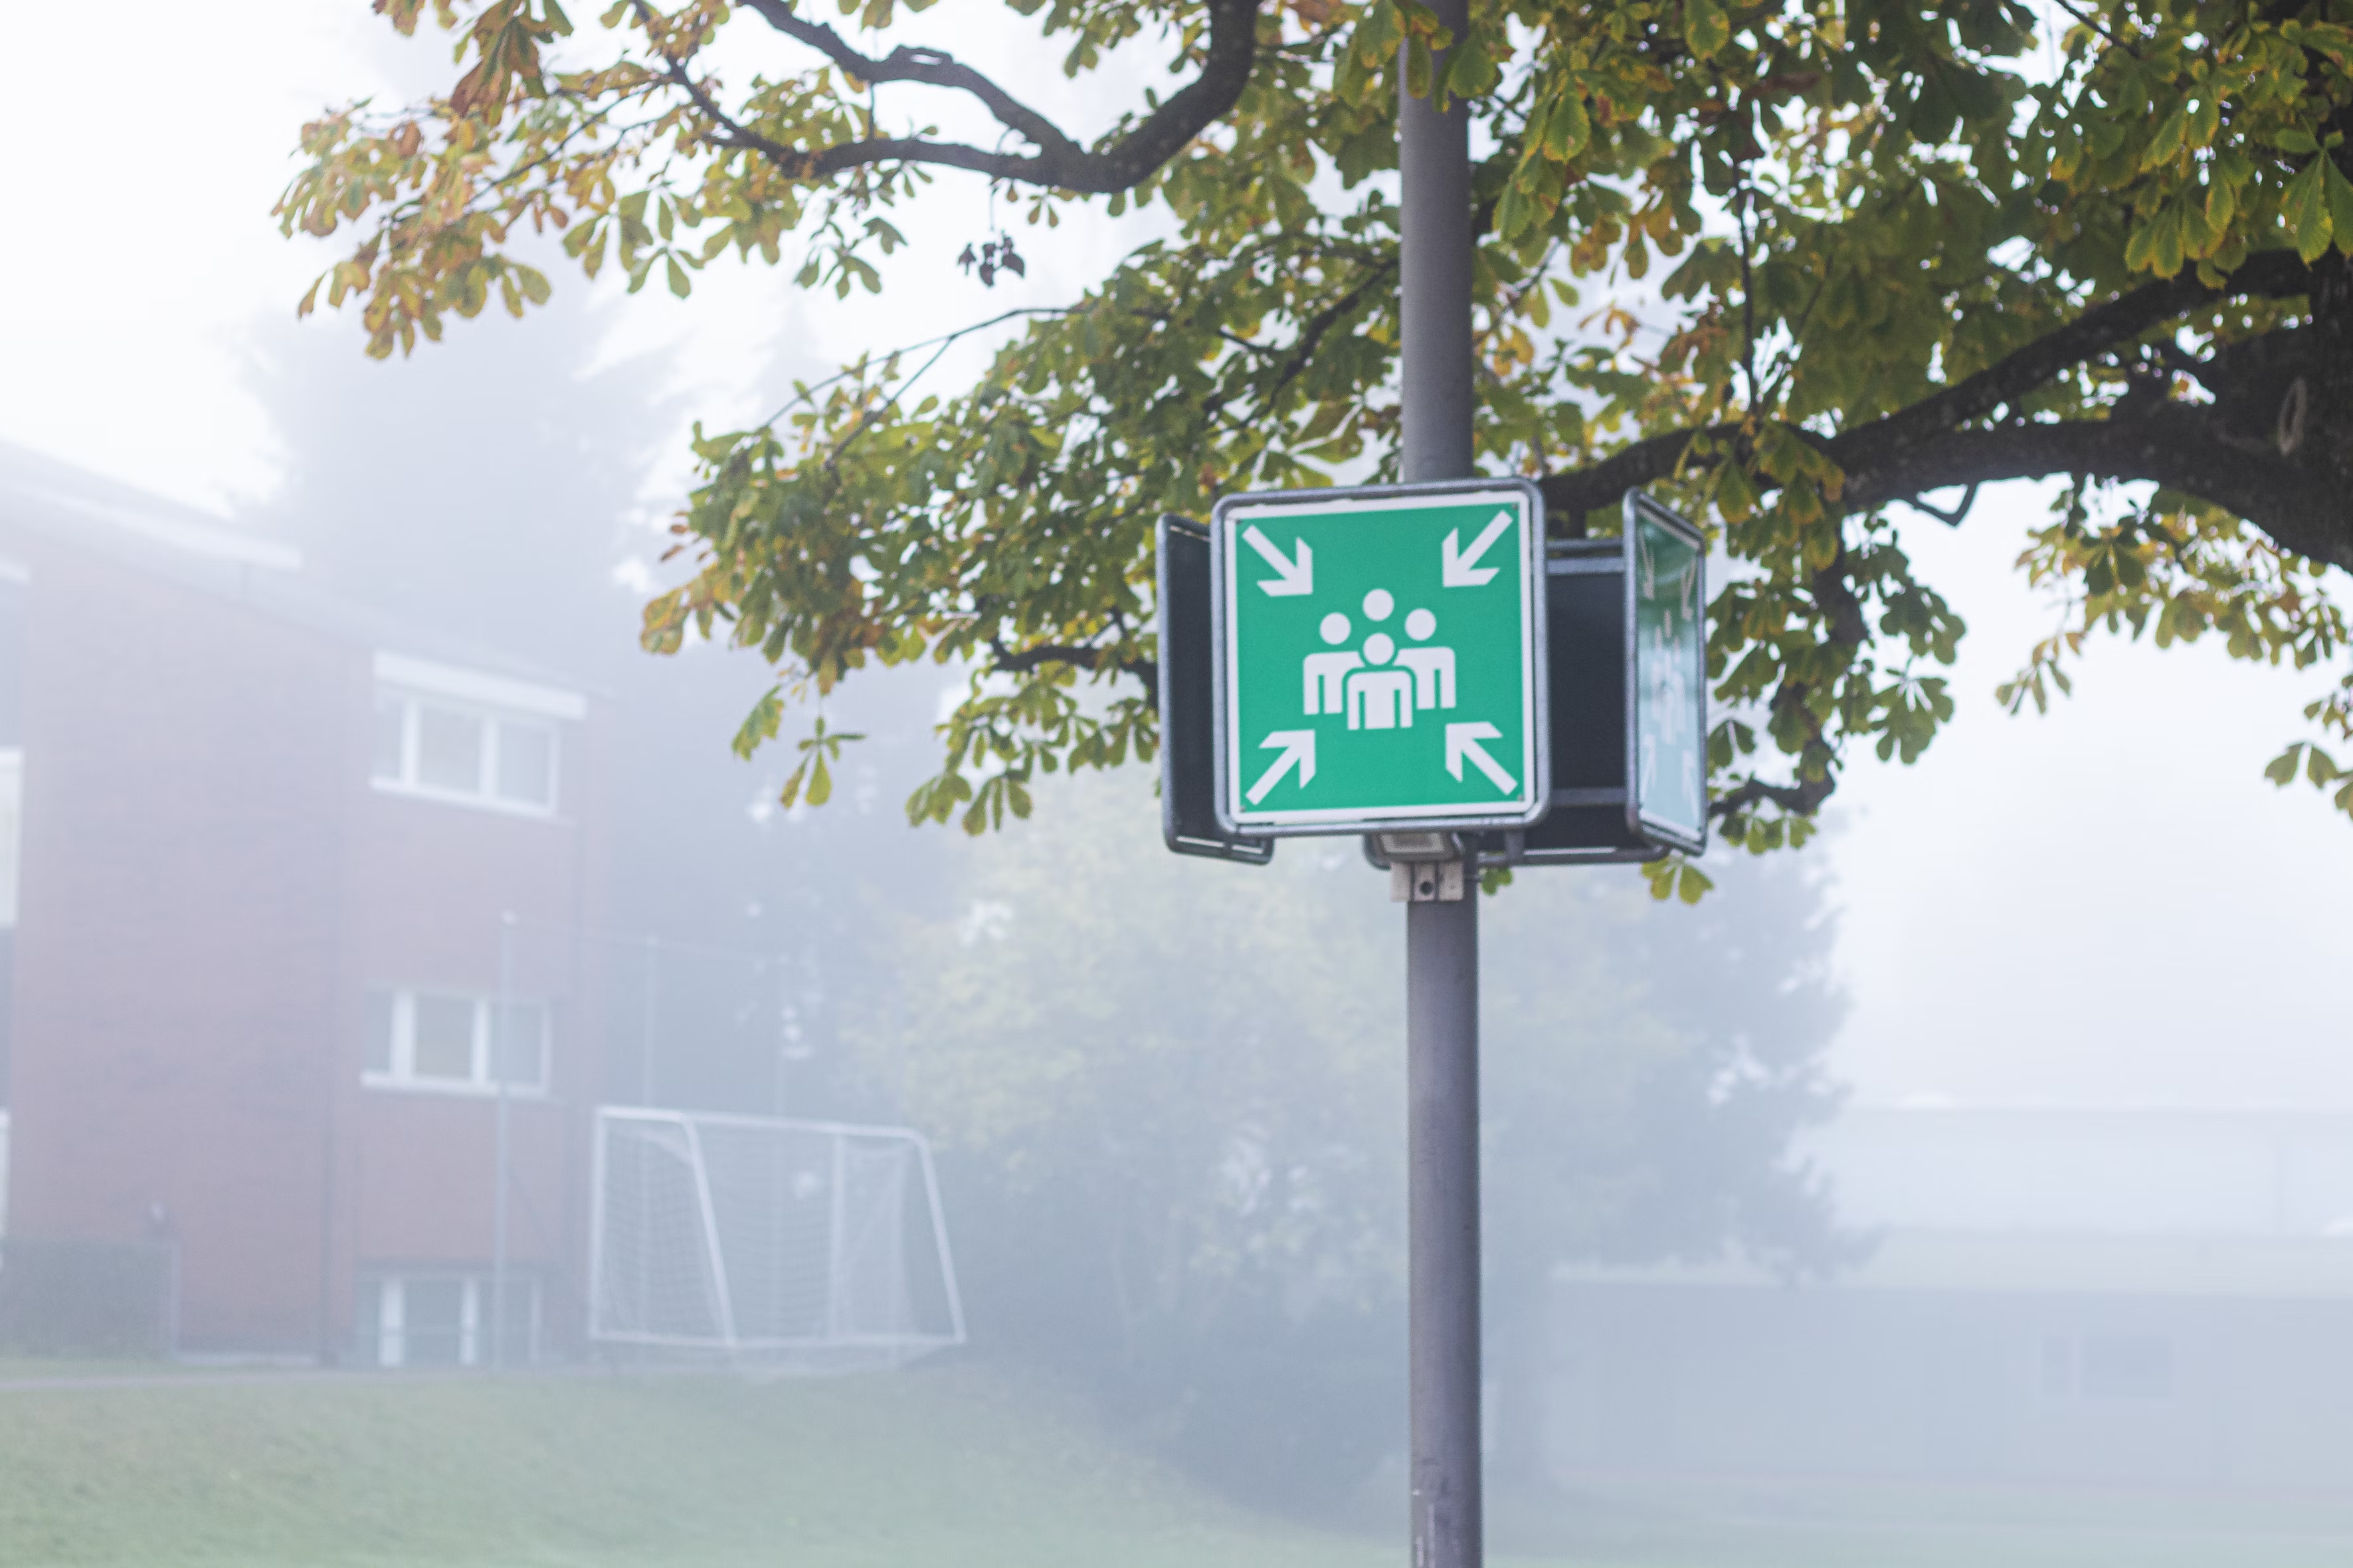
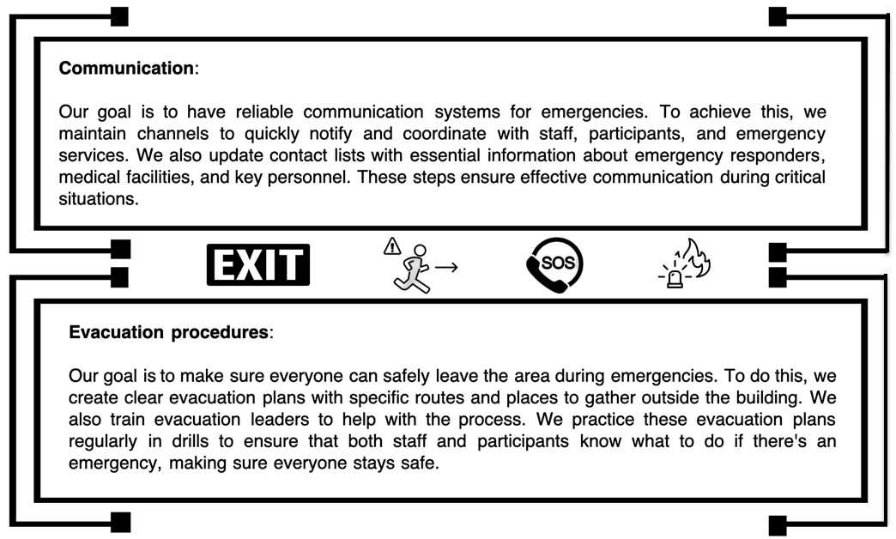
Examples of procedures

Slide 5
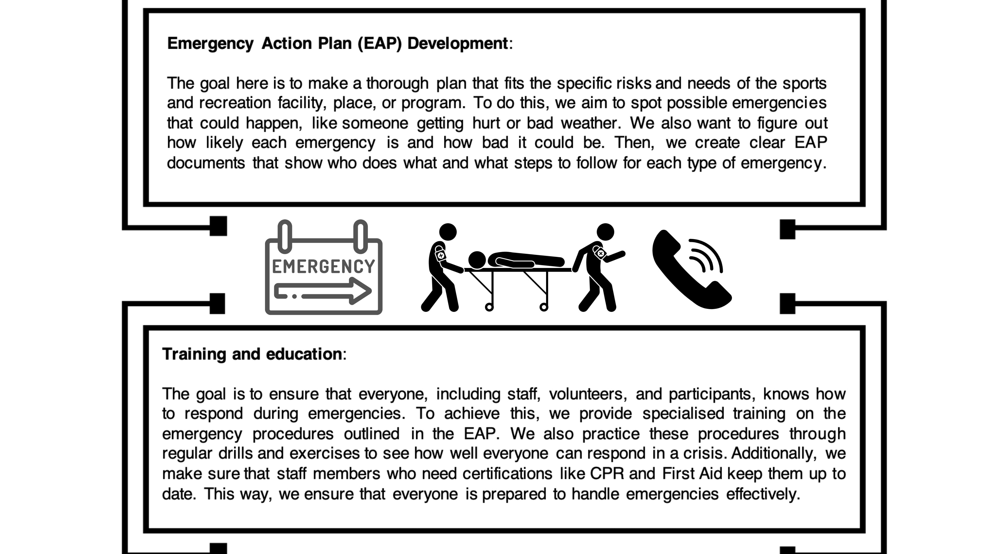

Slide 6
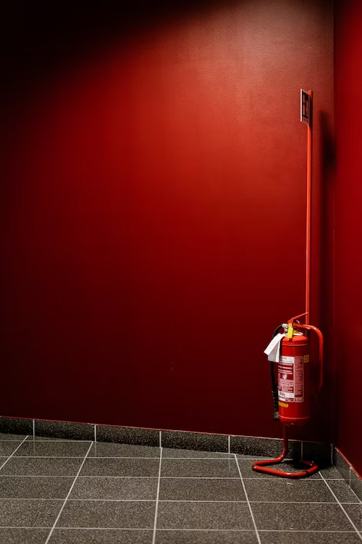
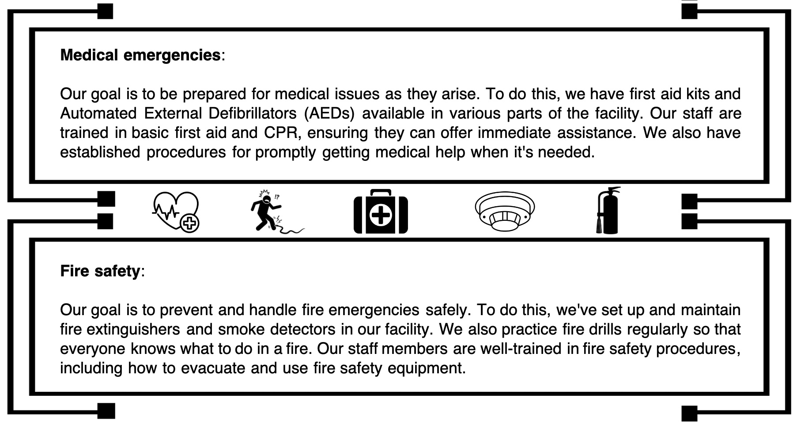

Complete Inquiry task 5A

Slide 7
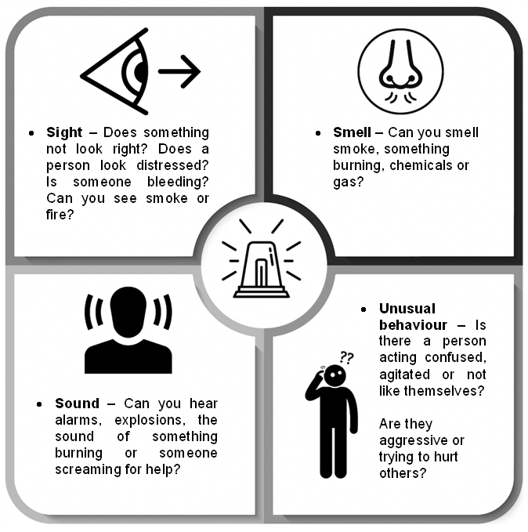
Recognising an Emergency
The faster you notice that something is seriously wrong, the quicker you can take action to prevent more harm. What counts as an emergency can vary – you can recognise an emergency in four ways

Slide 8
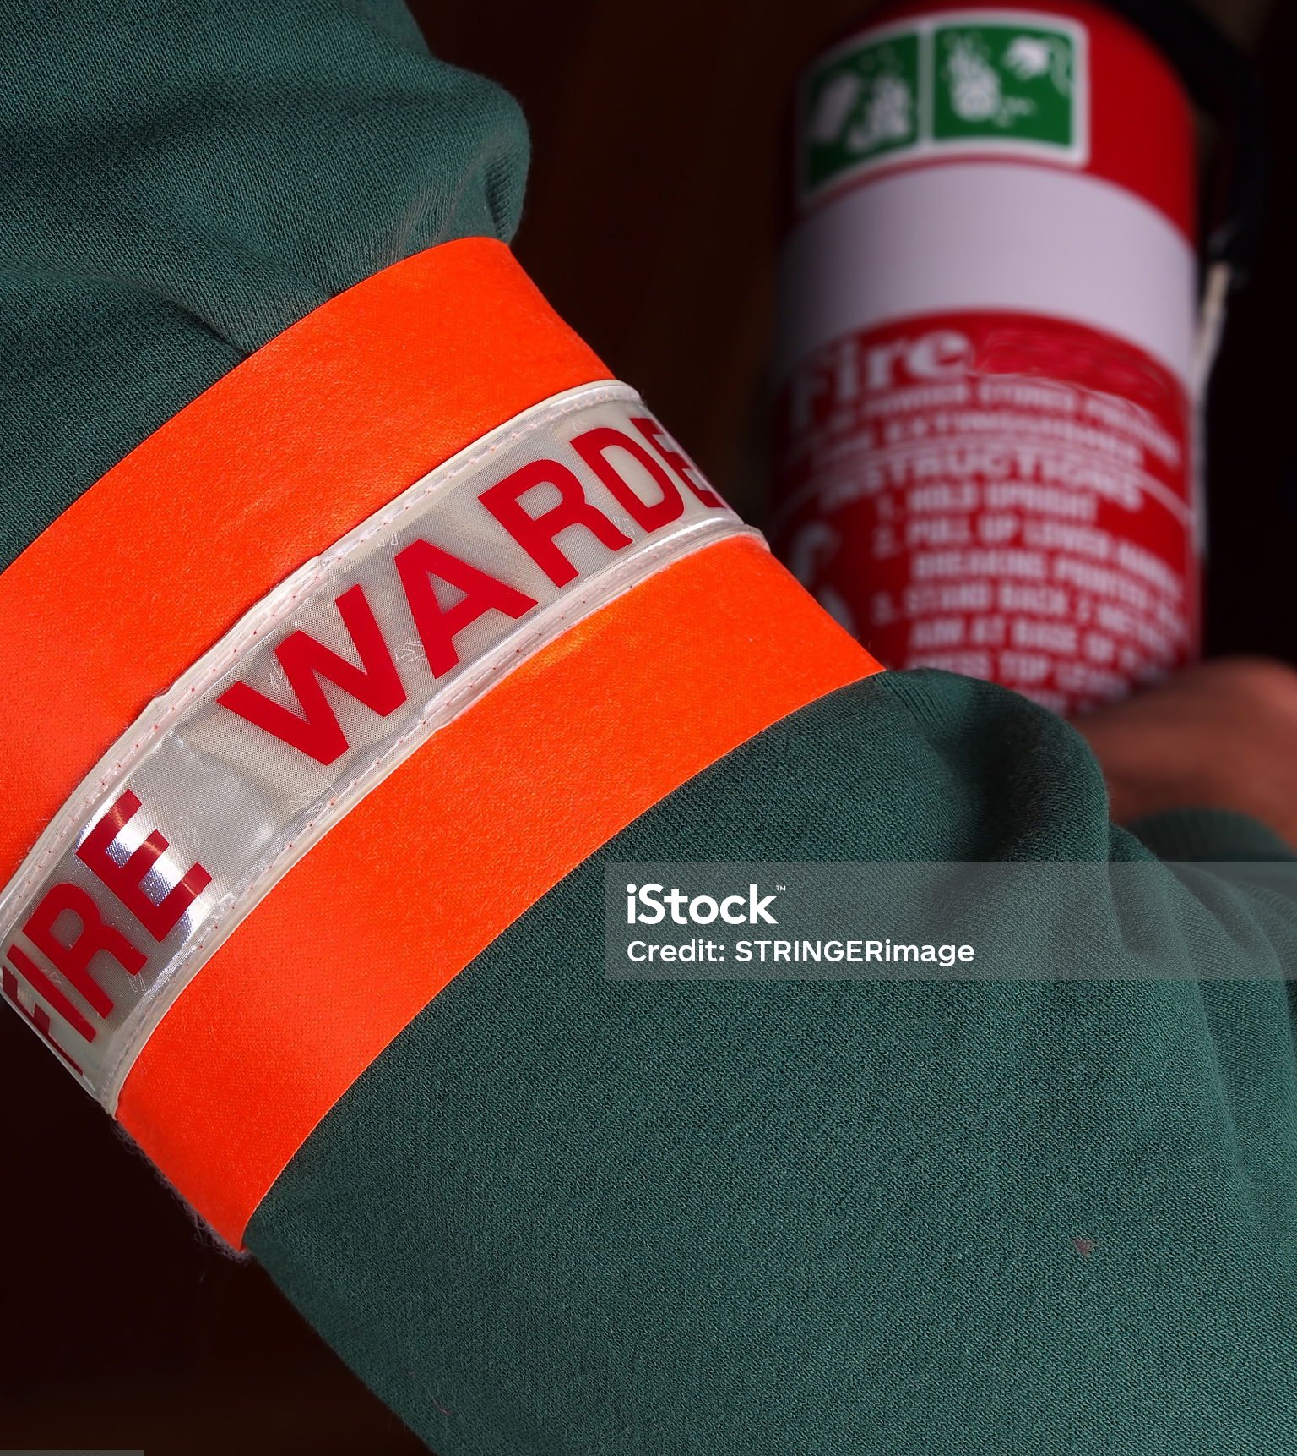
Role responsibilities in emergency situations
When an emergency situation presents itself, it is important to know who is responsible for attending to the emergency situation. Who is responsible will depend on the nature of the emergency.
Wardens and marshals - work to ensure the safety and orderly evacuation of people in different settings. They lead evacuations, guiding people to safe exit routes, accounting for everyone, and helping communication
Work health and safety/occupational health and safety representatives (HSR) - make sure everyone stays safe and follows the rules
Human resources personnel - make sure everyone knows what's happening and what to do
Security personnel - Security personnel keep a watchful eye to ensure people stay calm and orderly, preventing chaos during emergency situations
Fire Wardens - the captains of fire safety in sport and recreation workplaces. When there's a fire emergency, they step up to lead the way
First aider and AED operators - step in to provide immediate medical help to those who are injured or unwell, assessing, and stabilising injuries until advanced medical assistance arrives

Slide 9
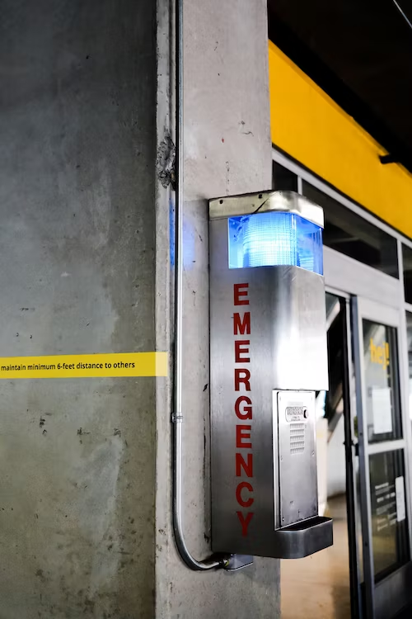
Boundaries of emergency responses
Having clear rules about who does what during emergencies is very important. makes things go smoother and faster because everyone knows their job
This is especially important when things are dangerous. It also helps prevent mistakes. When everyone knows their job, they are less likely to make errors.
Chain of command | Decide who's in charge during emergencies. Others follow their lead.
Qualifications | People doing special jobs should be trained and qualified. For example, those giving first aid or using special equipment.
Duty of care | Protecting others is crucial, but you should also stay safe. Don't risk your own safety to help others.
Communication | Say who talks to emergency services and how everyone gets information.
Special jobs | Only trained people should do special tasks, like first aid.
Search and rescue | In outdoor places, only experts should do search and rescue missions.
Security | Security staff should keep order. They shouldn't do medical or lifeguard jobs unless they're trained.
Emotional support | Give comfort to people, but let experts handle serious emotional help.
Records | Write down what happened and who did what.
Medical decisions | Respect rules about who can say yes to medical help.
Working with authorities | Understand your role when dealing with police or fire departments.
Evacuation | Follow rules for leaving safely during an emergency.
Safety tools | Only trained people should use safety equipment.

Slide 10
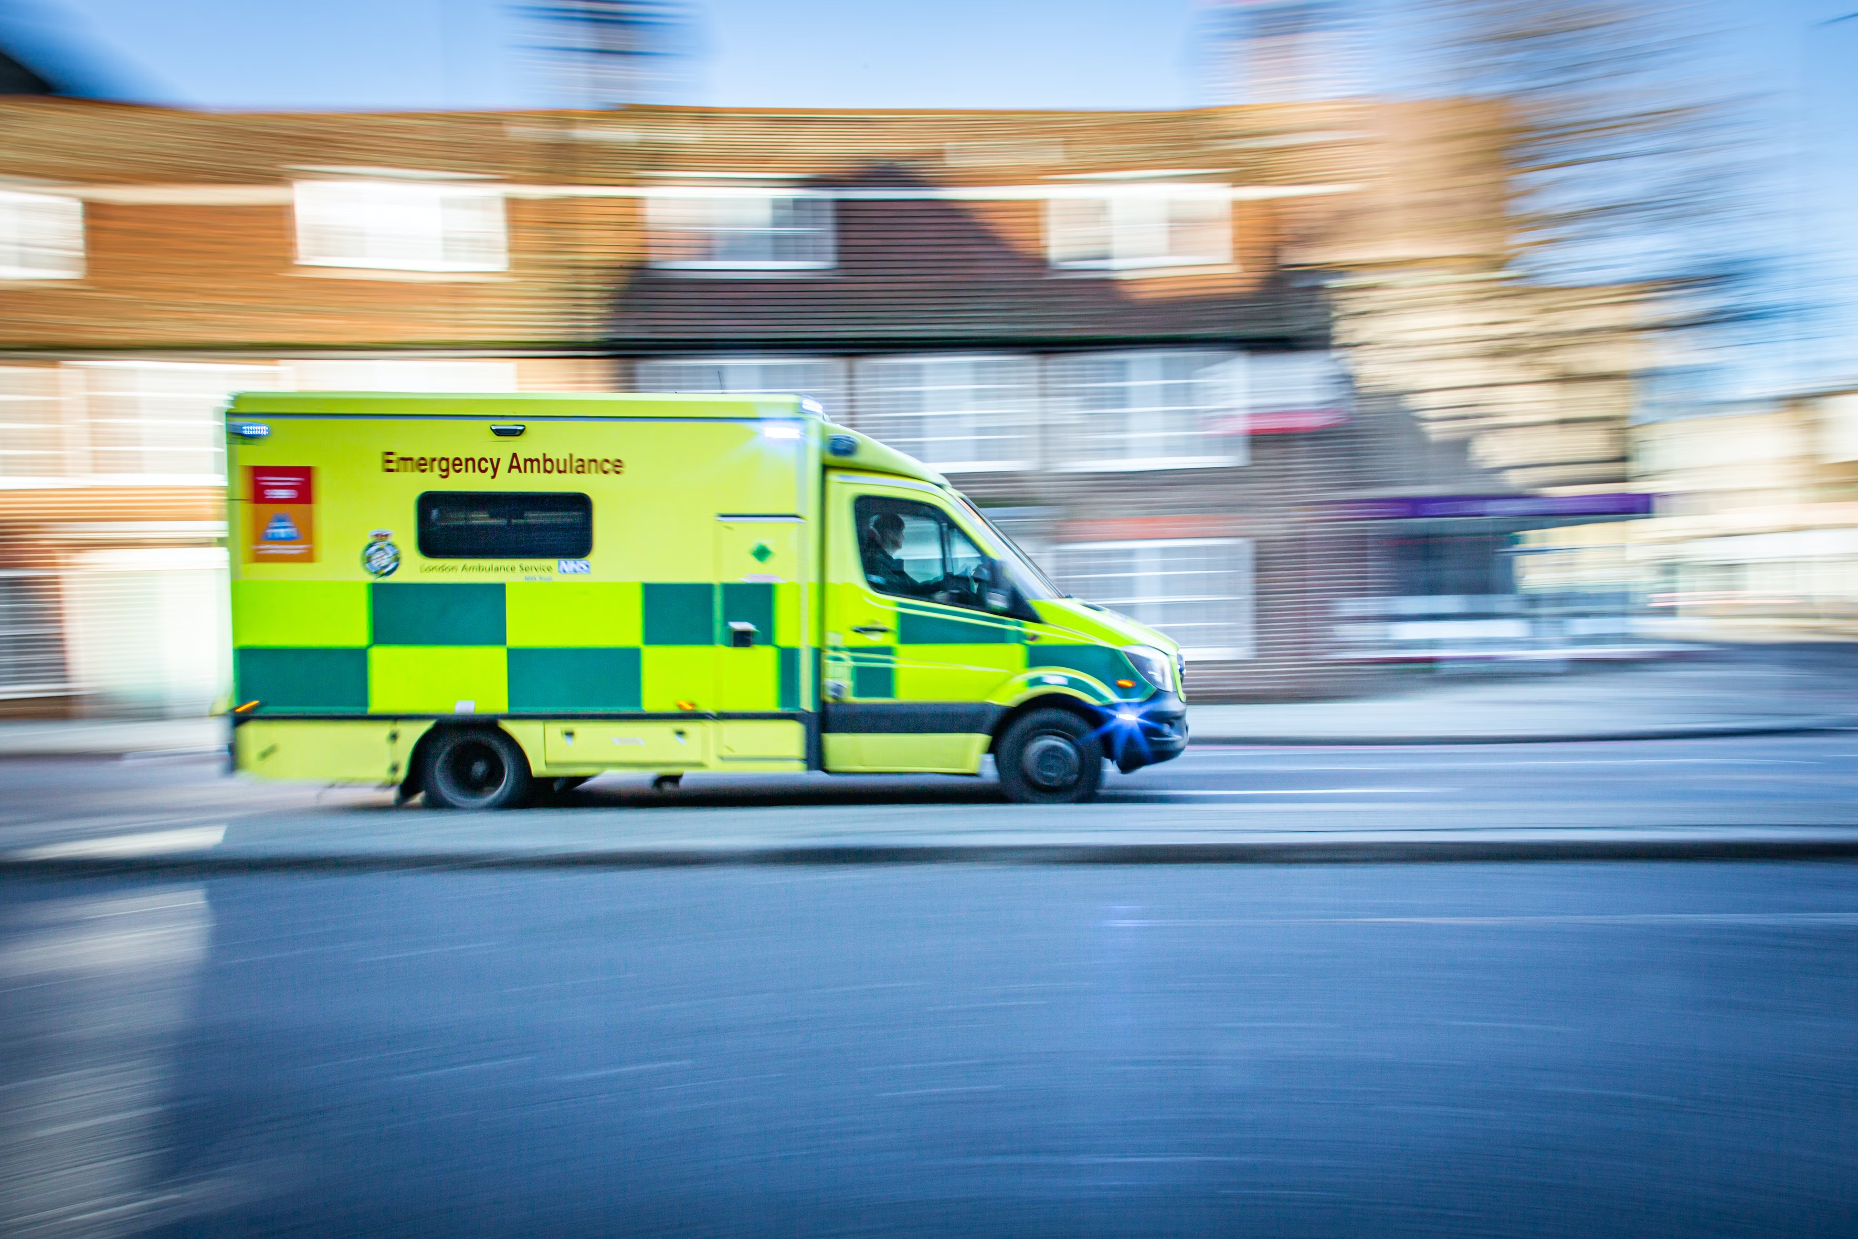
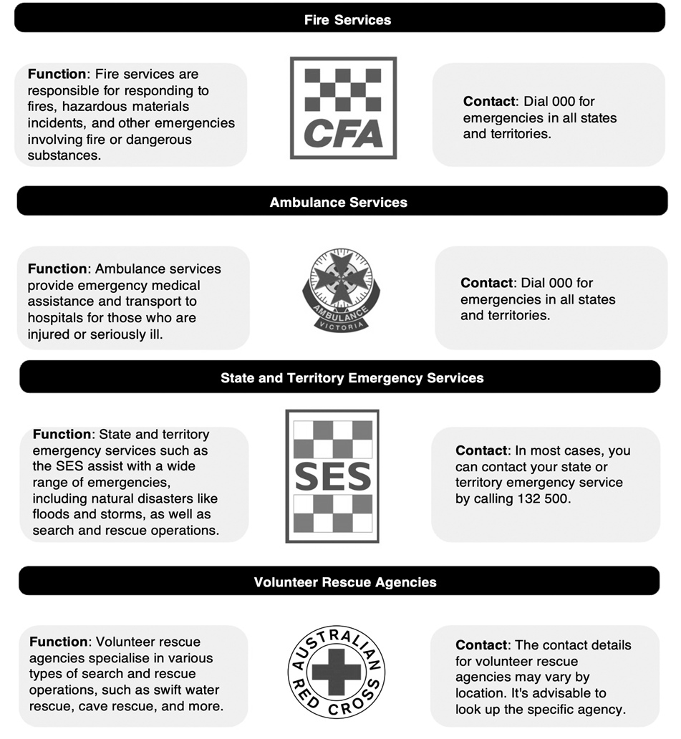
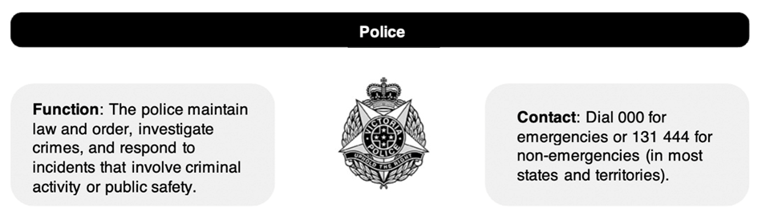
Emergency Services
Complete Inquiry task 5B

Slide 11

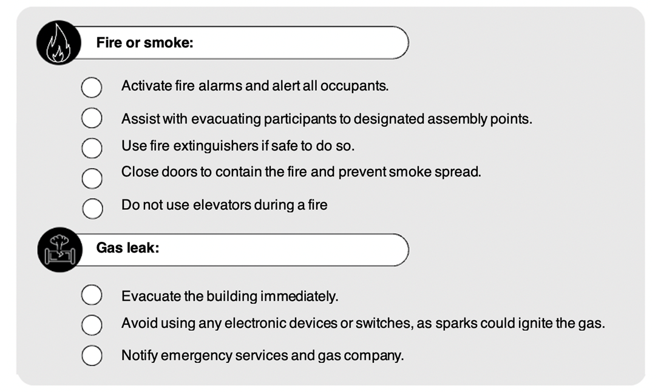
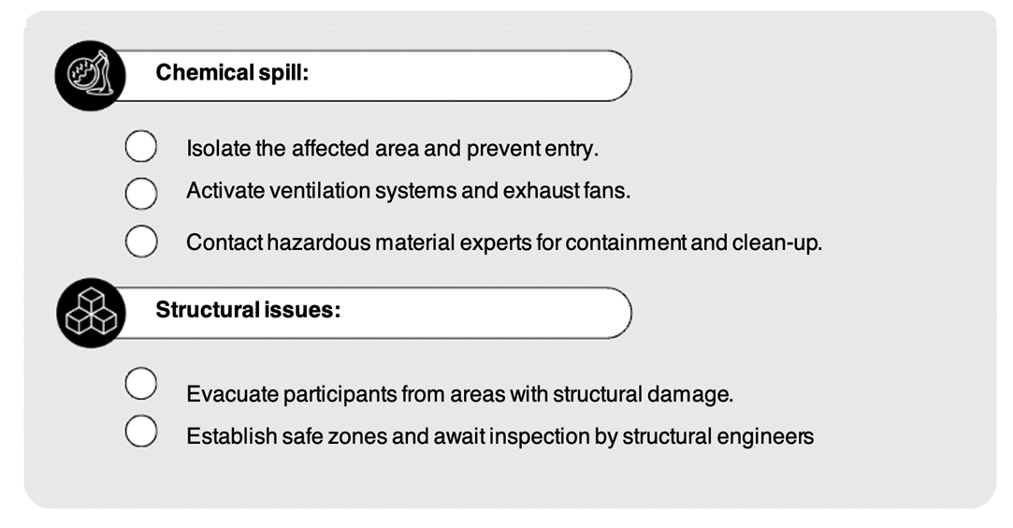
Types of Emergencies and how to respond
Indoor Environments

Slide 12
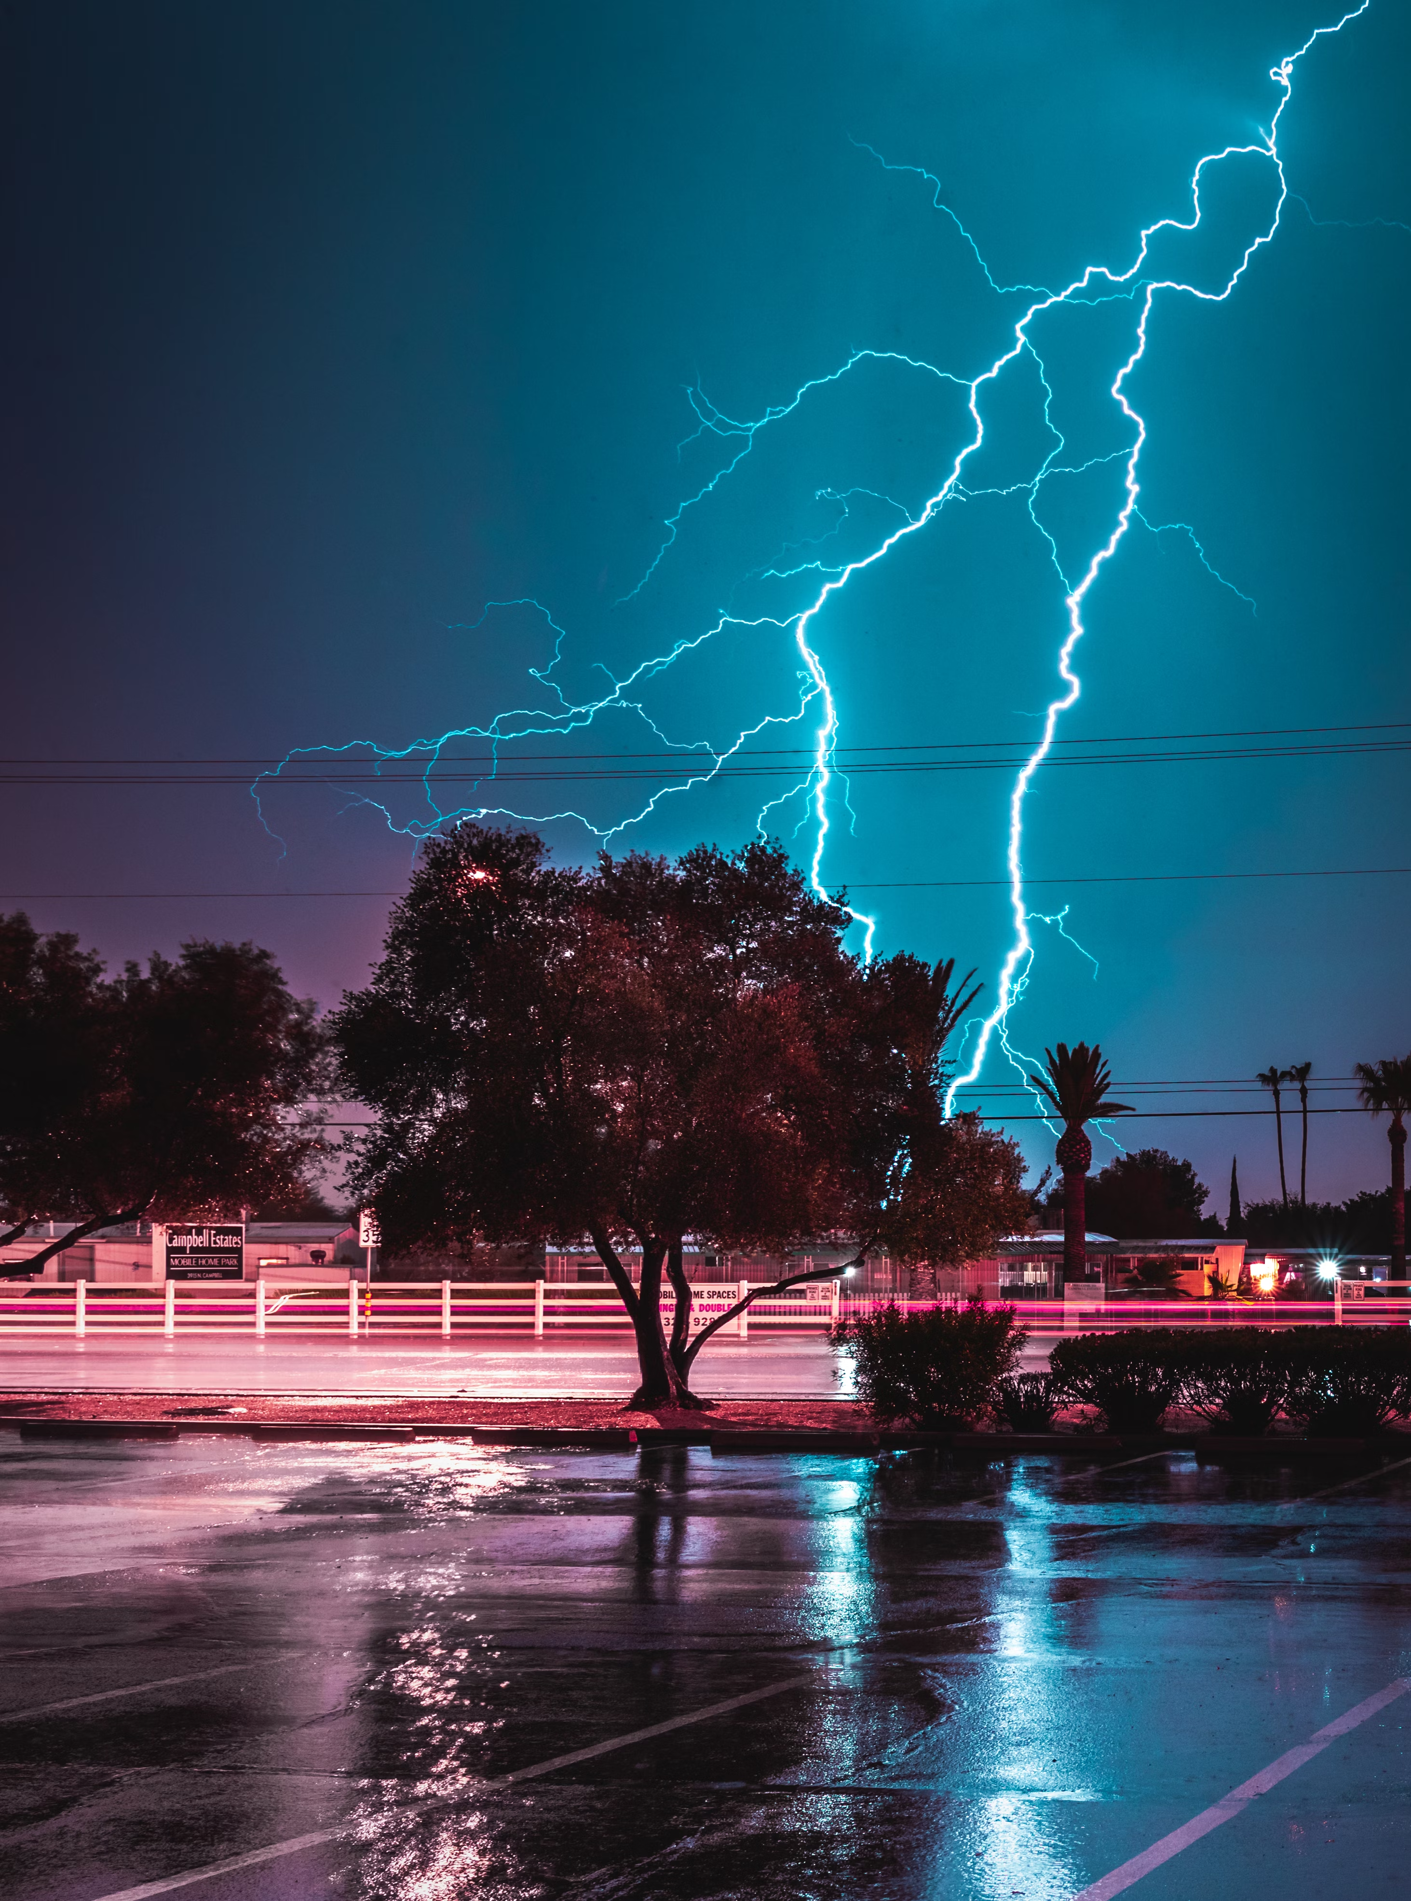
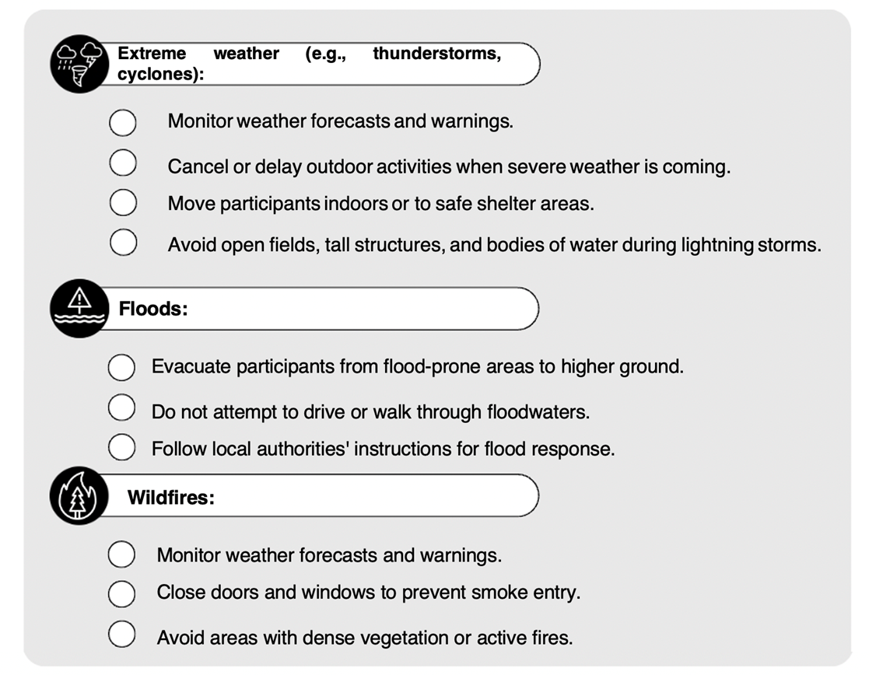
Outdoor Environments

Slide 13
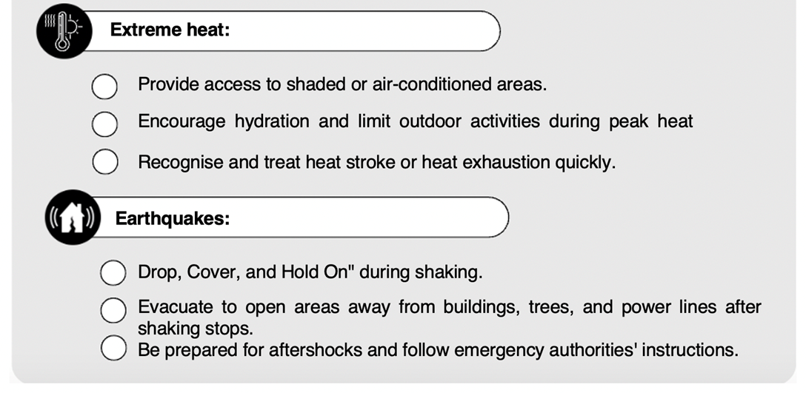
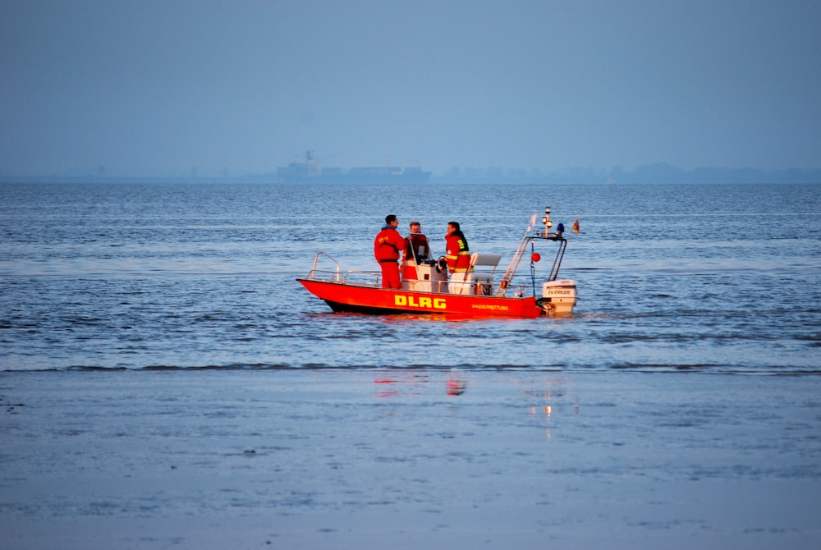
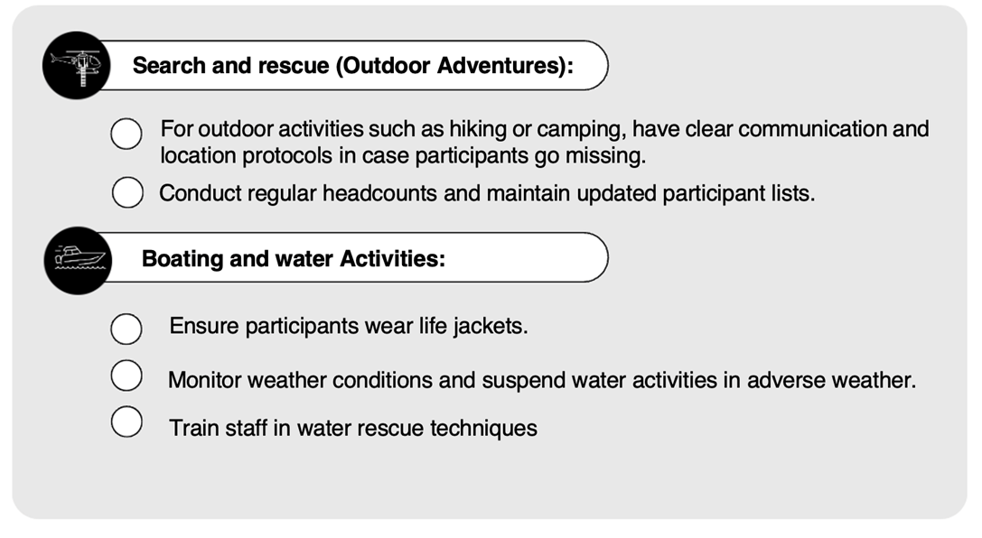

Slide 14

Complete Reflection Bank Set A

