Slide 1
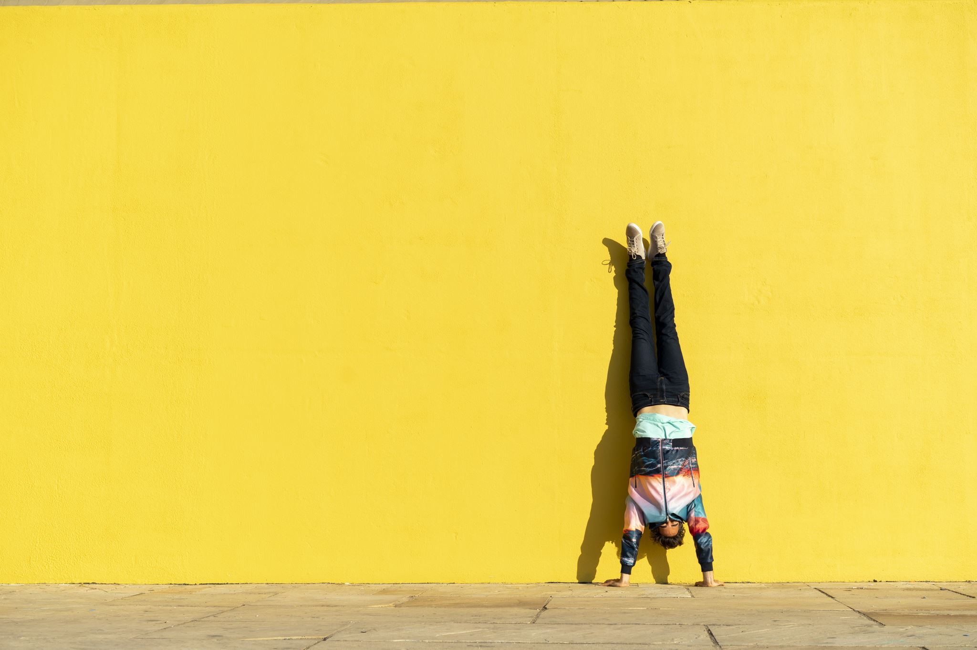
SISSPAR009
Participate in conditioning for sport
Through this unit you will develop the skills and knowledge required to participate in strength and conditioning to physically prepare for competition in a specific sport.
Part 2

Slide 2
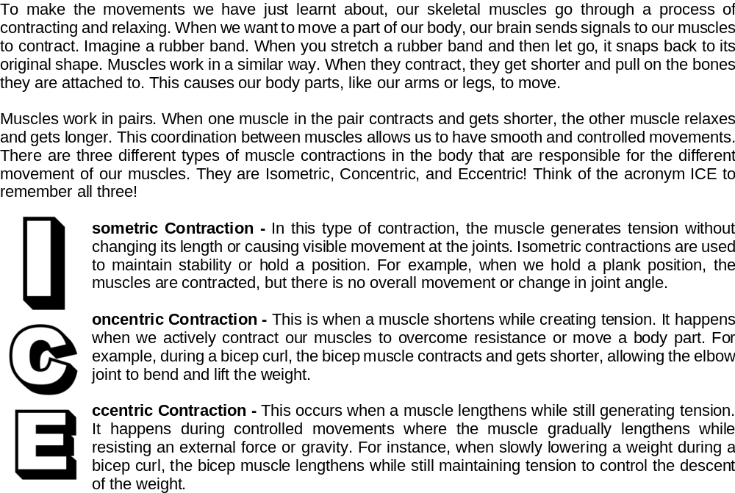
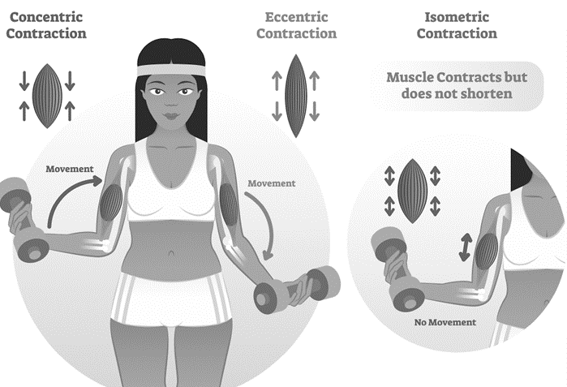
Muscle Contractions

Slide 3
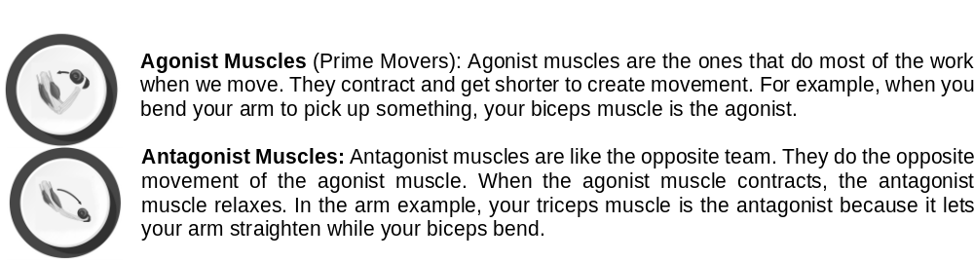
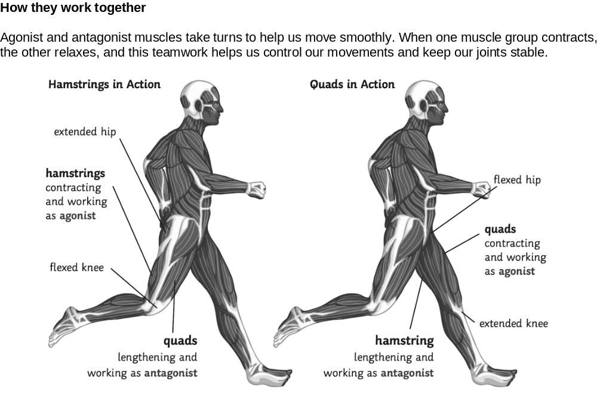
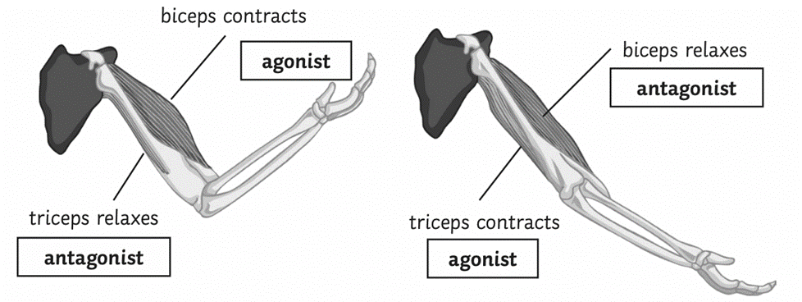

Agonist and Antagonist muscles
Complete Inquiry task 2E, 2F & 2G

Slide 4
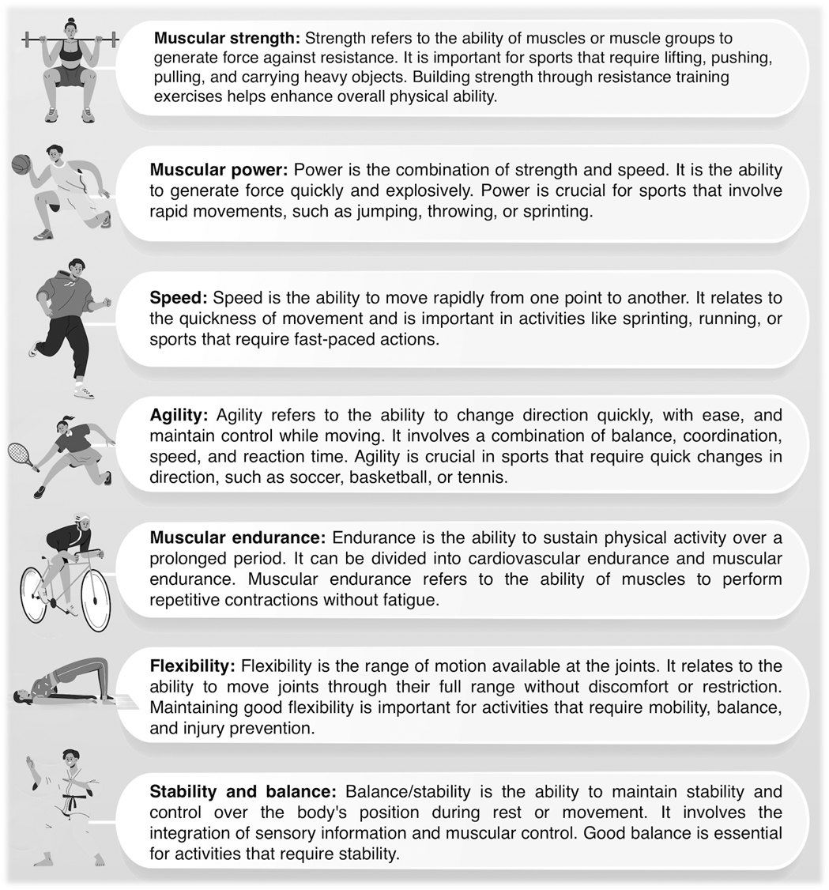
Fitness Components and Testing
The major fitness components of physical ability are different aspects of how our bodies can perform physically.
Each fitness component plays a role in our physical abilities and contributes to our overall fitness and well-being.
By improving and maintaining these components through exercise and training, we can enhance our performance, reduce the risk of injuries, and stay healthy and capable in our daily lives and activities.
They play an extremely important role in conditioning for sport as they directly impact an athlete's ability to meet the specific physical demands of their sport.
Here is each major fitness component and how they contribute to sports activities:
Complete Inquiry task 2H

Slide 5
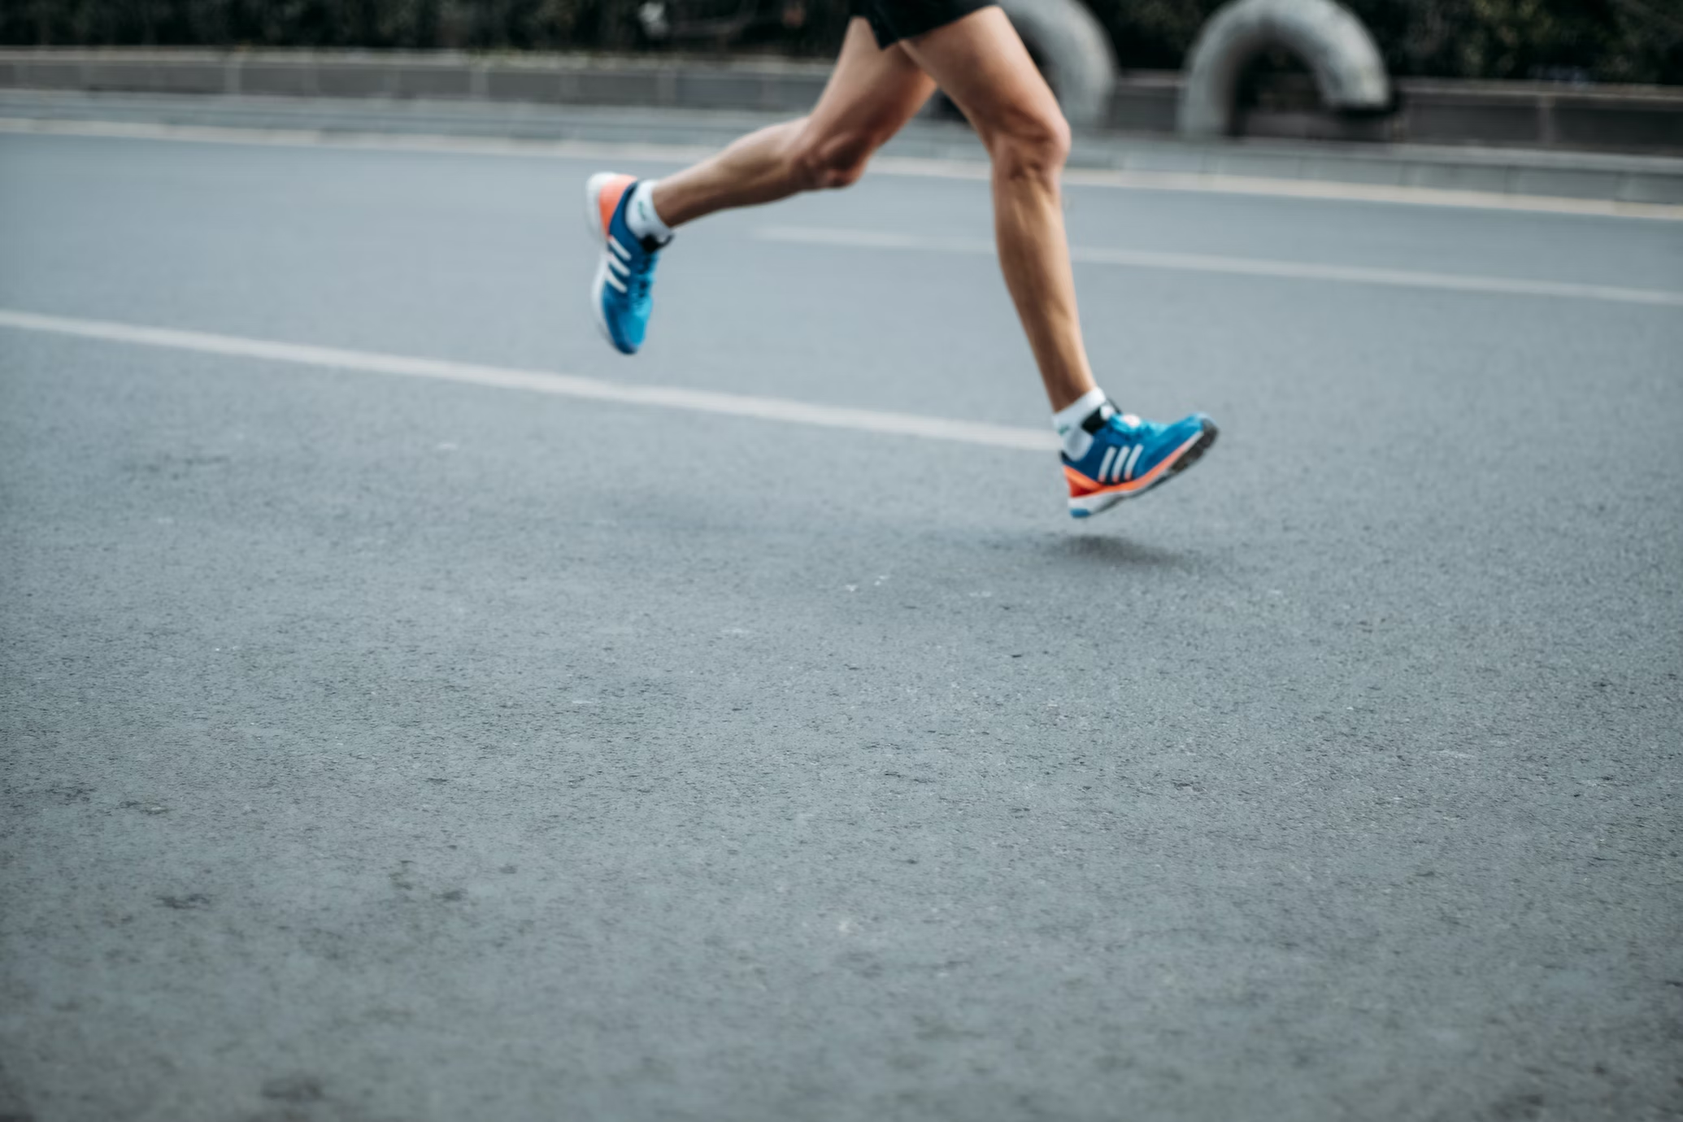
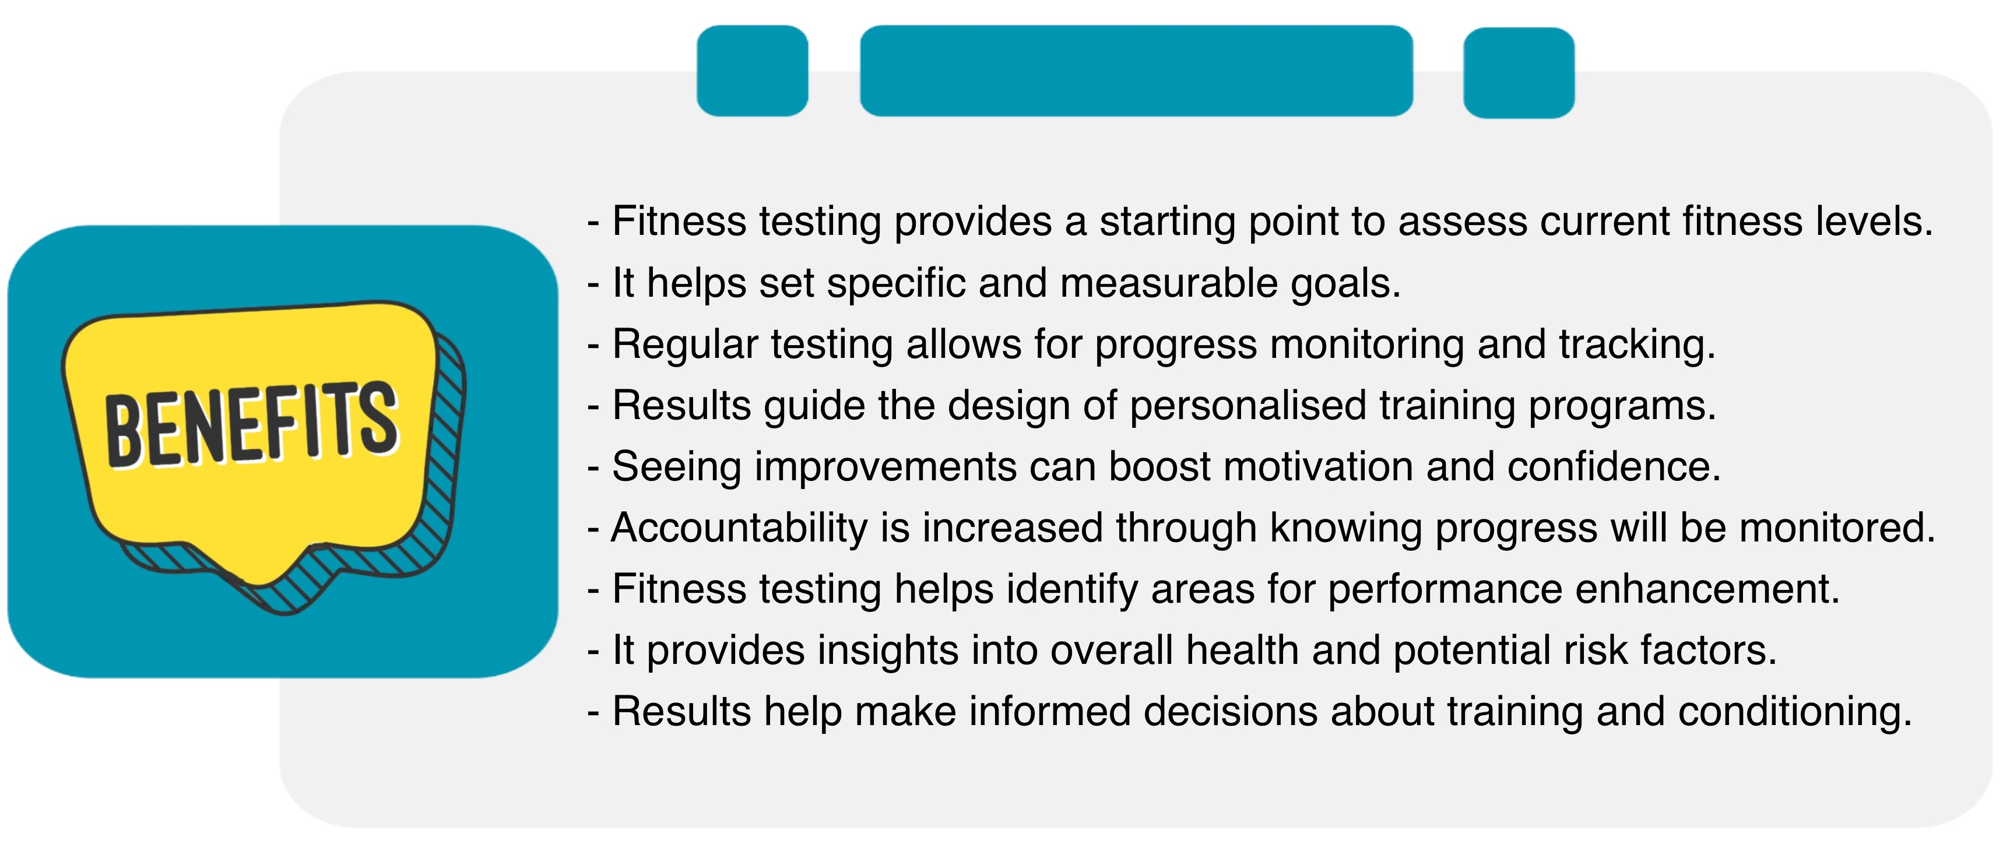
Fitness Tests
Fitness testing is a way to measure and evaluate different aspects of physical fitness. It helps us understand how fit we are and what areas we need to improve. During fitness testing, we do various tests and assessments to see how our body performs in terms of things like strength, endurance, flexibility, and endurance.
There are many benefits of fitness testing including:

Slide 6
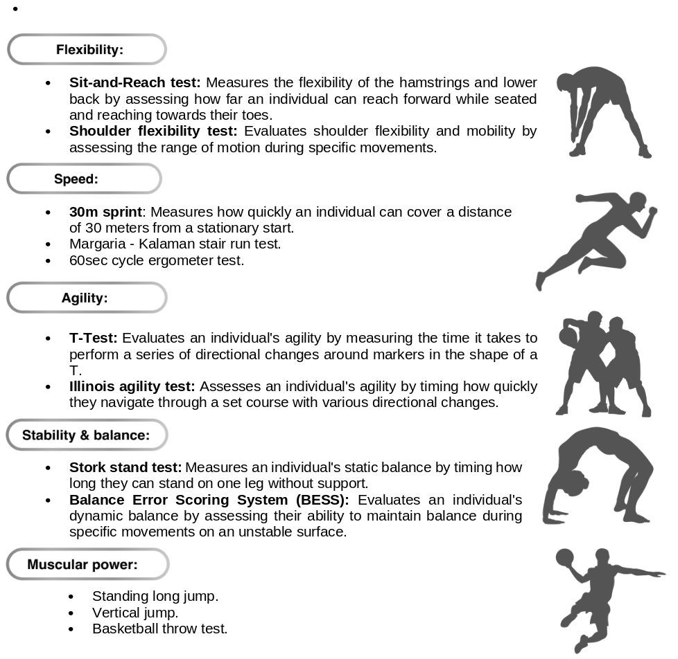
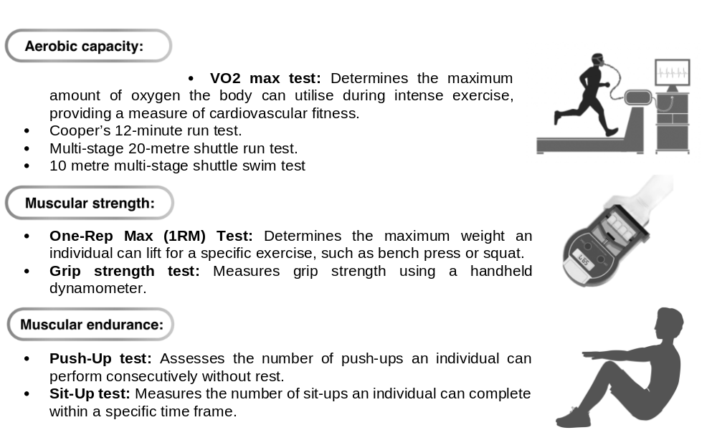
Fitness testing helps us understand our strengths and weaknesses, identify areas for improvement, and stay motivated.
Here are some common fitness tests for each major fitness component:
Complete Inquiry task 2I

Slide 7
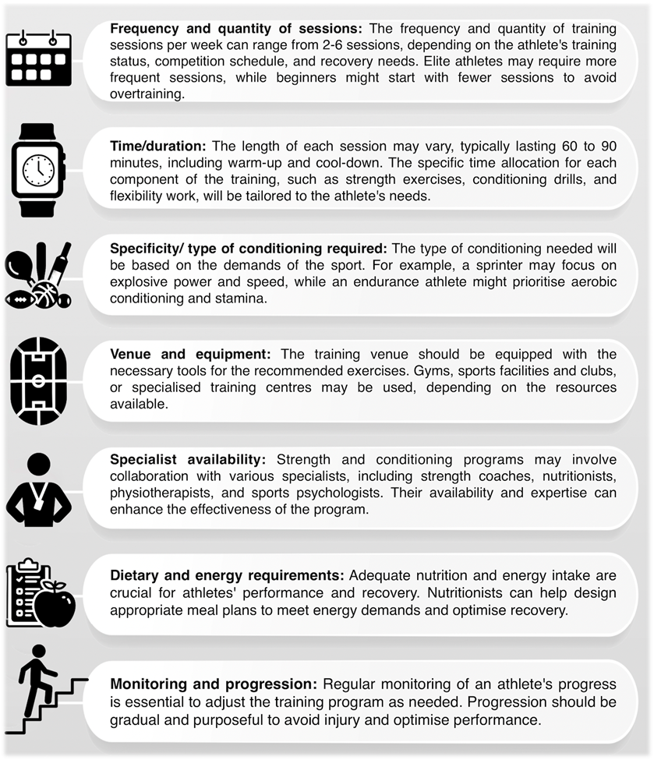
Strength and conditioning regimes
Planned and structured training programs aiming to improve physical fitness and athletic performance.
It includes exercises like strength training, aerobic conditioning, and flexibility work, tailored to meet the individual's goals and needs.
They enhance overall fitness, prevent injuries, and boost performance in sports or activities - designed as personalised programs, considering the athlete's abilities and progress.
Gradually increasing intensity and complexity to achieve the best results safely and effectively.
Here are some common types of strength and conditioning regimes along with considerations for each one:
Complete Reflection Bank Set A

Slide 8
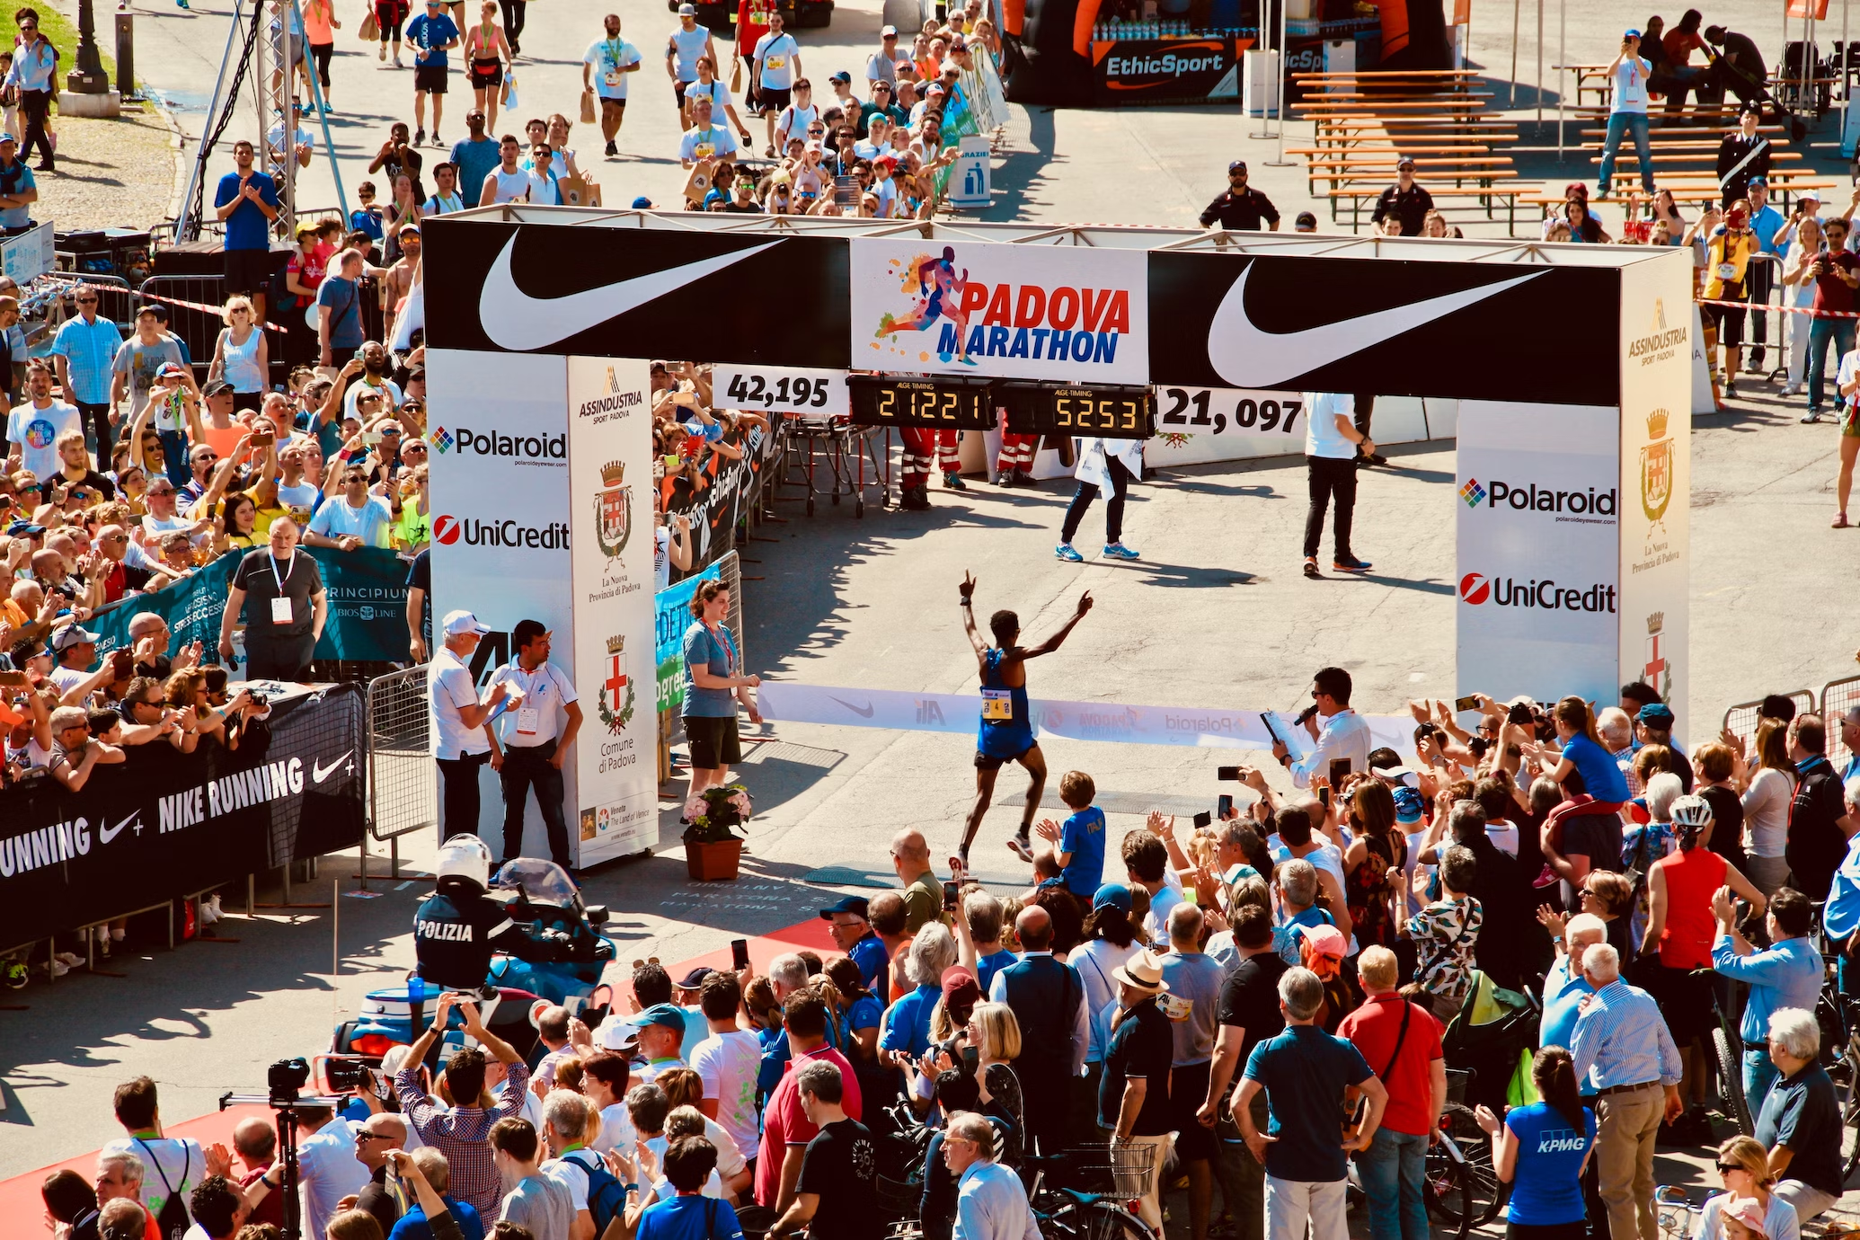
Participate in Training for sport-specific strength and conditioning
To perform at their best in a specific sport, athletes must include basic strength and conditioning techniques.
These techniques are vital for improving overall fitness, enhancing specific athletic abilities, and maximising performance.
By tailoring training programs to match the requirements of their sport, athletes can gain an advantage over their competitors and achieve the highest level of performance.

Slide 9
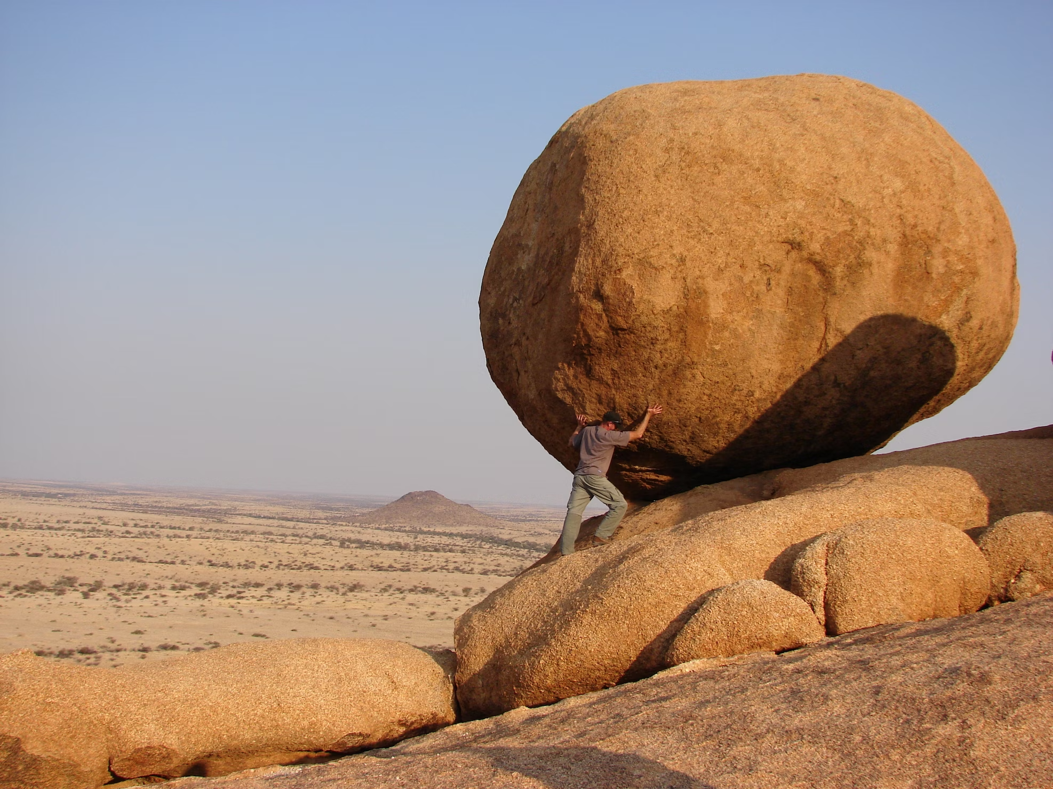
Strength and Conditioning Techniques
Techniques are tailored to address the unique demands and movement patterns of a particular sport
By incorporating resistance training, core stability, stretching, aerobic and anerobic conditioning and sport-specific exercises, athletes can enhance their overall physical capabilities.
It is crucial to acknowledge that only qualified professionals should be responsible for designing and implementing strength and conditioning programs
By staying within your scope of knowledge and seeking guidance from specialists, you can provide athletes with appropriate and effective training methods tailored to their needs

Slide 10
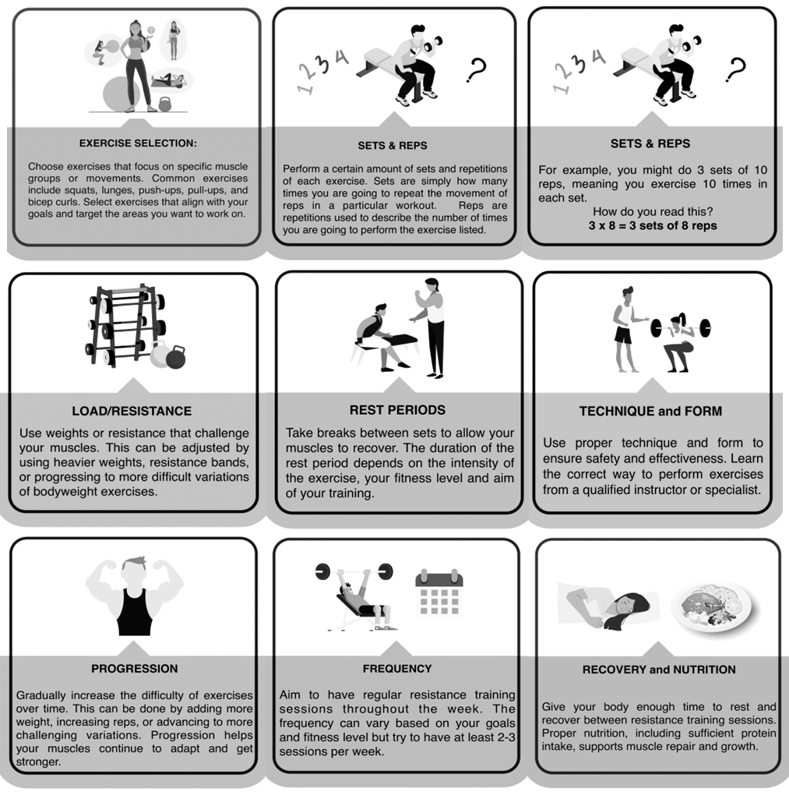
Resistance Training
Resistance from dumbbells, barbells, weight machines, or even your own body weight, gradually increasing in challenge on your muscles over time.
This leads to improvements in strength, muscle size, and muscular endurance.
It's important to start with manageable weights and gradually increase the challenge over time.
This allows the body to adapt and reduces the risk of injury
Complete Inquiry task 2J,2K, 2L & 2M

Slide 11
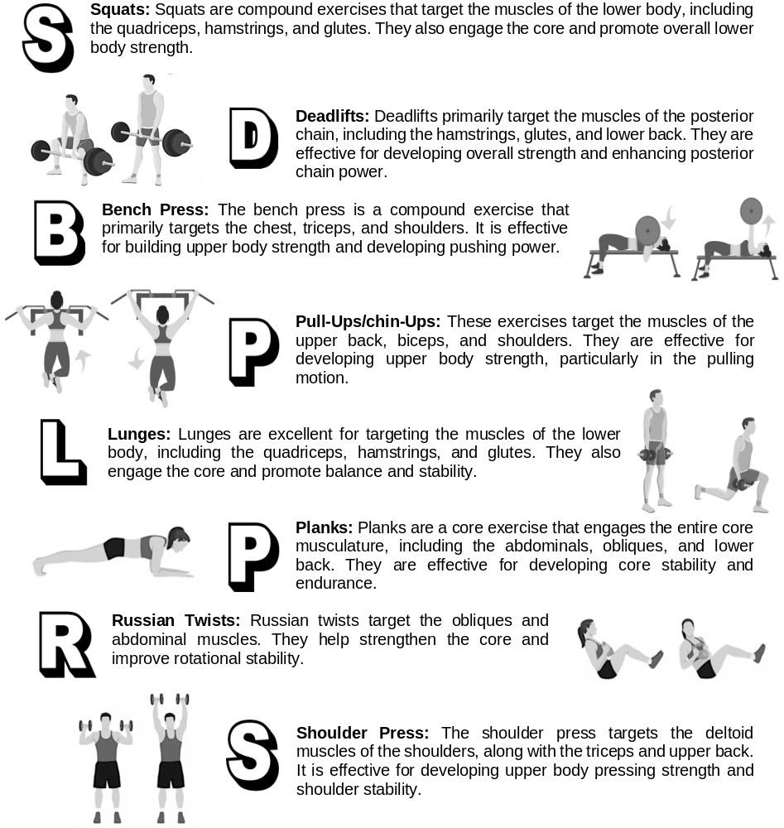
Most effective exercises in a resistance training program
When designing a resistance training program and selecting specific exercises it is vital that you have the appropriate knowledge and qualifications in order to keep your athletes safe.
Here are some of the most effective exercises that can be included in a resistance training program:
Complete Inquiry task 2N

Slide 12
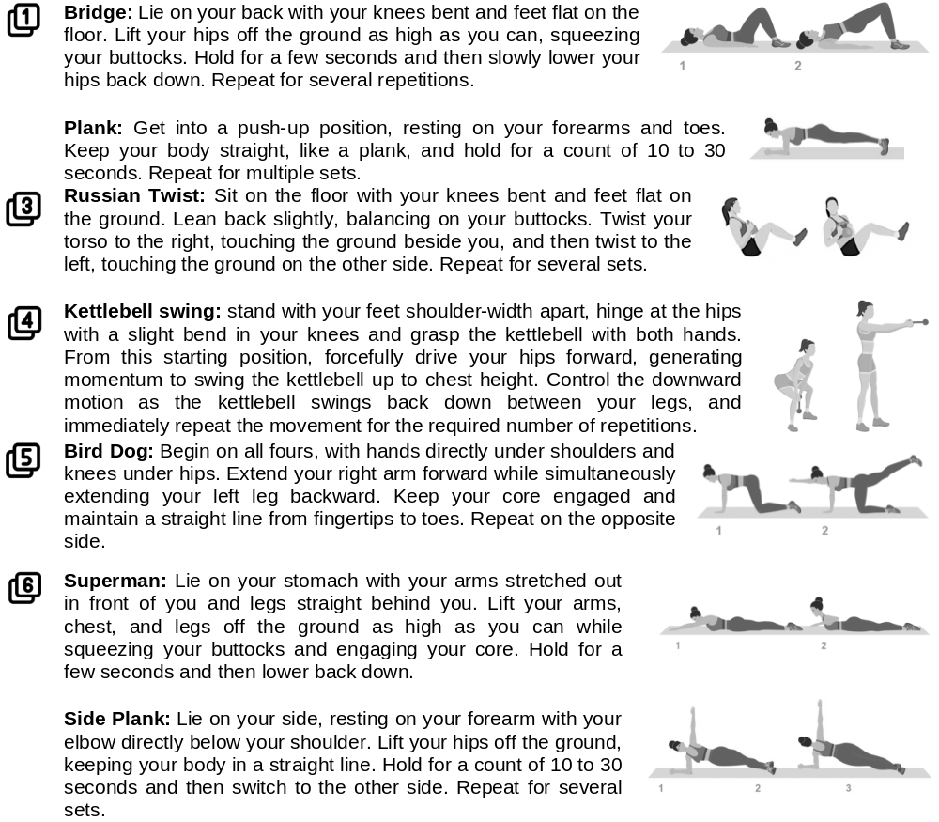
Core Stability
Core stability training is to effectively engage the muscles in the trunk area and manage the position of the lower back (lumbar spine) during various movements in sports or recreational activities.
Here are some of the most effective core exercise athletes could include in their core stability training program:
The number and frequency of core exercises in a resistance training program can vary depending on the individual's goals, fitness level, and the overall structure of the program
Complete Inquiry task 2O, 2P & 2Q

Slide 13
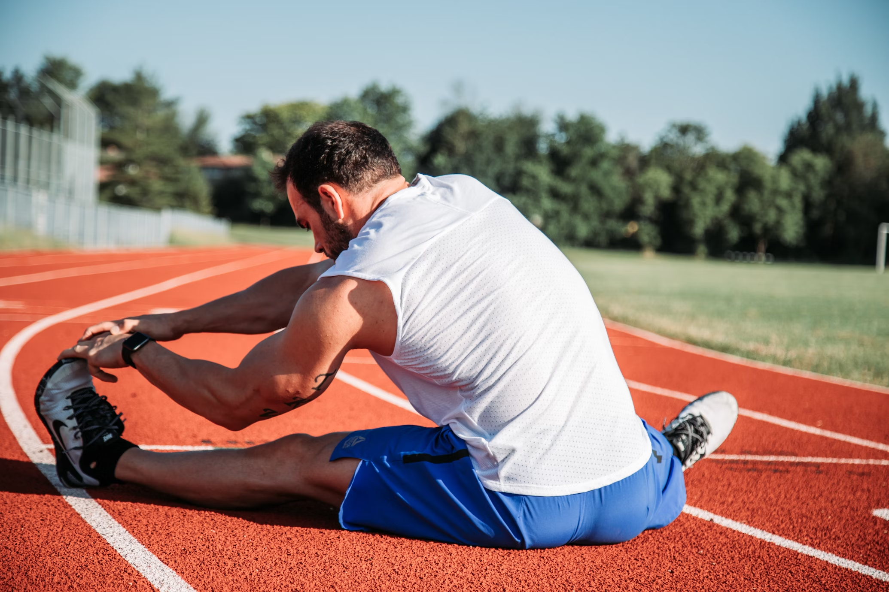
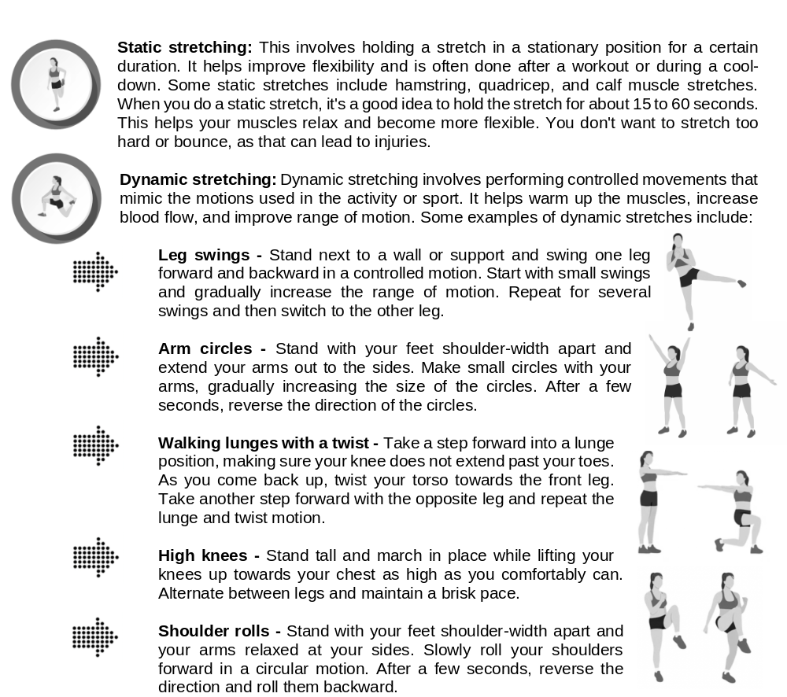
Stretching
Stretching is an important technique that should be part of an effective strength and conditioning program.
Just about every type of athlete in any sport can benefit from stretching, helping improve flexibility, range of motion, and overall muscle function
It can reduce the likelihood of injury and can increase muscle recovery.
Here are some commonly used stretching methods:

Slide 14
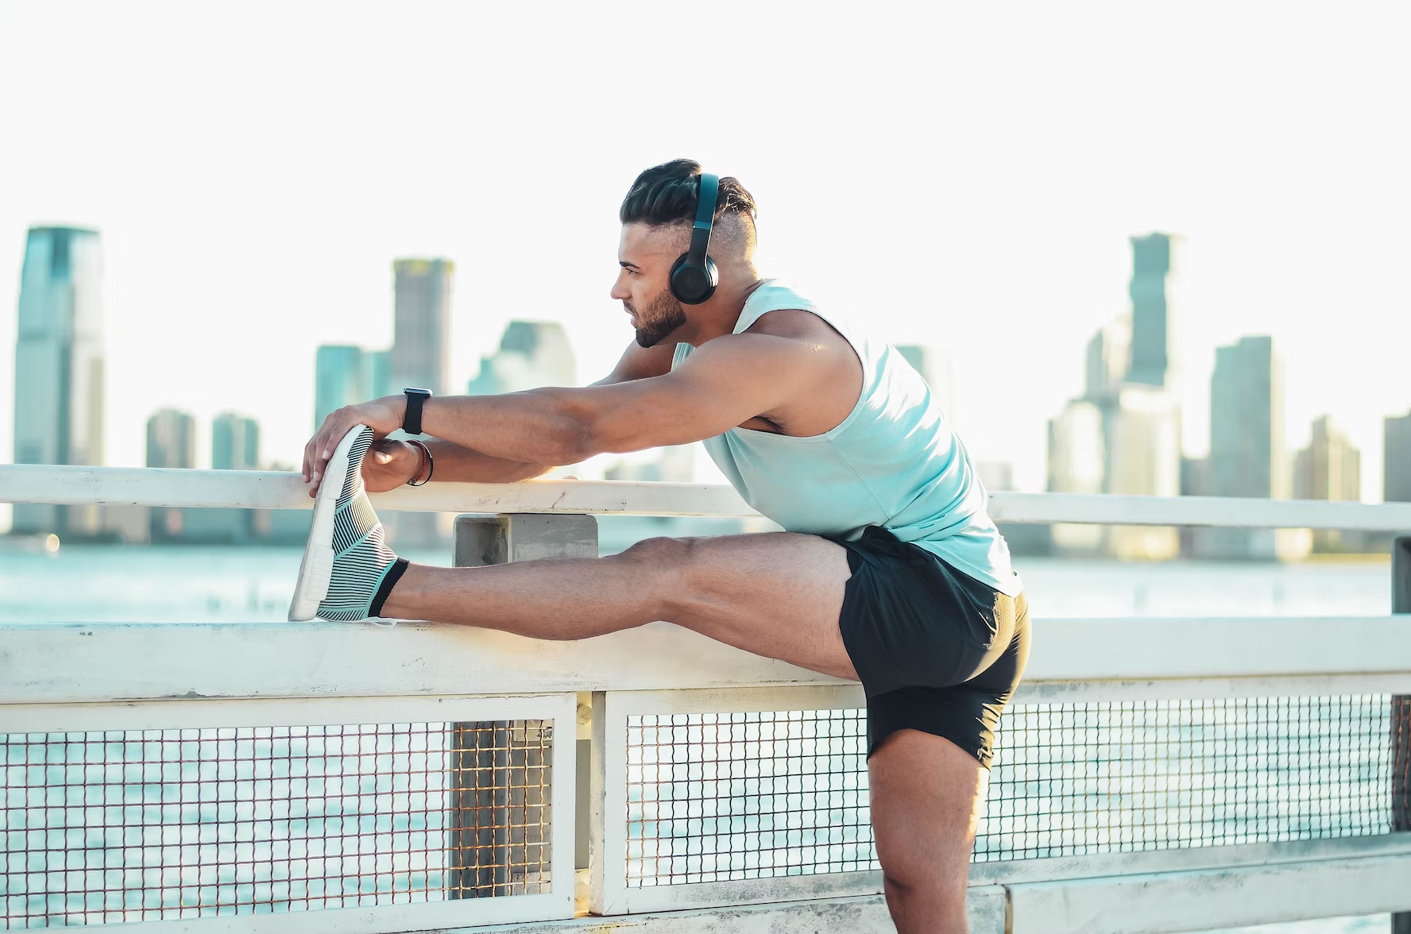
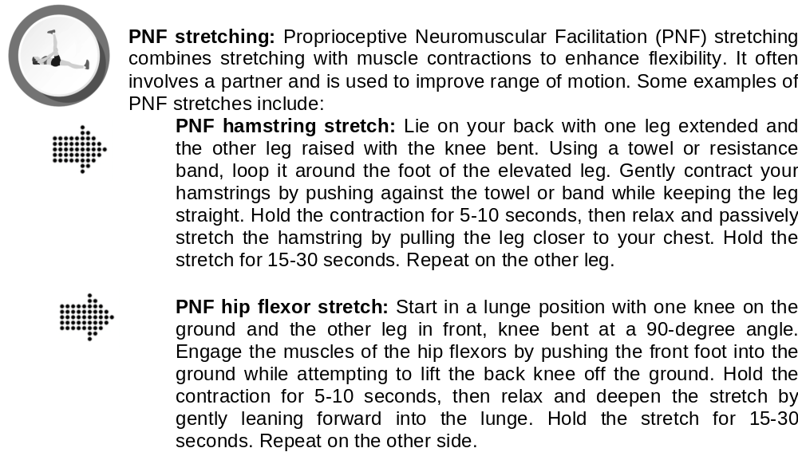
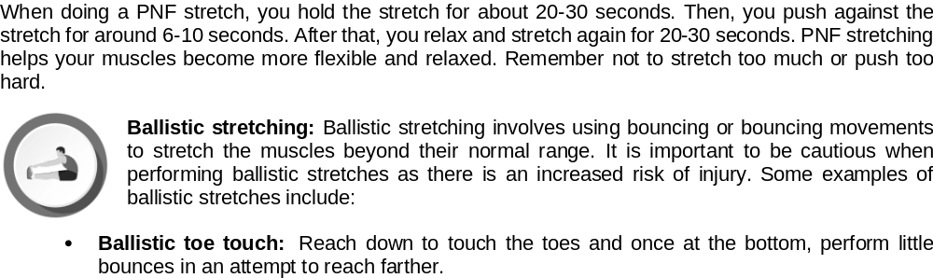

Slide 15
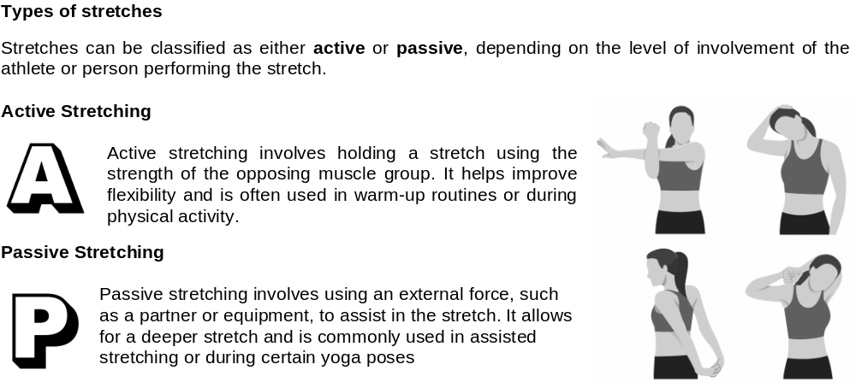
It is important that you check with a strength and conditioning specialist who has the proper qualifications to help you determine the most effective stretching methods for your strength and conditioning program
Complete Inquiry task 2R & 2S

Slide 16
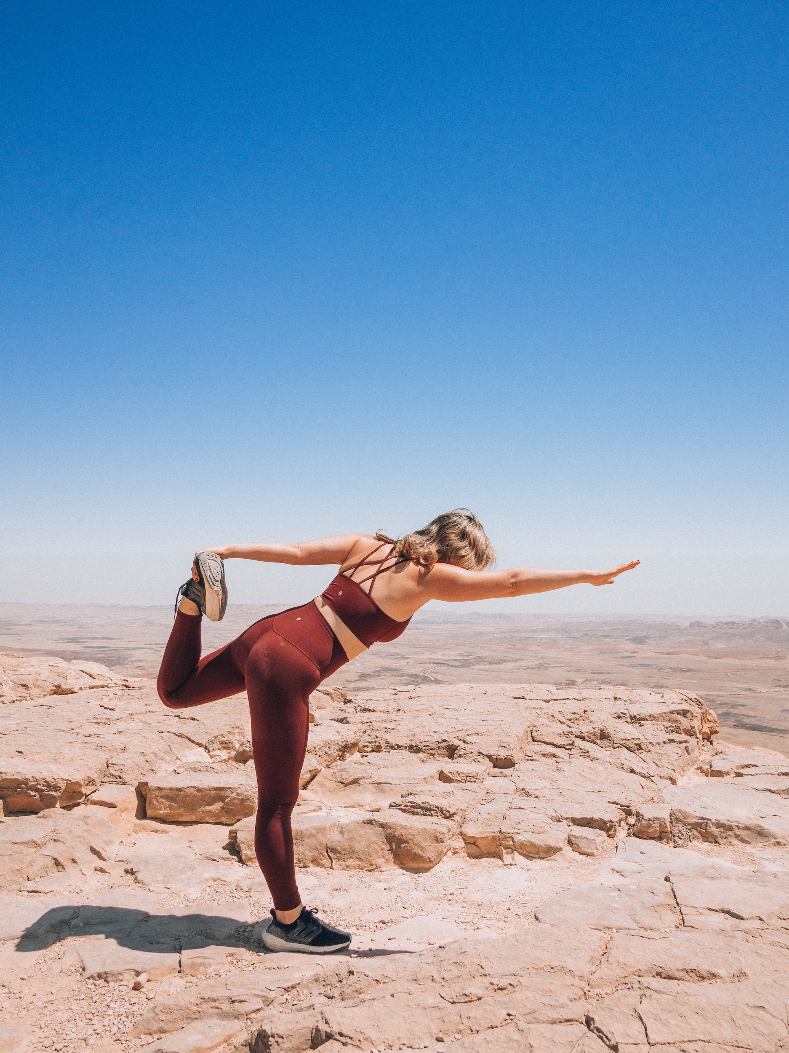
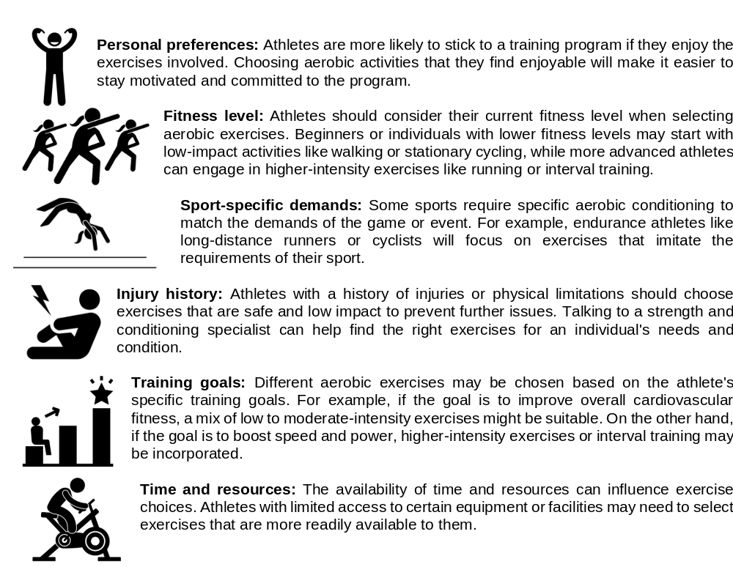
Aerobic Conditioning
Continuous activities like walking, running, cycling, swimming, or dancing.
It improves the efficiency of the cardiovascular system and the respiratory system
There are many different types of exercises such as running, cycling, interval training and swimming.
The specific choice of exercises that an athlete will use depends on a variety of factors.

Slide 17
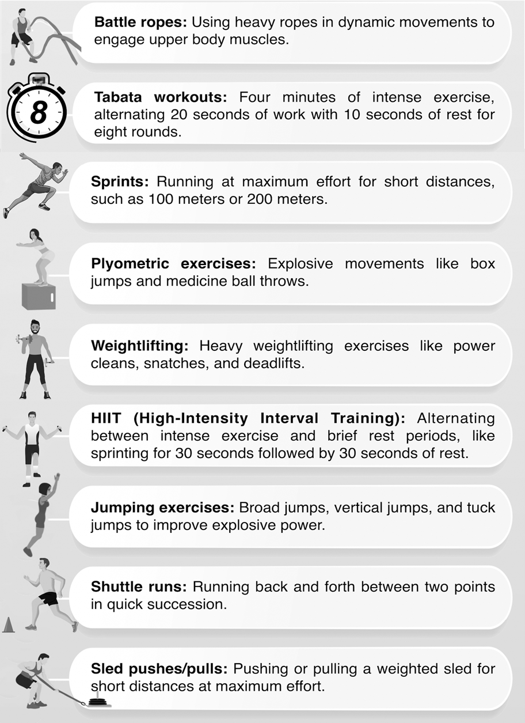
Anaerobic Conditioning
Anaerobic conditioning is intense exercise that doesn't rely on oxygen for energy.
It involves short bursts of high-intensity activities like sprinting, weightlifting, and jumping to improve the body's ability to perform short and intense bursts of activity without relying on oxygen.
Some common types of anaerobic conditioning exercises include:
Complete Inquiry task 3T
Complete Inquiry task 2T

Slide 18
Strength and conditioning equipment
The use of appropriate equipment allows athletes to perform a wide range of exercises and training techniques to achieve their fitness goals effectively
Strength and conditioning equipment are specifically designed to challenge the muscles and improve athletic abilities. Some common examples of strength and conditioning equipment include:
Free Weights
Bikes, rowers Ski ergs
Weight Machines
Treadmills
Benches and Racks
Resistance bands
Medicine balls
Plyometric boxes
Suspension trainers
Foam Rollers
Sleds and tires
Battle Ropes
Complete Inquiry task 2U

Slide 19
Safe use of equipment
Using equipment safely is vital to prevent injuries and ensure the workouts are effective. When athletes use equipment correctly, they reduce the risk of accidents and injuries, keeping themselves safe during training
safe usage of equipment helps to keep the equipment in good condition, extending its lifespan and reducing the need for repairs or replacements
Different equipment may have unique safety guidelines and techniques for proper usage.
Beginners may need more guidance and instruction to use equipment safely, while experienced athletes may be more familiar with proper techniques
Complete Inquiry task 2V & 2W

Slide 20

Review sport specific strength and conditioning outcomes
Strength and conditioning specialists have the expertise to design workouts that improve performance in specific sports or activities.
Seeking guidance from these professionals ensures that athletes receive proper instruction, minimise the risk of injuries, and achieve their fitness goals more efficiently.
Strength and conditioning specialists also play a crucial role in optimising an athlete's training routine, making it more effective and tailored to individual capabilities.
These specialists also have deep knowledge of exercise science, anatomy, and physiology to create effective and safe workout routines. Their main goal is to help athletes reach their full potential and succeed in their sports by optimising their physical abilities and preventing injuries.

Slide 21

Physiotherapists
Assess physical condition and create personalised treatment plans.
Physiotherapists are highly trained in assessing and treating musculoskeletal neurological and cardiorespiratory conditions
They help patients recover from injuries, manage chronic conditions, and prevent further physical limitations.
They use a combination of manual therapy techniques, therapeutic exercises, strapping and other treatments to address pain, improve mobility, and enhance physical performance.
In strength and conditioning, they play a vital role in improving an athlete’s performance and preventing injuries.
They work closely with athletes, coaches, and strength and other conditioning specialists to ensure that training programs are safe and effective, and provide guidance on injury prevention, proper warm-up routines and stretching techniques.

Slide 22

Sports trainer
Sport trainers focus on preventing and treating injuries that happen during sports and physical activities.
They are trained to recognise and manage sports-related injuries like sprains, fractures, and concussions. Sports trainers also teach athletes how to prevent injuries through exercises and proper techniques.
When injuries occur, sports trainers are there to provide immediate first aid and carry out treatment plans to help the athlete to recover. They may use techniques like taping, bracing, and other exercises to help in the rehabilitation process.
They design and apply injury prevention programs to reduce the risk of injuries during sports activities.

Slide 23
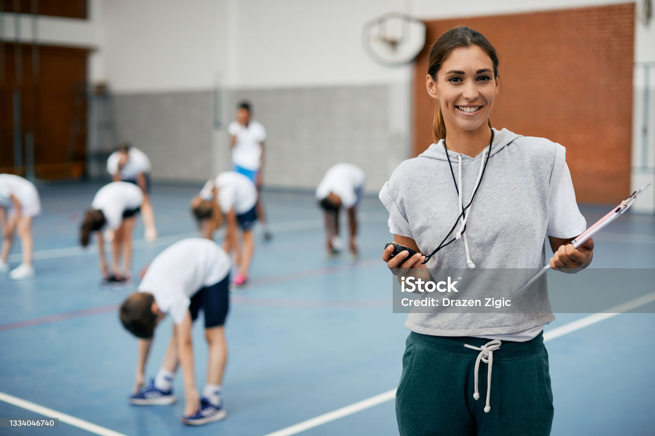
Sport specific coach
Use in-depth knowledge and expertise in that sport's requirements and techniques. They help athletes improve their skills, tactics, and strategies to excel in their chosen sport.
They assess the strengths and weaknesses of each athlete, highlighting capabilities and areas that require improvement.
They then design personalised strength and conditioning programs that focus on enhancing the specific skills and physical attributes needed for success in the sport.
Additionally, they closely monitor the progress of each athlete, making necessary adjustments to the training program to foster continuous improvement.
Their motivation, encouragement, and constructive feedback serve as vital factors in keeping athletes engaged and determined to achieve their goals

Slide 24
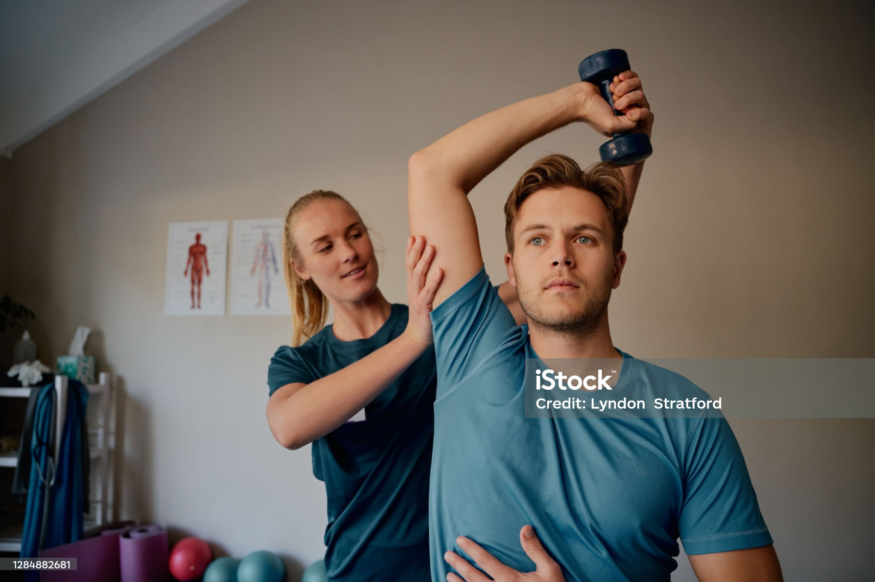
Strength and conditioning coach
Focus on making athletes stronger, faster, and better at the skills they need for their sport. They also help prevent injuries and improve overall fitness.
They have an in-depth knowledge of the body and how it adapts to stress and recovers, enabling them to apply appropriate periodisation techniques.
They carefully assess mental and physical fatigue to ensure that clients and athletes progress towards their goals safely and effectively, while minimising the risk of injuries
The role of a strength and conditioning coach involves understanding an athlete's goals and creating a personalised plan to help them achieve those objectives. They challenge athletes to step outside their comfort zones and grow both physically and mentally.

Slide 25
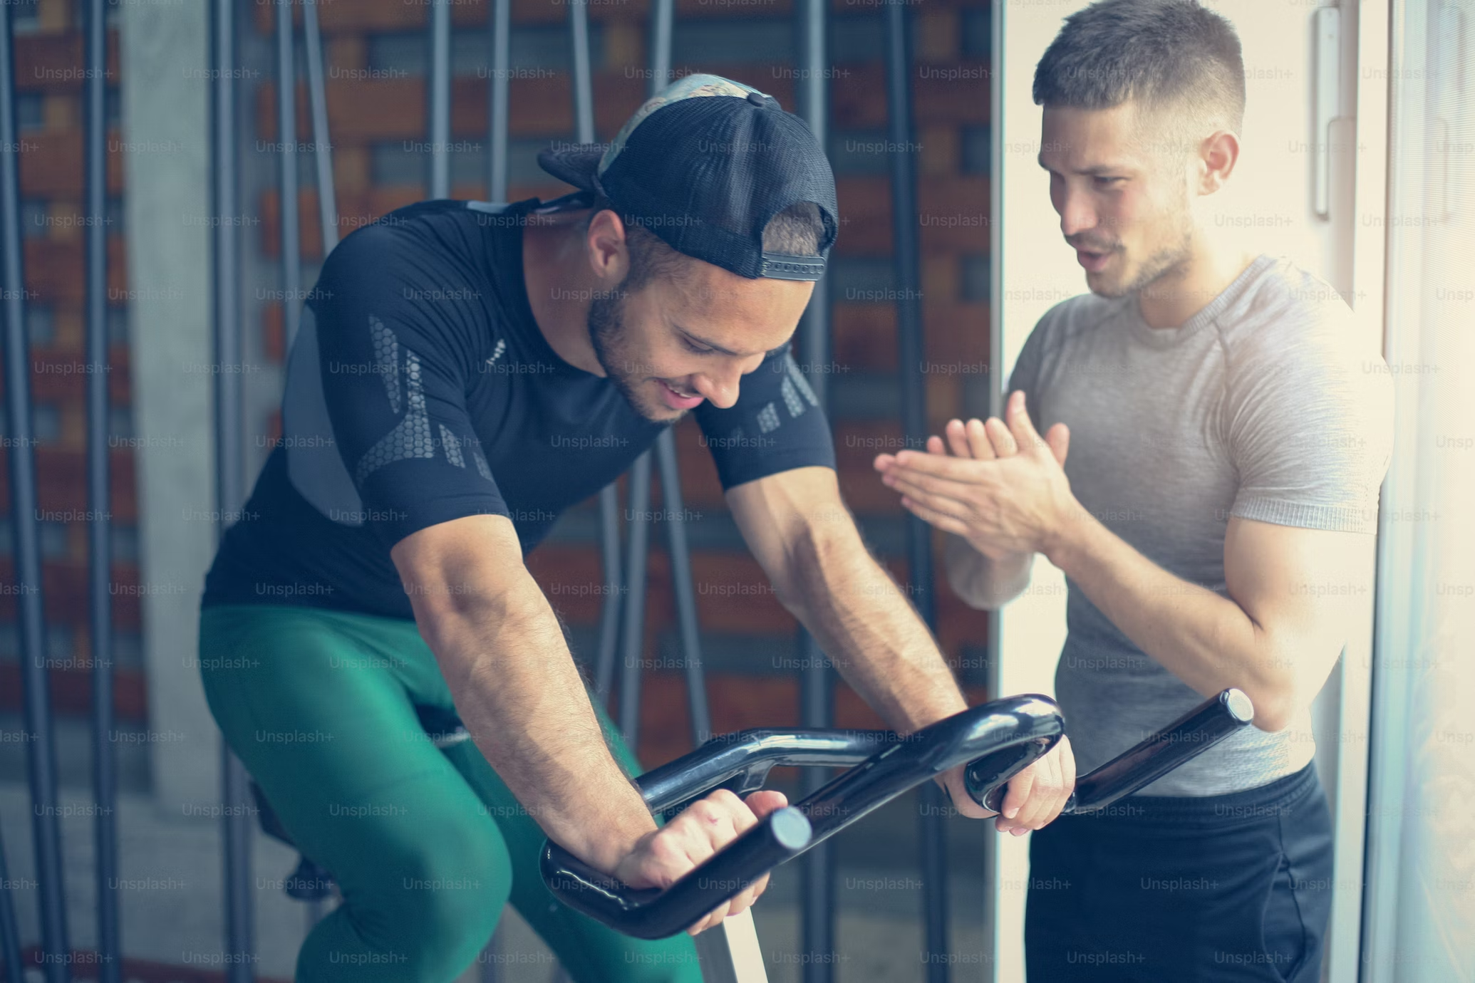
Fitness Instructor
. They teach different types of workouts, like aerobics, yoga, or cycling, and guide individuals in using exercise equipment safely and effectively. Their main goal is to motivate and educate people to improve their physical fitness and overall well-being
Fitness instructor may play a supporting role within a team of specialists working with athletes or sports teams, offering valuable assistance with general fitness training and exercise instruction
They may collaborate with strength and conditioning coaches and other professionals to provide a well-rounded approach to an athlete's overall fitness and well-being.
Complete Inquiry task 2X

Slide 26
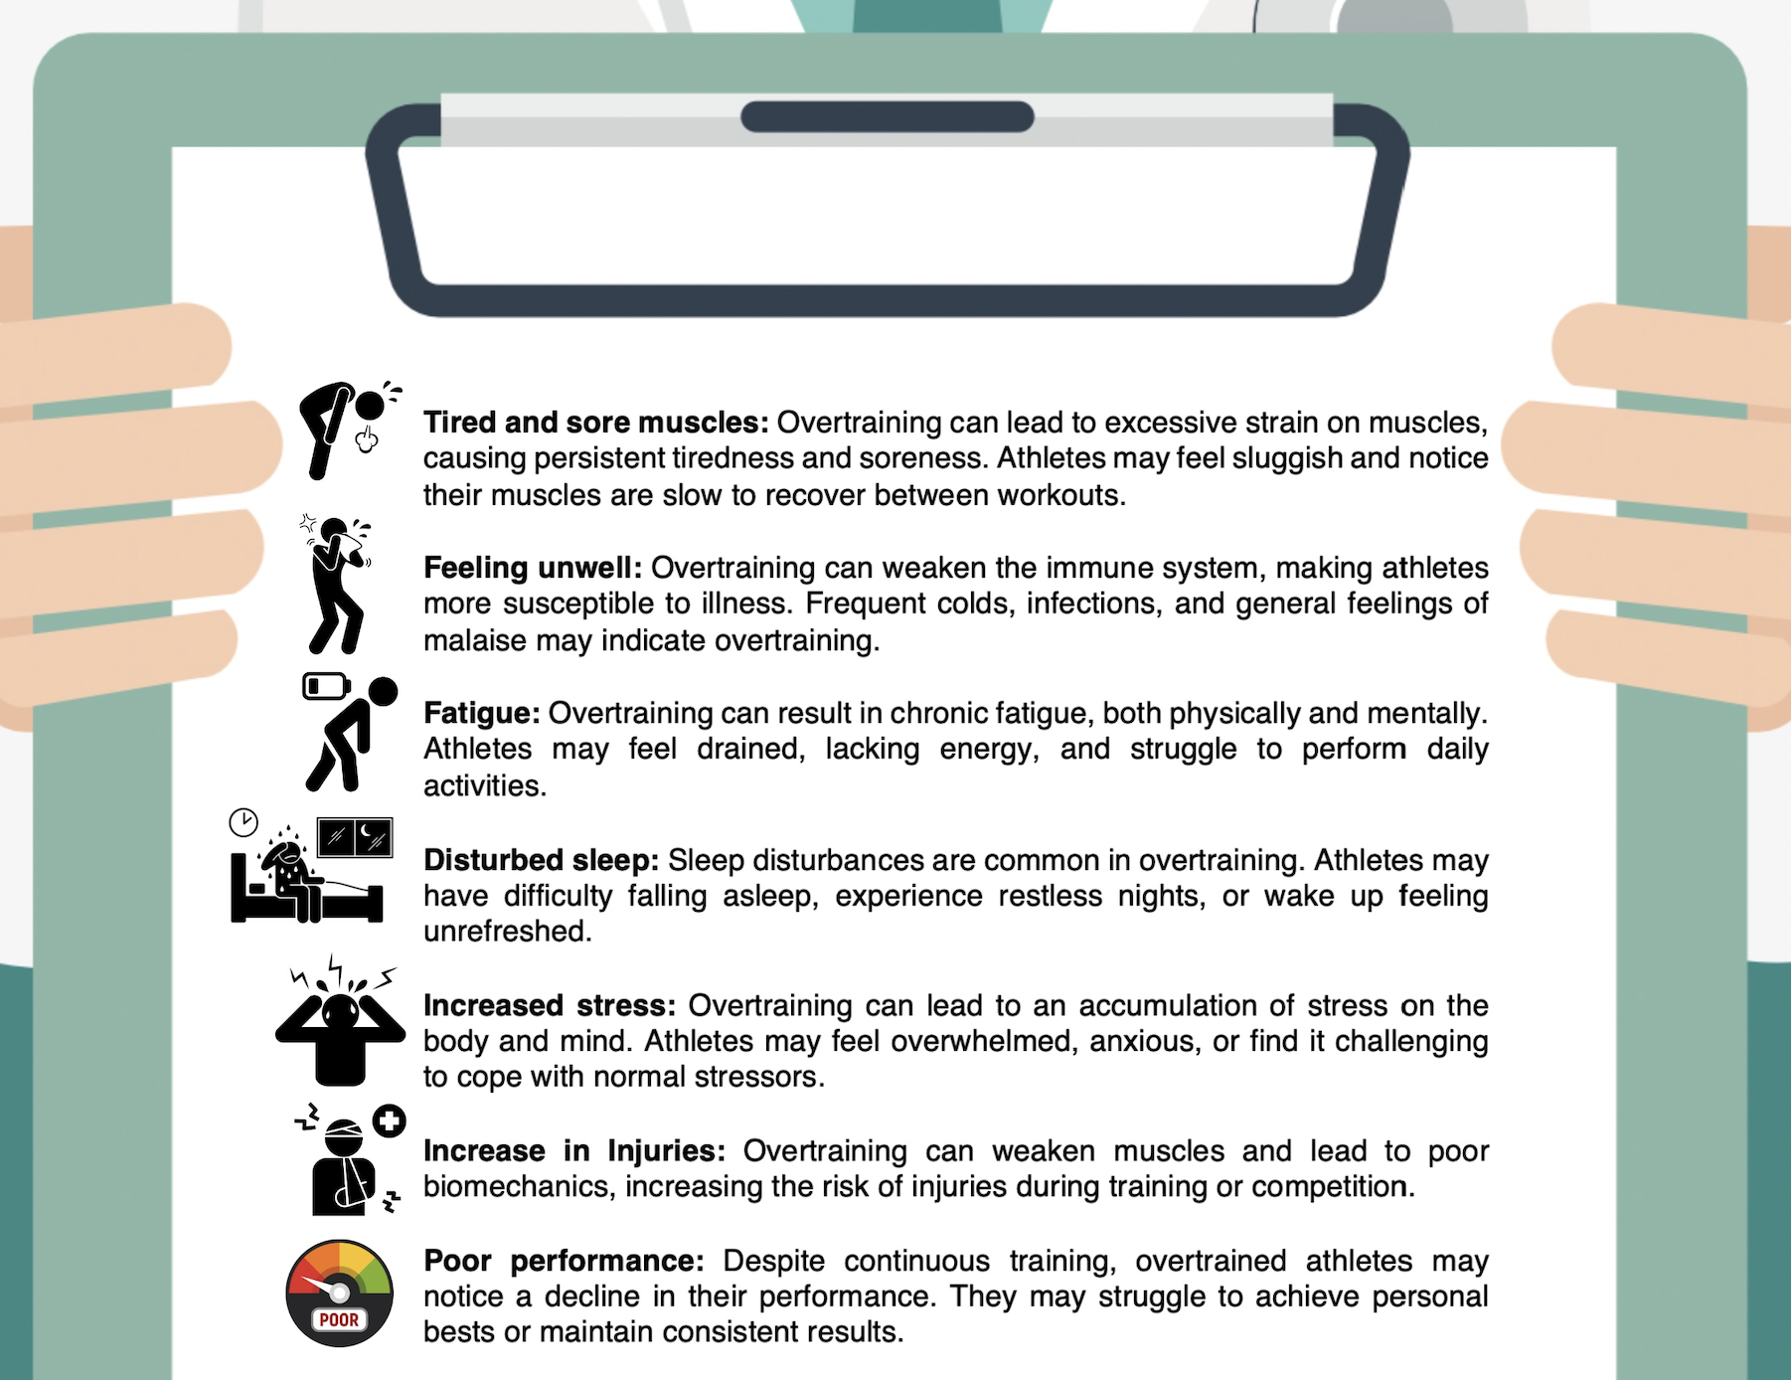
Overtraining
Overtraining is the result of consistently intense and prolonged training without proper rest and recovery periods.
It can lead to a drop in athletic performance, increased risk of injuries, and various physical and psychological symptoms, which we will explore next.
It's essential for athletes to recognise these signs and respond appropriately by adjusting their training intensity, incorporating rest days, and seeking guidance from coaches or sports medicine professionals.

Slide 27
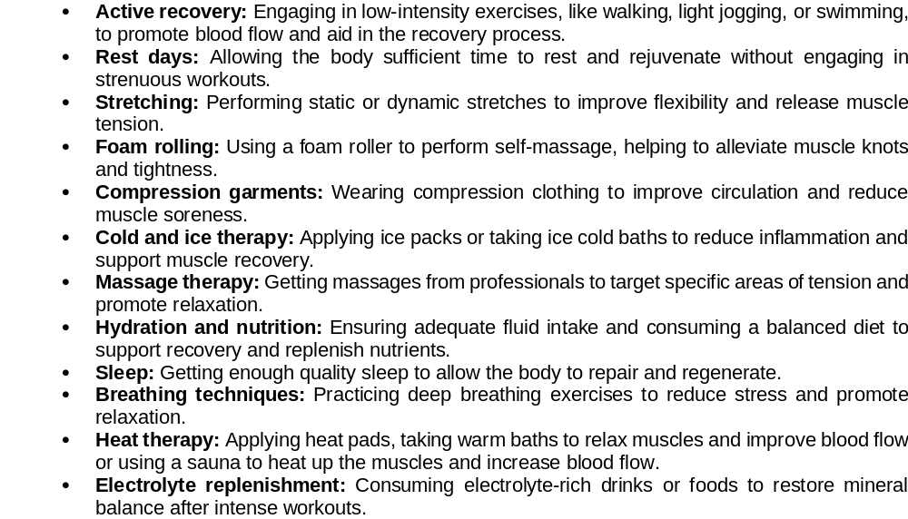
Types of recovery methods
After intense activity or training, our body needs time to recover and repair.
These methods help reduce muscle soreness, fatigue, and stress while improving the body's readiness for future workouts or competitions.
Recovery methods are essential for restoring these energy reserves, repairing muscle fibers, and reducing inflammation
Before choosing a recovery method, it is important to consult with a qualified strength and conditioning specialist or sports trainer.
Complete Inquiry task 2Y & 2Z

