Slide 1

SISSPAR009
Participate in conditioning for sport
Through this unit you will develop the skills and knowledge required to participate in strength and conditioning to physically prepare for competition in a specific sport.
Part 1

Slide 2
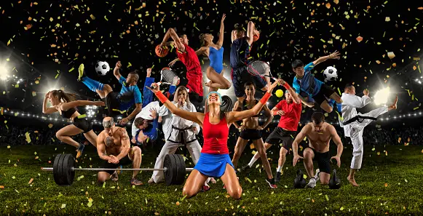
Participate in conditioning for spot
Conditioning is an essential aspect of sports training that focuses on improving an athlete's fitness, stamina, and overall performance. It involves a combination of exercises and activities tailored to enhance various physical attributes like strength, speed, power, endurance, agility, and flexibility
By regularly participating in conditioning for sport, athletes can improve their muscular strength, power, cardiovascular fitness, agility, and flexibility, leading to enhanced performance.
Sports conditioning is essential to any sport, regardless of the one you play.
Throughout this chapter we will cover every aspect of sport-specific conditioning, from organisational policies and procedures, to various forms of strength and conditioning techniques, to the body's energy systems and muscle groups.

Slide 3
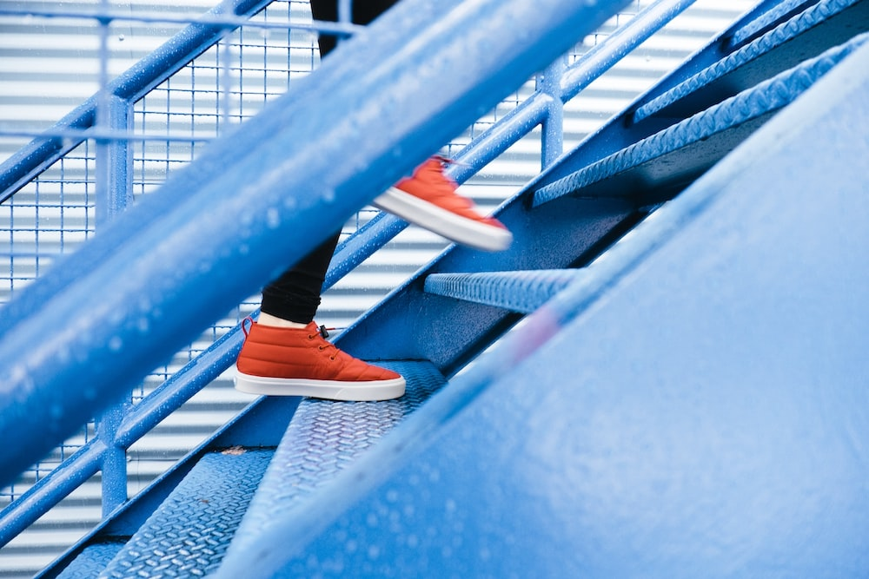
Organisational policies and procedures applicable to participating in conditioning for sport
Policies and procedures provide guidelines, rules, and standards that help maintain a structured and supportive environment for athletes, participants, and coaches,
Some key policies an procedures that are important to consider:
Work, health and safety – risk assessments, managing equipment, implementing routines and emergency protocols
Consent and participation – Making sure players are allowed to play, signed off from parents, guardians and doctors if there require medical clearance.
Supervision and coaching – Rules for staff to follow
Code of conduct and ethical behaviour – Rules regarding appropriate behaviour
Progression and individualisation programs – balancing programs to suit everyone's needs
Communication and feedback – Channels available to ensure effective communication

Slide 4
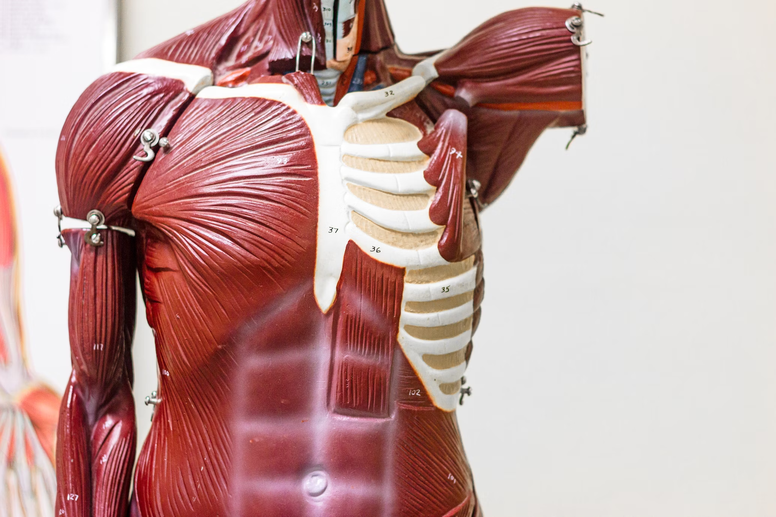
Basic anatomy and physiology
Anatomical terminology
When we move, our body uses different muscles and bones to work together. These movements have specific names, not just simple descriptions like "lifting the arm."
To understand these movements better, it's important to know the body positions and motions listed below.
Why do we need to know?
These motions are essential terms in the fitness field, helping us communicate with strength and conditioning specialists and colleagues about program stages like warm-ups and cool-downs.
They're also useful for explaining concepts like levers, base of support, and centre of gravity when demonstrating particular movements to others.

Slide 5
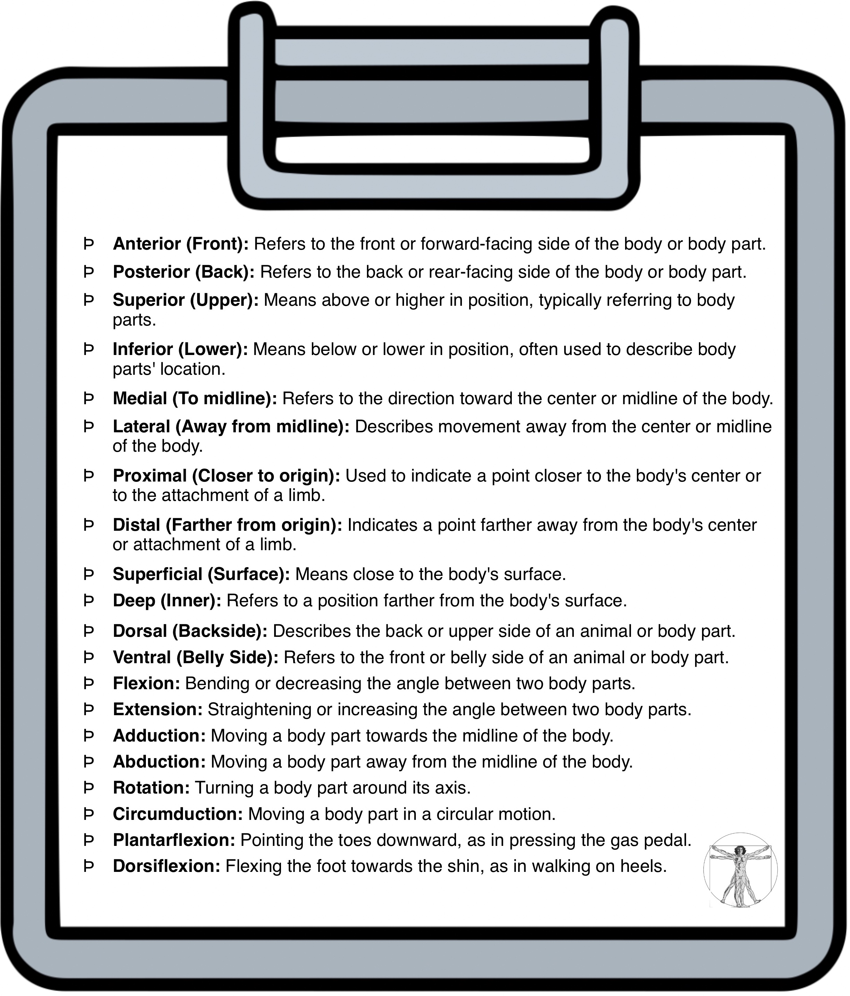
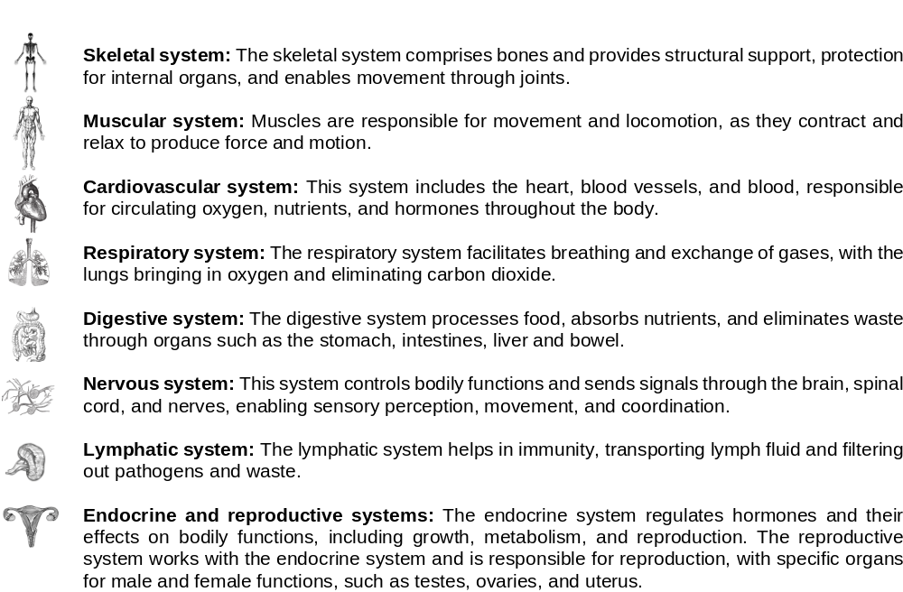
Key terminology

Slide 6
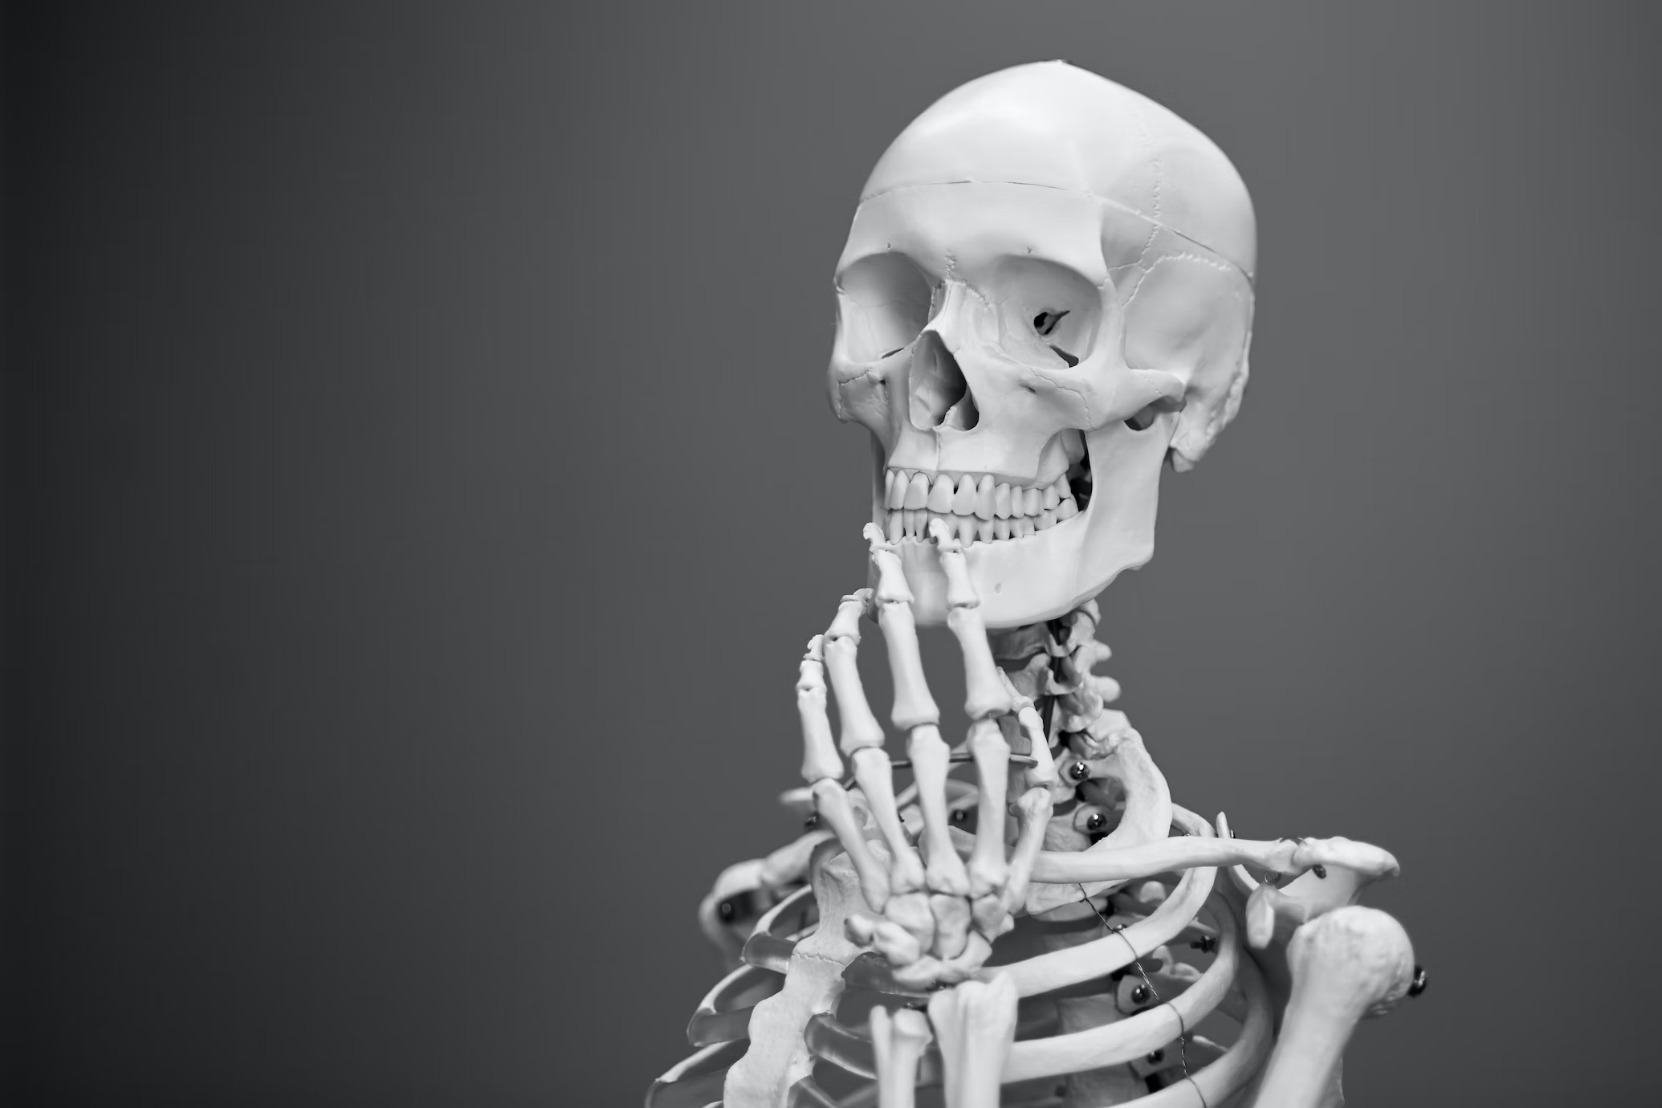
Skeletal System
Our body’s framework – long bones like in our arms and legs, flat bones like in our skull, and short bones like in our wrists and ankles.
Our bones connect at joints, allowing us to move.
There are different types of joints - hinge joints like our elbows and knees that move in one direction, ball-and-socket joints like our shoulders and hips that move in many directions, and pivot joints like in our neck that let us turn our head.
Our skeletal system protects our organs, helps us move, and gives our body its shape.

Slide 7
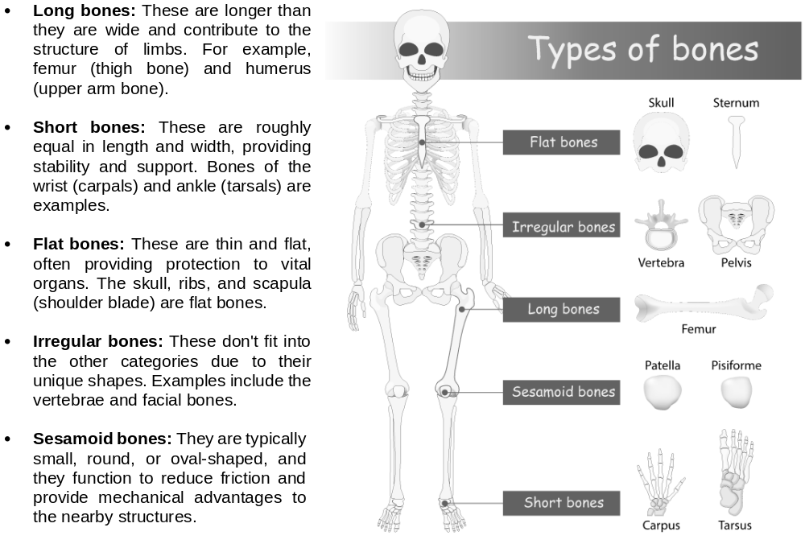
Types of Bones

Slide 8
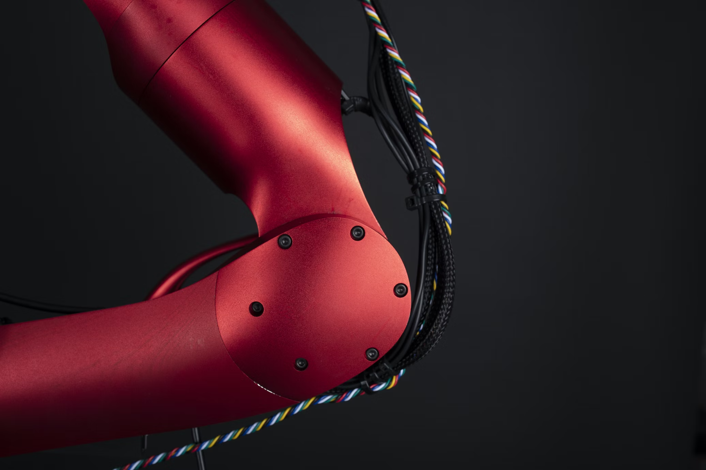
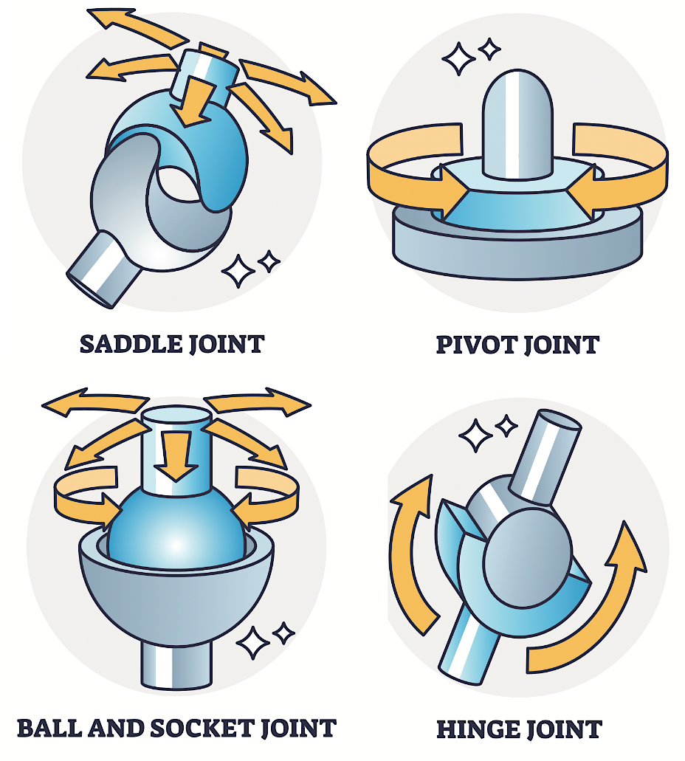
Joints
Joints are the places where two or more bones meet, allowing movement and flexibility. Different types of joints enable various types of movement:
Hinge joints: Allow movement in one plane, like the bending and straightening of the elbow or knee.
Ball-and-socket joints: Provide a wide range of motion, as seen in the hip and shoulder joints.
Pivot joints: Allow rotation, such as the joint between the first two vertebrae, which lets us nod our head.
Gliding joints: Enable bones to glide past each other, found in the wrists and ankles.
Saddle joints: Allow for a variety of motions, like the thumb joint.
Our skeletal system is dynamic, constantly undergoing changes throughout our lives.
It not only provides structural support but also plays a role in storing minerals like calcium and producing blood cells in the bone marrow.
By working in conjunction with muscles, tendons, and ligaments, our skeletal system facilitates movement, protects vital organs, and maintains the overall shape and framework of our body.

Slide 9
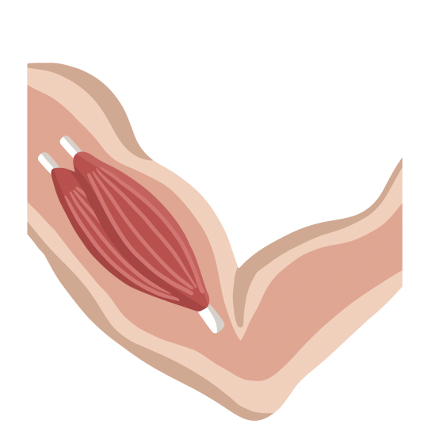
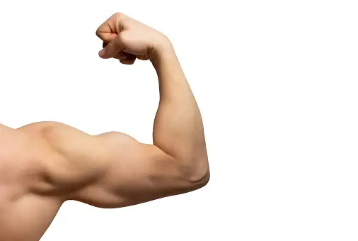
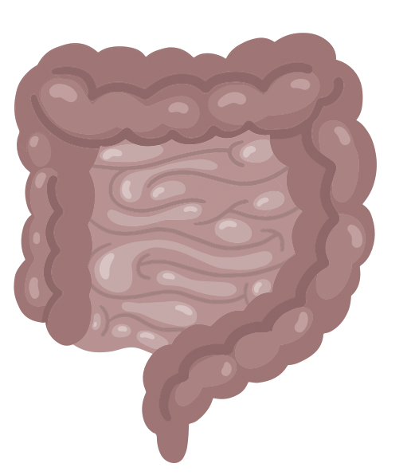
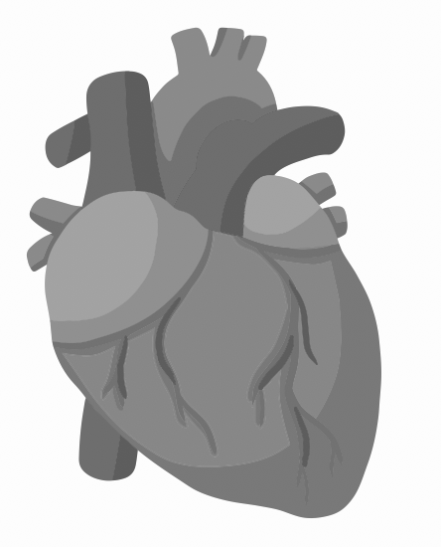
Muscular System
The muscular system is a complex network of muscles that work together to enable movement, provide stability, and generate body heat. Muscles are made up of specialized cells called muscle fibers that contract and relax to create motion.
There are three main types of muscles in the body:
Skeletal muscles: These are the muscles that attach to our bones and allow us to move. They're under conscious control, meaning we can decide when to contract or relax them. Skeletal muscles are responsible for activities like walking, running, lifting, and jumping.
Smooth muscles: Found in the walls of internal organs like the digestive tract, blood vessels, and airways, smooth muscles are not under conscious control. They contract involuntarily to help move substances through the body, like food through the digestive system or blood through the arteries.
Cardiac muscles: These muscles make up the heart and are responsible for pumping blood throughout the body. Similar to smooth muscles, cardiac muscles contract involuntarily and rhythmically to maintain circulation.
Muscles are attached to bones by tendons, which are tough connective tissues. When muscles contract, they pull on the bones, creating movement around joints. The muscular system not only supports physical activities but also plays a role in maintaining posture, generating body heat, and protecting internal organs

Slide 10
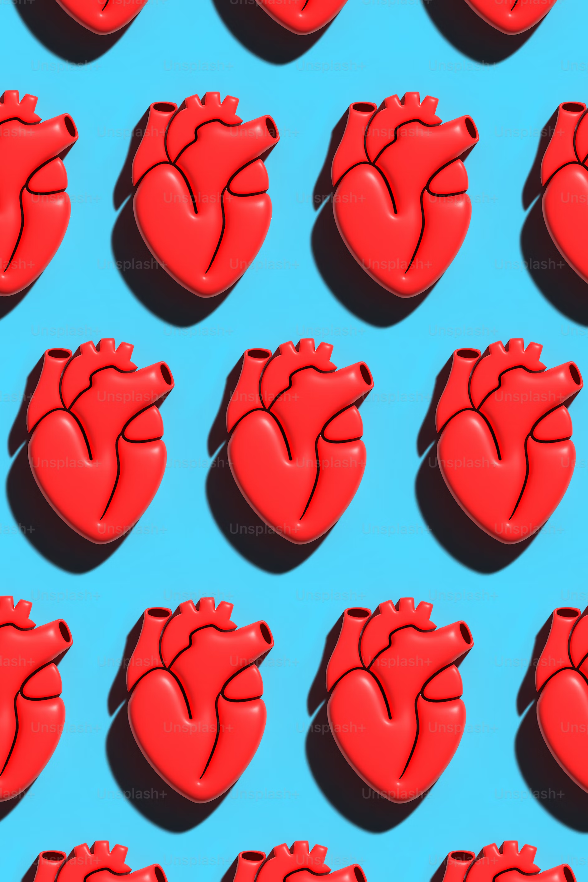
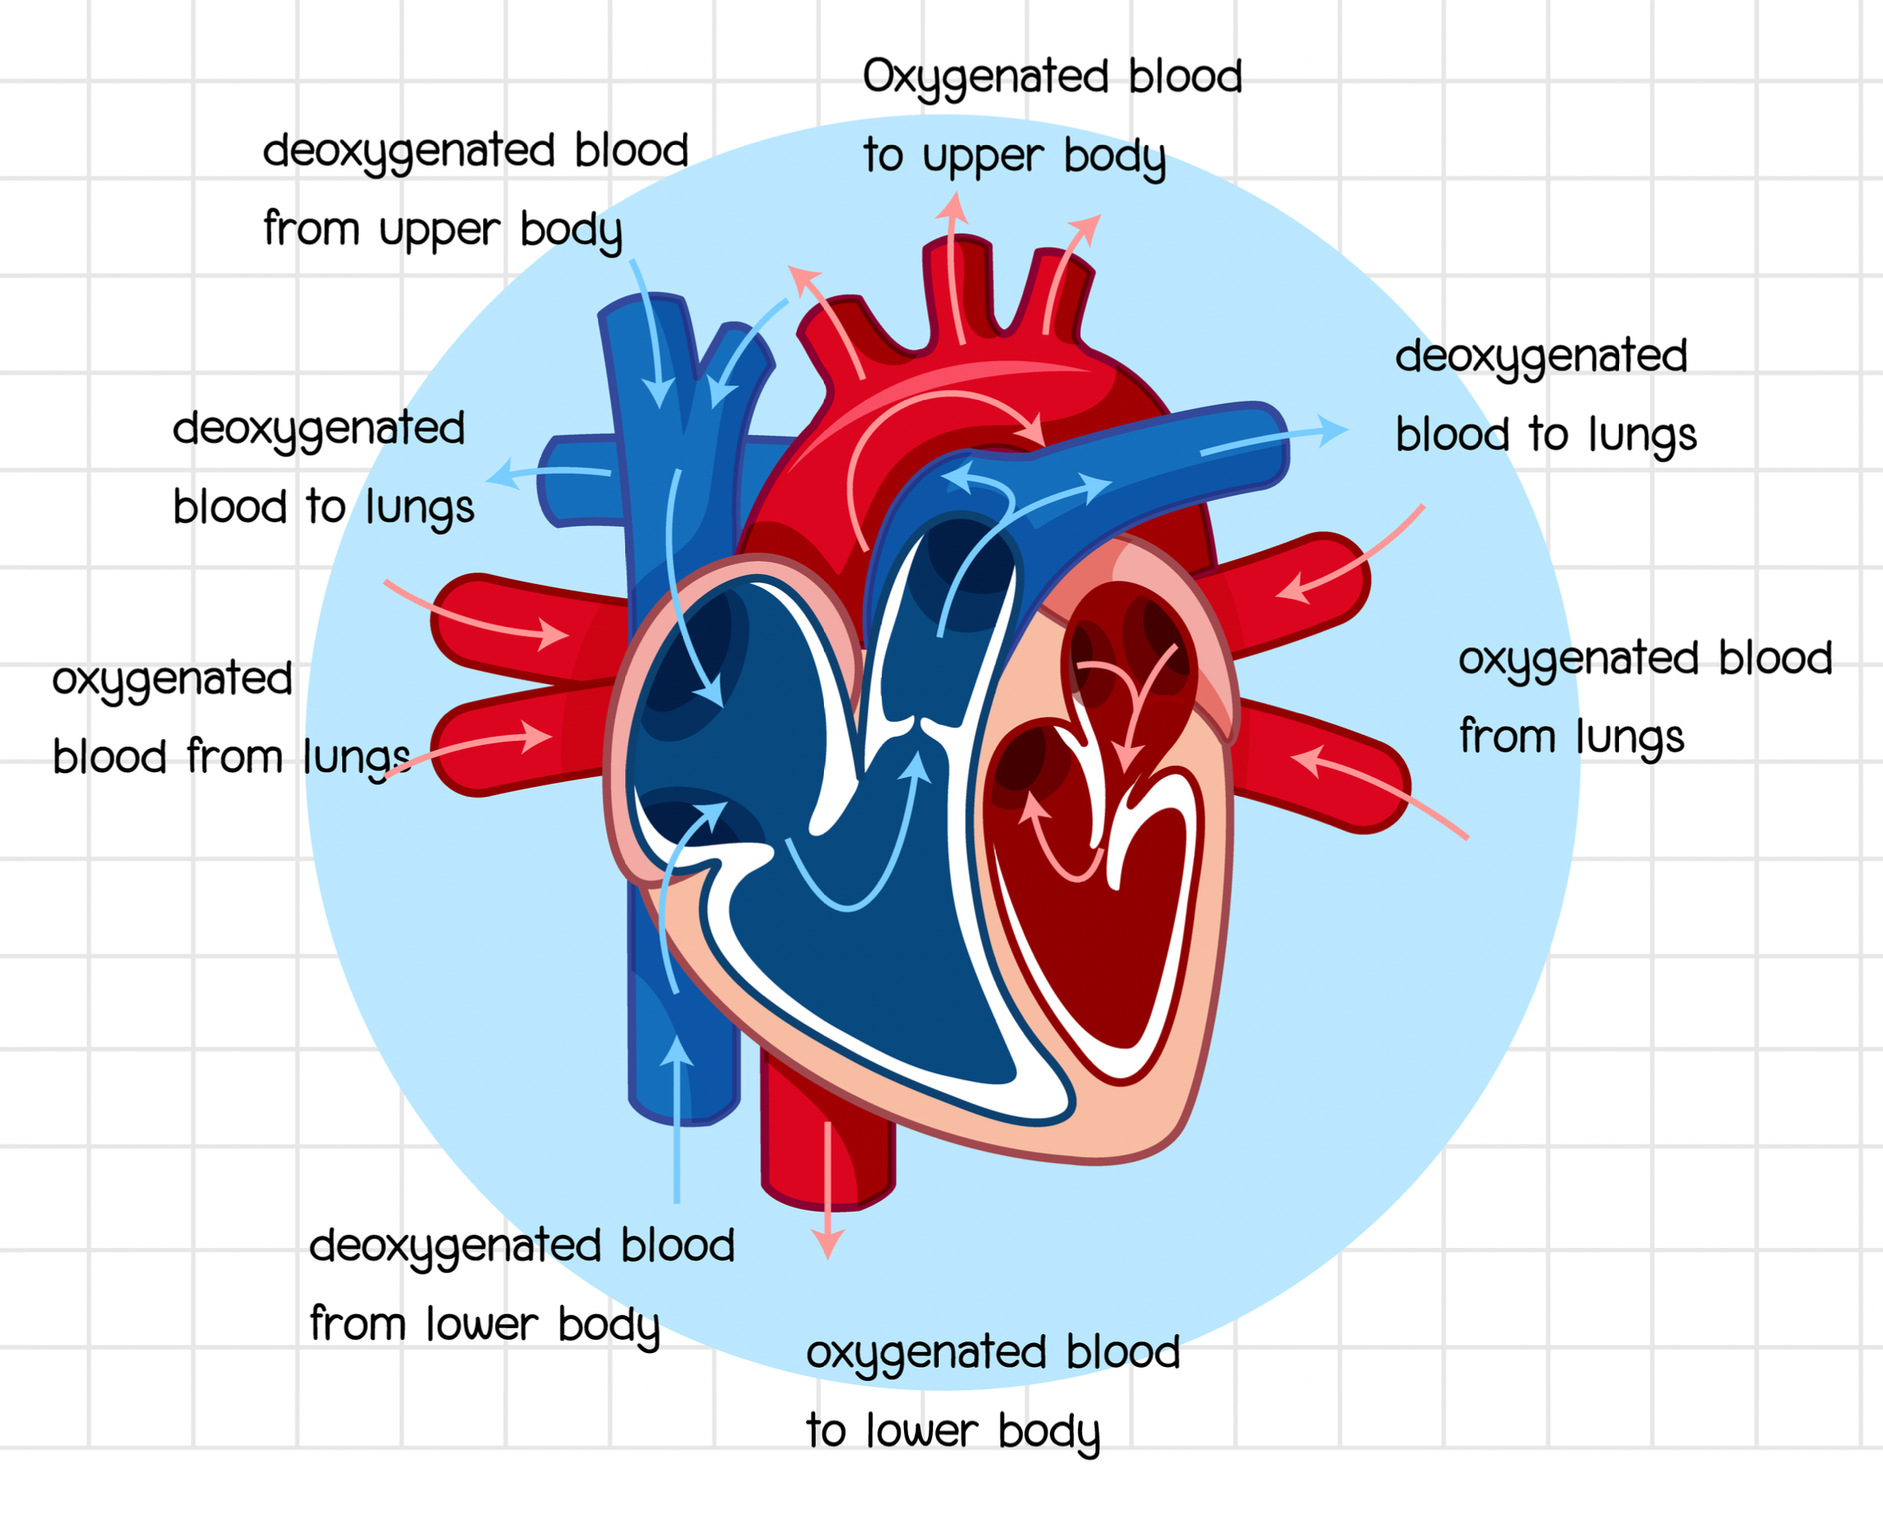
Cardio-respiratory system
Also known as the cardiovascular or circulatory system, is responsible for delivering oxygen and nutrients to cells while removing waste products like carbon dioxide.
It includes the heart, blood vessels, and lungs, all working together to maintain the body's overall function.
The respiratory system works in tandem with the cardiovascular system to provide the body with oxygen and remove carbon dioxide.
It includes the lungs, airways, and respiratory muscles.
These components ensure that oxygen-rich blood is efficiently transported to body tissues, supplying them with the energy needed for various activities.

Slide 11
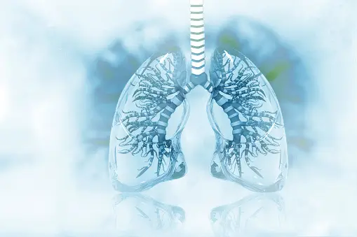
The Heart and blood vessels
The heart pumps oxygen-rich blood to the body's tissues and organs through a network of blood vessels.
It has four chambers: two atria that receive blood and two ventricles that pump blood out. Blood vessels of the human body include arteries, veins, and capillaries.
Arteries carry oxygenated blood away from the heart to various parts of the body, while veins return deoxygenated blood back to the heart.
Capillaries are tiny vessels that facilitate the exchange of oxygen, nutrients, and waste products between blood and body cells.
The Lungs
The lungs are where the exchange of oxygen and carbon dioxide takes place.
During inhalation, oxygen enters the bloodstream, and during exhalation, carbon dioxide is removed from the bloodstream and expelled from the body.

Slide 12
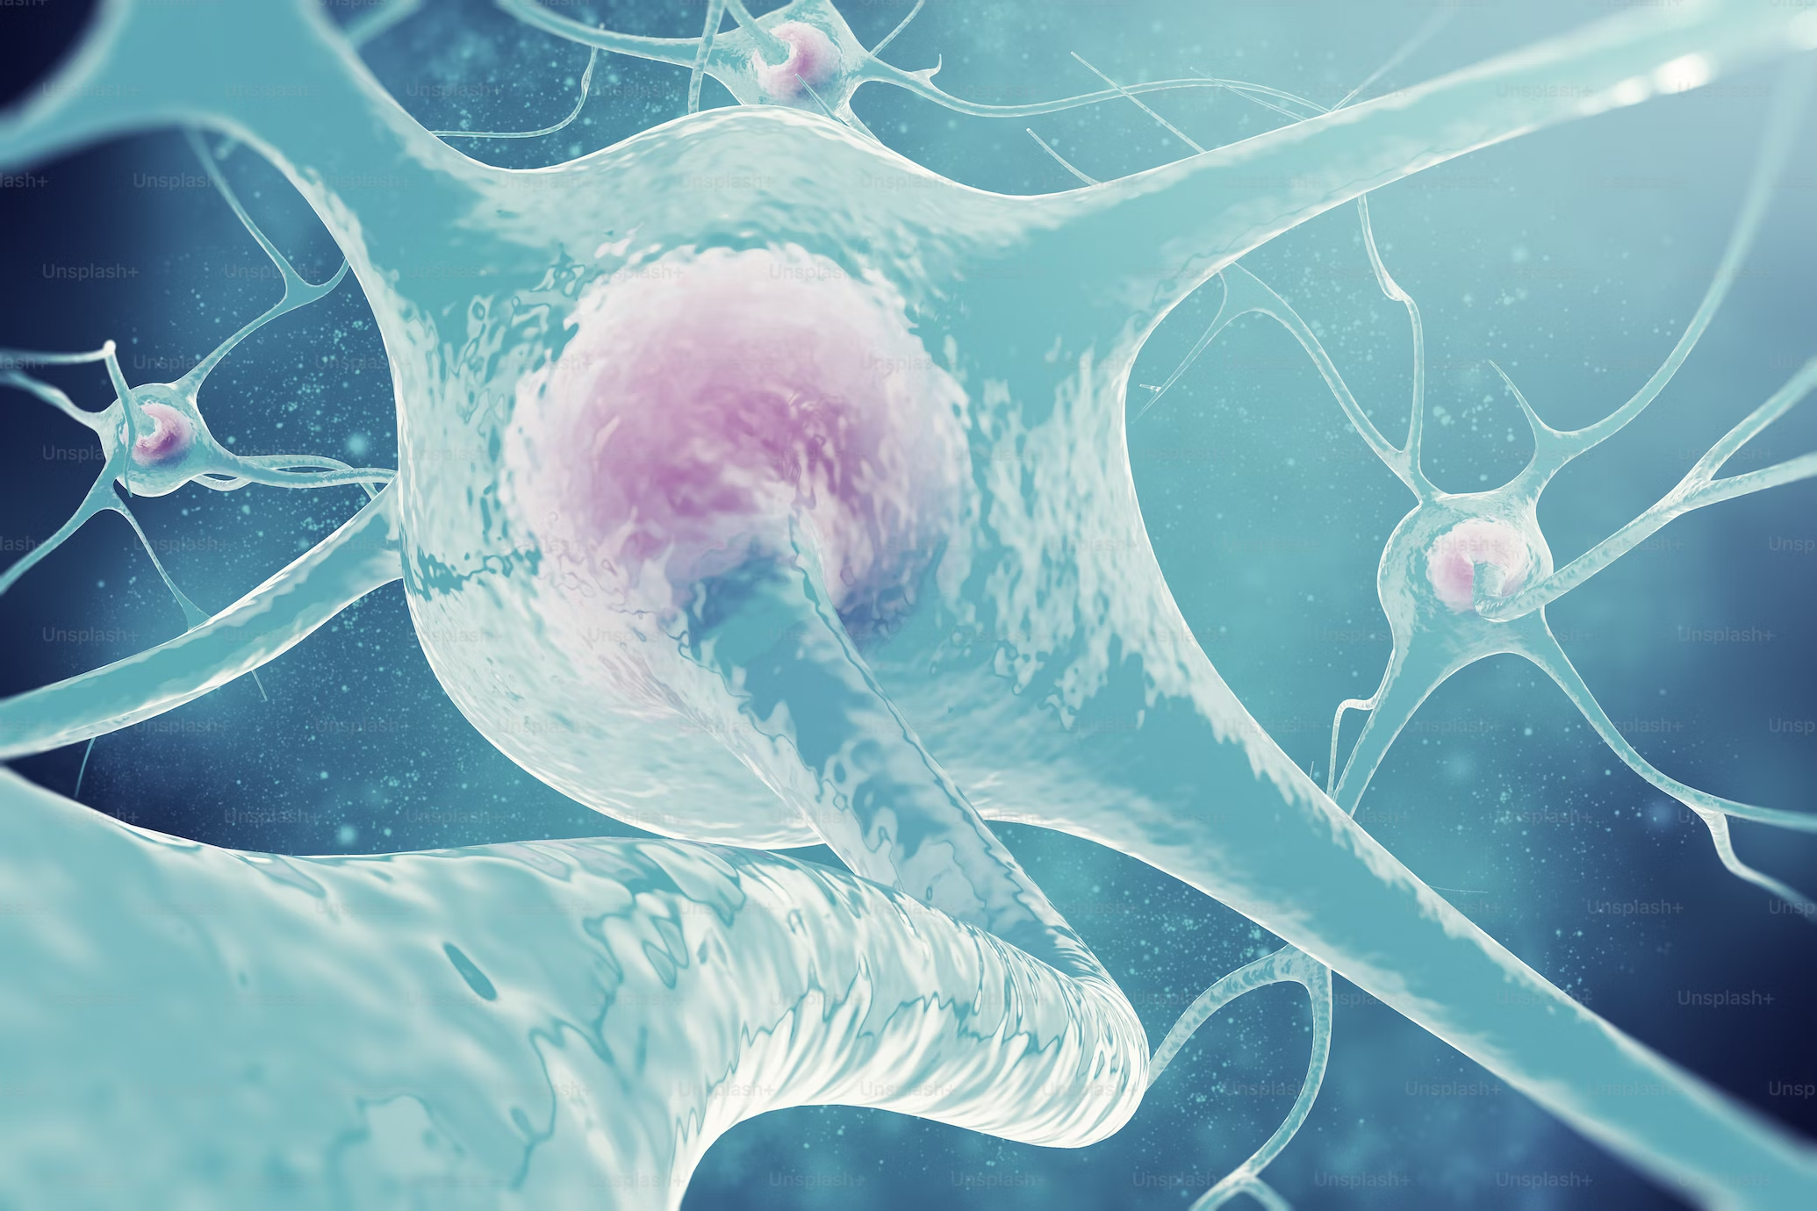
Nervous System
The nervous system coordinates and controls the activities of the body. It is divided into two main parts: the Central Nervous system (CNS) and the Peripheral Nervous System (PNS).
Central Nervous System (CNS)
The CNS consists of the brain and spinal cord.
It is the control center of the body, responsible for processing information, making decisions, and sending signals to the rest of the body.
The brain plays a crucial role in cognitive functions, sensory perception, and motor control.
The spinal cord serves as a pathway for communication between the brain and the body, as well as a reflex center that generates automatic responses to certain stimuli.
Peripheral Nervous System (PNS)
The PNS includes all the nerves outside the CNS.
It connects the CNS to the rest of the body, allowing for communication and control.
The PNS is further divided into the somatic nervous system, which controls voluntary movements and sensory perception, and the autonomic nervous system, which regulates involuntary functions like heart rate, digestion, and respiration (breathing).
Neurons and synapses
Neurons are the basic units of the nervous system, responsible for transmitting electrical signals, known as nerve impulses or action potentials.
They consist of a cell body, dendrites (receiving extensions), and an axon (transmitting extension).
Neurons communicate with each other and with muscles and glands through specialised junctions called synapses.
Neurotransmitters are chemicals that transmit signals across these synapses.

Slide 13
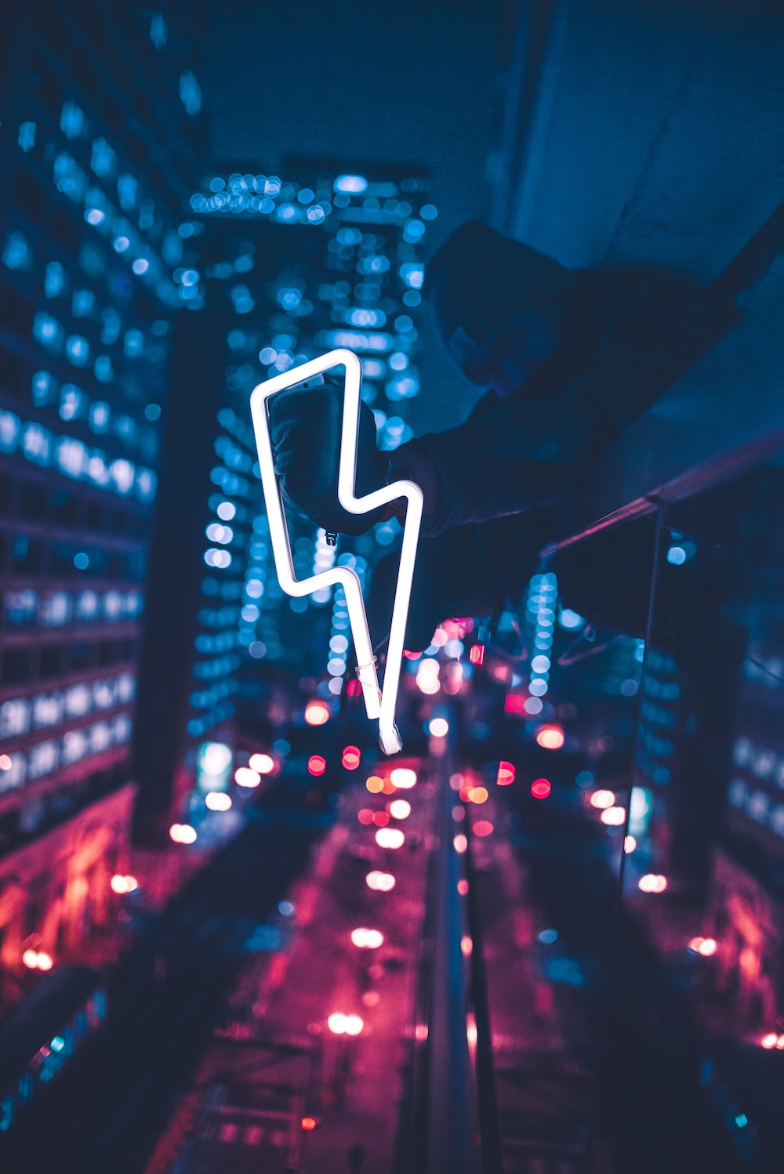
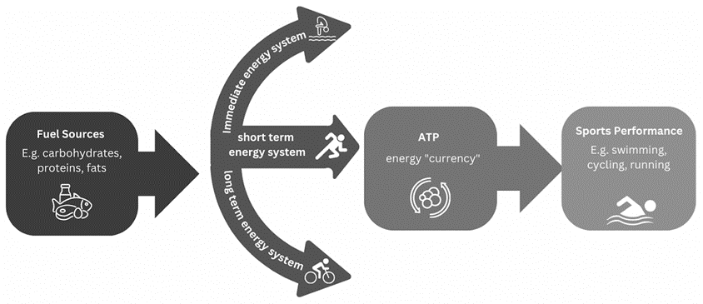
Prepare for Sport-specific strength and conditioning
Three energy systems of the body
Energy is necessary for our bodies to move, and when we must move in a specific way, there are specialist systems in charge of these movements.
ATP (adenosine triphosphate) is the energy used for all body movements and functions. It is often referred to as the "energy currency" of the body.
The amount of stored ATP in our muscle cells is limited, typically 1 to 2 seconds' worth of supply.
Continued activity after 1 to 2 seconds requires chemical and food fuel reactions to produce ATP via the three main energy systems.
The three energy systems relevant to sports conditioning are the ATP-PC (adenosine triphosphate) and PC (phosphocreatine) system, the glycolytic or anaerobic glycolysis (lactic acid) system, and the aerobic system.
Each system provides energy to fuel different intensities and durations of physical activity.

Slide 14
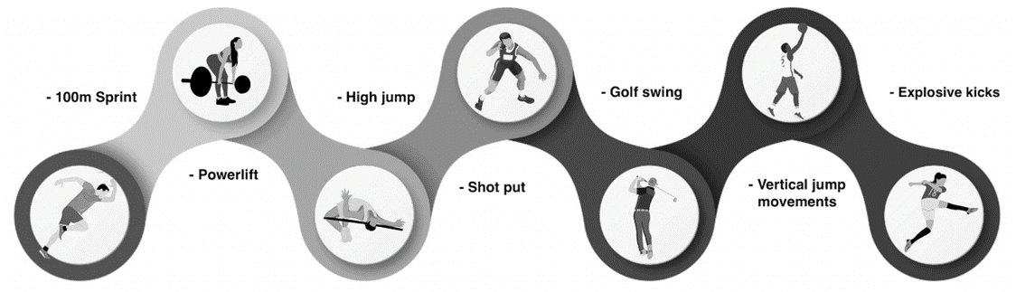
ATP-PC System
ATP-PC System (Phosphagen System): This system provides immediate energy for short bursts of high-intensity explosive exercise up to 5 to 10 seconds. It relies on stored ATP in the muscles. ATP is rapidly broken down to release energy, while PC helps regenerate ATP during intense exercise. Rest is required for the re-supply of creatine phosphate, 30 seconds = 50% and 3 minutes = 98%. This system reaches peak power output at around the 5 second mark of high intensity activity.
Examples of exercises that predominantly use this system:

Slide 15
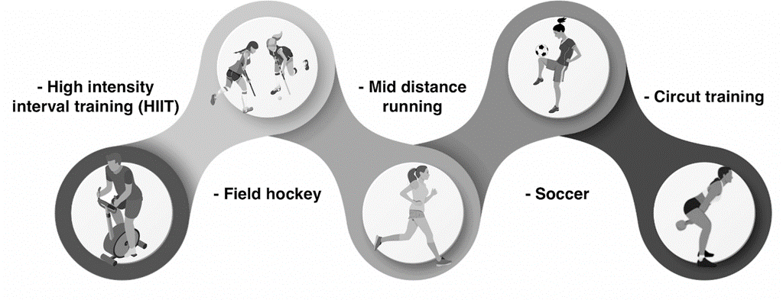
Glycolytic system
Glycolytic, Anaerobic glycolysis or Lactic acid system: This system provides energy for activities of moderate to high intensity and duration. It relies on the breakdown of stored glycogen (carbohydrates) into glucose, which is then converted into ATP through a process called glycolysis.
This system does not require oxygen (anaerobic), but it produces lactic acid as a by-product, leading to muscle fatigue. The glycolytic system can provide energy for several minutes but has a limited capacity compared to the aerobic system.
Examples of exercises that predominantly use this system:

Slide 16

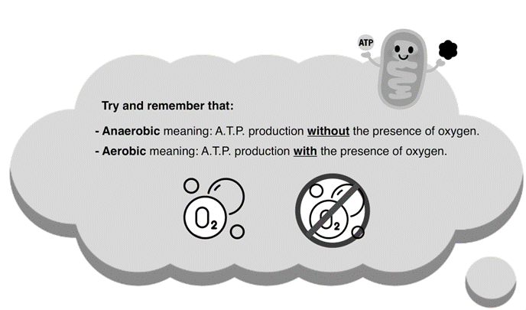
Aerobic system
Aerobic System The aerobic system is responsible for providing energy during longer duration activities, such as distance running or cycling.
It uses oxygen to break down carbohydrates, fats, and even proteins to produce ATP.
This system is highly efficient but requires a continuous supply of oxygen to sustain energy production.
It is the primary energy system used during low intensity exercises that last for hours.
Understanding the functions of these energy systems is crucial for designing training programs that target specific energy demands.
By appropriately challenging and training these systems, athletes can improve their energy production,
optimise performance, and enhance their overall conditioning for their chosen sport.

Slide 17
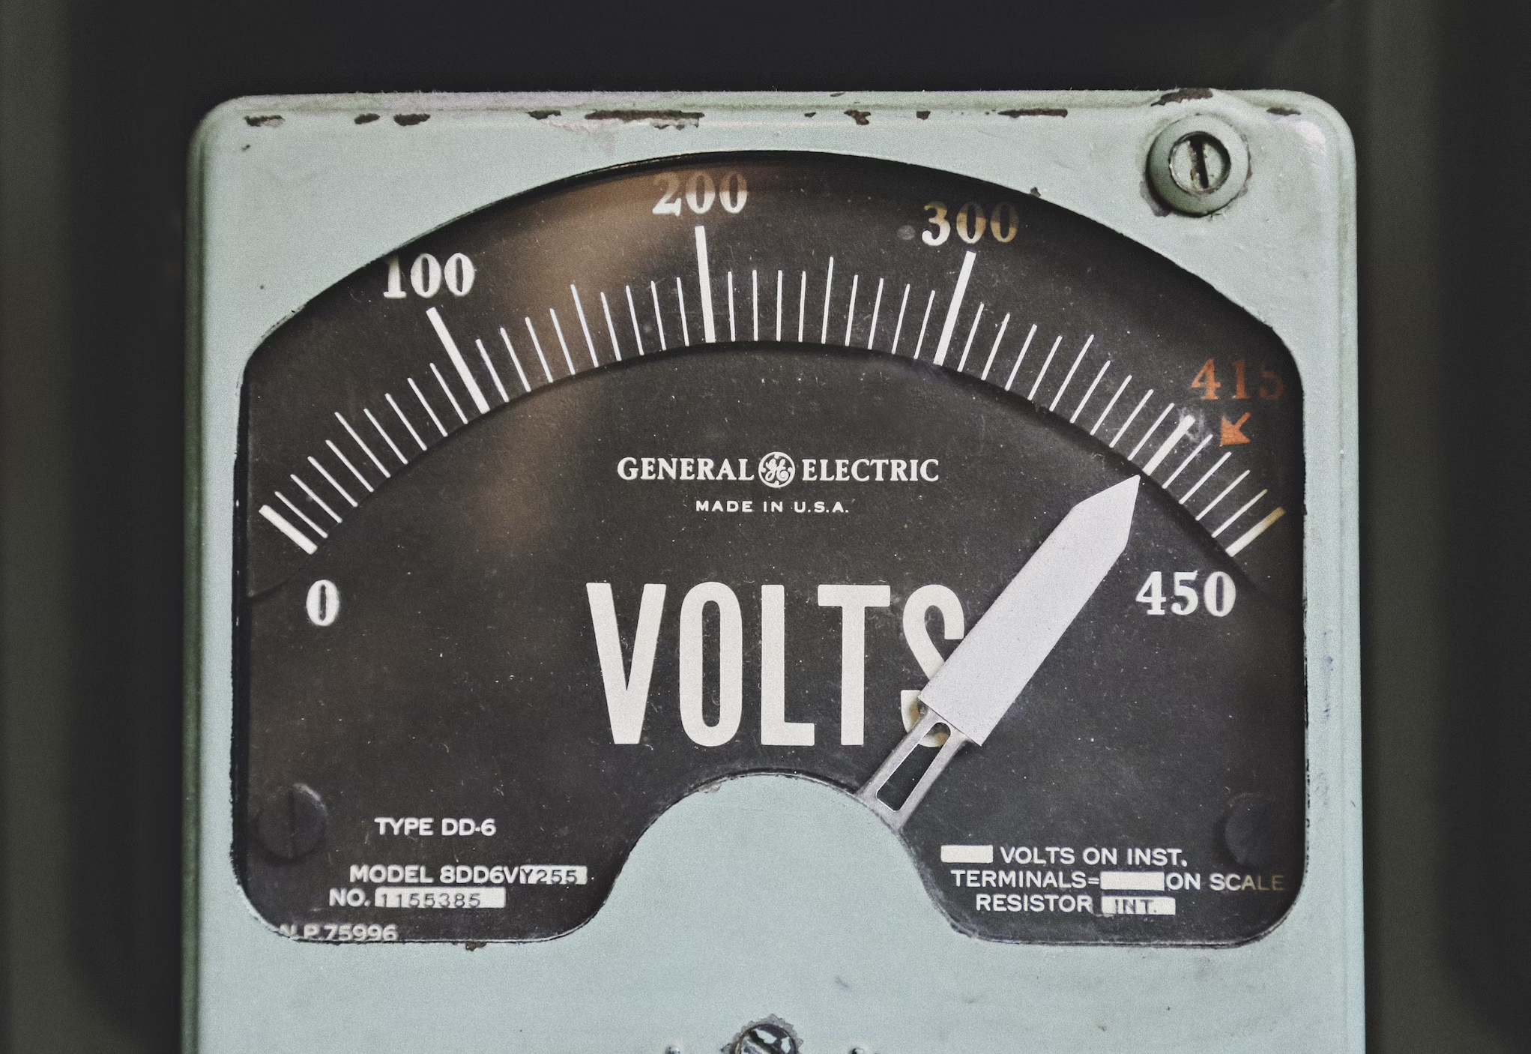
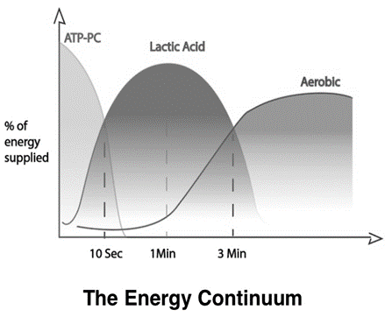
The predominant energy system used to supply ATP depend on the following three factors:
Intensity: How hard you are working? The more intense the exercise the greater amount of (Anaerobic Energy) – Creatine phosphate and muscle glycogen will be used. Low to medium intensity exercise will use predominantly the aerobic system.
Duration of exercise: For example, If the exercise is high intensity and lasts over 2 minutes then both CP and muscle glycogen will become depleted and need re-supplying. Intensity of exercise will drop as the aerobic system becomes more dominant.
Fitness level of the athlete. Individual levels of both aerobic and anaerobic fitness will impact on the predominant energy system being used.

Slide 18
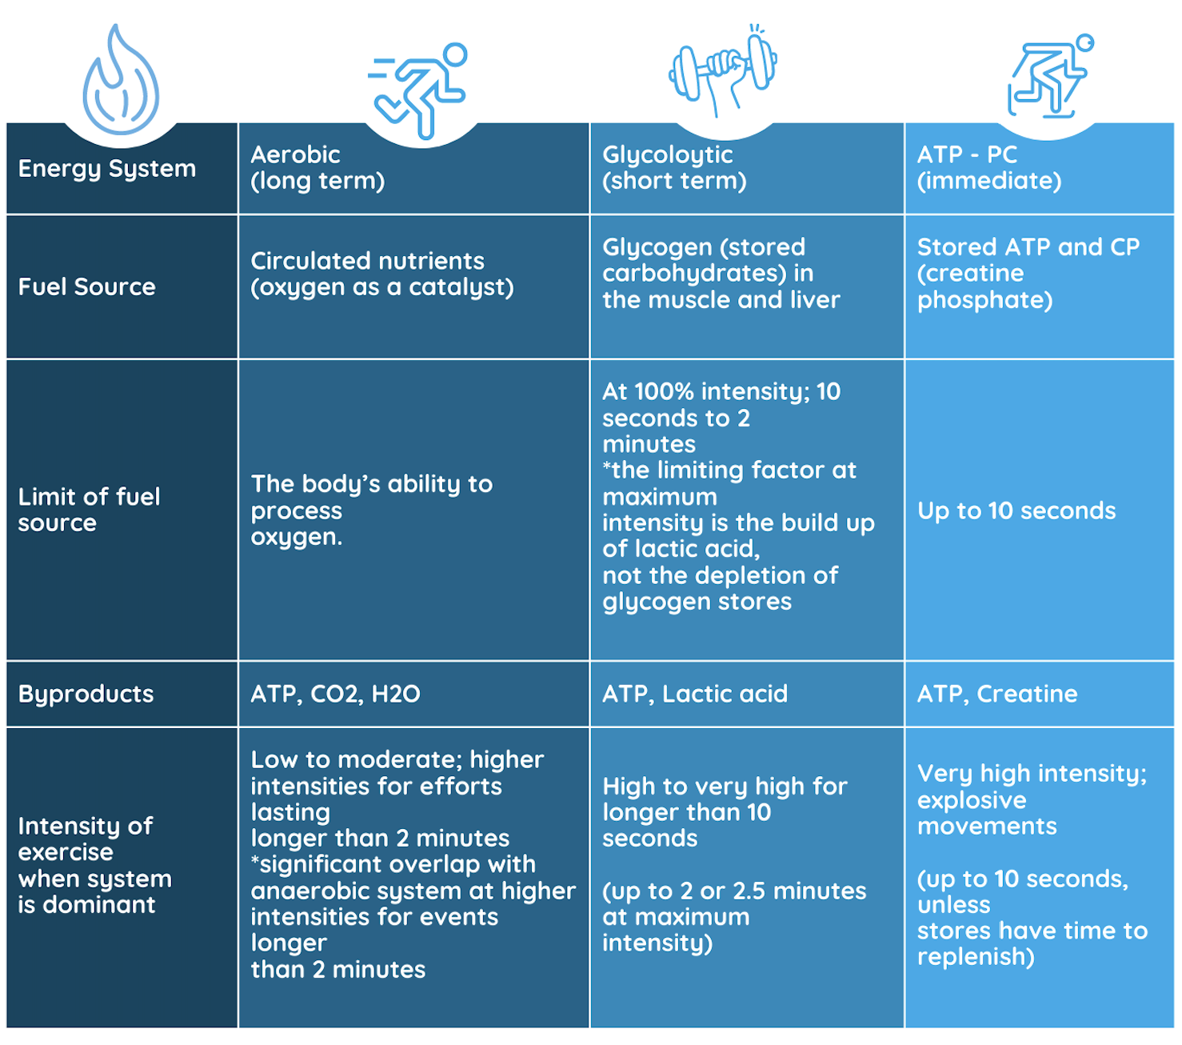

Energy Systems: Summary
Complete Inquiry task 2A, 2B & 2C

Slide 19
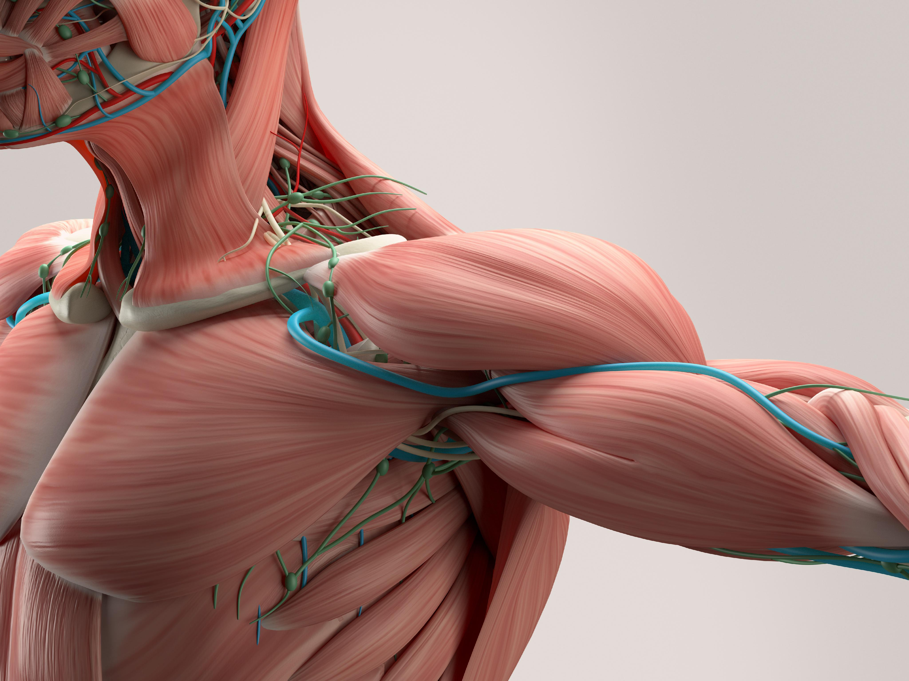
Major muscle groups
The human body contains approximately 650 skeletal muscles.
Skeletal muscles are the muscles that attach to bones and allow for voluntary movements. Voluntary movement means being able to control our body and make it do what we want.
The movements we perform in many sports, such as running, lifting, kicking, and throwing, are all performed by our skeletal muscles.
These skeletal muscles are made up of muscle fibres bundled together and connected to bones via tendons.
Each muscle has its own unique structure, size and function, allowing for a wide range of movements and providing support and stability to the body.

Slide 20
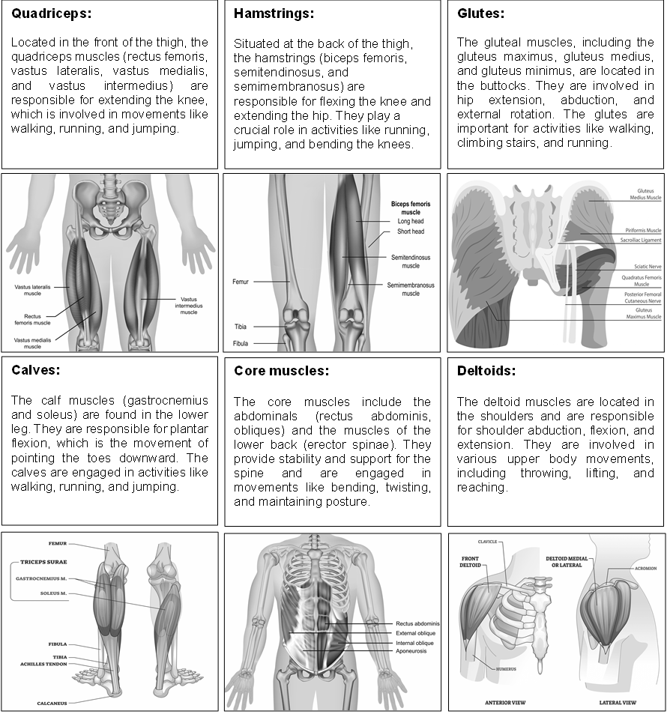
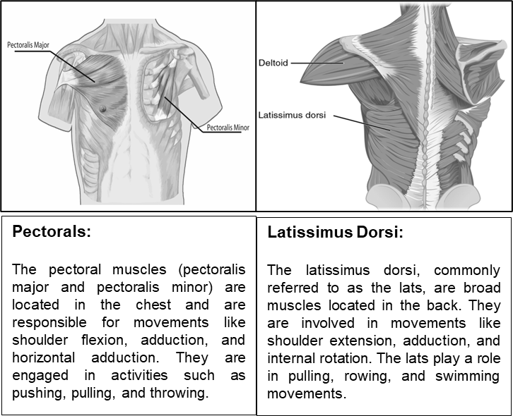
Major muscles groups of the body that are required for movement include:

Slide 21

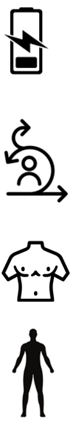
The types of muscle groups used in a specific sport depend on the types of movements required by that sport. Different sports involve a wide range of movements, from explosive power to endurance and agility.
Explosive power sports (e.g., weightlifting, sprinting): These sports require rapid and forceful movements, engaging primarily the fast-twitch muscle fibers and muscle groups responsible for generating explosive power.
This includes muscles like the quadriceps, hamstrings, glutes, and calf muscles, which are responsible for generating strong and explosive movements.
Endurance sports (e.g., long-distance running, cycling, eventing in horse riding): Endurance sports involve sustained efforts over a long period. They rely heavily on the aerobic energy system and engage muscles that can endure repetitive motions for extended periods.
Muscles such as the quadriceps, hamstrings, calves, and the core muscles (abdominals and lower back) are vital for maintaining a steady pace and enduring long-duration activities.
Agility and quickness sports (e.g., AFL, basketball, soccer): Sports that require quick changes in direction, agility, and speed involve various muscle groups.
This includes the lower body muscles such as the quadriceps, hamstrings, glutes, and calf muscles for explosive movements and quick changes in direction. Additionally, the core muscles play a crucial role in providing stability and balance during rapid movements.
Upper body dominant sports (e.g., tennis, swimming): Sports that heavily rely on upper body movements engage muscles such as the deltoids, pectorals, triceps, and biceps.
These muscles are responsible for actions like swinging a tennis racket, throwing a ball, or propelling through the water in swimming strokes.
Full-Body engagement sports (e.g., rowing, martial arts): Most sports involve a combination of upper and lower body movements, engaging a wide range of muscle groups.
For example, rowing engages muscles throughout the body, including the legs, core, back, and arms. Martial arts involve various movements that engage multiple muscle groups for striking, kicking, and wrestling.
Complete Inquiry task 2D

