Slide 1

HLTWHS001
Participate in workplace health and safety
Part 2
Through this unit you will develop the skills and knowledge required for workers to participate in safe work practices to ensure their own health and safety, and that of others.

Slide 2


What to do in an emergency
Take care of self – Remain calm and protect yourself
Understand the situation – What is the emergency? Locate source of, and who is in danger
Follow policies and procedures for acting in an emergency – Follow required steps, contact EMS or relevant staff, do you need to evacuate?
After the emergency – look after your own injuries, check others welfare, debrief
Complete Inquiry task 1D

Slide 3

Implement Safe Work Practices
It is every workers’ responsibility to adhere to safe work practices. Some examples of safe work practices from a variety of workplaces include:
Correctly wearing the required PPE equipment ensuring that it is clean, in good condition and functional.
Ensuring that you are not fatigued at work or under the influence of alcohol or other drugs.
Ensure that you take designated breaks.
Handle chemicals, poisons and other dangerous materials carefully as in accordance with workplace procedures.
Safely use any machinery in accordance with workplace procedures.
Ensuring safe posture and movements.
Working ergonomically and setting up safe workstations.
Complete Inquiry task 1E

Slide 4

Safety Signs
It is important that employees within an organisation are aware of and understand the meaning of alarms, safety signs and symbols
It is also important that those working and visiting the workplace understand these signs and that they are placed in areas where they will be immediately noticed.
Complete Inquiry task 1F

Slide 5

Reporting Incidents
When an incident or injury occurs at work it is important to report it to the designated WHS person.
Workplaces must report and keep records of serious accidents, emergencies or health incidents that occur
When an accident or injury occurs within a workplace you will be required to complete an incident form documenting the details of the incident.
This report may or may not need to be sent on to WorkSafe depending on how serious it was.

Slide 6
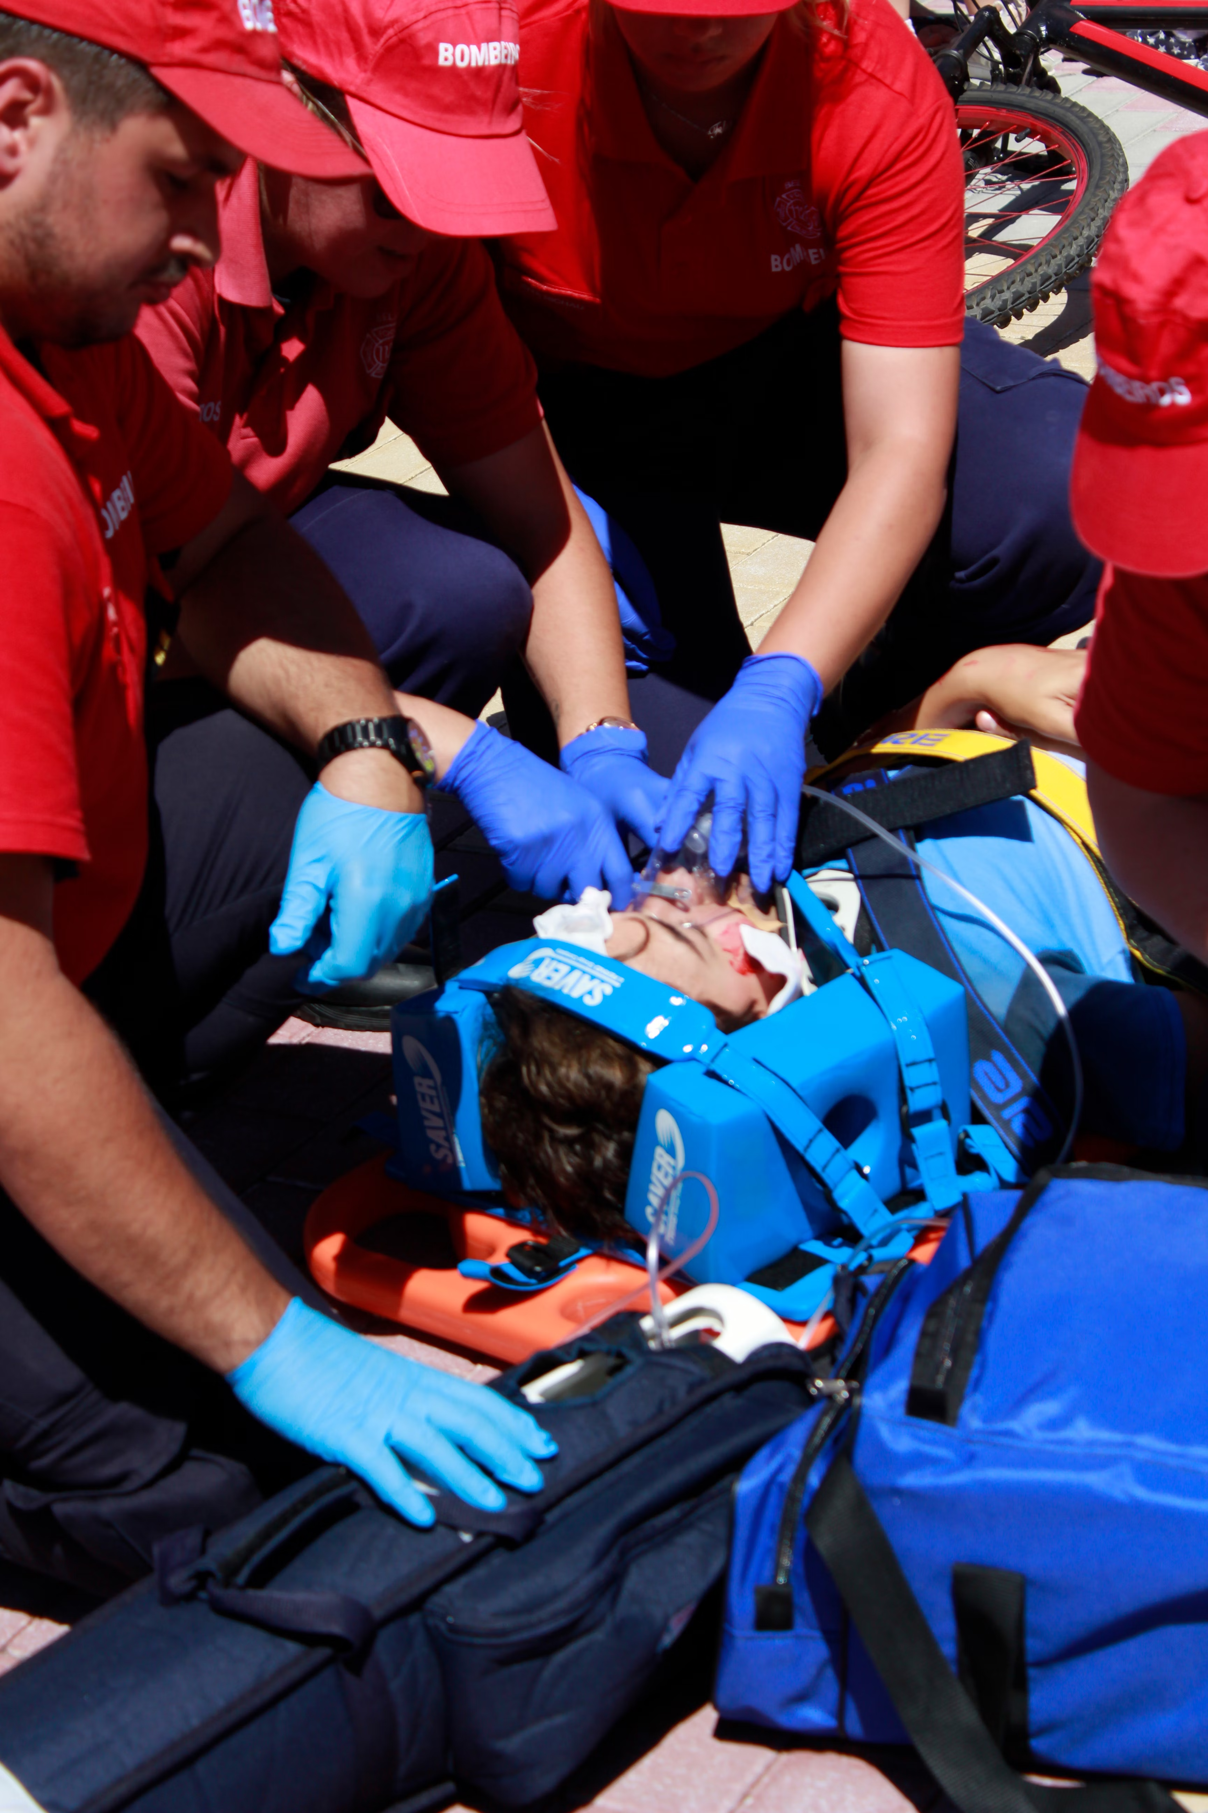
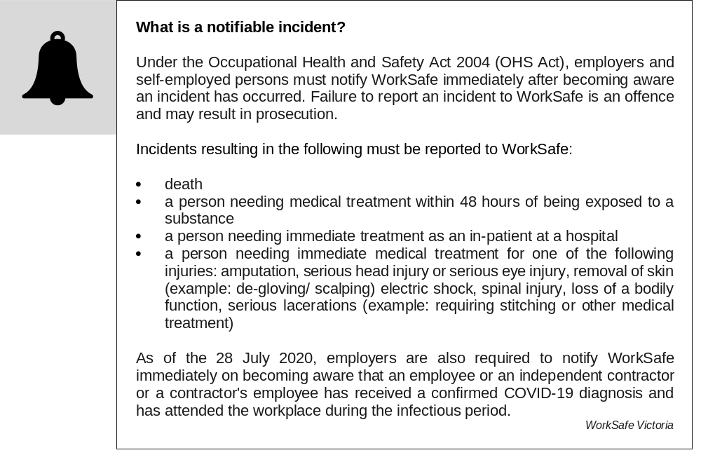

Slide 7
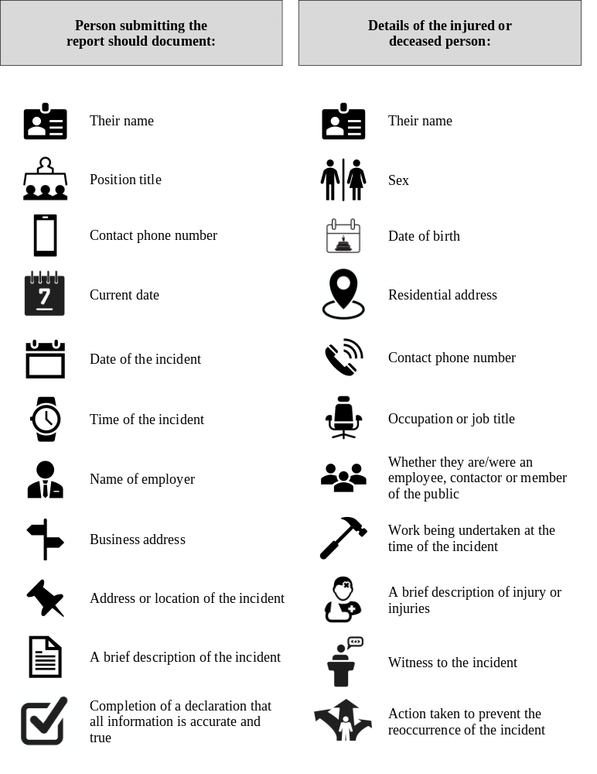
An incident report should document the following information.

Slide 8

Housekeeping Practice
Ensuring that your work area is clear of clutter that could potentially cause an accident.
Maintaining safe housekeeping practices in your work area can prevent injuries and improve productivity.
Slips, trips and falls are one of the highest causes of workplace injuries and one that can be prevented through safe housekeeping, such as:
Cleaning up any spills
Regular cleaning of flooring surfaces. Use appropriate ‘Cleaning in progress’ signs.
Checking the floor regularly for damage.
Not leaving items lying around on the floor.

Slide 9
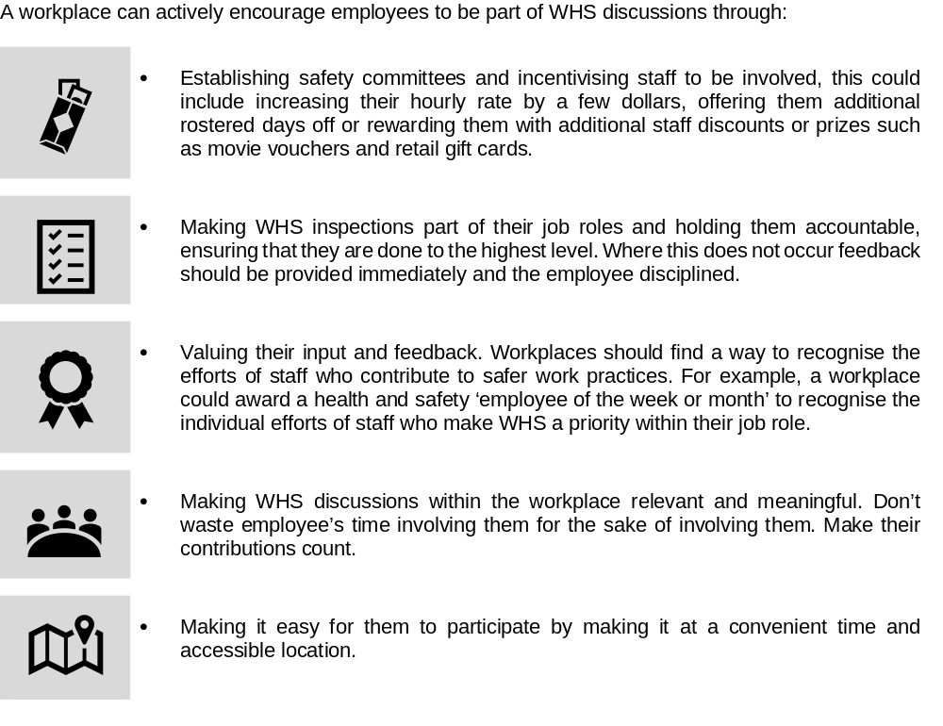
Contribute to safe work practices in the workplace

Slide 10

Reflect on own safe work practices
When a person has been doing a job for a long time it is easy to become complacent and this is when accidents occur. It is important that employees are encouraged and given the time needed to maintain their currency of safe work practices.
Engaging in training can help workers stay safe and current in their role
To ensure safe work practises it is also important to reflect on your own levels of stress and fatigue as these could impact on your ability to do your job safely
To prevent stress and fatigue, workplaces should avoid excessive workloads, unreasonable performance demands, long working hours or infrequent breaks

Slide 11
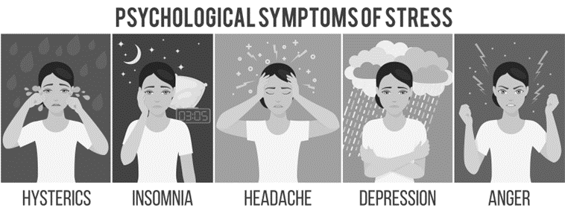
Stress
To prevent stress in the workplace you should always:
Take your rest times and breaks when they're allocated
Always take the time to sit back and relax, to clear your mind and rest your body
Get enough fresh air; take your breaks outside
Do not go to work when you are sick
Let your supervisor know if you are feeling stressed by events or issues at work.
Don't perform duties for which you are not trained, and focus firstly on your own duties and areas of responsibility before helping others.
Complete Inquiry task 1G

Slide 12
Complete Reflection Bank – Set A

