Slide 1

HLTWHS001
Participate in workplace health and safety
Part 1
Through this unit you will develop the skills and knowledge required for workers to participate in safe work practices to ensure their own health and safety, and that of others.

Slide 2

Workplace health and safety is an important aspect of all workplaces. It ensures that everyone within an organisation or business is safe.
In 2019 alone, 138 Australians were killed at work and $61.8 billion was spent on work related injury and disease.
Workplaces have a duty of care to their employees, clients, visitors and others entering their premises to implement Workplace Health and Safety (WHS) policies and procedures to protect them from harm.
Workplace health and safety legislation and regulations set out the health and safety requirements affecting all Australian workplaces and work activities.

Slide 3
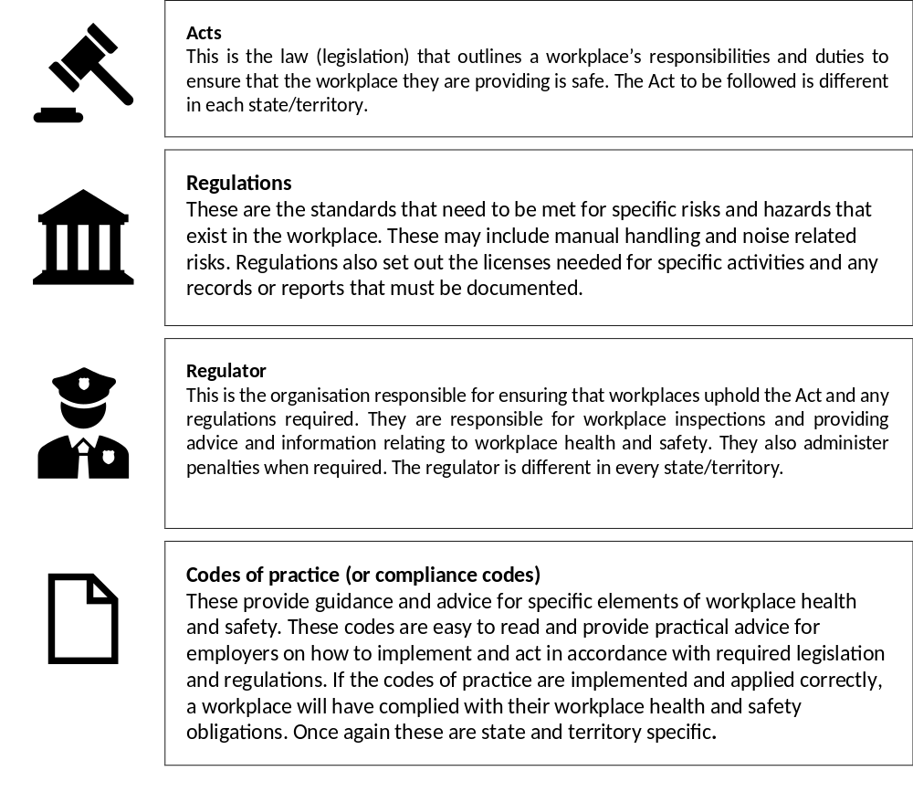

Health and Safety Requirements
Complete Inquiry task 1A

Slide 4
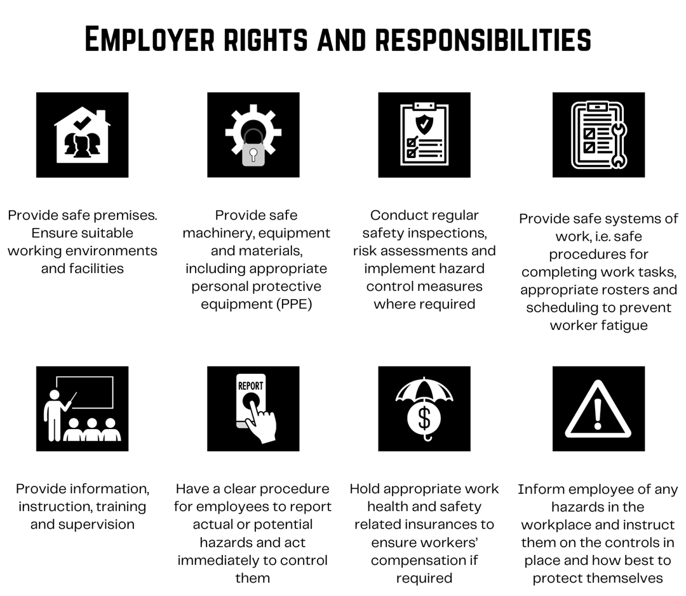
Follow safe work practices
Workplace Health and Safety is an obligation to exercise a ‘duty of care’ for health and safety in the workplace.
The duty of care is a legal obligation to anticipate and address potential hazards that could cause injury or illness in the workplace.

Slide 5
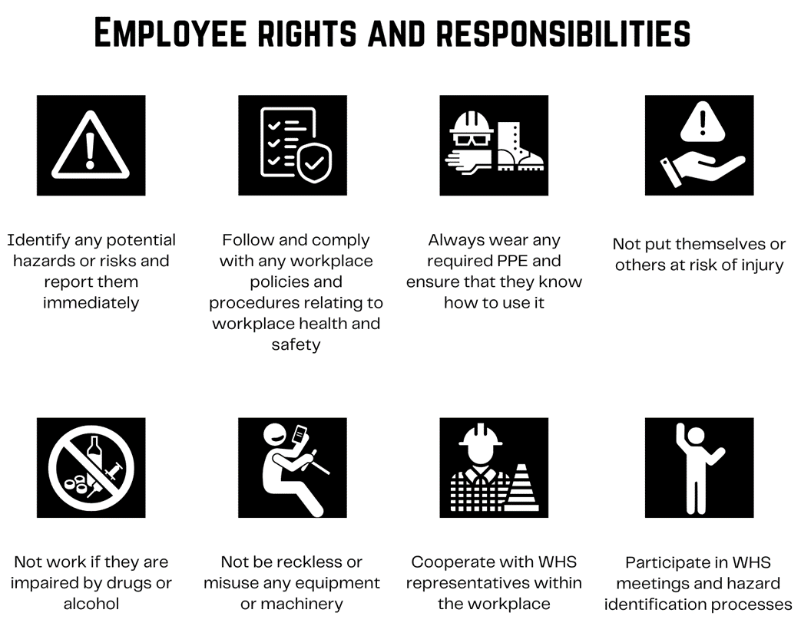
Within a workplace employees also have responsibilities to ensure workplace health and safety to prevent injuries to themselves and others in the workplace.

Slide 6
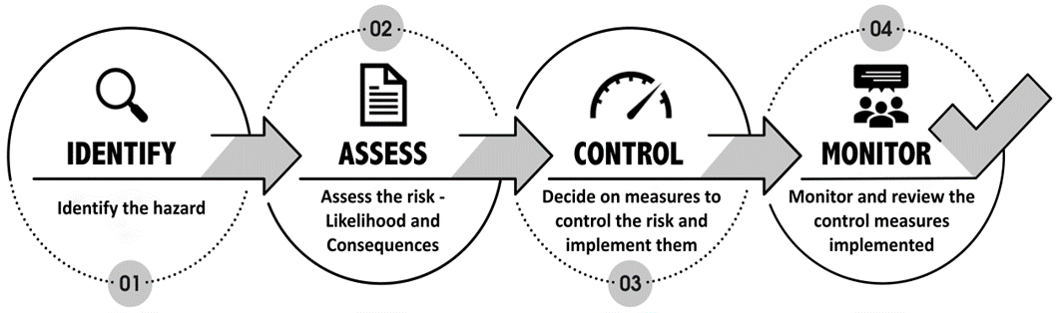
Risk management and assessment
To manage risk within the workplace you will need to conduct regular risk assessments where you will follow this four-step process:

Slide 7
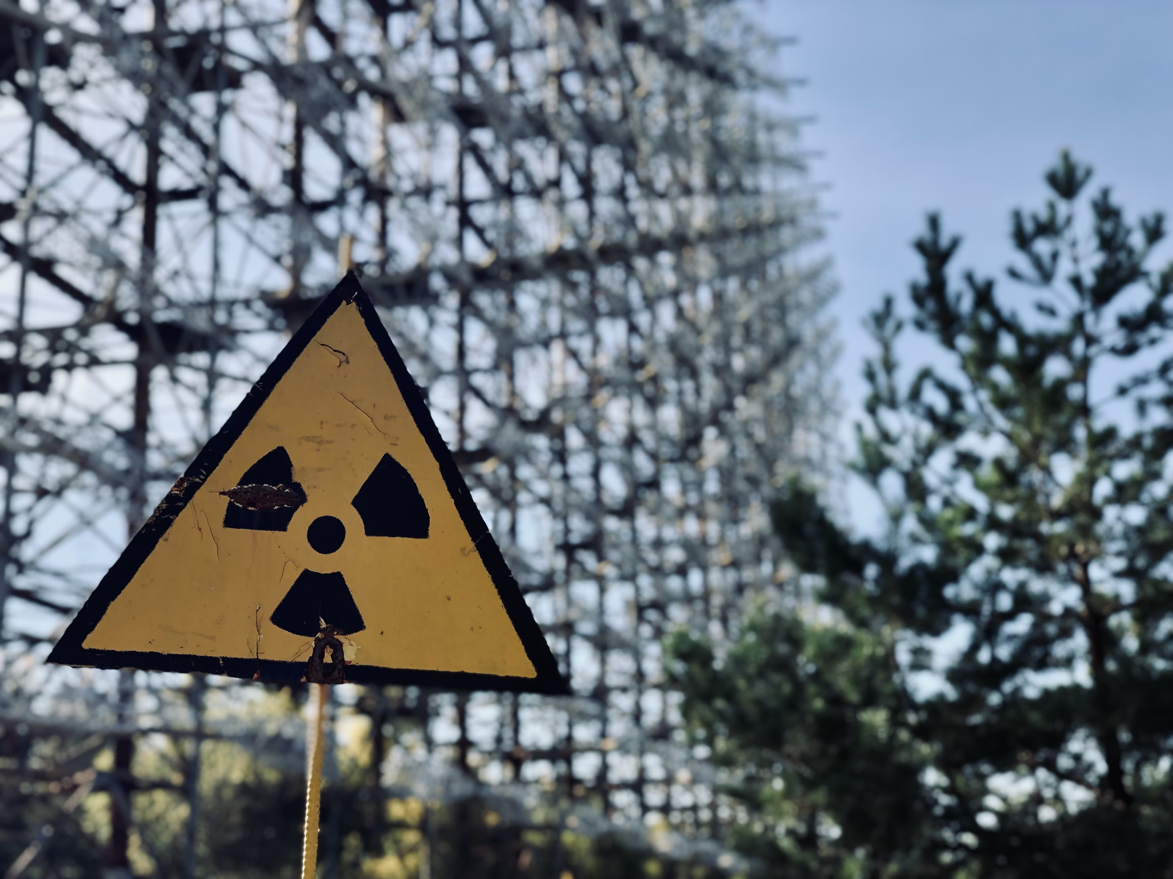
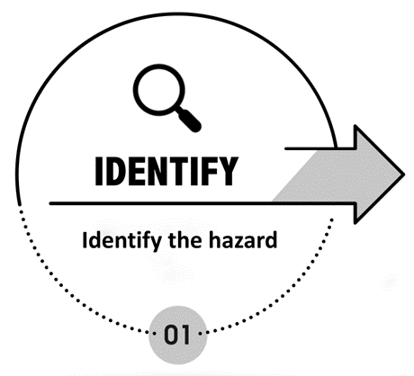
The first step in any risk assessment is to identify the hazards - things that can cause harm to people in your workplace
Physical
• Noise
• Heights
• Radiation
• Sharps
• Moving parts of machinery
• Extreme weather or temperatures
Biological
• Mould
• Blood and body fluids
• Dust
• Vermin
Chemical
• Toxic
• Flammable
• Reactive
• Corrosive
• Household chemicals
• Hazardous air
• Medicines and waste
Ergonomic
• Poor workstation set-up
• Poor posture
• Manual handling
• Repetitive work
Psychosocial
• Stress
• Workplace violence
• Mental health related issues
• Workload
• Fatigue

Slide 8

Within a workplace, hazards can be identified by:
Conducting audits
Conducting a physical inspections
Observation of work tasks.
Investigating accidents or incidents
Investigating ‘near misses’
Reviewing documentation
Environmental monitoring of any fumes etc
Review of employee complaints
Communicating and consulting with employees
Hiring an external professional safety consultant to conduct a safety audit of the premises and its work practices
Any identified hazards must be reported to the designated persons, and investigations conducted when:
An organisation or business is new
New forms of work are starting
When changes are made
A hazard has been identified
After an incident, accident or near miss has occurred
When concerns are voiced
When any new knowledge or information about hazards becomes available
When changes to equipment or materials are made

Slide 9
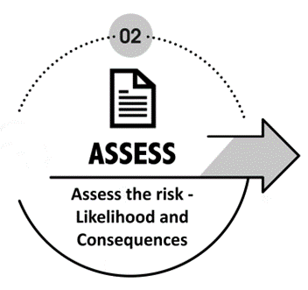
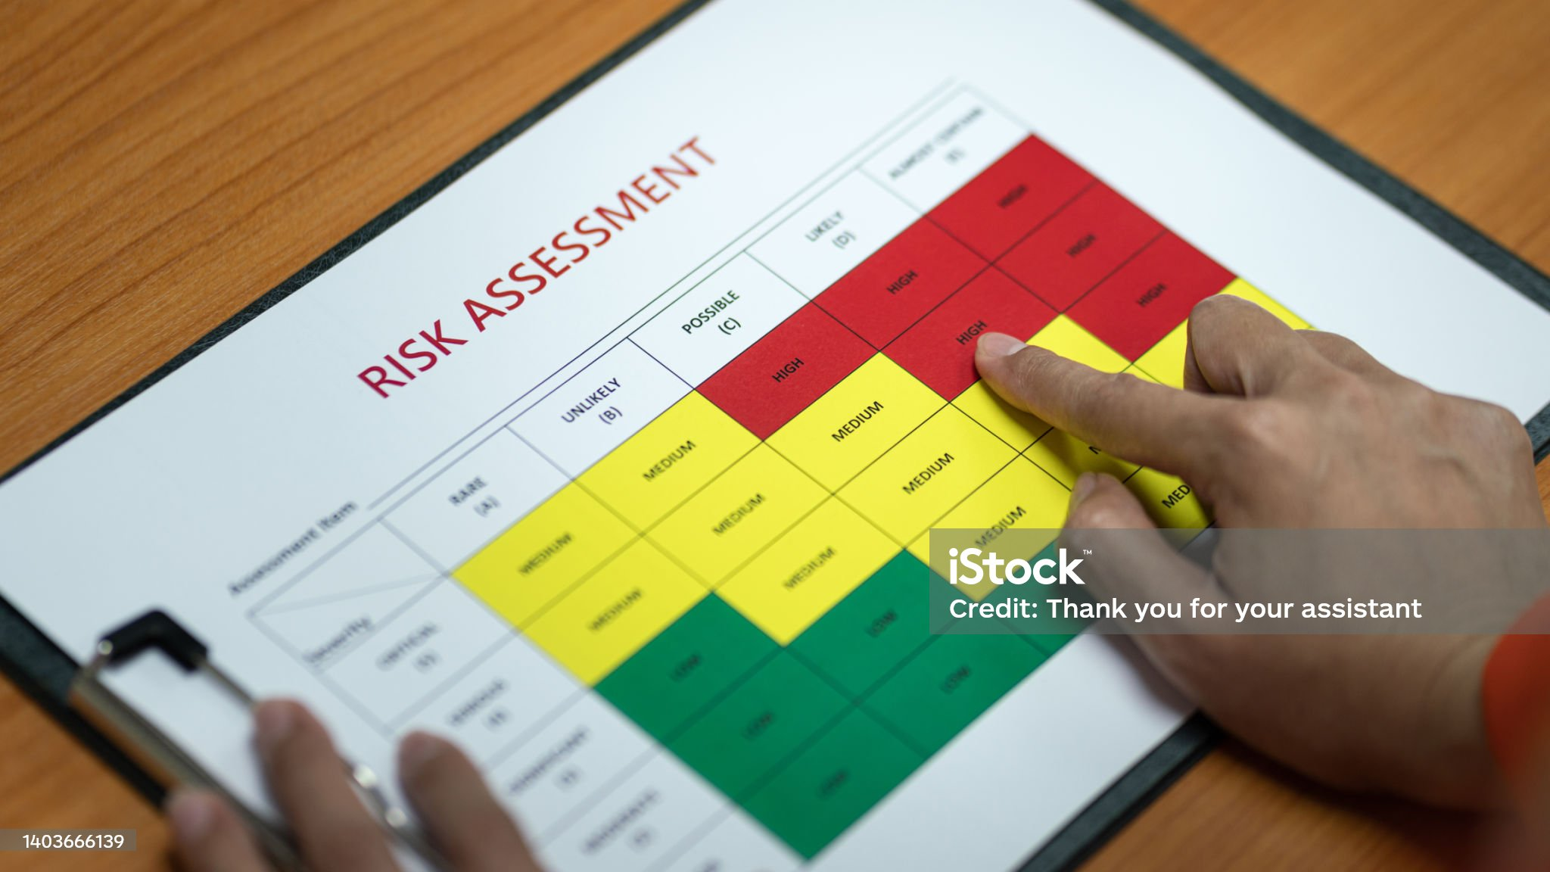
Once a hazard has been identified it will need to be assessed to determine what the likelihood of the risk occurring is and if it does what will be the consequences
You should consider:
How likely is it that the risk will cause injury?
Has it happened before? And if so was somebody injured and how badly?
Are there any controls currently in place to prevent the risk from occurring? And if so, how successful have they been to date?
How often are people within the workplace exposed to the hazard? The more often people are exposed the more likely the hazard is to cause harm.

Slide 10
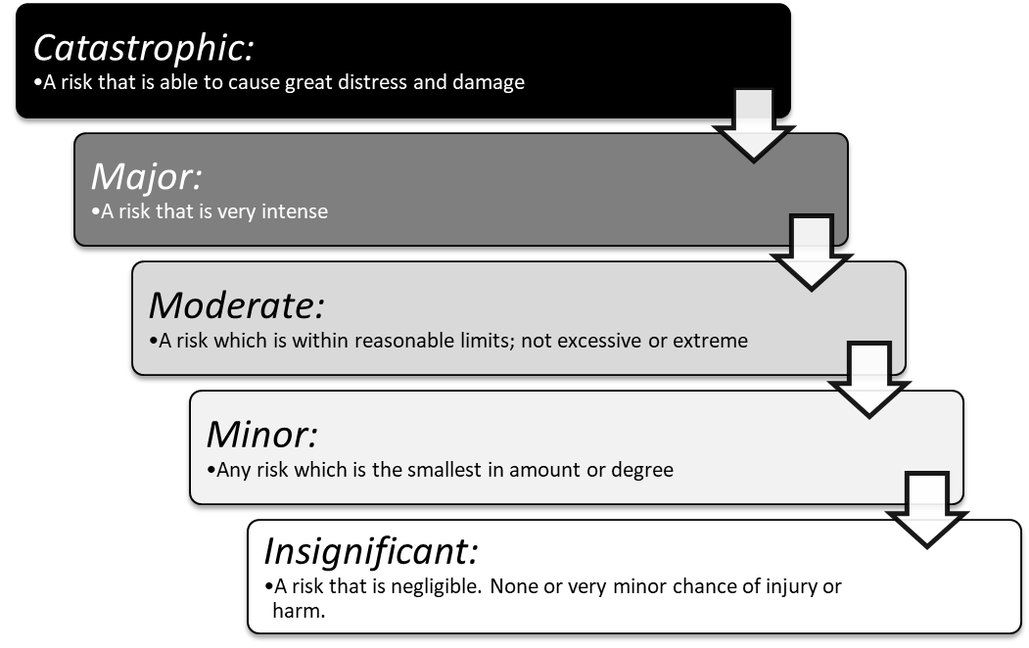
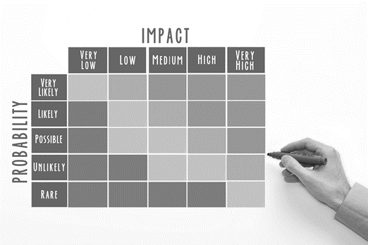
You will need to rank each risk based on the severity of the consequences if it was to occur. You will need a list that identifies and describes the significance of outcomes if the risk occurs.
Complete Inquiry task 1B

Slide 11

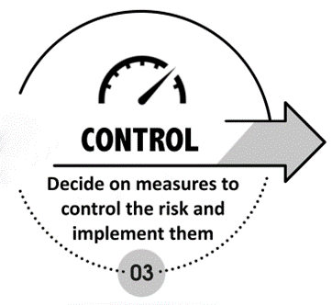
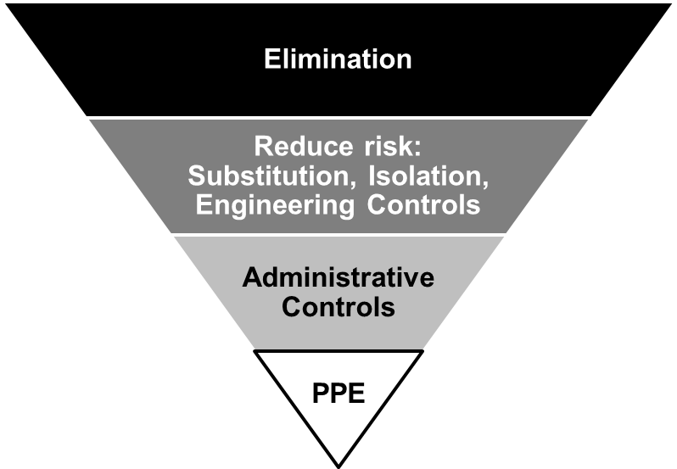
Determine what needs to be done and how quickly. In extreme cases where the risk is critical you may need to implement a stop work action to prevent injury or damage until the control has been implemented.
The Hierarchy of Control describes the preferred options for controlling risks. It is a list of control measures that can be used to eliminate or minimise exposure to workplace hazards

Slide 12

Elimination – Physically remove the hazard
Reduce the risk – Substitute, isolate or engineer controls for the risk.
Admin controls – Change the way that the work is done
PPE – Utilise personal protective equipment
Complete Inquiry task 1C

Slide 13
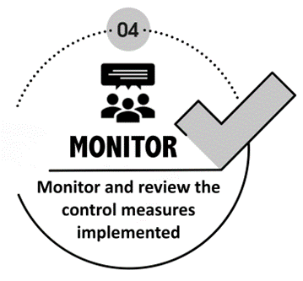
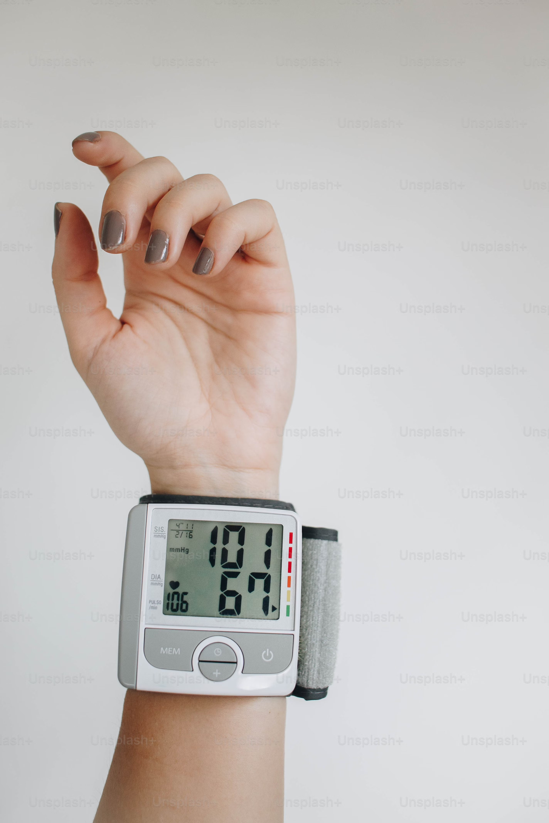
Once a control measure has been implemented it is important that you monitor it on a regular basis.
To monitor the control measures you should consider:
If the control measure has been implemented as intended
Whether the control measure is adequate
If the implementation of the control measure has created any other hazards or risks
To review the control measure, you will need to consider:
If anything has changed since that risk process
Whether the controls are still adequate, or do changes need to be made?
If the risk management process has been conducted effectively

Slide 14

Documentation
It is important for a workplace to keep adequate records of their risk management process. Records should be kept of the hazards identified, the likelihood and consequences of the risk, how it was controlled and what was implemented.
It is important to note that this should be done in accordance with applicable WHS laws and standards.
A risk register is a tool for documenting risks, actioning and managing them. Each risk is logged on the register and actions taken to respond to them. There is no set format for a risk register.

Slide 15

Workplace emergency procedure
A workplace emergency is a situation that threatens employees, customers or the public. It is often a sudden event or situation that requires an immediate response.
In emergencies, people can panic or become confused. The best way to make sure emergency situations are handled as well as possible, is to plan, prepare and practise for them.
All workplaces must have a comprehensive and well-practised plan in place to deal with emergencies. All workers need to be familiar with the plan and confident in their responsibilities to execute them effectively and efficiently.

