Slide 1


Slide 2
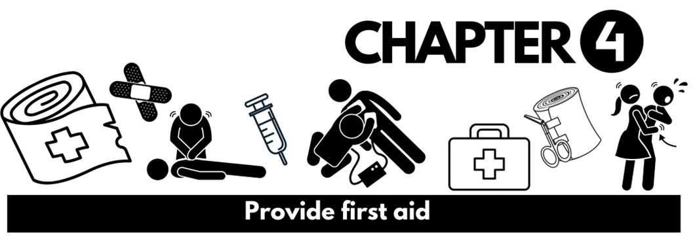
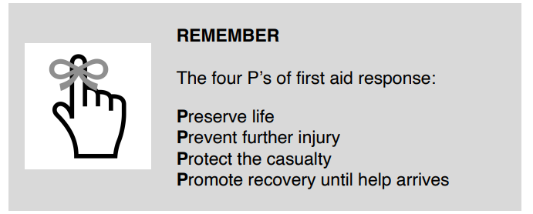
Providing even the most basic first aid treatment could be the difference between life and death. The faster a person receives first aid treatment, the better the chances of them making a full recovery.
The role of a first aider is to assess a situation and the casualty, call for emergency response (if the situation is serious) and provide first aid treatment while protecting themselves and bystanders from any danger

Slide 3
The Law
First aiders do not generally have an obligation to help someone in need.
If you owe a someone a Duty of Care because of work arrangements and are qualified to provide aid – you must take reasonable steps to assist.
A first aider cannot get into legally trouble for helping, as long as:
• their intentions were good
• they stayed within their level of training
• they didn’t make the situation any worse

Slide 4

Consent
You must gain a persons consent in order to assist them. You Should always remember to:
Introduce yourself
Tell the person you know first aid and can help
Ask if they want your help
If they refuse your help, you must respect this.
Parental consent for a minor should be obtained – if not possible, consent is implied.
If a person is unconscious – Consent is implied, and you may begin first aid.

Slide 5
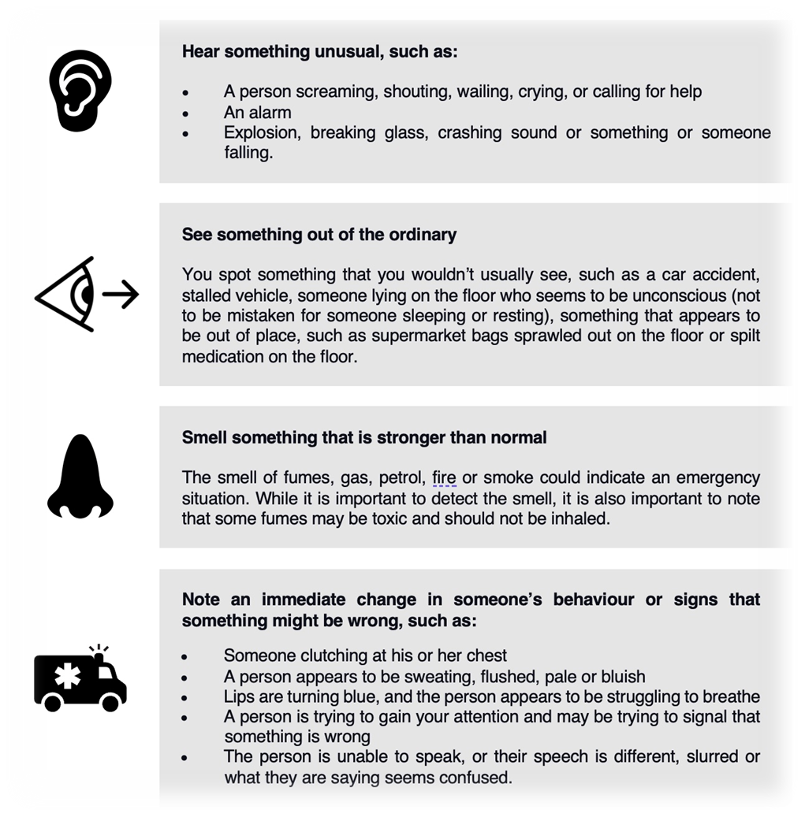
Recognising an Emergency

Slide 6
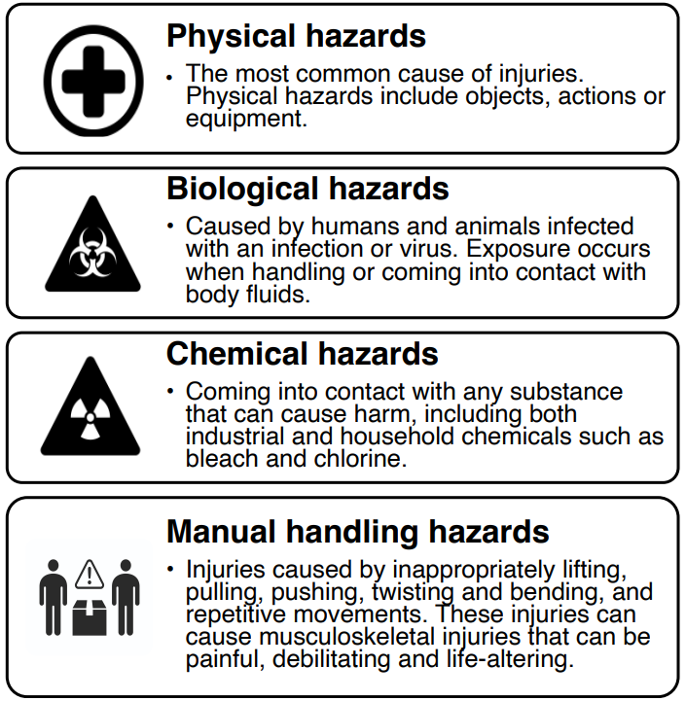
Identifying Hazards
A hazard is a source or situation with potential for harm - human injury or ill health, damage to property, the environment, or a combination of these.

Slide 7
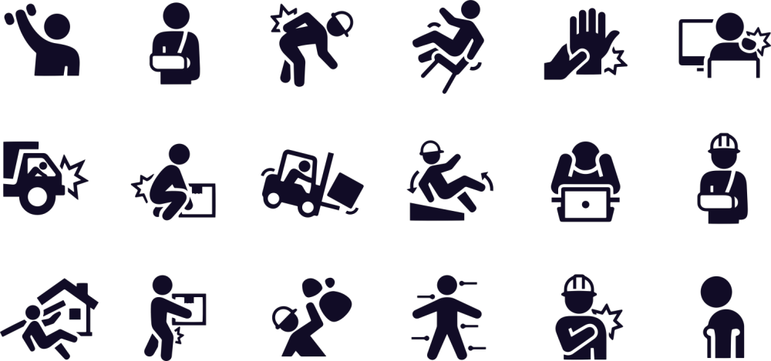
Protecting yourself and others
When providing first aid, you should never put yourself in harms way – you are always the most important person on the scene.
It is important to identify hazards to better avoid them – this may be things like traffic or electricity or it could be the risk of infection from touching blood or saliva.
If it is too dangerous to help, do what you can to minimise danger before proceeding, or wait for an emergency medical services.

Slide 8
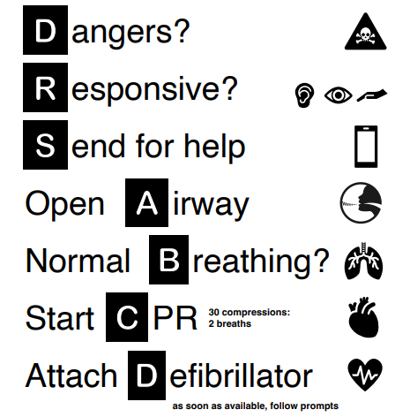
Assessing the situation
When you arrive at a situation where first aid may be required it is important to take a few quick seconds to assess the situation before rushing in to assist the casualty or casualties. The DRSABCD method should be applied
Continue CPR until responsiveness or normal breathing returns

Slide 9
Danger
There is potential for danger in any situation that someone requires first aid – especially if you didn’t see what caused the incident. Look for danger to yourself and bystanders by thinking about:
What caused the incident?
Are there obvious potential hazards?
Is it safe to enter the scene?
Can risks be removed?
Is it best just to wait for EMS?
Do you have any personal protective equipment?
Is it safe to move a casualty? And is it necessary?

Slide 10
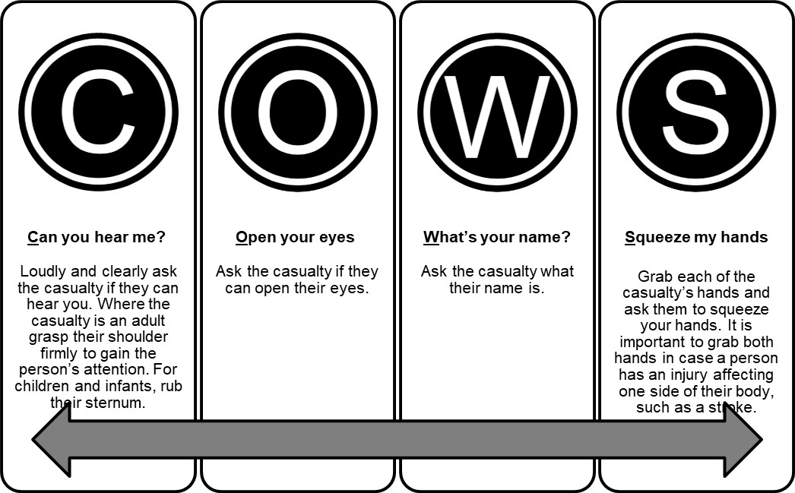
Responsiveness
When you have determined a scene is safe, you must establish if the casualty is responsive, and if they are conscious. We do this using COWS

Slide 11
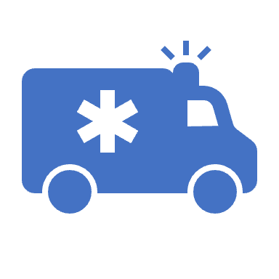
Send for help
Upon assessing a casualty you will need to determine if they require Emergency Medical Services
Do not leave the casualty alone
Call 000 from your mobile if you are able to
Direct a bystander to do so if not
Provide operator with information
Follow their prompts as the may be able to direct you
Have someone ready to receive EMS and direct them to the casualty

Slide 12
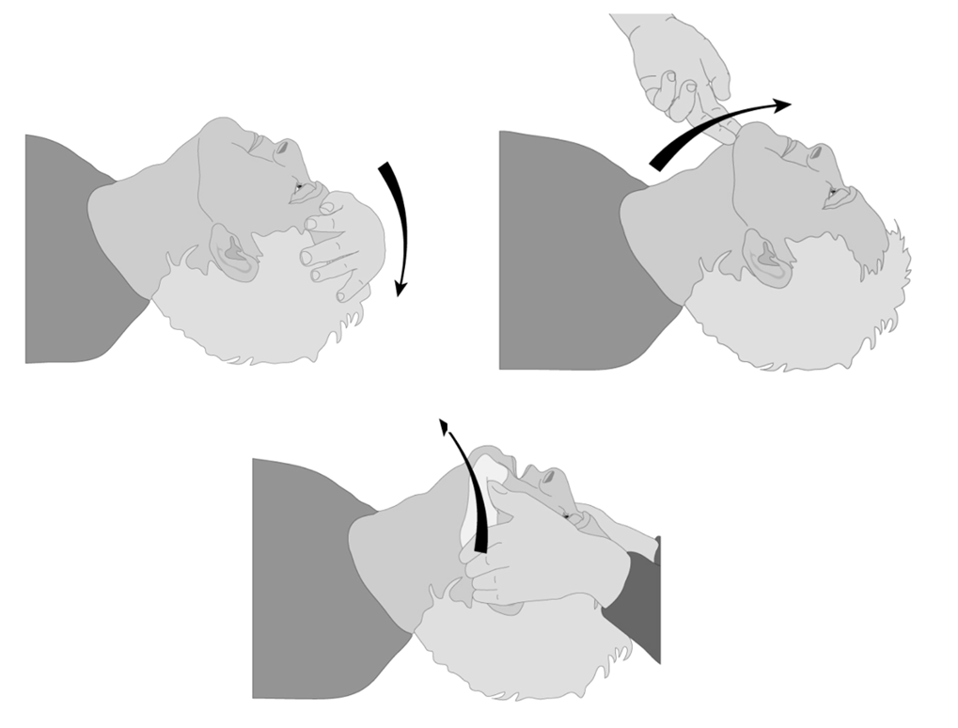
Airway
It is crucial to open the casualty’s airway and check for obstructions, this may be an indicator of what has happened, but will also hinder CPR if not clear. To clear obstructions:
Roll them into the recovery position on their side
Open their mouth
Use two fingers to scoop away obstructions, be careful not to force them down further
Once clear roll them back onto their back and keep the air way open by
Lifting the chin / tilting the head back for adults
Kept in a neutral position for an infant

Slide 13
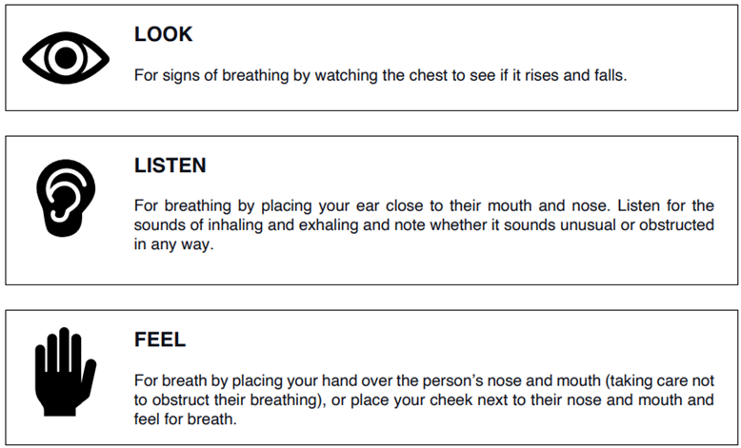
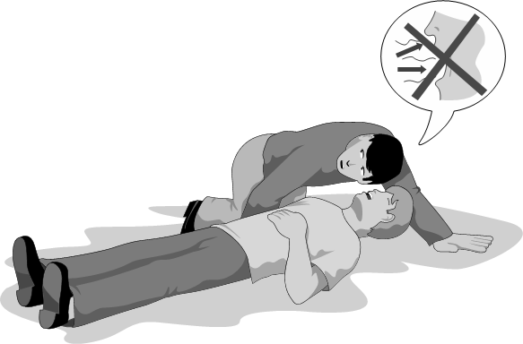
Breathing
Identify whether or not the casualty is breathing by using the LOOK, LISTEN and FEEL method:

Slide 14
Recovery Position
Kneel next to them
Place their furthest arm directly out from their body at a 90-degree angle
Place their closest arm to you across their chest
Raise their leg closest to you, so their knee is bent with the foot on the floor
Support their neck and head while rolling the casualty in one motion onto their side
Keep their leg bent to prevent further rolling.
Put the casualty’s hand under their chin to keep their airway open.

Slide 15
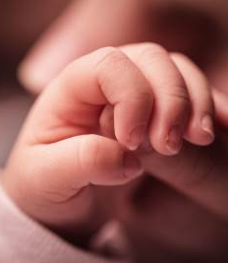
The Recover Position - Infants
For an infant – under 12 months old, airways are different to adults, instead of tilting the head back, the airway must remain in a neutral position.
Lie the infant face down across the length of your forearm
Support the head and neck with the palm of your hand.
Roll the infant gently so they are resting flush with your arm
Point the head downwards to allow for regurgitation

Slide 16
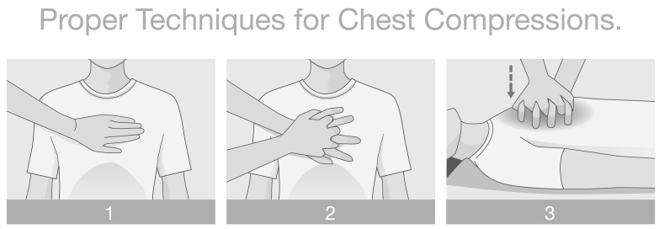
CPR
Cardiopulmonary resuscitation (CPR) is a combination of rescue breaths and chest compressions. CPR is used to maintain circulation to preserve brain function.
Adults and children
Kneel next to the casualty.
The compression point is on the sternum. This can be easily found by drawing an imaginary line between the armpits and placing your hand at the midpoint of this line with fingers pointing away from the body.
Put your other hand over the top and either interlock your fingers or grasp the top of your wrist. Both methods are effective; you should choose whichever feels more comfortable for you

Slide 17
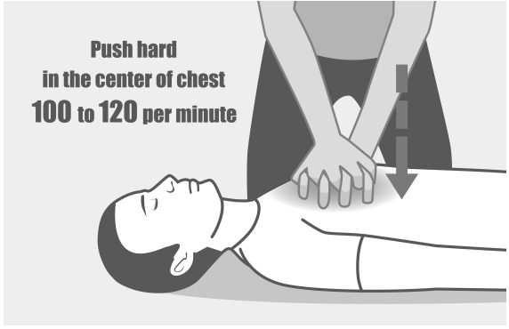
4. Arms straight with the heel of your palm and shoulders positioned over the casualty’s sternum.
5. Push down 1/3 of the depth of the chest cavity. Keep your arms straight.
6. Administer 30 compressions at a rate of 100 to 120 per minute. followed by two breaths.
7. Tilt the head fully back to give breaths. Make a tight seal over the casualty’s mouth, pinch their nose to block it.
8. Blow air into the casualty’s mouth, looking for a rise of the lower chest.
Full breaths for adults and gentle breaths for children aged 1-8. Administer one breath, turn your head to the side, breathe in and deliver the second breath. While taking your breath, look at the casualty’s chest to see if it is deflating.
9. Where two people are available to perform CPR, one person can deliver the two breaths while the other completes the compressions.

Slide 18
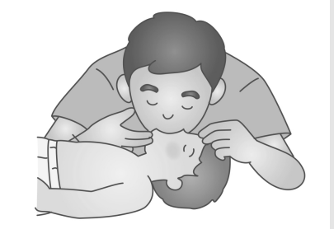
Infant CPR
Place infant on a table.
The compression point is located on the sternum as it is for adults and children, however, compressions should only be delivered using two fingers.
Breaths should be given with the head in a neutral position, and both the mouth and nose should be covered to produce a seal
Blow a gentle puff of air into the infant. Once you have administered the first breath, turn your head to the side, breathe in fresh oxygen and deliver the second breath. While taking your breath, look at the infant’s chest to see if it is deflating. Where you do not see the chest deflating, it is possible that there is still an airway obstruction or that you are not making the seal over the mouth and nose tight enough.

Slide 19
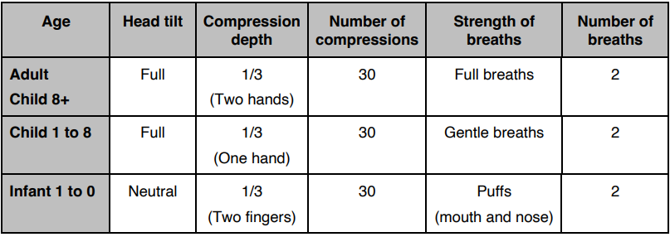
If at any time during CPR the casualty begins to breathe again, roll them into recovery position.
Monitor them until EMS arrives, and if the stop breathing again – recommence CPR

Slide 20
Defibrillator
An Automatic External Defibrillator (AED) will assess the heart rhythm of an Unconscious, Non breathing casualty – then if necessary, shock the heart back into normal rhythm. Steps to use the AED are simple so that almost anyone can easily use them:
Find an AED – follow signage in areas where people congregate
Remove AED from Case
Return To Casualty
Open AED
Turn on
Follow Prompts
The AED will communicate instructions verbally, and pads will have pictures to indicate correct placement.
Once on, the AED will analyse and advise that a shock is or isn’t recommended, if so push the flashing button with electrical signage.
Unless the AED states not to touch the patient – continuously perform CPR

Slide 21
Applying Appropriate First Aid Procedures
Not all first aid incidents require CPR or an AED – as you assess the situation using DRSABCD and establish the patient is breathing, you can point your attention to solving other issues.
• Abdominal injuries
• Allergic reactions
• Wound care and bleeding control
• Nose bleeds
• Burns
• Cardiac conditions
• Choking and airway obstructions
• Crush injuries
• Diabetes - hypoglycaemia and hyperglycaemia
• Drowning
• Envenomation
• Hypothermia
• Hyperthermia
• Dehydration
• Stroke
• Shock
• Eye and ear injuries
• Dislocations
• Fractures
• Febrile convulsions
• Seizures and epilepsy
• Head neck and spinal injuries
• Needle stick injuries
• Poisoning and toxic substances
• Asthma
• Soft tissue injuries

Slide 22
Abdominal Injuries
Abdominal injuries can be caused by blunt or penetrating trauma.
This can cause internal bleeding.
This type of injury usually shows with pain and distension.
Signs and symptoms of abdominal injury may include:
• A bleeding wound or obvious puncture
• Bruising of the skin in the abdominal region
• Protruding organs through an abdomen
• Nausea and vomiting
Shock
• Clammy and pale skin
• Pain in the abdominal region
• Unable to stand upright; may be hunched over in pain
• Odour may be present if an organ has been lacerated

Slide 23
Treating Abdominal Injuries
Call for help (000)
Assist the person to lie down in a position that is most comfortable
Loosen clothing
Control any external bleeding. Lying on the floor with elevated legs can help to reduce the bleeding
If a penetrating object is evident such as a metal rod, stabilise the object
If you can see protruding organs, do not touch them. Cover the wound with aluminium foil, glad wrap or a sterile non-stick dressing, soaked in saline. Take care not to put too much pressure on the area.
Secure the area with a wide bandage ensuring that it is not too tight
Ensure that the person has nothing to eat or drink
Monitor the person’s vital signs and if they stop breathing commence CPR

Slide 24
Allergic Reactions
An allergic reaction is where the body is exposed to an allergen (trigger), which causes the body’s immune system to react.
These reactions can progress quickly to anaphylaxis – a flood of chemicals released by the immune system that cause shock and tightened airways.
Signs and symptoms of general allergic reactions include:
Skin irritation such as redness and swelling
Raised rashes, itchiness, welts and hives
Swelling of the mouth, tongue and throat
Difficulties breathing, wheezing and coughing and difficulty talking
Nausea and vomiting
Dizziness
Collapse and become pale and floppy (mostly seen in children)
Loss of consciousness

Slide 25

Treating Allergic Reactions
DRSABCD
If the person is conscious lie them down
If you recognise the person’s symptoms as being anaphylactic in nature ask if the person has an adrenaline auto-injector (EpiPen).
Assist the person to administer it or you administer it
Call for help, dial 000
Ensure that person remains lying down
Monitor the person until help arrives
Complete Inquiry task 4A

Slide 26
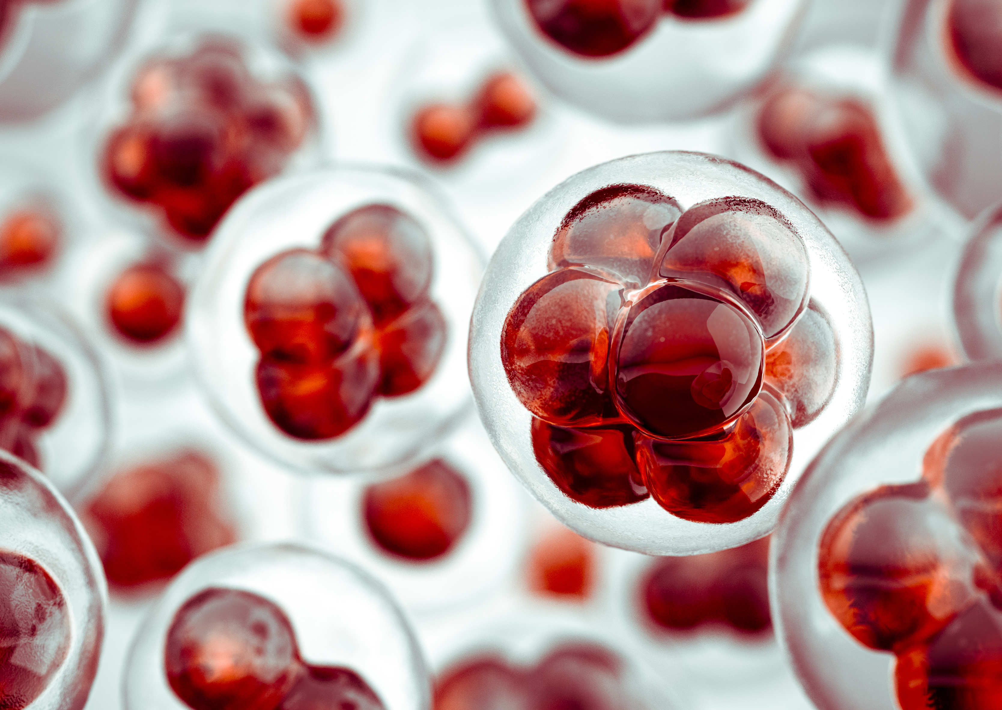
Wounds & Bleeding
A wound is an injury where a break in living tissue occurs, causing it to bleed. Management is essential to control bleeding and potentially save someone’s life but also to prevent infection.
Wounds Include:
Lacerations – A deep cut or tearing of the skin
Punctures – A small hole caused by something long and pointy
Incisions – This is a clean-cut caused by something sharp.
Abrasions – Caused by skin rubbing against a rough or hard surface
Avulsion – this is where the skin and the tissue beneath it are completely torn away

Slide 27
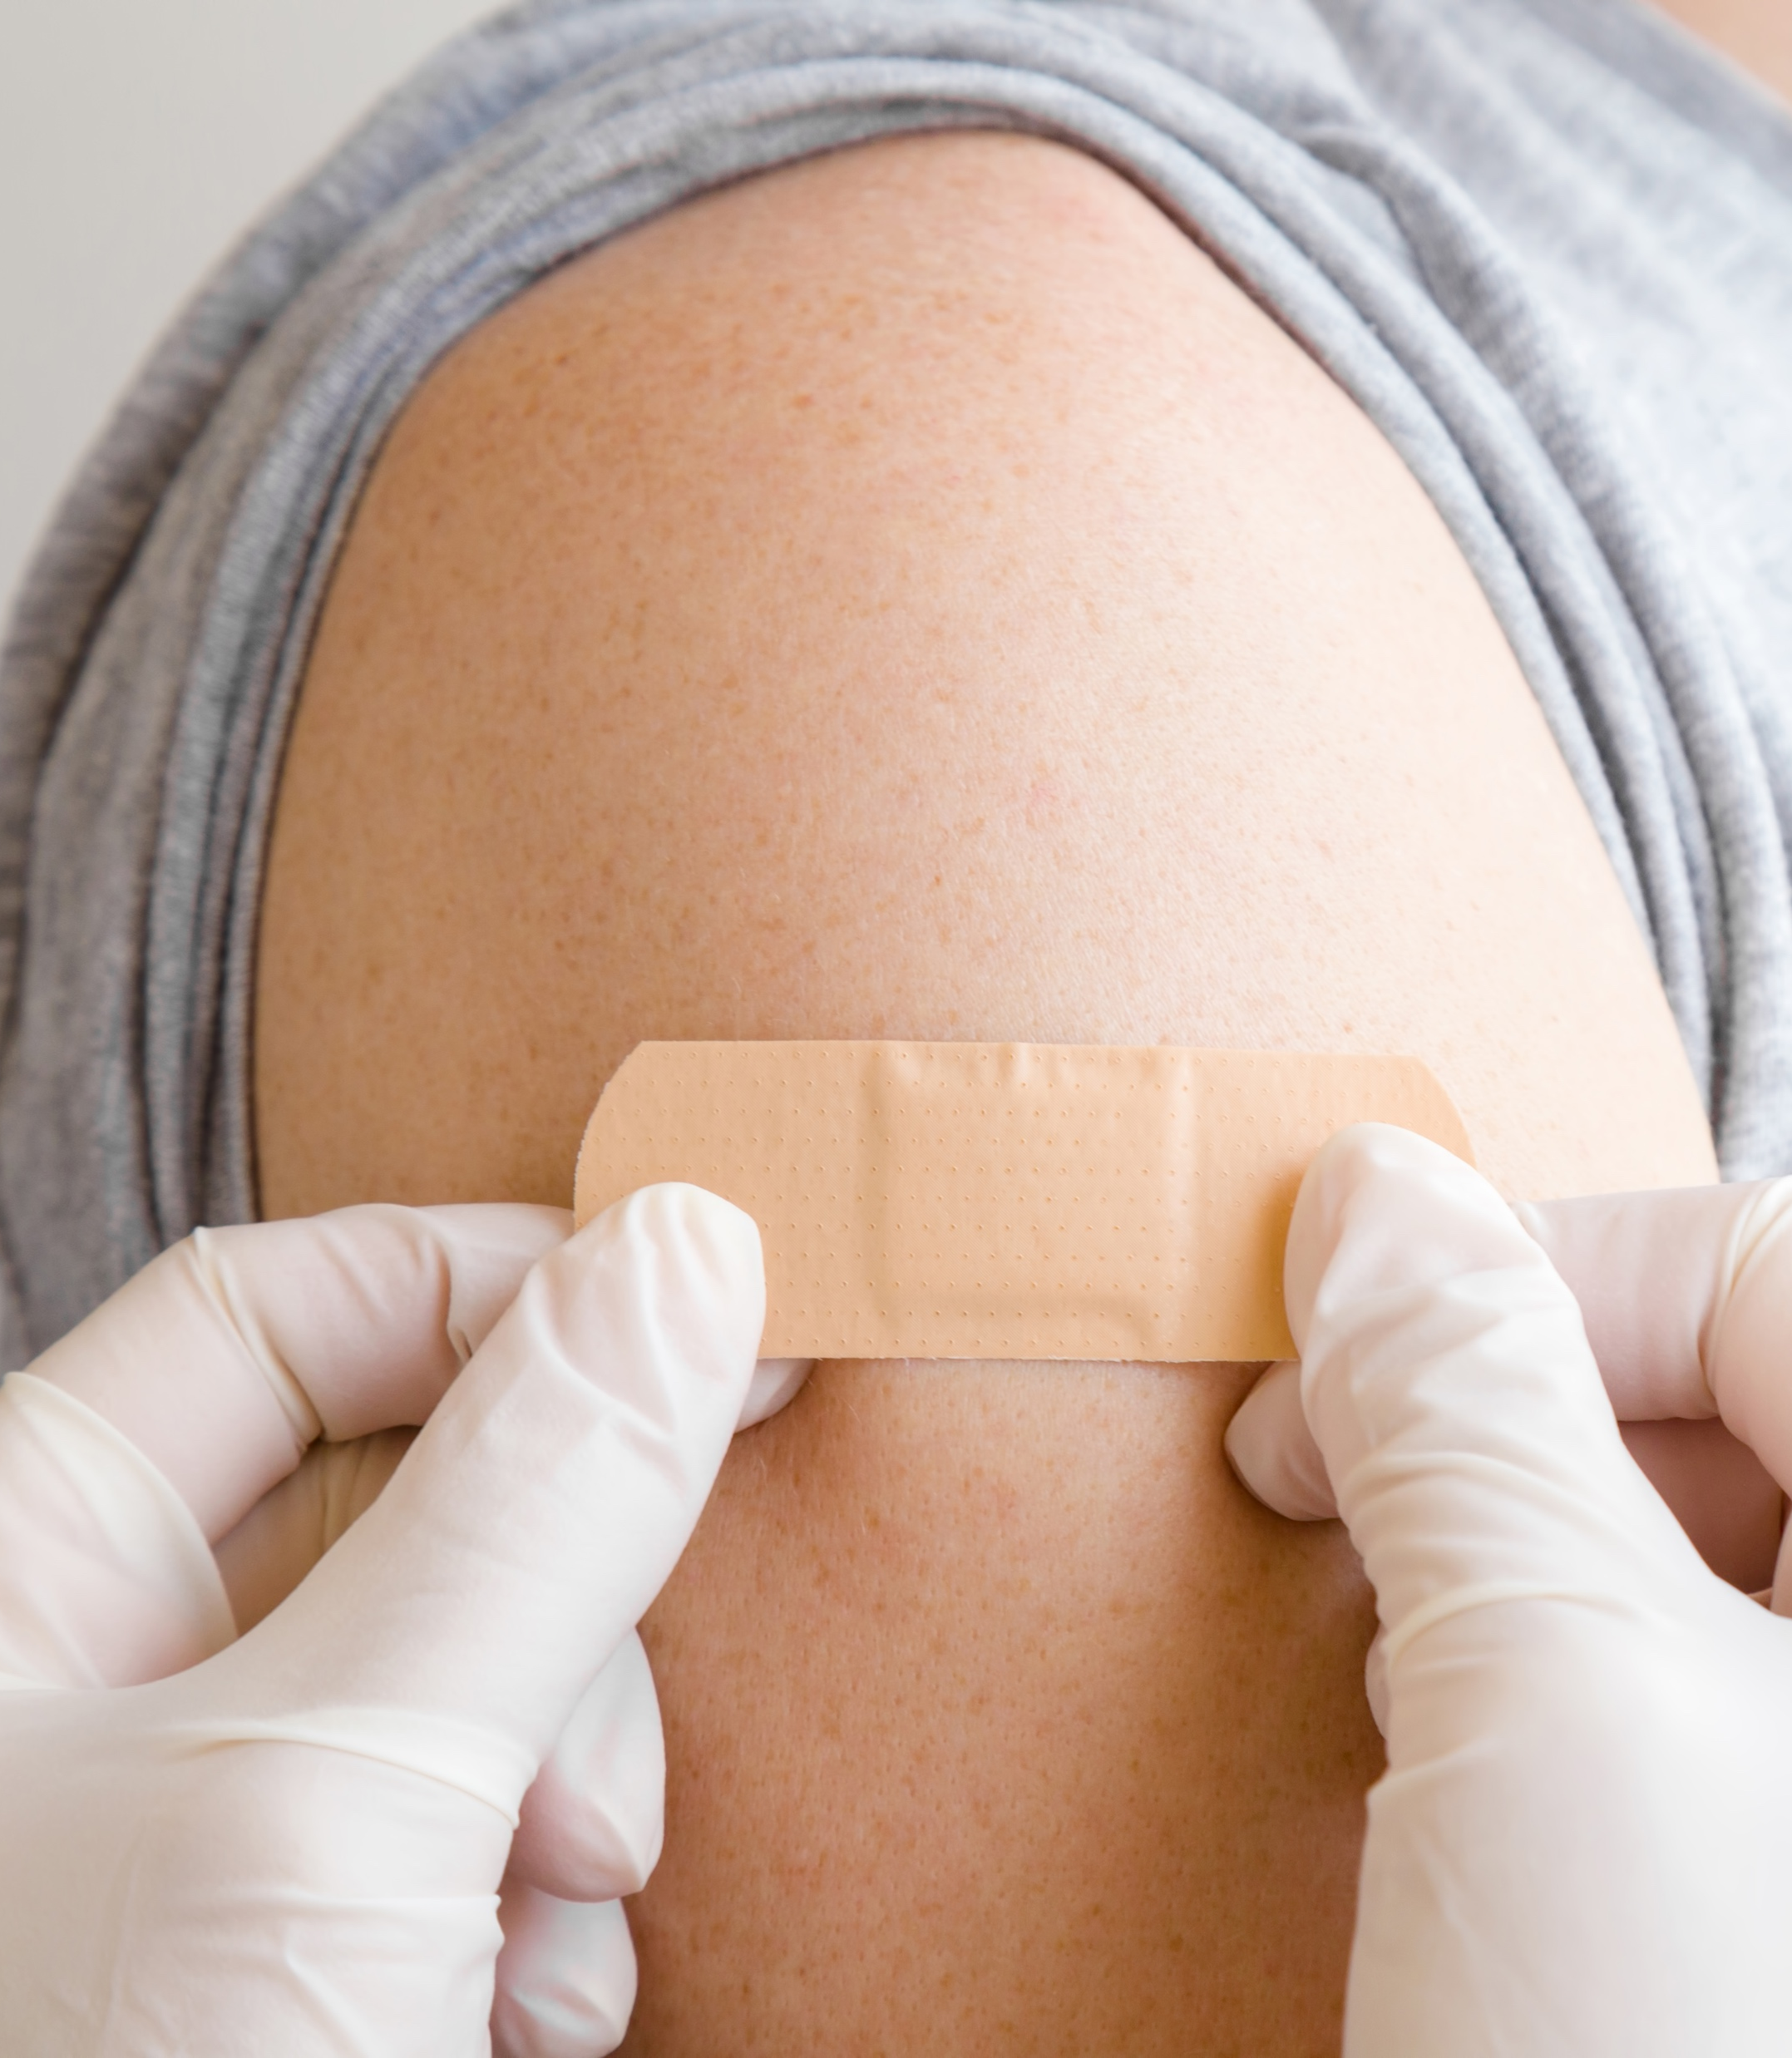
Treating Wounds
No matter the wound, the treatment remains the same
Control the bleeding
Prevent infection
Seek medical attention if required.
Blood consists of red blood cells which carry oxygen around the body, white blood cells that fight infection, plasma and platelets which enable blood to clot.
For a wound to stop bleeding the blood needs to clot – pressure will assist this

Slide 28
Management of a minor bleeding wound
Lie or sit the person down.
Gain clear access to the wound.
DO NOT REMOVE ANY PROTUDING OBJECT. Apply dressings around it, without too much pressure - this may cause the object to go deeper into the casualty.
Wearing disposable gloves, apply firm and direct pressure to the wound. Where gloves are not available you can direct the casualty to apply pressure to the wound.
Place a pad and bandage over the wound. For small cuts a bandaid would suffice.
If bleeding continues, remove bandages and apply another pad without removing the first pad. Then, rebandage the injured area. You can replace the second pad with a fresh one, but DO NOT remove the first pad.

Slide 29
Management of a major bleeding wound
Call for help, dial 000
Gain clear access to the wound without moving the person too much. You may need to cut their clothing.
If an object is protruding from the wound NOT REMOVE IT. You will need to apply dressings around the object ensuring that not too much pressure is applied which may cause the protruding object to go deeper into the casualty.
Wearing disposable gloves apply firm and direct pressure to the wound
Where possible lie the casualty down.

Slide 30

Nosebleeds
Nosebleeds can occur when a blood vessel in the lining of the nose ruptures. This can be due to injury, infection, allergic reaction, objects being pushed into the nostril or nose picking.
A nosebleed can also occur if a person is exposed to warm dry heat or after they exercise
Tell the casualty that everything is okay. This is very important for children as any crying can increase the flow of blood.
Have the casualty sit down and lean their head slightly forward.
Get the casualty to pinch the bridge of their nose, i.e. the fleshy part for 10 minutes or longer if still bleeding.
Apply an icepack or a cool towel or face washer to the casualty’s forehead and one around back of the casualty’s neck.
After 10 minutes check to see if the person’s nose is still bleeding. If it is still bleeding, seek medical assistance.
After a nose bleed it is important that the person does not attempt to blow their nose, pick it or sniff forcefully for at least 15 to 20 minutes.

Slide 31
Cleaning Wounds
It is important that any wounds are cleaned, and efforts are made to keep them clean to avoid infections and the growth of harmful bacteria.
Where possible rinse the wound under running water for a few minutes. If you don’t have access to running water, use a sterile wipe.
Use saline solution, an alcohol-free wipe or a soaked gauze pad in water to gently dab or wipe the wound. Wipe away from the wound and make sure that you use a new pad or wipe for each stroke.
Pat the wound dry with gauze or any clean, non-fluffy cloth, like a tea towel or pillowcase.
Apply a sterile, non-stick dressing to cover the wound.

Slide 32
Internal Bleeding
Internal bleeding is more difficult to identify than external bleeding.
Blunt force or a puncture wound where an object penetrates the skin most often causes internal bleeding.
Signs and symptoms of internal bleeding include:
• Blood coming from the ears or nose
• Pain and tenderness in the region of injury
• Coughing up of a frothy red liquid
• Shock
• Bruising at the injury site
Treatment Includes:
Lie the casualty down. If coughing up liquid you can sit them up slightly if it is more comfortable.
Raise the casualty’s legs or bend their knees.
Call for help, dial 000.
Monitor the casualty until help arrives. DO NOT allow them to drink or eat anything.

Slide 33
Complete Inquiry task 4B
Complete Reflection Bank – Set A

Slide 34
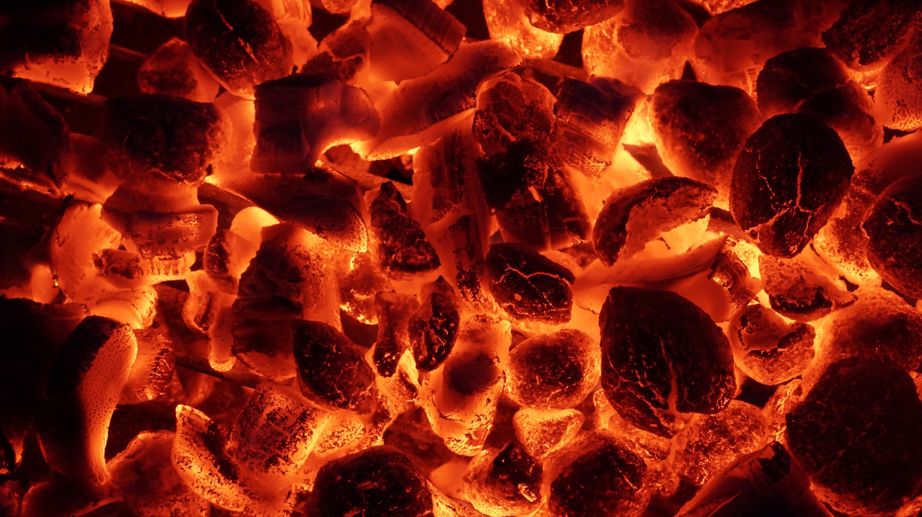
Burns
Burn injuries sustained can be superficial, partial thickness or full thickness based on their depth and size.
Superficial burns only affect the surface of the skin (epidermis), whereas deep burns affect both the surface of the skin (epidermis) and the dermis (below the surface).
In some extreme cases, deep burns can also impact bone, muscle and fat.

Slide 35

Treating Burns
Heat, cold, chemicals, friction, electricity can cause burns, with the most common being sunburn (radiation).
DRSABCD
Remove source of burn
Cool the burnt area with cool flowing water (up to 20 mins)
Cover the burn area with a light, loose, non adhesive dressing
Elevate the burnt area, if it is comfortable to do so
Monitor casualty for shock
Seek medical attention when a burn is deep, larger than a 20-cent piece and burns to sensitive areas.
DO NOT
• Remove clothing stuck to the burn
• Remove any jewellery stuck to the burn
• Use ice packs or ice water to cool the burn
• Break or pop any blisters that form
• Use Band-Aids or adhesive pads or strips to cover the burn
• Cover the casualty in blankets or towels
• Give alcohol

Slide 36

Cardiac Conditions
Any suspected conditions involving the heart require immediate medical attention without delay.
If the heart fails to work effectively the casualty can die without medical intervention.
These conditions can include
Heart Attacks
Angina
Cardiac Arrest

Slide 37
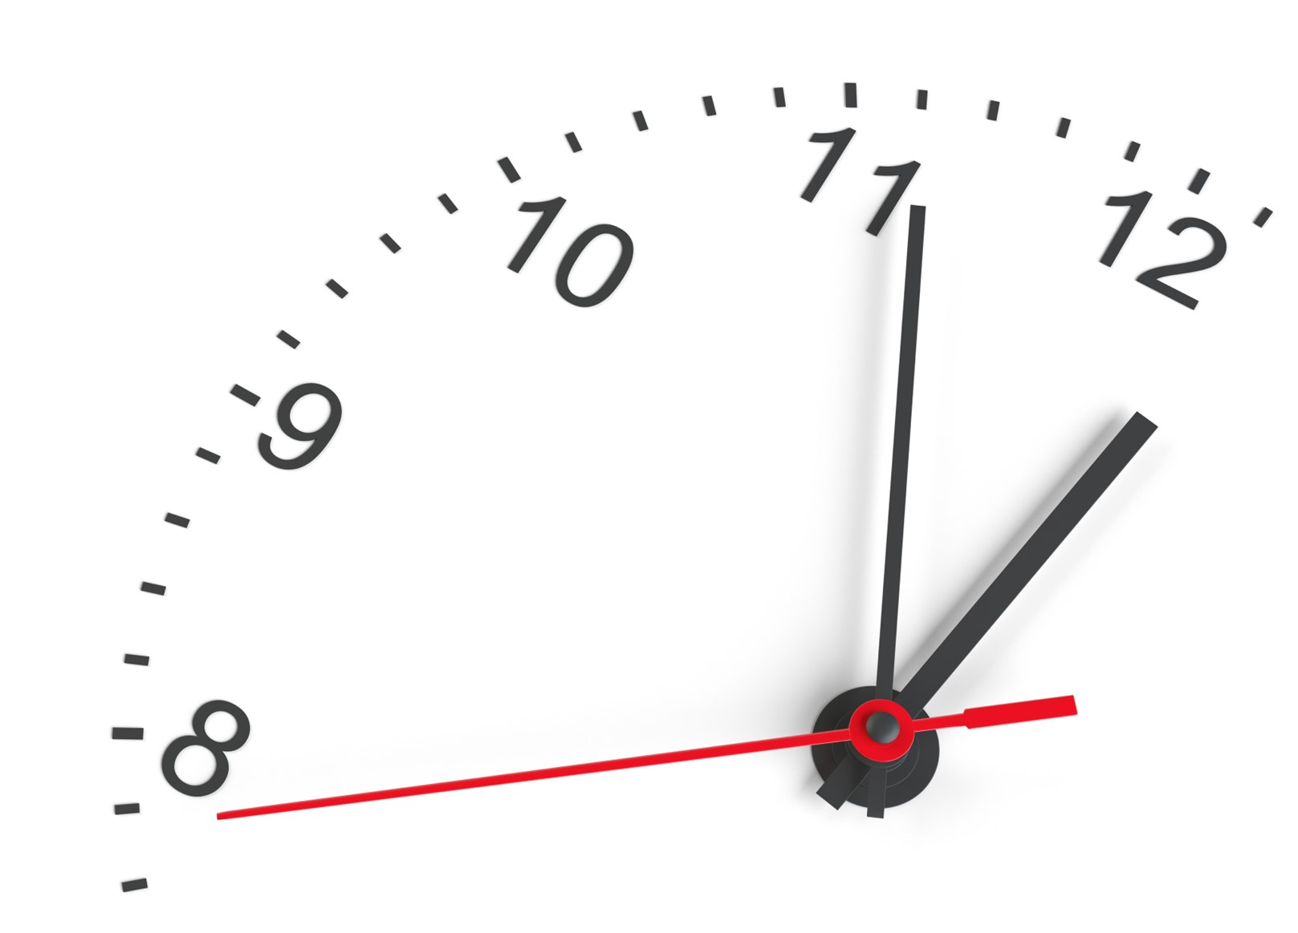
Heart Attack
A complete blockage of the coronary artery that supplies blood to the heart – Stopping the flow of oxygen to the heart.
Signs of a heart attack include:
• Chest pain and/discomfort
• Feelings of heaviness, pressure or tightness in the chest, shoulder(s), jaw, back, arm(s) or neck.
• Difficulty breathing and shortness of breath
• Feelings of nausea, light-headedness or dizziness
• Shortness of breath or difficulty breathing
• Pale skin, cold sweats and/or cool and clammy skin
• Abdominal pain
• Heart flutters
• Unusual fatigue and an inability to sleep
First Aid Treatment for a Heart Attack involves
• DRSABCD
• Assist a conscious casualty into a comfortable sitting position
• Call 000 for medical assistance. Tell them that you have a casualty with a suspected heart attack.

Slide 38
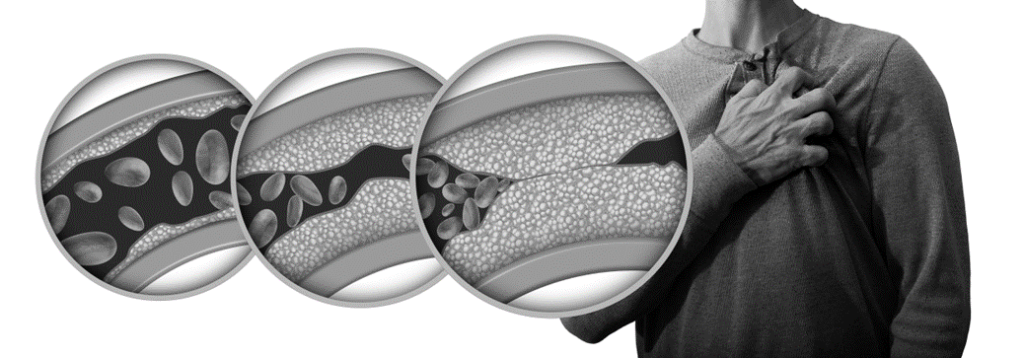
Angina
Angina is where the blood supply to the heart is reduced, causing severe chest pain, discomfort and shortness of breath.
Signs of angina include:
• Chest pain and/discomfort which may be described by the casualty as pressure, squeezing, fullness or burning
• Pain in the arms, neck, jaw, shoulder or back
• Difficulty breathing and shortness of breath
• Feelings of nausea, light-headedness or dizziness
• Shortness of breath or difficulty breathing
• Sweating
Treatment Includes
Assist the person to sit down
Ask them if they have any medication to treat the condition with them. You may need to retrieve it for them
Assist administering medication
Wait 5 minutes. If they are not feeling any better redoes medication
Wait another 5 minutes and if the symptoms persist or have gotten worse call 000 for medical assistance

Slide 39
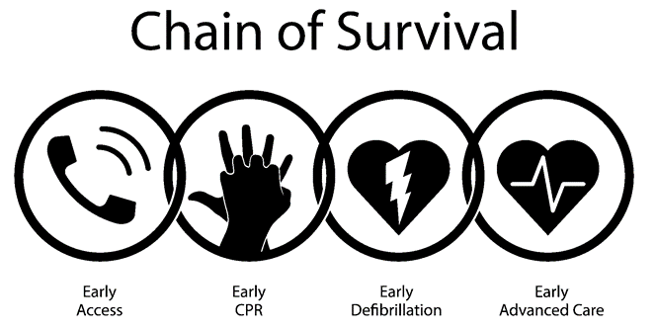
Cardiac Arrest
A cardiac arrest is where an electrical malfunction occurs in the heart, causing an irregular heartbeat and disrupting the heart’s ability to effectively pump blood.
Managing a cardiac arrest involves implementing the chain of survival.

Slide 40
Choking
Choking is most often caused by food or foreign objects becoming stuck in a person’s airway.
Signs and symptoms that a person is choking:
• Person is having difficulty breathing / gasping for air
• Coughing, wheezing and or gagging
• Difficulty or inability to talk or swallow
• Person is clutching at their throat and looks to be distressed
• The person’s lips, face, earlobes and fingernails appear to be turning blue (cyanosis)
• Flaring of nostrils (in children and infants)
• Loss of consciousness

Slide 41
Treating Choking
Where a person is conscious you should:
Encourage the casualty to cough
If this fails, call 000 for help and prepare to deliver back blows
Stand behind the casualty and assist them to bend forward
With the heel or your hand deliver up to five sharp blows to the back between the shoulder blades. After each blow check to see if the obstruction has been cleared
If after 5 back blows the obstruction has not been cleared, you will need to deliver chest thrusts
Place one hand on the casualty’s back for support. Using the heel of your hand deliver a slow and sharp thrust to the chest (lower half of the sternum). After each thrust check to see if the obstruction has been cleared
If the obstruction remains continue to alternate and deliver five back blows and five chest thrusts until help arrives

Slide 42
Treating Choking - Infants
Call 000 immediately without delay
Place the infant’s face down on your forearm and angle it towards the ground
Support the infant’s head with your hand while holding the infant’s mouth open with your fingers
With the heel or your hand deliver up to five sharp blows to the back between the shoulder blades. After each blow check to see if the obstruction has been cleared. You may need to use your little finger to clear the obstruction from the infant’s mouth once it has been dislodged taking care to scoop it out and not push it further into its mouth
If after 5 back blows the obstruction has not been cleared, you will need to deliver chest thrusts
Place the infant on their back on a hard surface like a table or bench.
Support the head with one hand and use two fingers of the other to deliver up to five chest thrusts to the lower half of the sternum. After each thrust check to see if the obstruction has been cleared
If the obstruction remains continue to alternate and deliver five back blows and five chest thrusts until help arrives

Slide 43
Crush Injuries
A crush injury occurs when extreme pressure or force is put on a body part. Most often, crush injuries result from something heavy falling on someone or becoming pinned between two heavy objects.
Common injuries caused by someone being crushed include:
• Internal and external bleeding
• Bruising
• Broken bones and fractures
• Compartment syndrome (where extreme pressure on limbs causes serious muscle, nerve, blood vessel and tissue damage)

Slide 44
Treating A Crush Injury
Call 000 for help
Remove the crushing force, if possible and it is safe to do so
Assess the casualty’s injuries
Control any bleeding
Support and immobilise any suspected broken bones, fractures and/or dislocations
If the casualty becomes unresponsive follow DRSABCD

Slide 45
Diabetes
People with diabetes are unable to efficiently create insulin.
If insulin is not secreted as required, glucose levels in the bloodstream are not kept in check, and if left untreated, this can be life-threatening.
Type I – The body’s immune system attacks insulin-producing cells and cannot produce insulin. They need insulin to be injected 4 to 5 times a day.
Type II – The body becomes resistant to insulin - losing ability to produce enough insulin. This is either genetic or developed through poor diet.
Gestational - This occurs in pregnant women. The placenta produces hormones that help the baby to grow and causes insulin to be blocked.

Slide 46
Hypoglycaemia
Hypoglycaemia is where a person’s blood sugar (glucose) levels are too low.
This can occur quickly, and without immediate treatment it can be life-threatening.
Diabetes needs to carefully and regularly monitored by testing blood sugar levels.
This occurs by administering too much insulin, missing meals, when people over exert themselves, or they have been ill causing vomiting and diarrhoea.

Slide 47
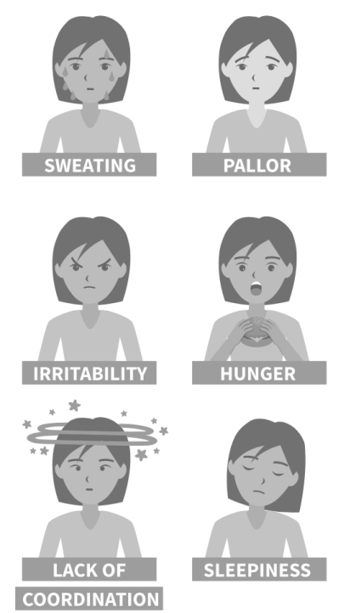
Treating Hypoglycaemia
Sit the casualty down or help them to lie in a position that is comfortable
Administer food or drink with a high sugar content such as a soft drink or jellybeans. Continue doing so every 15 minutes until the person starts to feel better
Once they are feeling better give them something with carbohydrates to eat such as crackers or a sandwich
See medical assistance if the casualty does not appear to be improving or seems to be getting worse.

Slide 48
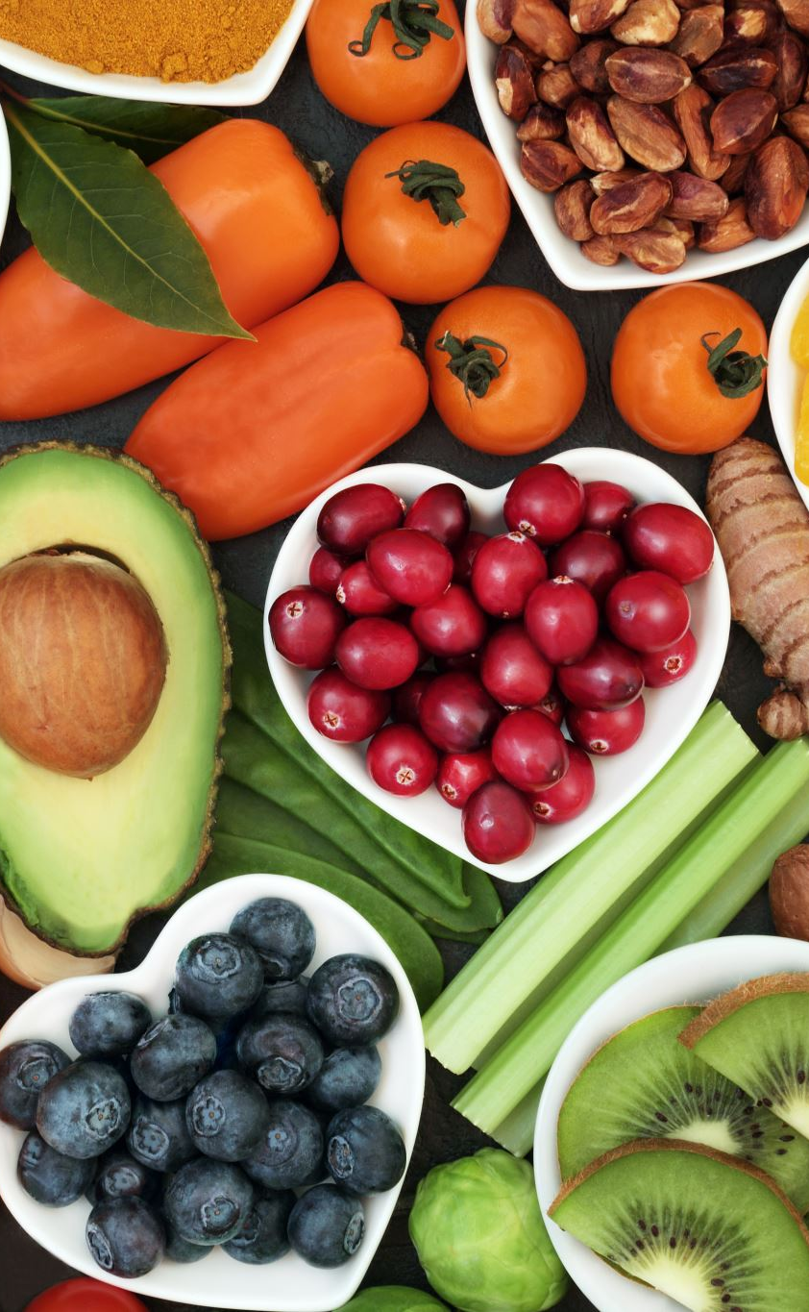
Hyperglycaemia
Hyperglycaemia is where a person’s blood sugar (glucose) levels are too high.
Overeating foods high in sugar, low exercise levels or where a person has not taken their insulin can cause this
If not managed, glucose cant be moved from the bloodstream and converted to energy. The body will instead search for alternative energy like fats.
When fats are used for energy by the body, a toxic chemical (ketones) is produced as a by-product. This can cause blood to become acidic, which can lead to death.

Slide 49
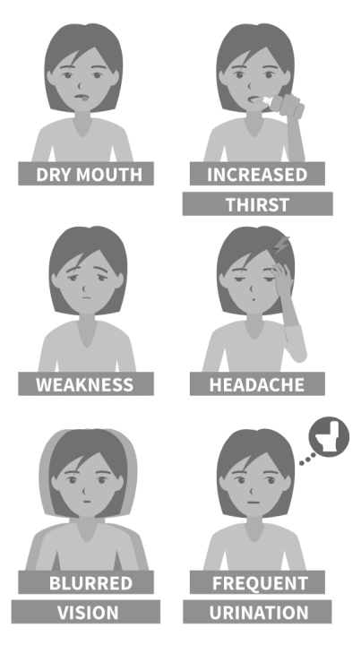
Treating Hyperglycaemia
Ask the casualty if they are diabetic, if they have medication and if they require help to administer it.
Sit the casualty down and encourage them to drink water
Seek medical assistance

Slide 50
Drowning
Drowning deaths are preventable, but numbers continue to grow.
Near-drowning effect can be life-long - the symptoms debilitating, often leading to premature death.
Even if a person looks fine, they should still seek medical assistance as they could still die from drowning related causes up to 72hrs after the event – Known as secondary drowning.
Swallowing water and being deprived of oxygen can cause brain damage within 5 minutes.

Slide 51
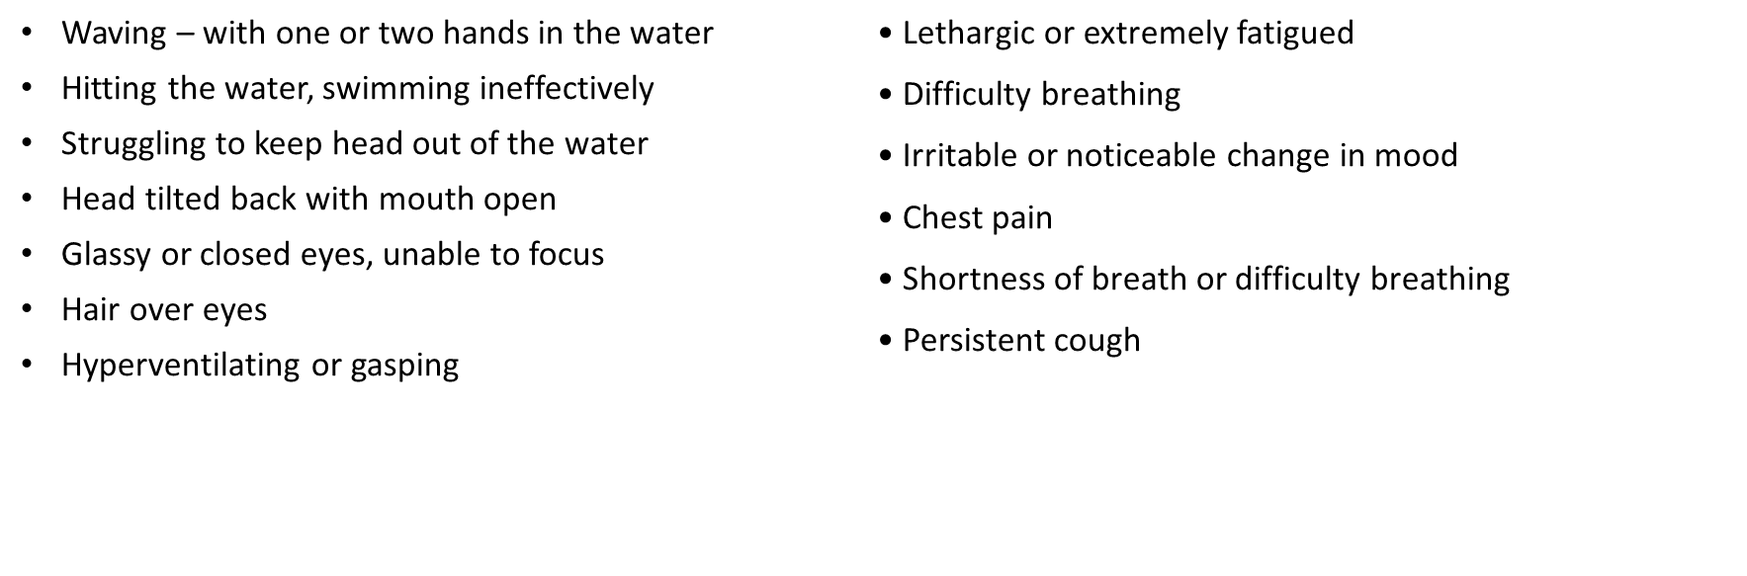
Signs of Drowning
Symptoms of Drowning
Treatment:
Call 000
DRSABCD
If not breathing – Commence CPR
If breathing place the person in the recovery position and monitor their airway and circulation and wait for help to arrive
Treat any hypothermia or any other injuries sustained.

Slide 52

Envenomation
Caused by a bite or sting from a venomous animal – most cause pain and irritation, but some examples – Snakes, Spiders, Jelly Fish, Octopus, Cone Shells etc. can be life threatening and incredibly painful.
Signs and symptoms of minor incidents include:
• A painful and/or itchy lesion at the site of the bite or sting.
• Minor swelling
• Redness
• Blisters
Signs and symptoms of major incident include:
• Widespread rash
• Hives with severe itching
• Swelling of the lips, eyelids and throat
• Difficulties breathing, wheezing and coughing and talking
• Collapse, limpness, paleness
• Profuse sweating
• Nausea, vomiting and/or cramps
• Severe and sharp pain at the bite or sting site
• Fear of Impending Doom
• Rapid heartbeat

Slide 53
Envenomation Treatment
Treatment for bites and stings by venomous animals includes one of the following, depending on the animal in question
Ice management
Vinegar
Pressure immobilisation
Heat Management
Anti Venom

Slide 54

Ice Management
Commonly used to reduce swelling for bites and stings by common household insects like bees, wasps, mosquitos and ants.
How to:
If you can still see the sting remove it by sliding or scraping it. Do not use tweezers as you could accidently squeeze out more venom.
Gently wash the area of the bite or sting with soap and water.
Place an ice pack or cold compress on the site for 10 minutes. You may need to wrap the ice pack in a cloth to protect the person’s skin from ice burn.
Elevating the injured area can also help to reduce any swelling.
If you have it on hand you can administer an antihistamine or apply an antihistamine cream or calamine lotion.

Slide 55
Pressure Immobilisation
Apply a broad pressure bandage from the extremities (fingers or toes) upwards. Cover the bite sight and as much of the limb as possible.
The bandage needs to be firm but not too tight. You should still be able to slide two fingers under the bandage.
The bandage can be applied to clothing there is no need to remove it.
Splint the limb to restrict movement or use a sling if the sting is on the upper limbs.
Seek medical treatment. Preferably an ambulance should be called.
Common treatment for potentially deadly animals such as Snake, Funnel Web and Blue Ring Octopus bites, or Cone Shell stings.
Pressure will slow the spread of venom through the body

Slide 56

Heat Management
Placing the sting or bite site in hot water.
This neutralises the toxin and reduces the effect of the venom.
It also helps to reduce the pain of the sting or bite.
How to:
Apply hot water or a heat pack to the injured area. The water should be as hot as can be tolerated by the person, ideally around 42°C – 45°C. You can soak the injured area in a bucket, basin or in a bath
2. Soak the injured area for 30 to 90 minutes until the pain subsides.

Slide 57
Vinegar
Vinegar treatment is often used for alkaline marine stings, like jellyfish as it deactivates the Jelly’s stinging nematocysts.
This neutralises the sting but will not relieve the pain.
Hot water immersion or a hot pack should be used after.
Cold/fresh water should NOT be used as it can cause the stingers to refire.
Rinse area with vinegar for 30 seconds
Remove tentacles with a pair of tweezers
Soak the affected area in hot water for 20 to 30 minutes. Alternatively instruct the casualty to have a hot shower and concentrate the water on the injured area
If available you can use an antihistamine or hydrocortisone cream to relieve the itching and swelling
If the person has a severe reaction and loses consciousness begin CPR

Slide 58
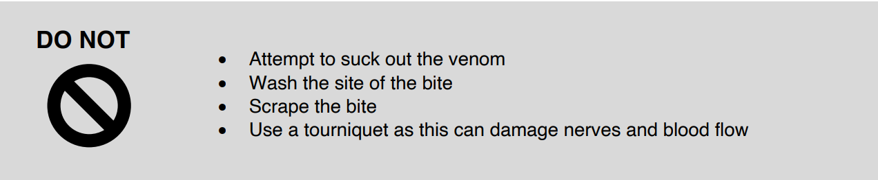
Complete Inquiry task 4C

Slide 59
Hypothermia
Hypothermia occurs when a person is exposed to extreme cold, causing their body temperature to fall below 35°C
With hypothermia, the body is losing heat faster than it can produce it. This prevents a person’s heart, nervous system and organs from working properly, which can lead to death.
Signs and symptoms of hypothermia:
Stage 1: Shivering and a reduction in circulation.
Stage 2: Pulse becomes slower and weaker, slowed breathing, a lack of coordination, irritability and confusion. The person may also appear to be sleepy and seems to be having trouble staying awake.
Stage 3: Slower and weaker pulse and an absence of respiration and pulse. At this stage a person will lose consciousness.

Slide 60
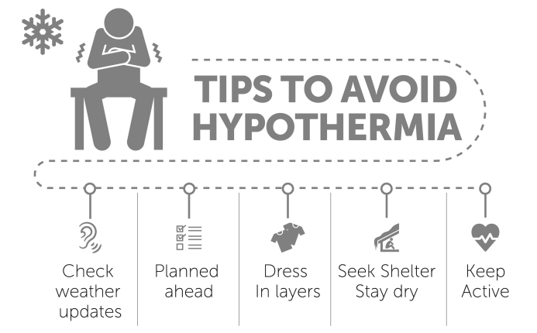
Treating Hypothermia
DRSABCD
Remove wet clothing and dry the casualty
Slowly warm them with blankets. Cover them from head to toe, only leaving their face uncovered. DO NOT put them in a hot bath or shower. This can shock the body and potentially cause irregular heartbeats and/or damage a person’s skin
If conscious, make the person comfortable and give the casualty a warm drink. DO NOT give them alcohol.

Slide 61
Hyperthermia
Hyperthermia is where a person’s body temperature rises above it’s regular range, with different stages showing different symptoms and levels of severity.
Signs and symptoms of heat fatigue:
• Excessive sweating
• Feelings of exhaustion
• Mild headache and feelings of light-headedness
• Nausea, muscle cramps and pain
Signs and symptoms of heat exhaustion:
• Cold, pale, wet skin and extreme sweating
• Fast and weak pulse
• Dizziness and headache
• Intense thirst
• Dark and infrequent urination
• Difficulties in concentration and paying attention
• Cramps, weakness, nausea, vomiting and diarrhoea
• May potentially faint or lose consciousness
Signs and Symptoms of Heat Stroke:
• Hot, red wet or dry skin
• Disorientation, blurred vision and a lack of coordination • Irritability and mood swings
• Rapid, deep breathing
• Changes in pulse with fast and strong or very weak
• Dizziness, headache and nausea
• Inability to sweat

Slide 62
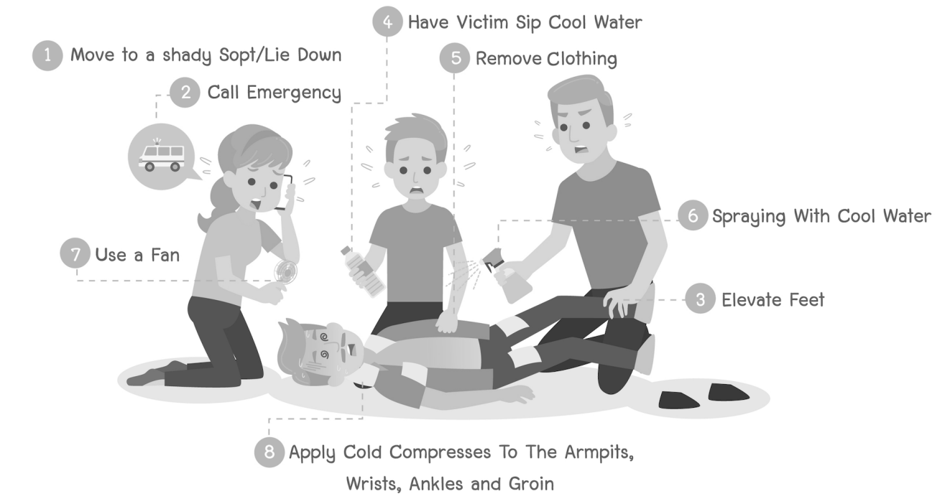
Treating Hyperthermia

Slide 63
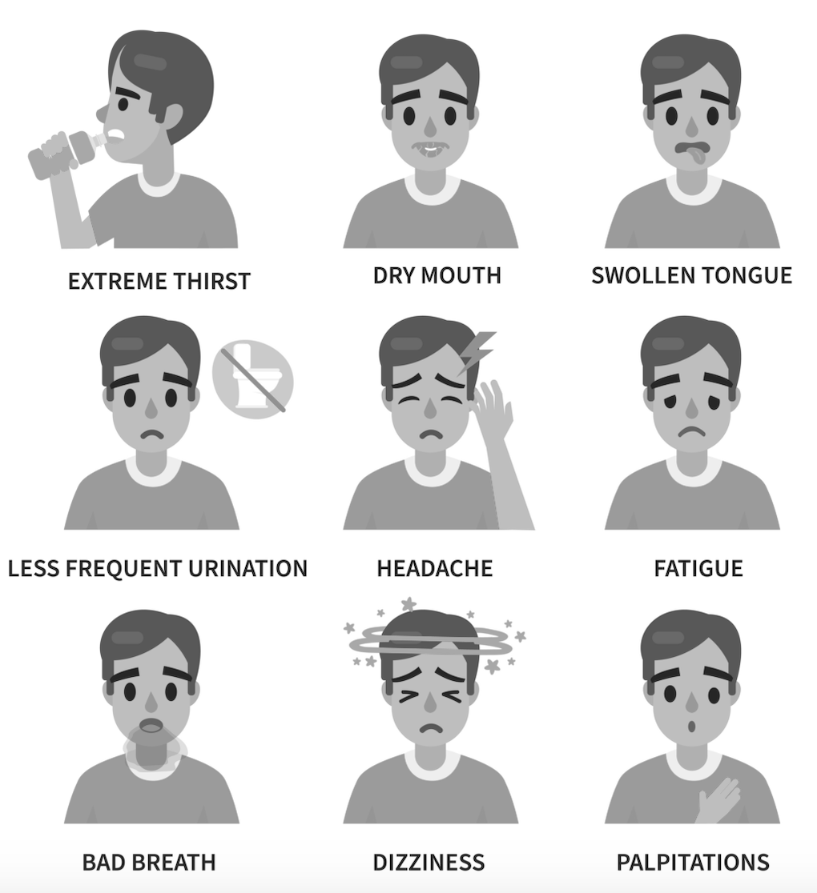
Dehydration
Dehydration is caused when a person cannot replace the lost fluids to the required level
Treatment Includes:
Drink fluids, water or something with electrolytes. Avoid caffeine or alcohol. They should drink 600mls and within 45 minutes their hydration levels should be within normal range.
A person may need medical treatment to be administered such as intravenous therapy.

Slide 64
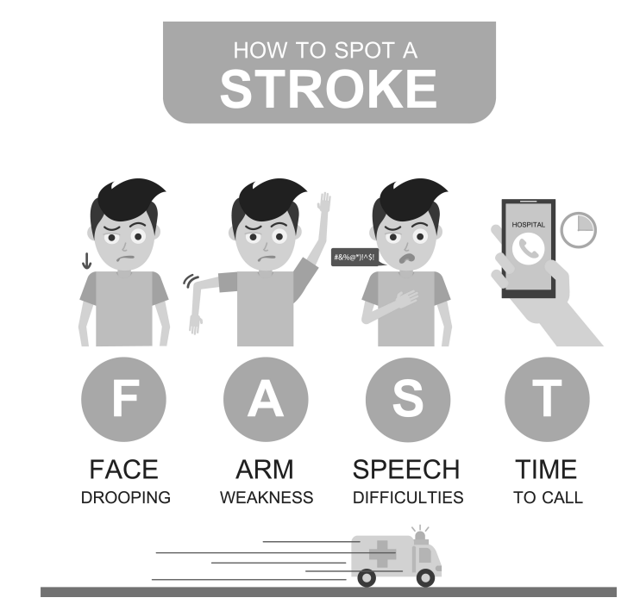
Stroke
A stroke occurs when the blood supply to the brain is blocked or disrupted, and oxygen cannot reach the brain.
It is caused when a blood vessel is blocked (occlusion) or it ruptures, causing bleeding on the brain (intracranial haemorrhage).

Slide 65
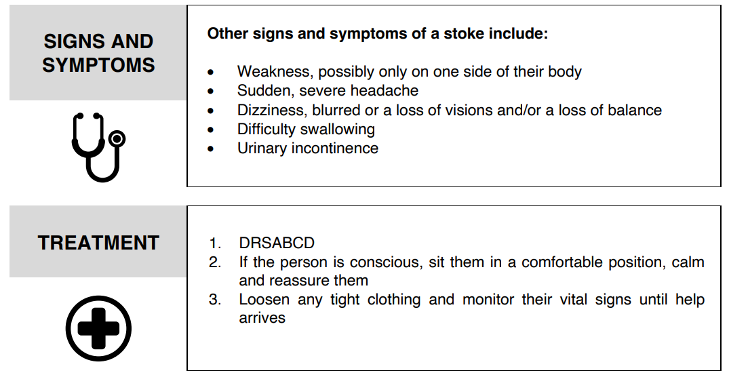
Complete Inquiry task 4D

Slide 66
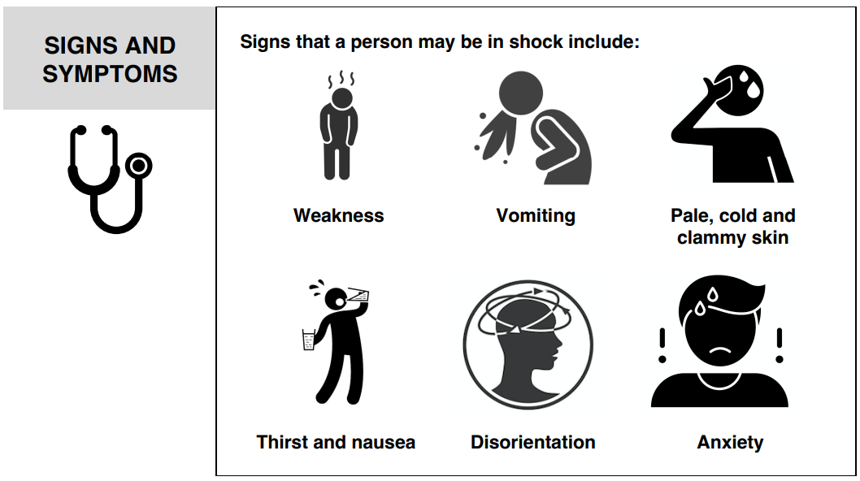
Shock
Shock often occurs when a person experiences a trauma or life threatening situation. Inadequate blood flow reaches the body tissues and the organs do not receive the amount of oxygen needed

Slide 67
Treatment of Shock
If the casualty is unconscious:
DRSABCD
Place the casualty on their side
Control any bleeding or manage any other injuries 4. Monitor vital signs until help arrives
If the casualty is conscious:
Lie the casualty down on their back in a supine (lying) position
Keep them warm
Control any bleeding or manage any other injuries
Call for an ambulance
Reassure the casualty
Monitor the person until help arrives

Slide 68
Eye Injuries
Eye injuries need to be managed and treated carefully. If not it can cause permanent damage
If minor, you should:
Use saline or water to rinse the eye. DO NOT use eye drops.
If vision is affected, seek medical assistance – Particularly an Eye and Ear Hospital.
Cover the eye with an eye patch to reduce its use.
For serious trauma, like a penetrating wound, you must call 000 immediately.
You should NEVER attempt to transport a person or attempt removal of the object.

Slide 69
Ear Injuries
Ear injuries need to be managed and treated carefully. If not it can cause permanent damage
Signs and symptoms that something may be wrong with your ear/s:
• You are experiencing ear pain
• You have pus or blood coming from the ear
• Hearing loss
• Ringing in the ear
• Nausea and/or vertigo
Treatment will depend on the type of ear injury.
• Insect in the ear - If this happens you should use warm water to attempt to remove/’float’ the insect out.
• Eardrum rupture –Where ruptured you should cover the person’s ear and seek medical attention.
• Foreign object is lodged - Seek medical attention. Do not dig it out as you could push it further down the ear canal

Slide 70
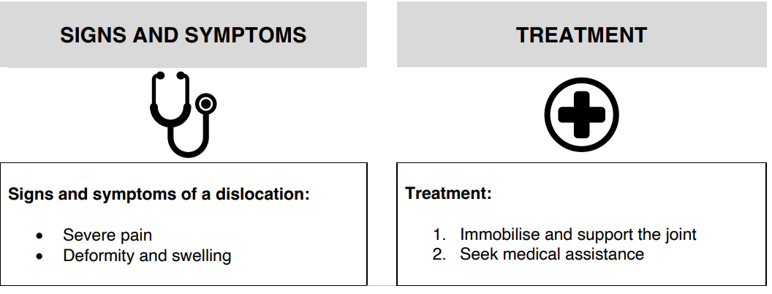

Dislocations
A dislocation is where a bone becomes displaced from its joint.

Slide 71
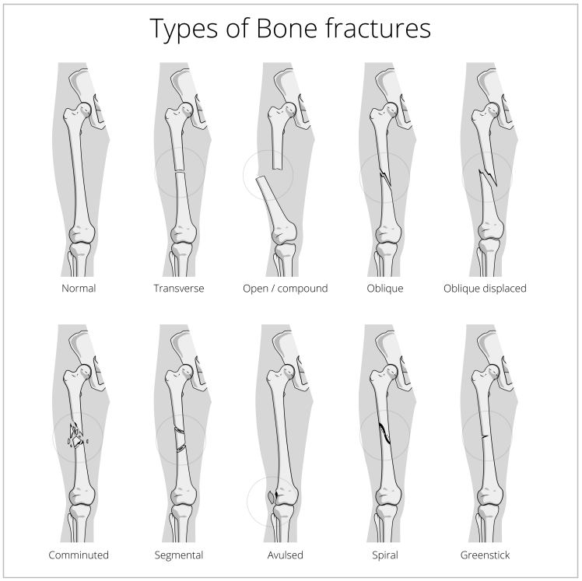
Fractures
A fracture is a broken bone, caused by Direct or Indirect Impact

Slide 72
Treating a Fracture
Signs of a fracture include:
• Pain and tenderness
• Swelling
• Deformity
• Bruising
• Inability to use or move area without pain
• A bone protruding from a wound
Treatment of a fracture involves Immobilisation and Seeking Medical Attention
How to make an arm sling and an elevated sling:
https://m.youtube.com/watch?v=PwfBGkBXkFA
How to make a collar and cuff sling:
https://m.youtube.com/watch?v=G_F7uxmVUt4

Slide 73

Febrile Convulsions
A seizure that occurs when there is a sudden change in a child’s temperature.
Signs and symptoms include:
• A loss of consciousness
• Twitching and jerking of arms and legs
• Pale, red or bluish skin
You cannot stop a febrile convulsion. Stay calm and not panic.
Move anything that could injure the child during the convulsion. Move to a soft surface and lie them on their side or on their back.
Time convulsions, record it for a doctor to view later.
When a child stops convulsing, they will be tired and irritable.
Call for an ambulance if:
• The convulsion lasts more than 5 minutes
• This is the child’s first convulsion
• The child looks unwell after or they do not wake up

Slide 74
Epilepsy and Seizures
Abnormal electrical activity in the brain causes seizures - Some of which cause convulsions.
Epilepsy is most commonly associated with seizures.
Signs and symptoms of an epileptic seizure include:
Temporary confusion and/or staring spell
Loss of consciousness or awareness
Jerking movements of the legs and arms that are uncontrollable or muscle twitching
Sensations such as pins and needles
Besides epilepsy, seizures can also occur when:
There is a lack of oxygen reaching the brain, for example where a person has drowned
The brain has been injured by some form of trauma
The person has been poisoned
A child has a sudden change in temperature – Febrile convulsion

Slide 75
What to do if I see a Seizure
Protect the casualty by moving any objects that could harm them while seizing. You should loosen any tight clothing that could cause injury and place something soft under their head.
If the person was eating at the time of the seizure roll them on their side immediately.
Time the seizure and wait for it to end and then follow DRSABCD.
When the casualty regains consciousness after a seizure they most often have no recollection of the seizure and may feel drowsy and want to sleep. Let them do so but ensure that you continue to monitor them.
Treat any other injuries the casualty has sustained.
Epileptics can have seizures often, in this case, call 000 only if they are injured, the seizure lasts longer than 5 minutes, or they have more than one seizure in a short time.

Slide 76
Needle Stick Injuries
Being pricked with a used needle can be harmful, as it could carry infections from the person who used it.
Treatment Includes
Treat any bleeding as a result of the needle stick injury.
Thoroughly but gently wash the area with soap and water.
Apply antiseptic to the wound and cover with a clean dressing.
Referral to a doctor or hospital is required to discuss the possibility of transmission and the required testing. This should be done within 24 hours of the injury.
Dispose of the needle appropriately.

Slide 77
Head Injuries
Head Injuries must be managed appropriately, no matter how minor as one wrong move could affect a person’s brain or spinal cord.
Facial injuries can also affect a person’s airway and their ability to breathe.
Signs and symptoms of a serious head injury include:
• A loss of consciousness
• A serious and obvious wound
• Abnormal breathing
• Fluid / bleeding coming from nose, ears or mouth
• Abnormal speech
• Vision problems or pupils being unequal in size
• Weakness or paralysis
• Pain or stiffness
• Headache, nausea and/or vomiting
1. DRSABCD 2. Treat obvious wounds or bleeding 3. Rest. If unconscious put them in the recovery position 4. Call 000

Slide 78
Spinal Injuries
If you suspect a person may have injured their neck or spine you must take extreme care to prevent movement, as even the smallest amount could cause irreversible damage making the person a paraplegic or quadriplegic.
Signs of a possible spinal or neck injury may include:
Trauma
The person is unable to move
Loss of sensation, i.e. the person can’t feel their arms and/or legs
Difficulty breathing
Loss of bowel or bladder control
Shock
Tingling of the limbs and/or numbness

Slide 79
Treating Spinal Injuries
DO NOT move the casualty unless their life depends on it, i.e they are lying on the train tracks and a train is coming.
DRSABCD.
Call for help and keep the person still. Where the person is unconscious but breathing you will need to roll them into the recovery position while supporting their head and neck.
Where the casualty is breathing and conscious you can leave them in the position you found them.
Treat any other injuries.
Keep the casualty calm and maintain their body heat by covering them with blankets.
Hold their head and neck steady to prevent any movement.
Complete Inquiry task 4E

Slide 80
Poisoning
Poisons, depending on how they were taken into the body, can spread quickly causing irreversible damage and even death.
Where you suspect that a person has been poisoned it is important to try your best to find out:
What was taken?
How much was taken?
When was it taken? – This is particularly important, as this will help medical personnel decide what treatment will be most effective.
Signs and symptoms someone has been poisoned:
Blurred visions
Burns or signs of burning around the mouth
Nausea, vomiting and/or diarrhoea
Headache
Seizures
Drowsiness and disorientation
Difficulty breathing
Sudden collapse
Cardiac arrest
Unconsciousness

Slide 81
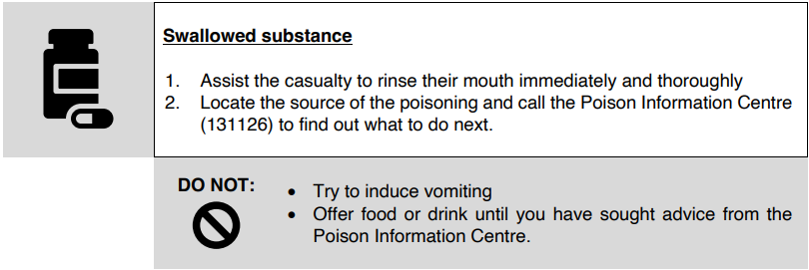
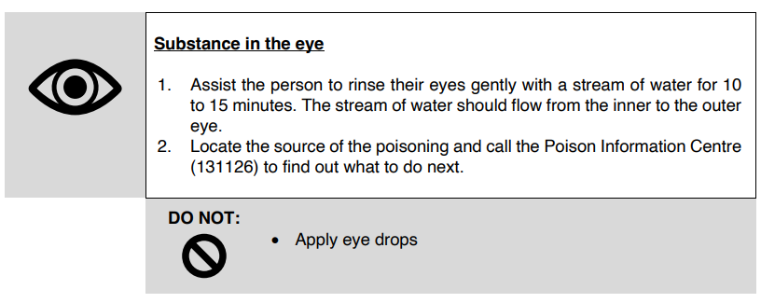
Poison Treatment

Slide 82
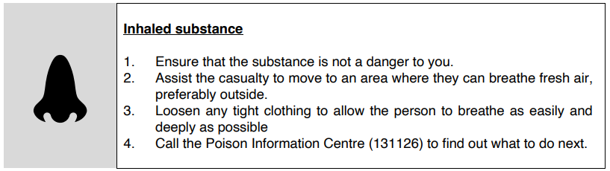
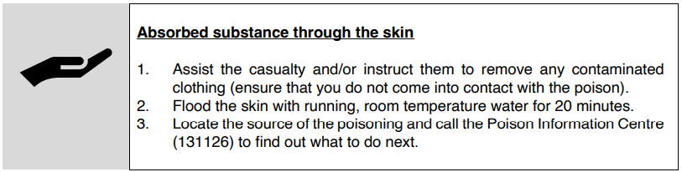
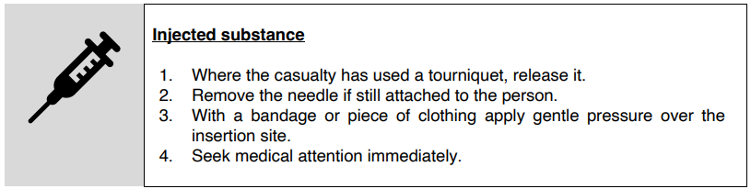
Complete Reflection Bank – Set B

Slide 83
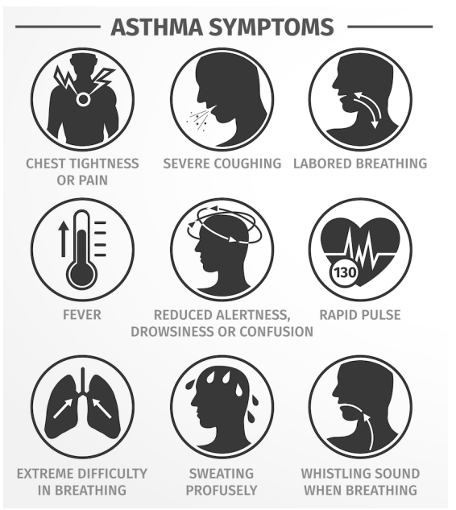
Asthma
Asthma is a condition that causes a person’s airways to narrow when exposed to a ‘trigger’
Common triggers for asthmatics include:
• Exposure to allergens such as dust mites, animal hair and mould
• Excessive exercise
• Exposure to irritants such as cigarette smoke
• Food such as nuts
• Changes in weather
• Respiratory infections
• Emotions, stress and anxiety

Slide 84
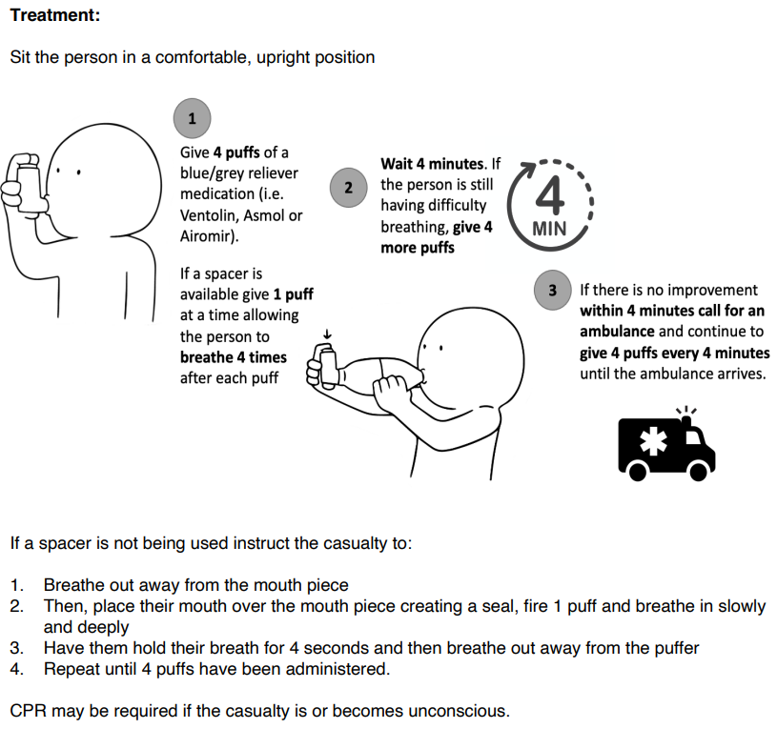
Treating Asthma

Slide 85
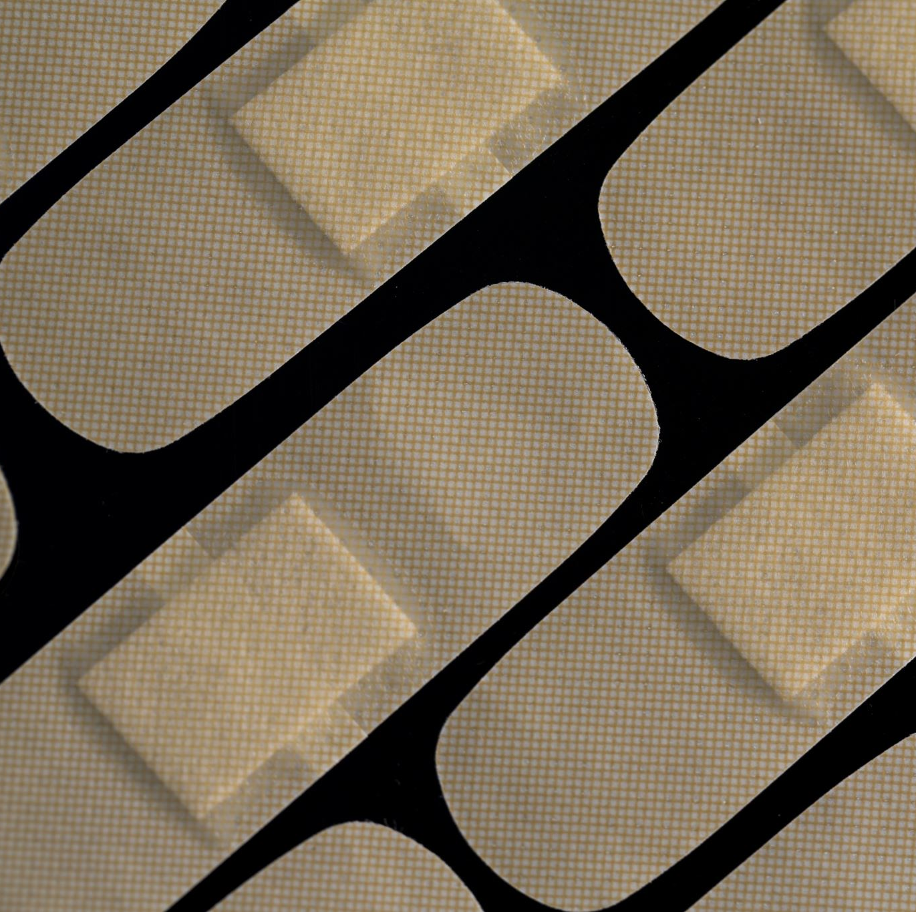
Soft Tissue Injuries
Sprains are where a ligament is damaged – Swelling, Bruising, Pain, Hard to bear weight
Strains are where the muscle is over stretched – Snapping or cracking sound, Swelling, Hard to bear weight
Treatment involves using the ‘RICER’ and ‘NO HARM’ tecniques

Slide 86
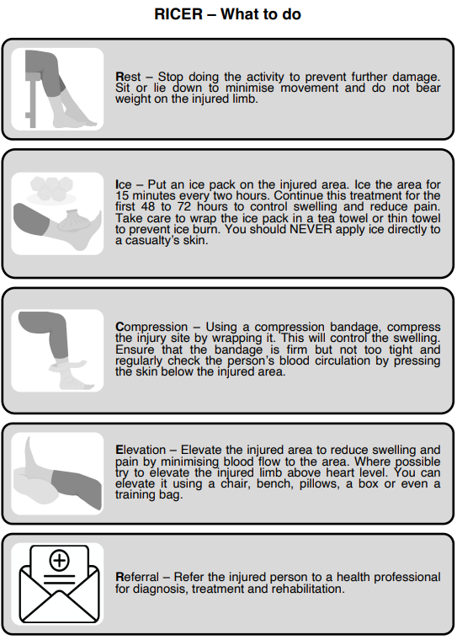
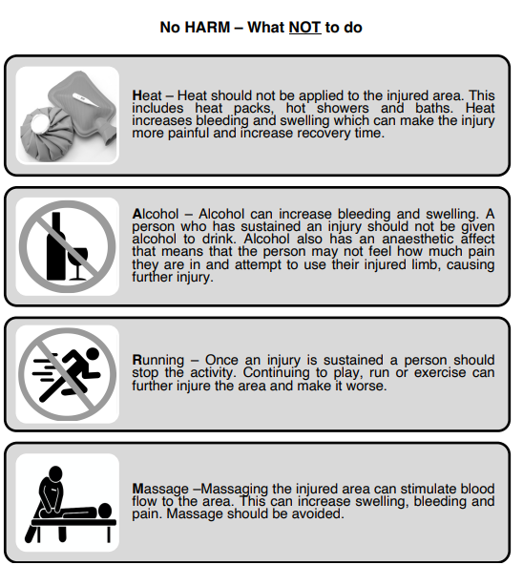
Complete Inquiry task 4F

Slide 87
Communicate details of incident
A first aider is required by law to document any first aid treatment they provide, no matter how minor or major it is. Within a workplace, an injury report form will need to be completed, and in some cases, WorkSafe will need to be notified.
Taking the time, if possible, to document details of the incident will enable you to accurately convey the incident details to emergency response services as well as report the details of the incident to your workplace supervisor
Details to include:
Date and time of the incident
Casualty details
Contact details
Allergies, medication and/or known medical conditions
Description of injury
Vital signs
Fluid output
Treatment
Referral
Witness
Signatures

Slide 88

Confidentiality
When writing an incident report, you will have to acquire information about the casualty - you must observe these principles and maintain their confidentiality by:
• Ensuring that the casualty understands why and for what purposes you are collecting their information.
• Ensuring that the casualty understands whom you will be sharing their information with, i.e. doctors, paramedics and other medical staff.
• Keeping their records private, including incident reports. These should only be shared with the consent of the patient.
• Allow the casualty to read over and check the information documented to ensure that it is correct, accurate and up-to-date.
• Keeping all documentation secure. It should not be left lying around where anyone could access it and read it.
• Not talking about the casualty or discussing the incident without the casualty’s permission or where it is required for medical treatment. For example, when providing a handover to paramedics after an incident

Slide 89
Reviewing an Incident
Being involved in a life or death situation can cause trauma and psychological impacts. first aid respondents and other rescuers can experience depression, stress and other post-traumatic stress symptoms after responding to a critical incident. These may include:
Debriefing after an incident can be helpful, sharing details and feelings with a trusted source to put the incident into perspective – helping to lessen emotional trauma, assist recovery, help identify the need to assist other responders and make improvements to systems.
• Feelings of fear and panic
• Re-living the event, flashbacks and nightmares
• Inability to sleep
• Irritability and a lack of concentration
• Becoming easily scared or startled
• Being on edge constantly looking out for danger
• A feeling of emotional numbness, where a person loses interest in life and things that they used to enjoy
• Avoidance of places or things that remind them of the incident
Complete Reflection Bank – Set C

