Slide 1

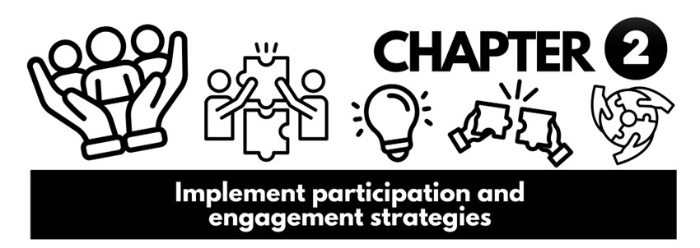

Slide 2

Communities and groups often develop their own norms, communication styles, values, and even specific needs that differ from the broader society.
Recognising and understanding these unique aspects is vital for providing effective and respectful support, as a one-size-fits-all approach will fail to address the nuances of their experiences.
Formation of Specific Communities
Communities form around shared characteristics or circumstances:
Cultural heritage (e.g., Aboriginal and Torres Strait Islander groups)
Life experiences (e.g., disability, homelessness)
Religious affiliation
Common interests/goals (e.g., advocacy groups)
Geographical proximity vs. Virtual communities

Slide 3

Understanding specific communities requires a grasp of key sociological concepts
family dynamics and power
culture
diversity
deviance
socialisation and identity theories.

Slide 4

Our ‘models of society’
Conceptual tools to:
Describe social organisation
Explain social operation
Predict social outcomes
Influence policy and change
No model is "absolute truth" – each offers a unique lens

Slide 5

Common Models of Society
Common types of models:
Consensus
Conflict
Interpretivist / Interactionist
Ecological
Each model:
Offers a core idea
Has a focus area
Provides implications for social issues

Slide 6



Consensus Models
Core Idea: Society functions as a system of interdependent parts, working harmoniously to help society function
Focus: Social order, shared values, institutional roles
Example: Unemployment seen as a dysfunction needing correction
Conflict Model
Core Idea: Society is marked by inequality and power struggles
Focus: Class, power, oppression, social change
Example: Unemployment as a result of systemic exploitation

Slide 7


Interpretivist / Interactionist Model
Core Idea: Society is built through everyday social interactions
Focus: Micro-level meaning-making, identity, symbols
Example: How being labelled “unemployed” affects self-perception
Ecological Model
Core Idea: Human development is shaped by multiple environments
Focus: Individual ↔ environment interaction across systems
Example: Unemployment influenced by cultural norms, local job access, and policy
Complete Inquiry task 2a on page 76

Slide 8

Expanding on the Models into Different Dynamics
Family – Usually the first point of support; what initially shapes a person's worldview
Power – distribution of authority, influence and decision making among family members
Culture – Shared ways of life among groups
Diversity – Differences between and within groups
Deviance – the violation of significant social norms

Slide 9
Identity Theories
Explore how individuals form their sense of self.
Identity shaped by social interactions and group memberships, not just individual traits.
Social Identity Theory
How people view themselves, is partly based on group membership (e.g., ethnicity, gender, religion, profession).
Community Impact
Shared identity provides strength, resilience, and collective action.
Especially powerful for marginalised groups
Group affiliation shapes self-esteem and social behaviour.
Socialisation Theory
Explains how people learn to live in a society
A lifelong learning process –Norms, beliefs, behaviours, skills
Happens through key influence – family, peers, media, religion

Slide 10


Undertaking a ‘critique’ of socialisation theory
Identifying its assumptions - What core ideas do the theory take for granted about human nature, society, and the learning process?
Highlighting its omissions or blind spots - What aspects of socialisation does the theory fail to adequately explain or overlook entirely?
Pointing out its biases - Does the theory privilege certain perspectives or does it downplay the experiences of marginalised groups?
Assessing its explanatory power - How well does it actually explain real-world social phenomena? Are there instances where it falls short?
Proposing alternative explanations or refinements - What other factors might be at play that the theory doesn't account for, or how could the theory be improved to be more comprehensive or accurate?

Slide 11

Common criticisms
The "over socialised" concept of man – That individual agency, resistance, creativity and ability are overlooked
Neglect of power and inequality – Power dynamics are not adequately addressed
Lack of attention to conflict and change – Excessive focus on maintaining social order and norms
Ignoring a lifelong and dynamic nature – Too much emphasis on early childhood, not growth
Ethnocentric or universalist assumptions – Doesn’t account for cultural variation
The role of trauma – Do not account for the impact trauma plays
Complete Inquiry task 2B on page 80

Slide 12




Issues Specific Communities and Groups Can Face Social – Poverty, inequality, discrimination, access to services education, employment and social norms Political – Impact by government on a group’s rights, resources and opportunities Cultural – How beliefs, values. Customs, traditions, languages, arts and social behaviours define a group Historical – The required understanding of past events, policies and experiences that have shaped a groups past

Slide 13
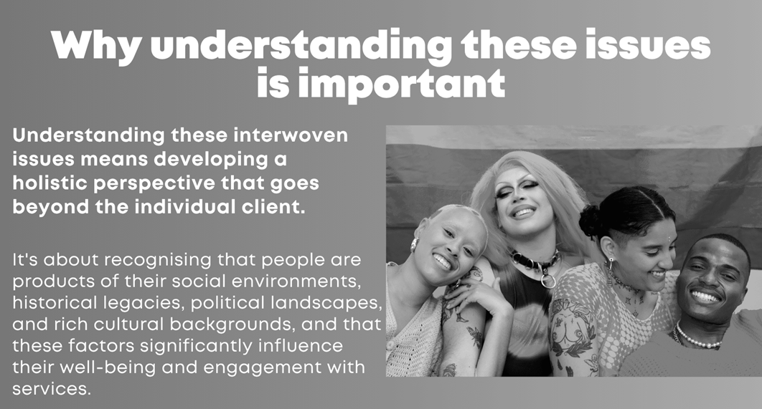

Slide 14
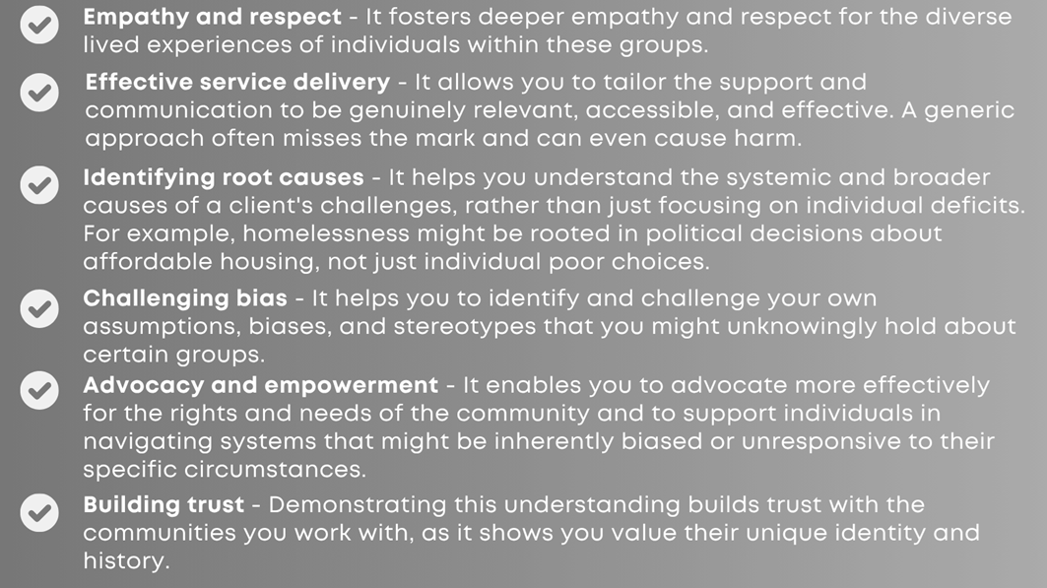

Slide 15
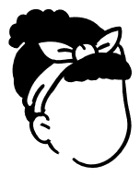

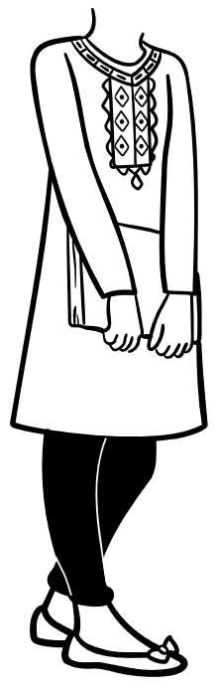
Identifying the priorities of a specific group
We can identify group priorities by:
Carrying out appropriate research.
Engaging with stakeholders for their participation and insights.
The type of information you may need to know about any specific group can include:
The group composition and the structures
The people, stakeholders and any networks
The group values and practices.
Community values and structures
Strength, talents and abilities
Social issues relevant to the group.
If the group has cultural preferences.
Specific communication protocols.
Any relevant health issues for the group.

Slide 16
What is appropriate research?
Informed consent - Participants understand the purpose, methods, risks, and benefits, and voluntarily agree to participate without coercion.
Confidentiality and anonymity - Protecting the identity and sensitive information of participants.
Beneficence and non-maleficence - Does good and does no harm.
Justice - Benefits and burdens of the research are distributed fairly.
Community-led or participatory approaches - Research done with or by the community.
Cultural safety and responsiveness - Recognising and valuing the unique cultural norms, values, communication styles, and historical experiences.
Reciprocity and benefit - Tangible or intangible benefits back to the community.
Rigour and validity - Methodologically sound, reliable and trustworthy.

Slide 17

Relationship Building and Trust (the foundation)
Invest Time – Spend significant time building genuine relationships
Be present and engaged – Participate and be available to learn
Being Transparent – State your intentions and be open.

Slide 18



Community consultation and design (engaging the stakeholders)
Asking the community
Ask the community what they want to know, what problems they identify, and what solutions they might envision. Their priorities should shape the research questions.
Local review
Seek input and approval from relevant community governing bodies, elders' councils, or respected community leaders.
Co-design of methods
Work with community to decide on the best research methods. What are the most appropriate settings and times for these activities?

Slide 19

In depth interviews
Group Discussions or Focus Groups
Yarning circles (for Indigenous communities)
Community forums or workshops
Participatory or non-participatory observation
Life stories and narrative approaches
Visual methods

Slide 20

Photovoice
It is a method of community-based participatory research (CBPR) that has participants use photography, and stories about their photos to identify and represent issues of importance to them, which enables researchers to have a greater understanding of the issue under study’

Slide 21
Analysing and interpreting your findings
Community input
Involve community members in the analysis phase. Contextualise
Always interpret findings within the specific social, political, cultural, and historical context of the community.

Slide 22
Disseminating the findings and taking action
Share findings with the community first
Always share your research findings back with community stakeholders in an accessible and culturally appropriate format such as:
o a community meeting
o a plain language report
o a presentation.
Action-oriented outcomes
The research should aim to contribute to practical improvements or advocacy for the community,
such as:
o What will happen with the findings?
o How will they inform policy or service delivery?
o What community initiatives are available?

Slide 23
Preferred means of communicating

Slide 24
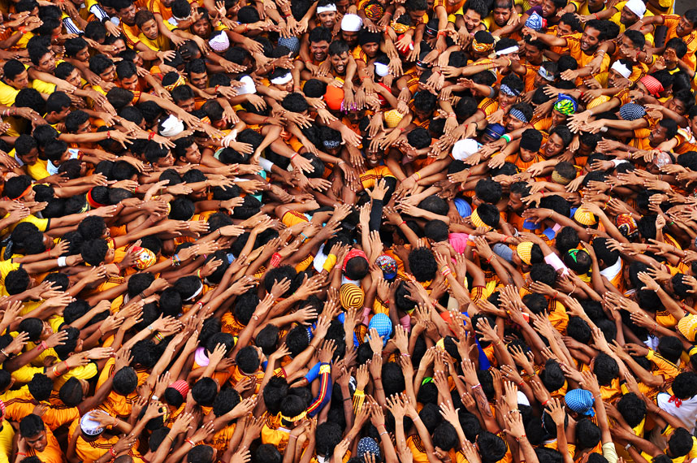
What does this look like in practice?
Build trust and understanding with the community.
Interactions will dictate how communication should take place
Engage key community leaders/gatekeepers
Identify leaders, advisors, or influential figures.
Ask direct questions (Respectfully)
Observe existing communication patterns
Consider language and format.
Look at how the community already communicates internally.
Note what works, and what doesn’t!
Trial and aim to improve
Initially, if you are unsure, use a blend of communication methods, like a phone call followed by an email, or sharing information at a community gathering.
After an interaction you can also seek feedback on your communication.

Slide 25

Accessibility and inclusion checkpoints to consider
Is there a ‘digital divide’?
Not everyone has internet access, smartphones, or digital literacy. Some may prefer traditional methods.
The current literacy levels
Are written materials in plain language and appropriate for varying literacy levels?
Are there any sensory impairments?
Consider alternative formats for individuals with vision or hearing impairments.
Cultural nuances
Be aware of cultural protocols for delivering sensitive information, who delivers it, and in what setting.

Slide 26
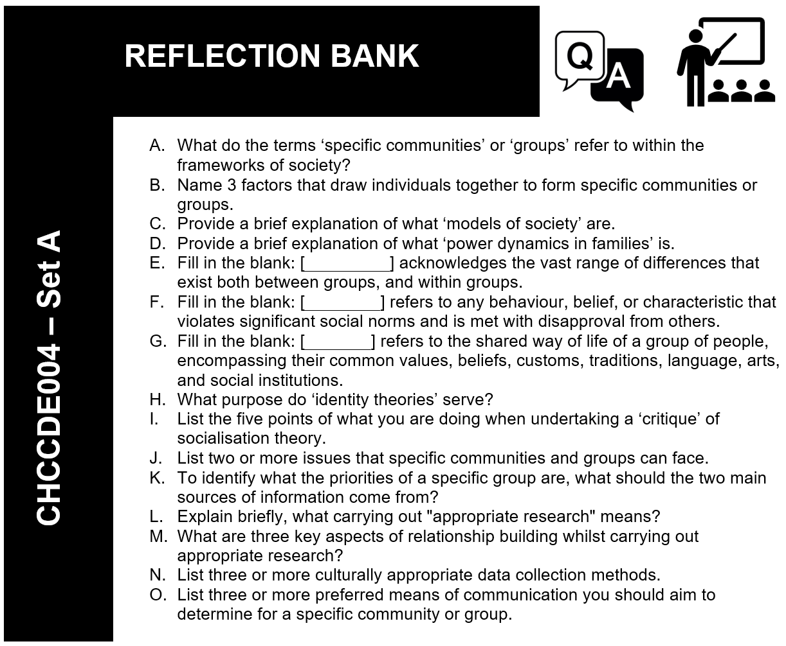

Slide 27

Some of the key groups and specific communities

Slide 29
Complete Inquiry task 2C on page 97

Slide 30

How to use a community’s values, priorities and structures effectively
Effective work requires understanding a community’s values, priorities and structures
Moves from a generic model → to a tailored, culturally safe, empowering approach.
Focus is on working with communities, not just on/for them.
Using community Values to define ways of working
What are community values?
Core principles, beliefs, and ethics guiding behaviour and relationships.
They define what is seen as right/wrong and important/unimportant.
Why Values Matter in Practice
They build trust and show respect.
They prevent unintentional harm or offence.

Slide 31



Using Community Priorities to define ways of working
What are community priorities?
Pressing needs, concerns, goals, and aspirations that the community identifies as important to their well-being and future.
How priorities influence ways of working
Aligning priorities ensures your work is relevant, desired, and sustainable. The work matter to them, increasing engagement, and avoiding imposing external agendas.

Slide 32

Using Community structures to define ways of working
What are community structures?
Ways a community is organised. This includes leadership roles, existing groups and networks, decision-making processes, communication channels, and established institutions.
How structures influence ways of working
Understanding structures helps you navigate the community effectively, identify key stakeholders, leverage existing strengths, and avoid disrupting established pathways.

Slide 33

Maximise outcomes by evaluating community structures
What does evaluating a community structure involve?
Evaluating community structures means assessing the ways a community is organised and operates.
Four key aspects to evaluate include:
1. The formal structures – Government bodies, community organisations, religious institutions, businesses
2. Informal structures – Kinship networks, leaders, social networks, communication channels
3. Power dynamics within the identified structures – who holds power, assets or makes decisions? How has history influenced trust?
4. Existing Resources and gaps – What are the strengths and assets? Where are there gaps or unmet needs?

Slide 34
Methods for evaluating a community structure

Slide 35
Utilising community structures to maximise outcomes
Leverage Existing Strengths
Build on what already works (e.g., local clubs, groups).
✅ Increases trust, reduces duplication, ensures sustainability.
Engage Key Gatekeepers/Champions
Involve respected leaders early (e.g., elders, principals).
✅ Gains community buy-in, boosts participation, eases implementation.
Streamline Communication
Use trusted local channels (radio, Facebook, newsletters, networks).
✅ Improves reach, reduces misinformation, builds credibility.
Build Capacity in Existing Structures
Strengthen community groups (training, resources, funding).
✅ Promotes sustainability, self-determination, empowerment.
Foster Community-Led Initiatives
Support bottom-up ideas and change efforts.
✅ Increases ownership, relevance, resilience.
Respect Decision-Making Processes
Follow how the community makes decisions (consensus, elders, voting).
✅ Avoids conflict, builds trust, increases acceptance.

Slide 36

Remaining consistent within your work
Your ‘Job Role’ dictates what you are expected to and what you cannot do. Ensure consistency by:
Aiming to thoroughly understand your job description
Understanding your scope of practice
Identifying clear referral pathways
Engaging in continuous Professional Development (PD)
Taking advantage of supervision and peer support

Slide 37

Maintaining Consistency with agreed protocols
Agreed protocols are non-negotiable standards of practice. Ensure consistency by:
Understand organisational Policies and Procedures (P&Ps)
Adhere to ethical guidelines and codes of conduct
Understand reporting lines and procedures
Comply with legal and legislative requirements
Document everything accurately and timely
Participate in reviews and audits

Slide 38


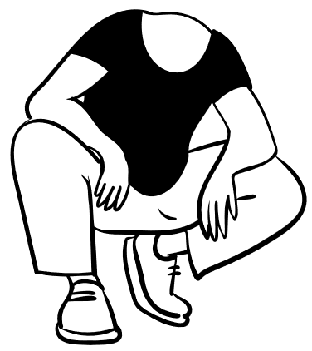
Using Interpersonal Skills
Interpersonal skills refer to your ability to interact effectively and appropriately with others. This includes:
Verbal communication - What you say, your tone, clarity, and choice of words.
Non-verbal communication - Your body language, eye contact, gestures, facial expressions, and use of personal space.
Active listening - Not just hearing words, but understanding, acknowledging, and responding to verbal and non-verbal cues.
Empathy and emotional intelligence - Understand and sharing the feelings of others, and to manage your own emotions effectively in interactions.
Rapport building - Your ability to establish a connection based on trust, respect, and mutual understanding.
Conflict resolution - Your capacity to address disagreements constructively.
Patience and flexibility - Your willingness to adapt to different paces and approaches.

Slide 39


What are "Community Practices and Standards" for interpersonal skills?
Rules, preferred methods, and expected behaviours within a specific community or group.
They are shaped by a community’s:
Cultural preferences and values - How are elders addressed? Is direct eye contact seen as respectful or aggressive? Is storytelling a preferred way of communicating information?
History and experiences - Has the community had negative experiences with external agencies that might lead to initial distrust?
Social structures - Who speaks on behalf of whom? What are the protocols for approaching families or leaders?
Communication styles - Typically direct or indirect? Is silence valued?
Context - What is acceptable in a formal meeting versus an informal gathering?

Slide 40
Interpersonal Skills Consistent with Community Practices
Utilising interpersonal skills that are consistent with community practices requires a process of learning, observation, reflection, and adaptation.
Prioritise cultural humility and continuous learning
Observe and adapt non-verbal cues
Master active listening and patience
Adapt verbal communication – language, tone, and content
Prioritise relationship and trust building
Seek and respond to feedback
Complete Inquiry task 2D on page 111

Slide 41
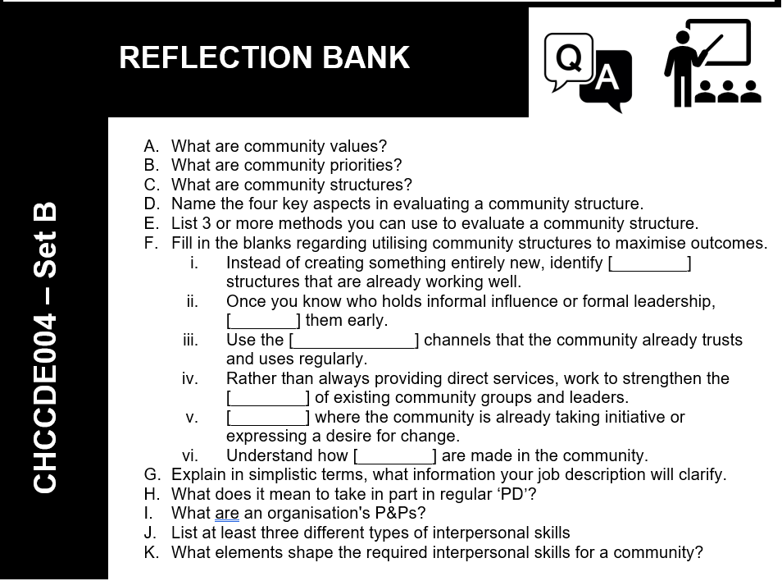

Slide 42
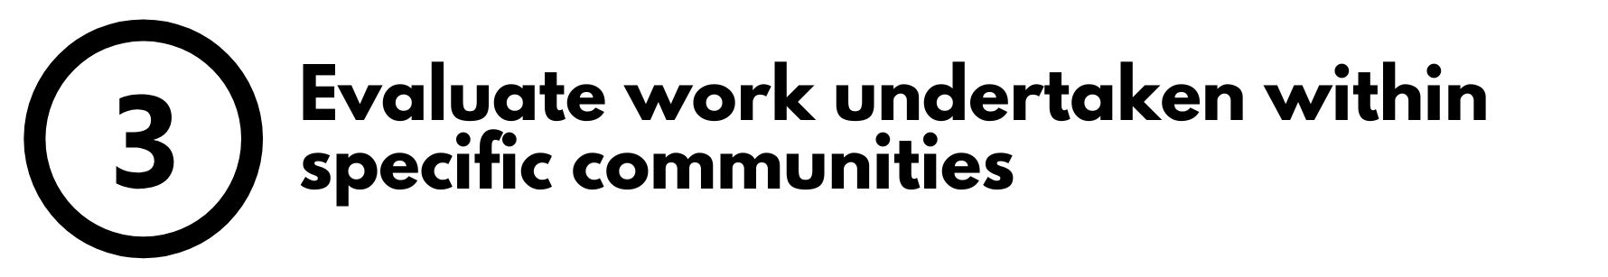

Appropriate Evaluation of Work
Involves engaging community stakeholders in the process.
Ensures evaluation is:
Meaningful, ethical, culturally sensitive
Reflects community perspectives & priorities
Evaluation goes beyond measuring outcomes → values community definition of success.
It is important that there is stakeholder involvement at all stages:
Builds trust and capacity
Supports well-being and self-determination

Slide 43
What is ‘Appropriate evaluation’ in this context?

Slide 44
These are the individuals, groups, and organisations who have a direct interest in, are affected by, or have influence over the work you are evaluating. The stakeholders can include:
Direct beneficiaries/participants - The individuals and families who directly engaged with the service or program.
Community leaders – Elders, cultural leaders, religious leaders, formal elected representatives.
Community groups and associations - Local community-controlled organisations, multicultural associations, disability advocacy groups, youth groups, women's groups, neighbourhood watch, sporting clubs.
Local service providers - Other health, education, social service, or legal aid organisations in the area who work with the same community.
Frontline staff/volunteers - Those directly involved in delivering the work.
Families and carers - Individuals who support the direct beneficiaries.

Slide 45
The Evaluation Process
Step 1: Building the Foundation
Build a foundation based on genuine relationships.
You cannot start evaluation without trust and rapport with community members and leaders.
Spend time in the community, listening, and offering support without an immediate evaluation agenda.
Clarify the purpose TOGETHER
Before evaluation, sit down with key community stakeholders.
Don't just tell them you're evaluating; ask them what they want to learn from monitoring and evaluation

Slide 46


Step 2: Co-design a monitoring and evaluation plan
Work with stakeholders to define the key evaluation questions. These should reflect organisational needs and, the community's priorities.
Discuss and agree on appropriate methods to monitor and collect information. This
Step 3: Determine Who Collects Data
Involve community members in data collection. This builds capacity and ensures cultural sensitivity during data gathering.
Agree on timelines and roles by clearly defining who will do what, by when, and how decisions will be made throughout the monitoring and evaluation process.

Slide 47
Step 4: Conduct monitoring in line with values and structures

Slide 48

Step 5: Analysis and interpretation of findings
Collaborate and share findings. Bring information back to the required stakeholders.
Ensure findings are in response to community priorities
Facilitate the interpretation and alignment with priorities by asking stakeholders:
What do these findings mean to you?
Do they make sense?
Are we missing anything?
What are the implications from your perspective?
Identify strengths and challenges together
Work together to identify what worked well, what didn't, and why, always looking for context-specific explanations rather than universal assumptions.

Slide 49
Step 6: Dissemination and action
Based on the interpreted findings, collaboratively develop recommendations for things like future work, program improvements, or advocacy.
Agree on dissemination
Decide how to share findings. With presentations, easy-to-read summaries, or visual reports. Ensure the community controls their narrative.
Action plan
Plan how findings will be used to make improvements for the group. Showing that their participation was meaningful and has positive outcomes.
Celebrate successes
Celebrate the achievements, reinforcing the value of participation
Complete Inquiry task 2E on page 120

Slide 50
