Slide 1
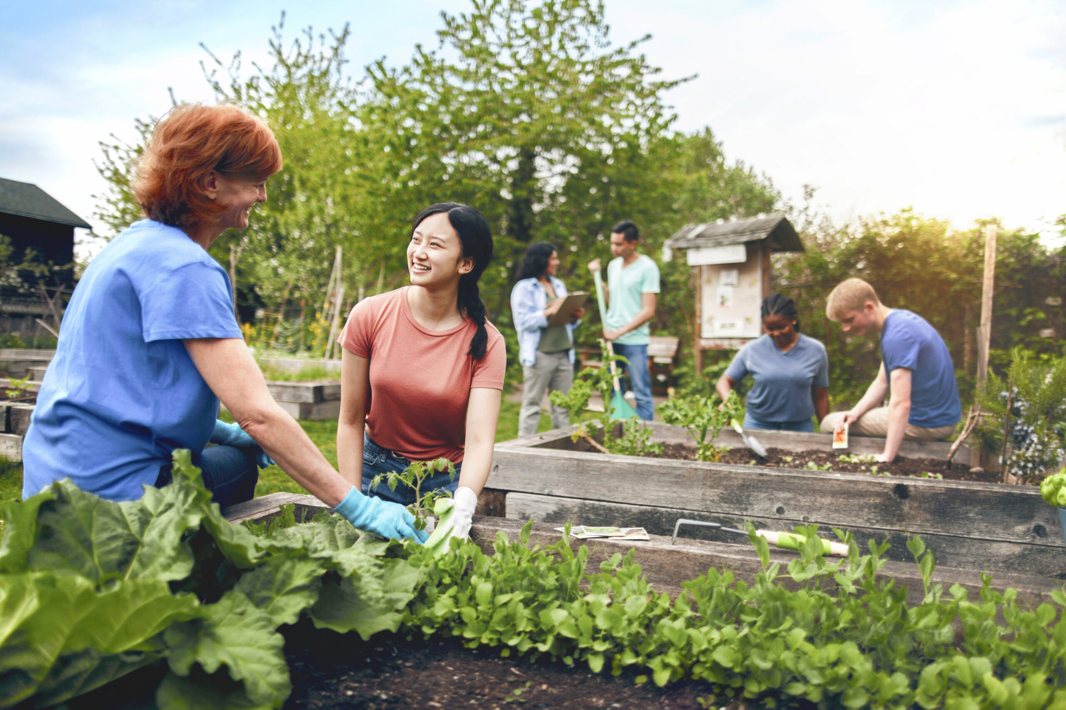
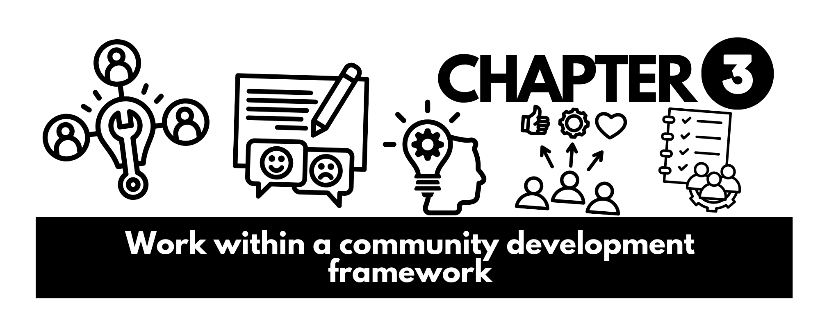

Slide 2
Each ‘community’ that you belong to is like a small society that includes the following elements:
a group of people
common values, beliefs, customs, ways of doing things and identity
a sense of place
social structures and social institutions
relatively enduring relationships.

Slide 3
Community Development Work
A way of working with communities to address shared issues.
Collective action from the bottom up.
Empowers community members to:
Identify issues
Decide priorities
Take action

Slide 4


Roles in Community Development
Workers may act as:
Advocate, Educator, Planner, Researcher, Outreach worker, Caregiver, Mobiliser
Focus is not service delivery, but facilitating community-led solutions.
Principles of Community Development
Democratic and collaborative
Promotes empowerment, social justice, and equality
Builds capacity of groups & individuals
Works to change unequal structure

Slide 5

Community-Based vs. Community Development
Community-Based Work
Issues defined by agencies
Short-term, pre-set outcomes
Decision-making rests with professionals
Community Development
Issues defined by community
Long-term, capacity building
Negotiated power-sharing
Complete Inquiry task 3A on page 127

Slide 6

Community Development Practices & Principles
Justice, equality, fairness
Human rights focus
Empowerment of communities
Participation & inclusion
Commitment to Participation
Genuine involvement, not tokenistic
Community input at all stages:
Identifying issues
Planning & implementation
Evaluation
Inclusive of diverse voices

Slide 7

Role & Functions in Sustainability
Environmental – education, advocacy, community-led initiatives
Economic – skills development, support for local business
Workforce – morale, diversity, recruitment
Social – equity, cohesion, resilience

Slide 8
Traditional Approaches
Needs-based: Focuses on deficits → unsustainable
Gap-based: Focuses on service gaps → assumes outside solutions
Contemporary Approaches
Assets-based (ABCD): Identify, Connect, Solve – builds on community skills talents and resources.
Rights-based: Focuses on upholding legal human rights (PANEL framework: Participation, Accountability, Non-discrimination, Empowerment, Legality)

Slide 9

Practices within the human rights-based approach
Rights-based principles translate into concrete practices throughout the development cycle.
Human rights analysis
Capacity building of rights-holders
Capacity building of duty-bearers
Addressing discrimination and inequality
Establishing accountability mechanisms
Participatory planning, implementation, and monitoring

Slide 10

Mobilising a human rights-based approach
These are the specific tools and methods used to put the principles and practices into action.
Human rights education and raising awareness
Community organising and mobilisation
Advocacy and lobbying
Participatory Action Research (PAR)
Documentation and monitoring of human rights issues
Legal literacy and aid

Slide 11
Planning in Community Development
Process begins with:
Identifying concerns
Prioritising issues
Collaborative action planning
Your role includes:
Identifying key figures
Consulting
Collaborating to agree on goals
Identify strengths
Develop Plans
Worker skills: facilitation, communication, research, flexibility, networking

Slide 12



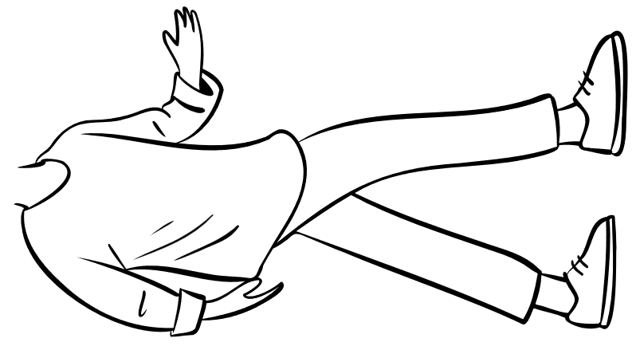


A focus for the work plan
A clear vision and mission aligns all community development activities
Vision = aspirational future state
Mission = core purpose & action focus
Why Vision & Mission Matter
Aligns efforts to goals
Provides shared purpose
Guides decision-making
Communicates goals clearly
Be sure to communicate and socialize the vision and mission!

Slide 13
Preparatory activities that support the Vision and Mission
Conduct environmental scan – Learn more about your mission and vision
Identify key stakeholders
Review available resources
Build relationships & trust
Complete Inquiry task 3B on page 141

Slide 14

Priorities and rights
Rights and priorities are interconnected at all levels
A violation in one level affects the others
Helps us:
Understand root causes
Develop holistic solutions
Strengthen advocacy for change
Identify discrimination & disproportionate impacts

Slide 15

Levels of Analysis
Individual – Aspirations, goals, needs
Personal rights
Family – Collective aspirations, goals, needs
Family rights
Community – Shared concerns
Cultural/environmental rights
Society – National goals
National Laws, international obligations

Slide 16


Methods for Identifying Interrelationships
Participation workshops – discussions, sticky notes, flip charts
Key informant interviews – leaders, elders, youth, providers
Maps & diagrams – mind maps, problem-solution webs, rights-duty matrices
Other Types of Mapping
Community Asset mapping
Rights Duty Bearer Matrix
Problem-Solution Web
Complete Inquiry task 3C on page 145

Slide 17
Formally Documenting the Interrelationships
Use narrative reports:
Descriptive, explains connections with stories and example
Combine with visual maps and diagrams:
Flowcharts
Venn diagrams
Ecosystem maps
Tables/matrices

Slide 18
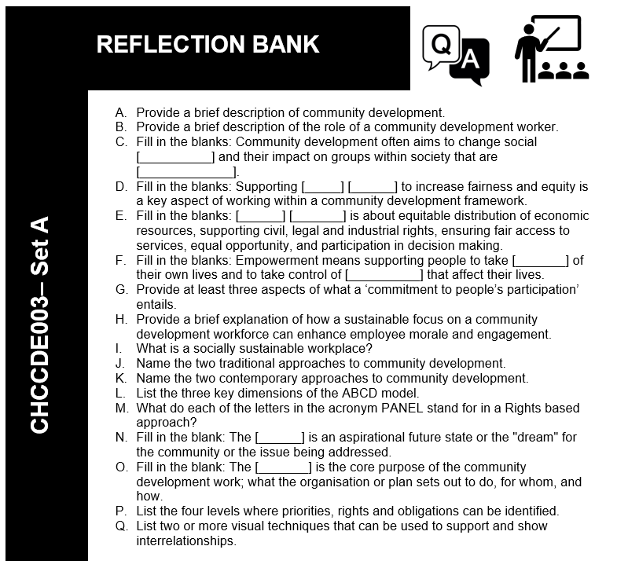

Slide 19


Recognising personal and public political processes
Many community initiatives begin with personal issues
It’s important to:
Hear individual stories
Recognise systemic patterns
Move issues into the public/political space
Leads to advocacy, empowerment & collective solutions
Effective advocacy - Framing individual struggles as broader societal issues.
Holistic solutions - Developing community-level interventions, not just individual ones.
Resource allocation - Directing efforts where they will have the greatest collective impact.
Empowerment - Helping individuals see their experiences as shared, reducing isolation and fostering collective action.

Slide 20
Employing appropriate interpersonal skills to hear individuals
Active Listening – word and emotions, body language and non verbal cues
Empathy and non judgement – Putting yourself in their shoes
Building Rapport and Trust – Showing genuine interest
Cultural Sensitivity and Humility – Respecting differences
Creating a safe and confidential space – Ensuring privacy

Slide 21
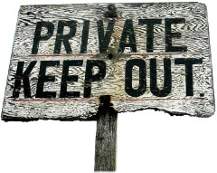
Private vs Public Issues
Private Trouble – experienced by individual/family
Unemployment, rent stress, youth anxiety
Public Issue – structural, societal, affects many
Regional unemployment, lack of affordable housing, youth mental health crisis
TIP: To learn more about Sociological Imagination watch the video What is The Sociological Imagination? (Easy Explanation) by the Helpful Professor Explains! (YouTube 4.11min)
https://youtu.be/dkA-mXNGyr4?si=6_v3c6RX7WGcOjqJ

Slide 22

Understanding the concepts of sociological imagination
Private trouble (or personal trouble)
An issue experienced by an individual or within a limited range of their immediate relations. It's often seen as a personal failing or bad luck.
Public issue (or social issue)
A problem that extends beyond the individual and is linked to the structure of society, broader social forces, systemic inequalities, or historical context. It affects many people, not just one.

Slide 23

Skills to Distinguish Issues
Critical questioning & probing
Pattern recognition
Contextual analysis (economic, historical, cultural)
Linking to rights-based frameworks
Asking the “So what?” question
So What?

Slide 24

Changing Contexts in community development
Community development shaped by:
Social context – shifting norms, high-profile issues (DV, homelessness, youth crime, etc.)
Political context – which party is in power, government priorities
Economic context – recessions, pandemics, funding availability

Slide 25


Duty of Care
When supporting individuals going public, consider and communicate risks:
Reliving trauma
Loss of privacy
Public scrutiny or reputational damage
Relationship impacts
Your responsibilities:
Protect privacy & confidentiality
Support informed consent
Avoid persuasion
Refer to support services
Complete Inquiry task 3Don page 155

Slide 26
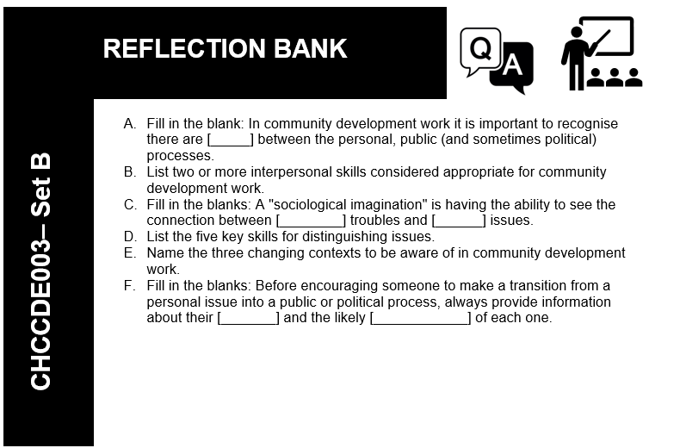

Slide 27


Research – collecting information or evidence about a topic (like trying a new recipe or deciding which product to buy)
Data Analysis – Formalised research
This may include:
Quantitative data - numbers, measurements, frequency
Qualitative data - experiences, stories, depth and meaning
Primary data - first-hand (interviews, observation)
Secondary data - already recorded (stats, reports, articles)

Slide 28
Collecting Data for Analysis
Surveys - questionnaires, interviews, focus groups
Observation - behaviour, patterns, environmental influences
Focus Groups - shared interests, recorded discussions
Choose method carefully based on participants (e.g. literacy, language)

Slide 29
Using Data Wisely
Sort and analyse collected data
Convert into usable content for the group
Focus on:
Shared issues and priorities
Impacts on individuals, families, groups
Consequences of inaction
Complete Inquiry task 3E page 159

Slide 30

Planning and strategising with the group
Community consultation is essential
Community makes decisions
Worker facilitates and supports
Partnership approach
Group tasks roles and functions
Task-focused - getting the job done
Relationship-focused - maintaining harmony
Task roles: initiating, seeking, elaborating, coordinating, summarising

Slide 31



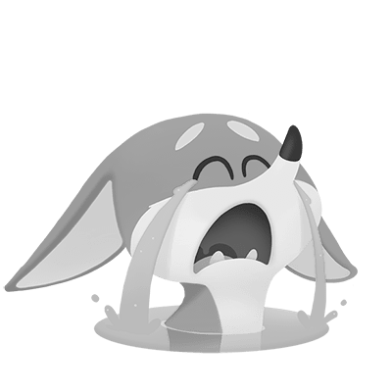



Group Dynamics and Communication
Watch for communication patterns
Identify cliques, alliances, conflicts
Recognise disruptive behaviours:
Aggressiveness
Blocking
Competing
Seeking sympathy
Horsing around
Attention-seeking
Withdrawing

Slide 32

Groups and Decision Making
Allow time for questions and clarity
Aim for consensus (everyone agrees)
If not possible - majority decision
Voting methods: open (hands/voice) or ballot (private
Conflict in Groups
Conflict is natural – outcome can be positive or negative
Types:
Controversy (ideas/opinions clash)
Conflict of interest (resources, values)
Developmental conflict (stability vs change)
Conceptual conflict (contradictory ideas)

Slide 33
Maintaining Good Relationships
Encouraging – being warm, friendly, praising others’ ideas.
‘Gate keeping’ – making sure everyone has a turn to talk.
Setting standards – pointing out when group norms are not followed, suggesting new group norms.
Listening and following – following group decisions, paraphrasing
Expressing feelings – saying how you feel, restating others’ feelings.
Compromising – admitting mistakes.
Relieving tension – making jokes, suggesting breaks.
Complete Inquiry task 3F & 3G on 164-165

Slide 34

Project Planning
Key decisions:
Best strategies for goals/objectives
Resources and skills needed
Criteria for measuring success
Realistic timeframes
Allocating roles and responsibilities

Slide 35
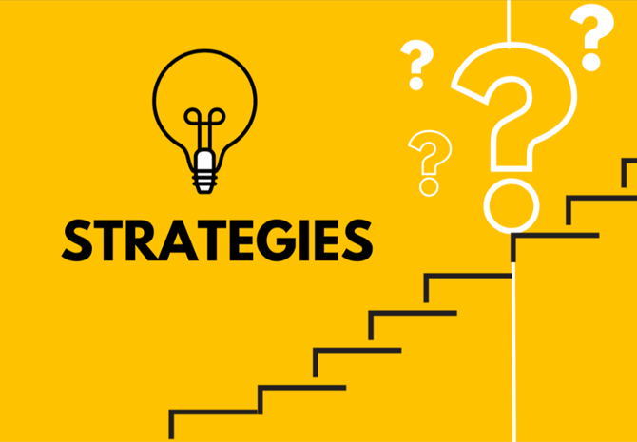
Documenting Strategies and Resources
Strategies: networking, fundraising, advocacy, communication
Resources:
Existing community skills & assets
Additional resources (funding, training, sponsorship)
Acquisition plans
Project Review & Evaluation
Define criteria for measuring success
Collect and analyse outcome data
Flexible & cyclical process
Revise strategies and set new goals if needed

Slide 36

Use of Advocacy and Lobbying Strategies
Goals:
Amplify community voices
Address root causes
Influence policies, laws, budgets
Support self-advocacy
Forms of Advocacy
Individual advocacy
Case advocacy
Systemic/policy advocacy
Self-advocacy
Community advocacy
Public/media advocacy

Slide 37

What is Lobbying?
Subset of advocacy - direct engagement with decision-makers
Involves direct contact with decision-makers. E.g. meeting Mayor or a state MP, making submissions to government inquiries.
Involves clear, specific requests for policy changes, funding, or amendments to legislation.
Relies on providing information, evidence, and compelling arguments to decision-makers.
Often involves building ongoing relationships with key political figures and their staff.
Can be formal via registered lobbyists, or informal, such as a community group presenting a petition to council. In community development, it's often more informal but still targeted.

Slide 38
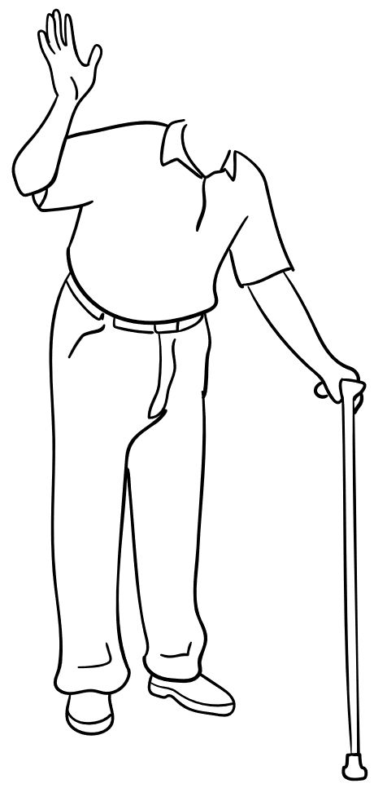

Your work practices and continuous improvement
Review practice against principles:
Participation
Empowerment
Social justice & equity
Rights-based
Assets & strengths-based
Sustainability
Cultural competence
Collaboration

Slide 39





Steps and Tools for Reviewing Work Practice
Methods for Structures, self reflection
Feedback from stakeholders
Journaling & reflection logs
Critical incident analysis
Compare against principles and plans
Improving Practice
Set measurable goals
Break into action steps
Experiment and adapt
Seek mentorship & training
Document and share learnings
Complete Inquiry task 3E page 159

Slide 40
