Slide 1



Slide 2


Community services involves supporting individuals by providing person-centred services.
This may include the day-to-day support or building community-based programs.
The individuals you work with will be referred to as ‘clients’ throughout this unit of study.
This unit helps build skills to meet the needs of a range of clients.
Complete Inquiry task 1A on page 5

Slide 3

It’s very important to build strong, respectful, and trusting relationships with each client.
But, there is no ‘one size fits all’ approach. All clients will be different, with different needs.
It’s also important to understand the legal side, and ethics for working in community services

Slide 4

Professional ethics
Sometimes, you’ll need to make decisions and take the right actions in response.
This is where a good understanding of the required ethical behaviours combined with industry legislation comes in.
Legal and ethical considerations can include
human rights
preventing discrimination
privacy, confidentiality and disclosure
duty of care
mandatory reporting
the work role boundaries - your responsibilities and limitations
dignity of risk
work health and safety.

Slide 5
Understanding human rights
Human rights are things every person is entitled to.
Some examples of the basic human rights are:
Safety
To have your own thoughts and beliefs.
The right to an education.
To have enough food and a safe place to live.
To be treated equally.
These aren't just nice ideas; they're agreed upon by most countries in the world and are meant to be protected by laws.
In community services, upholding these human rights begins with treating every client fairly and with respect.

Slide 6
Preventing discrimination
Types of discrimination:
Cultural or religious
Racial vilification
Sexual preferences / gender
Workplace discrimination
Age or disability
financial discrimination.
Australia's federal anti-discrimination laws contain:
Age Discrimination Act 2004 (Cth)
Disability Discrimination Act 1992 (Cth)
Racial Discrimination Act 1975 (Cth)
Sex Discrimination Act 1984 (Cth)
Australian Human Rights Commission Act 1986 (Cth).
Your workplace is responsible for ensuing there are anti-discrimination policies in place.

Slide 7

Privacy, confidentiality and disclosure
Community service providers have to protect client privacy and confidentiality, and know when it’s ok to disclose information
Privacy - Respecting rights to keep personal information hidden. Eg. health, financial, and family details. But also protecting it from being used by others
Confidentiality - Guarding information shared by a client with a service provider. It's crucial for building trust between clients and service providers.
Disclosure - Making information known or public, often regulated by law and ethical guidelines.
Service providers may be required to disclose information, such as when there is a risk of harm to the client or others, or when required by law.

Slide 8

What is your duty of care in Community Services?
Duty of care is your legal obligation to try to prevent harm to clients, colleagues, and the community
Foreseeable harm: If you can detect harm about to happen, you should try and prevent it
Relationship of proximity: When you build trust with clients, they will begin to depend on you
Reasonable steps: You’re not expected to be able to prevent all harm, but you should do what you can to try.

Slide 9


What does ‘Duty of Care’ look like in practice?
Risk assessment and management: Identifying potential risks and trying to mitigate them.
Providing safe services: Ensuring you work in a safe manner.
Providing adequate information and warning: Informing clients about potential risks and making sure they understand them
Maintaining confidentiality: Protecting clients' personal information and privacy (except where there is a legal or ethical obligation)
Obtaining informed consent: Ensuring clients understand and consent to the services being provided to them.
Accurate record keeping: Maintaining records of your interactions with clients, risk assessments, and actions taken.
Reporting concerns: Reporting suspected abuse, neglect, or other significant concerns.
Working only within your role and scope of practice: Knowing what is your job, and when to refer to others
Advocacy: Speaking up and acting for your clients, particularly when they are vulnerable, or their human rights are at risk.
Professional development: Updating your knowledge and skills to ensure you provide the best and safest service.
Following organisational policies and procedures: Following workplace policies, procedures, and guidelines
Maintaining professional boundaries: Ensure the professional nature of the relationship

Slide 10
Who else holds this Duty of Care? In community services, the duty of care is held by various parties: Workers: You, as the frontline worker, have a direct responsibility to exercise duty of care in your interactions and service delivery. Supervisors and managers: Provide adequate training, support, and resources. They also have a responsibility to oversee and monitor the delivery of services. The organisation that provides your employment: Your employer has a primary duty of care to ensure a safe working environment. The organisation employing you also has a broader responsibility for the safety and well-being of its clients.

Slide 11

Consequences of breaching duty of care
Failure to meet the duty of care can have serious consequences:
Harm to the client: Potentially leading to physical, psychological, emotional, or financial harm.
Legal action: Legal action against you or your organisation for negligence
Professional sanctions: Sanctions, such as suspension or loss of registration.
Employment consequences: Your employer may terminate your employment.
Damage to trust and relationships: Damage to trust between clients and service providers.

Slide 12

Mandatory reporting in Child Protection
Mandatory reporting requires specific professionals to report suspected child abuse or harm
Laws vary across Australian states and territories; each has its own regulations
Adults in certain settings (e.g., aged care, psychiatric facilities) may also be protected and required to report
A reasonable suspicion may be sufficient to trigger a report
Workplaces must have clear policies and procedures aligned with local laws

Slide 13

Codes of Conduct
Working in Aged Care
The Aged Care sector has a Charter of Aged Care Rights for providers which is a commitment by providers to uphold the mandated Aged Care Quality Standards. The Code of Conduct for Aged Care forms part of these standards.
Working in disability support
The National Disability Insurance Scheme (NDIS) has for service providers the NDIS Code of Conduct which must be followed by all registered and unregistered NDIS providers, their key personnel and NDIS workers.
Complete Inquiry task 1B on page 13

Slide 14
Using Communication to Establish Trust and Respect
Active listening: Paying attention, responding with cues, reflect and summarise, ask questions
Empathy: Understand their perspective, acknowledge their feelings
Respectful language and tone: Use ‘person first’ language, be mindful, choose your tone, avoid jargon
Non verbal communication: Think about you eye contact, body language and personal space.
Build Rapport: Find common ground, be authentic, show interest
Clear and concise communication: Be direct, provide structured information, check they understand

Slide 15

Boundaries
In an ethical working relationship, you must define clear boundaries
Be explicit and clear from the beginning
Maintain consistency
Be assertive yet respectful
Knowing your organisations policies
Seek supervision and support

Slide 16
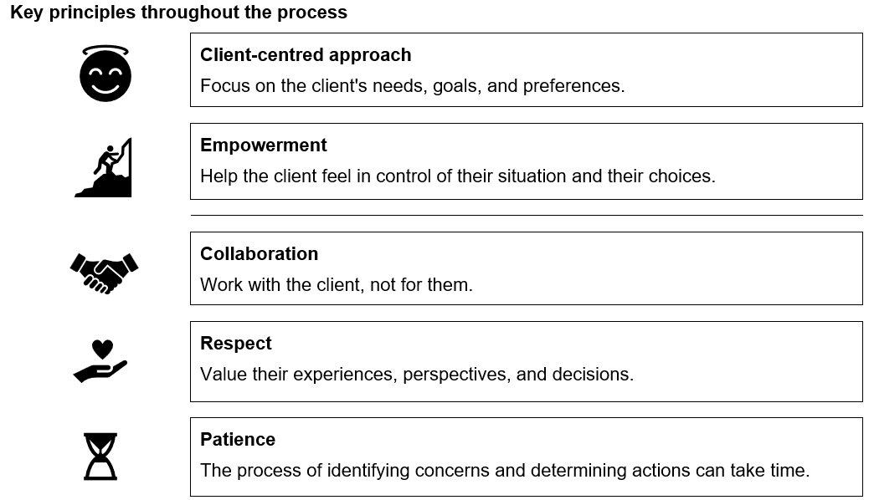
Identify Client’s Concerns

Slide 17
Identify Client’s Concerns
Phase 1: Identifying Areas of Concern
Build rapport and establish trust
Use open ended questions
Actively listen and explore further
Use different angles
Prioritise concerns
Summarise and Validation
Phase 2: Determining Options for Action
Brainstorm Together
Explore Resources and Services
Consider Pros and Cons
Assess Feasibility and Client Capacity
Empower Client Choice
Develop an Action Plan

Slide 18

Components of an Action Plan
The typical components of an action plan might include:
Specific steps to take.
Who is responsible for each step.
Timelines (if appropriate).
Any resources needed.
Providing ongoing support and review:
Let the client know you will continue to support them as they take action.
Schedule follow-up meetings to review progress, address any challenges, and adjust the plan as needed.

Slide 19

Dignity of Risk
Dignity of risk is all about respecting someone's right to make their own choices
It's about balancing safety with the right to autonomy and a meaningful life.
You can balance dignity of risk with informed decision making in many ways:
Person centred approach – Tailoring support and respecting individual goals
Empowering autonomy and choice – Foster independence whilst promoting self determination
Balancing safety and well being – Risk assessment and promoting holistic well-being
Building trust and rapport – respect agency and avoid power imbalances
Adapting to different needs and capacities – Work with cognitive impairment and support individual’s mental health challenges

Slide 20
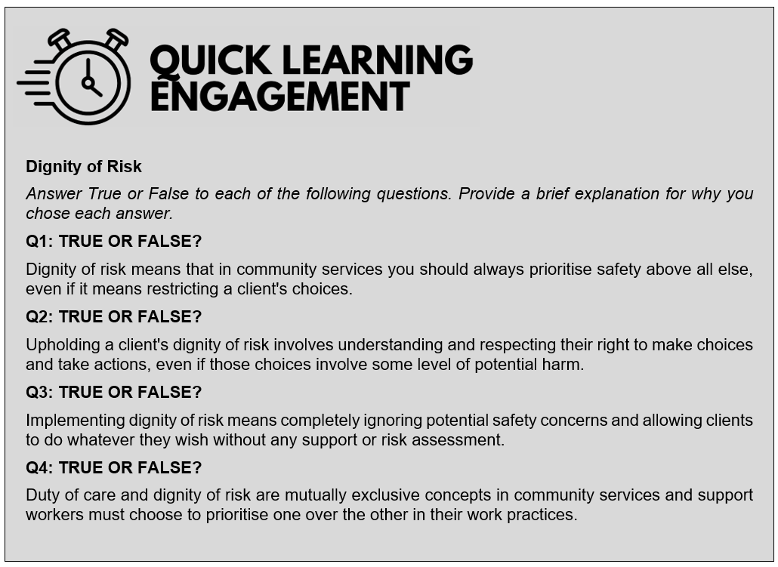

Slide 21

Work Health and Safety (WHS) when working with clients Ensure the health and safety of their workers and other persons affected by their work
Risk assessment and management ( Client related)
Home Visits – Assessing the safety of the client’s home environment
Manual Handling – Training in safe techniques to prevent injury
Aggression and Violence – Assessing the risks from clients and having protocols in place
Infection Control – Follow hygiene protocols
Transportation - Make sure vehicles are safe, ensured and used correctly

Slide 22
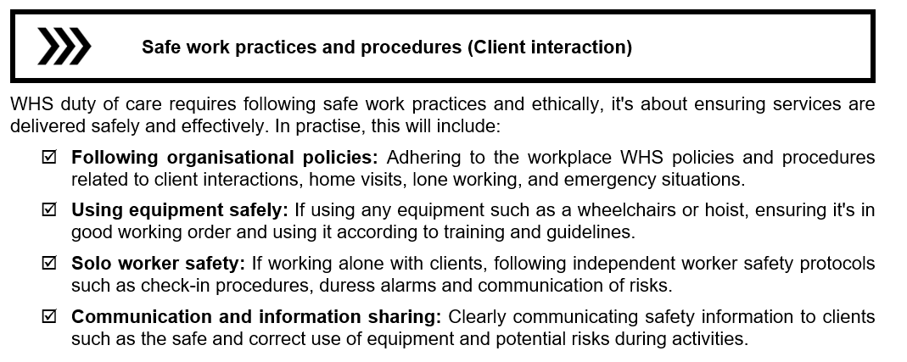


Slide 23

Reporting Hazards and Incidents Hazards incidents and injuries in the workplace must be reported. You should also take steps to avoid them in the future. Training and Competency Employers must provide adequate training to keep workers and their clients safe. Balancing WHS Overly strict WHS measures, if not applied thoughtfully, could inadvertently restrict a client's choices and independence.

Slide 24
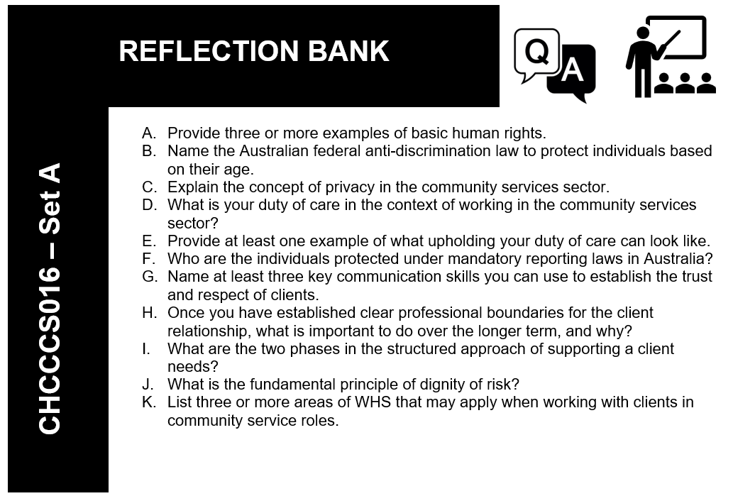


Slide 25


Impacts and interrelationships between issues
Physical health: Can lead to pain, reduced mobility, difficulty, and increased healthcare costs. It can also impact mental well-being and the ability to work.
Mental health: Can affect mood, thinking, and behaviour, making it hard to cope with stress, maintain relationships, and work.
Child protection: Issues like abuse or neglect can have devastating impacts on a child's physical and mental health, development, and future opportunities.
Domestic violence: Involves harm or control within a relationship and can cause injuries, distress, fear, isolation, homelessness, and financial hardship for victims.
Disability: Can create barriers to education, employment, housing, and social participation. It can also impact physical and mental health and financial stability.
Homelessness: Means lacking safe and stable housing, leading to exposure to the elements, poor health, safety risks, difficulty accessing services, and stress.
Unemployment: Results in loss of income, financial strain, reduced self-esteem, social isolation, and can negatively impact mental and physical health.
Financial issues: Poverty and lack of money can lead to stress, difficulty affording basic needs, and can worsen physical and mental health.
Alcohol and other drugs (AOD): Can lead to physical and mental health problems, addiction, relationship difficulties, financial problems, legal issues, and homelessness.
Trauma: Can result from experiencing traumatic events. It can have long-lasting effects on mental and physical health, relationships, and behaviour.
Culture and religion: While often sources of strength and support, cultural or religious differences can sometimes lead to discrimination, isolation, or conflict, impacting well-being and access to services.

Slide 26
Understanding the Relationships Matters
Clients often face multiple, overlapping challenges.
Addressing one issue might require addressing others. Simply finding someone housing might not be enough if their mental health isn't also supported.
It helps you see the bigger picture.
You can better understand the root causes of a client's difficulties and develop more effective and holistic support plans.
It encourages collaboration.
Recognising these interrelationships highlights the need for different services and professionals to work together to provide comprehensive support.
Complete Inquiry task 1C on page 29 and 1D on Page 30

Slide 27
Identifying indicators of harm, neglect, abuse or risk of harm
Physical Indicators - things you might see on someone's body or in their environment.
Behavioural and emotional indicators - These are changes in how someone acts or feels.
Verbal indicators - These are things someone might say.
Environmental indicators - These are things you might notice about someone's living situation or care.

Slide 28

Seeking information from a range of appropriate sources
To help identify issues clients face, it may be important to seek information from multiple sources
Primary source - The client.
Internal sources - Existing records and documentation.
External sources - External referral agencies and other professionals.
Family, carers, and support networks - Where client consent has been obtained.
Contextual Sources - Relevant legislation, policies, and guidelines.

Slide 29




Key Principals for obtaining Information
Obtain informed consent
Maintain confidentiality
Be respectful and culturally sensitive
Be objective and facts-based.
Document your sources and findings
Triangulate information
Focus on relevance
Be mindful of power dynamics

Slide 30
Analysing Client Information
Familiarisation with procedures – know the documentation and participate in training
Adhere to the standardised tools and templates – Use forms approved by your work, and understand the purpose of each field
Accuracy and objectivity in collection – record facts not opinions, use their own words and be timely
Secure and ethical handling of information – adhere to privacy and confidentiality, secure data and record only what is necessary
Systematic and purposeful analysis – understand the framework, look for patterns, use multiple data points, identify key challenges, use analysis tools
Collaboration and communication – Discuss findings, Communicate findings, involve the client if possible
Continuous improvement and feedback – provide feedback on procedures, stay up to date

Slide 31
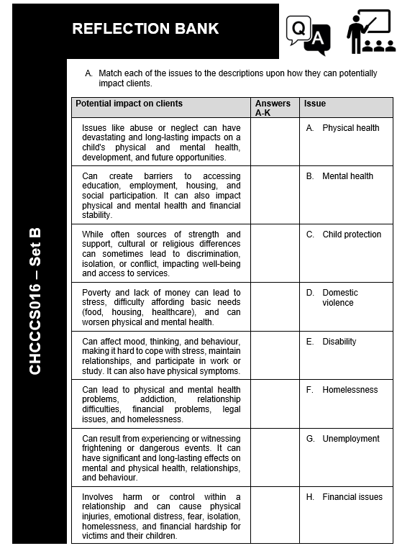

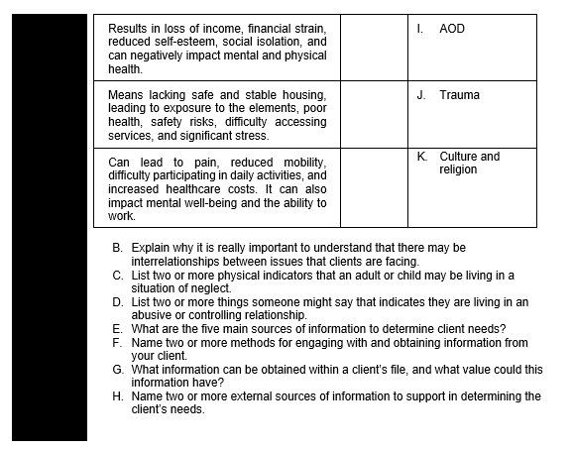

Slide 32

Identifying & Prioritising Client Needs in Community Services
Prioritisation is essential when clients present with multiple or complex needs – address the most urgent and risky issues first (e.g. safety, mental health, survival).
Use a collaborative approach – involve clients in identifying and ranking their own needs and goals.
Tools like a Prioritisation Matrix can help structure this process.
Leverage client strengths – explore past successes, personal resilience, and existing supports (e.g. family, community).
Mandatory reporting: Serious risks must be flagged immediately by mandated reporters.
Incorporate SMART goal setting where appropriate – goals must be realistic, measurable, and aligned with the client’s capacity and resources.
Encourage clients to see challenges as opportunities for growth.
Stay flexible – client priorities may change.
Ensure clients feel heard, respected, and empowered throughout the process.

Slide 33




Slide 34

Internal capacity to meet client needs
By Identifying their ability to meet client needs, an organisation can learn how well they can meet diverse needs, identify areas for growth, and plan for the future. They can achieve this through:
Internal Assessment – Assessing staff, surveys, meetings, resource evaluation, partnerships and collaborations, management and leadership input
Comparative Analysis – Checking budget, Service utilisation stats, outcome data and referral data

Slide 35

When Client Needs Exceed the Limitations of Service
When working around issues that affect clients, organisations have a responsibility to ensure a safe, ethical, and effective service delivery.
This involves working with the organisation, and understanding each of the appropriate referral pathways for the different areas of support
These pathways can be found on pages 45-50 of the reding material
Complete Inquiry task 1E on page 51 and 1F on Page 52

Slide 36

Sometimes you may identify a need for additional support - something beyond your direct scope of support that may suggest a bigger, underlying issue or a gap in the current resources being provided.
Identifying there may be a need for additional support
Clients have wide and varying needs, some are not initially apparent. Many clients’ concerns are often interrelated.
Listen, observe, and recognise when something falls outside your expertise or resources, and then connect them to someone who can provide that help.
Complete Inquiry task 1G on page 55

Slide 37


Motivating, Supporting and Encouraging Clients
Combine effective need prioritisation with strong knowledge of local resources to deliver meaningful support.
Aim to empower clients to navigate services independently – building confidence, self-efficacy, and long-term capacity.
Support work is not just about doing for clients, but teaching them how to do it themselves.
Provide clear, relevant information and guide clients through service systems to foster autonomy.
Refer to pages 58 – 60 of the reading material for examples of support

Slide 38
Making Referrals as appropriate
If someone's needs are outside the scope of what you can provide, referral is needed
Identify sources of assistance – Make a map of available resources, keep info up to date, facilitate referrals
Local, state and federal government, as well as non government organisations (NGOs) will offer a vast array of different resources that you can refer clients to.

Slide 39

Supporting clients to exit the service
Initiate exit conversations early and clearly
Outline the key steps involved
Emphasise client involvement and rights
Provide clear timelines and documentation
Be supportive and empathetic

Slide 40
