Slide 1
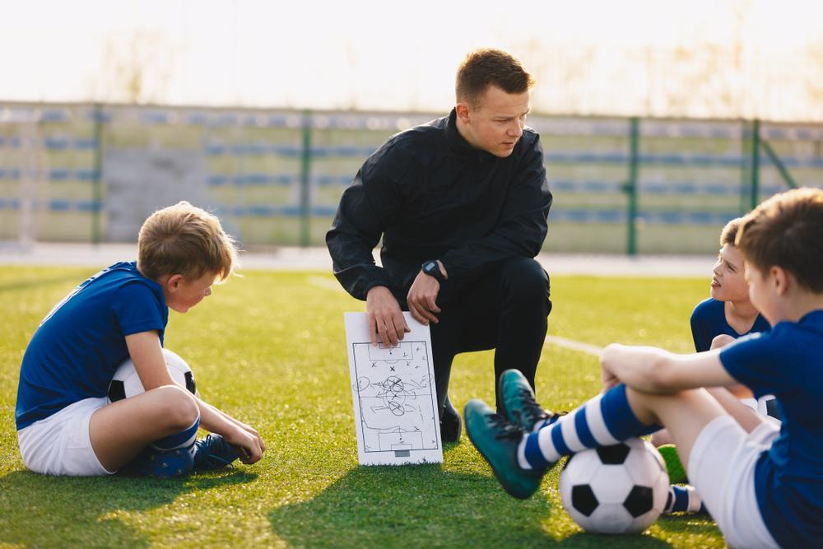


Slide 2

The Value and Impact of a Coach
Coaches do more than improve athletic performance—they build community connections, act as mentors, teach life skills, and encourage healthy lifestyles.
Inclusive coaching ensures everyone feels welcome. This chapter provides tools and techniques to help both new and experienced coaches inspire and empower athletes

Slide 3

There are rules that must be followed working in community-based coaching.
You must understand the sport and the different organisations surrounding it.
You will need to understand the legal, ethical and behavioural responsibilities of your role.

Slide 4

National Overview
Sports in Australia are governed at the national level
Overseen by the Australian Sports Commission (ASC)
ASC recognises and supports National Sporting Organisations (NSOs) and National Sporting Organisations for People with Disability (NSODs)
Role of the ASC
Provides funding and support for sport at all levels
Works with NSOs/NSODs to deliver national sporting objectives
Example: Cricket Australia as an ASC-recognised NSO

Slide 5
Work of NSOs/NSODs
Governance & rules – establish regulations and run competitions
Development & training – provide policies, guides, and programs
National teams – select, train and manage teams for major events
State affiliations – link to state-level bodies (e.g. Vicsport, NSW Sports Federation

Slide 6

ASC Recognition (Not Automatic)
To be recognised, organisations must show evidence of:
National reach & 1,000+ active members
Incorporated, not-for-profit, operating ≥ 3 years
Strategic plan for sport development
Integrity in sport policies (via Sport Integrity Australia)
Financial sustainability
Sound governance aligned with ASC principles
Complete Inquiry task 2A on page6

Slide 7

Governance for All Sporting Organisations
Governance applies to all levels (not just national)
Ensures ethical, effective, and transparent management
Organisations held accountable for their governance
Sound Governance Principles
Key elements include:
Transparency
Accountability
Integrity & fairness
Effectiveness & efficiency
Responsiveness
Rule of law
Participation
Stewardship

Slide 8

Roles in Governance
Board of Directors (elected by members)
Chair/President – leadership & strategic direction
Vice Chair – support & deputising
Directors/Board Members – oversight & compliance
Secretary – records, legal, communication
Committees – specialised areas (finance, risk, nominations, integrity

Slide 9



Sport Governance Principles (2019)
Nine ASC principles to guide sporting organisations:
The spirit of the game
The team
The gameplan
The players
The rulebook
The playbook
The defence
The best and fairest
The scorecard
Other Key Roles
Chief Executive Officer (CEO) – manages operations, reports to board
Members – elect directors, approve major changes, central to organisation
Complete Inquiry task 2B on page 10

Slide 10
NSO Policies Each NSO/NSOD has documented policies for all levels of sport Purpose: protect participants and set behaviour standards Promote fairness, honesty, and integrity in competitions Examples: child protection, member protection, anti-doping, WHS Policy Requirements Coaches, athletes, officials, and clubs must follow policies Member clubs must adapt policies and develop procedures Clear policies help define roles & responsibilities for everyone

Slide 11
Club Membership in NSOs
Community clubs apply to become NSO members
Criteria often includes:
Adherence to rules & regulations
Ethical & integrity commitment
Governance & financial compliance
Alignment with NSO objectives
Benefits: access to resources, funding, development pathways

Slide 12

Integrity in Sport
Integrity = honesty, fairness, preventing unethical behaviour
In 2020: ASADA, NISU & Sport Australia integrity units merged - Sport Integrity Australia
Mission: keep Australian sport safe & fair at all levels
Sport Integrity Australia
Provides advice & assistance on:
Prohibited substances & doping
Abuse & safeguarding concerns
Competition manipulation & corruption
Bullying, harassment, discrimination
Framework: Sport Integrity Australia Act 2020 + Regulations

Slide 13

National Integrity Framework
A suite of policies to protect participants:
Member Protection
Safeguarding Children & Young People
Competition Manipulation & Sports Wagering
Improper Use of Drugs & Medicine
Complaints, Disputes & Discipline
Defines “Prohibited Conduct” (unacceptable behaviours)

Slide 14

Member Protection Policy
Protects athletes, coaches, volunteers, officials, spectators
Covers bullying, harassment, discrimination, victimisation
Includes reporting pathways & complaint procedures
May also include social media conduct
Complete Inquiry task 2C on page 13

Slide 15
Safeguarding Children & Young People
Protects child and youth participants
Covers: abuse, grooming, misconduct, supply of drugs/alcohol
Guidelines for: travel, social media, supervision, photos/filming, change rooms
Requires background checks for coaches/volunteers
Complete Inquiry task 2D on page 15

Slide 16

Drugs & Medicine Policy
Prevents use of banned drugs & substances in sport
Provides education & guidance on safe supplement/medicine use
Covers: injections for pain relief, illegal drugs, prohibited conduct
Supports clean sport, complements WADA & National Anti-Doping Policy
Complete Inquiry task 2E on page 16

Slide 17

Social Media Benefits
Engages Fans and Builds Community
Marketing and Promotion Opportunities
Communication and Information Sharing
Brand Management
Content Diversification
Complete Inquiry task 2F on page 18

Slide 18

Policy area outside the framework
Code of Conduct
A code of conduct is a rulebook for behaviour
Promotes respect, fairness, sportsmanship and set guidelines on and off the field.

Slide 19
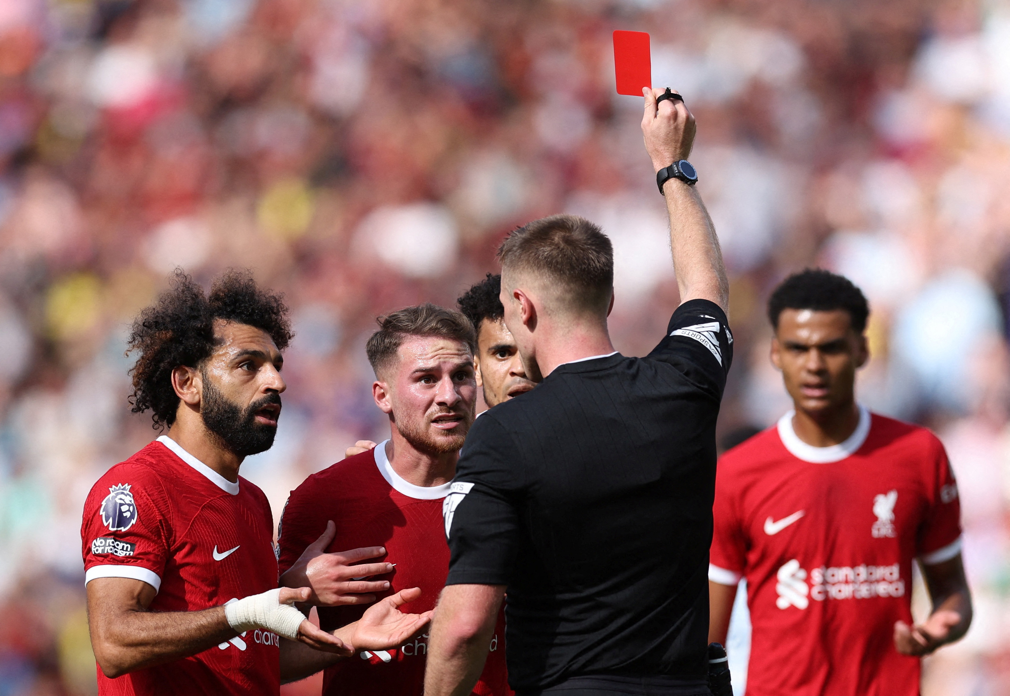
Legal and ethical responsibilities as a community coach
Member Protection
Child Protection
Work health and safety
Negligence and duty of care
Insurance
Privacy and Confidentiality

Slide 20


Reflect on your Own Coaching Practice
Self reflection and questioning
Legal Responsibilities
Ethical Responsibilities
Seeking and Using Feedback
Feedback from athletes, parents and carers
Peer Reviews
Professional development and staying current
Continuous Learning
Reviewing
Record Keeping

Slide 21
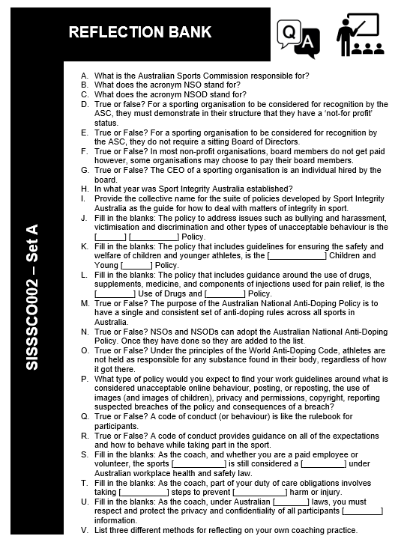

Slide 22

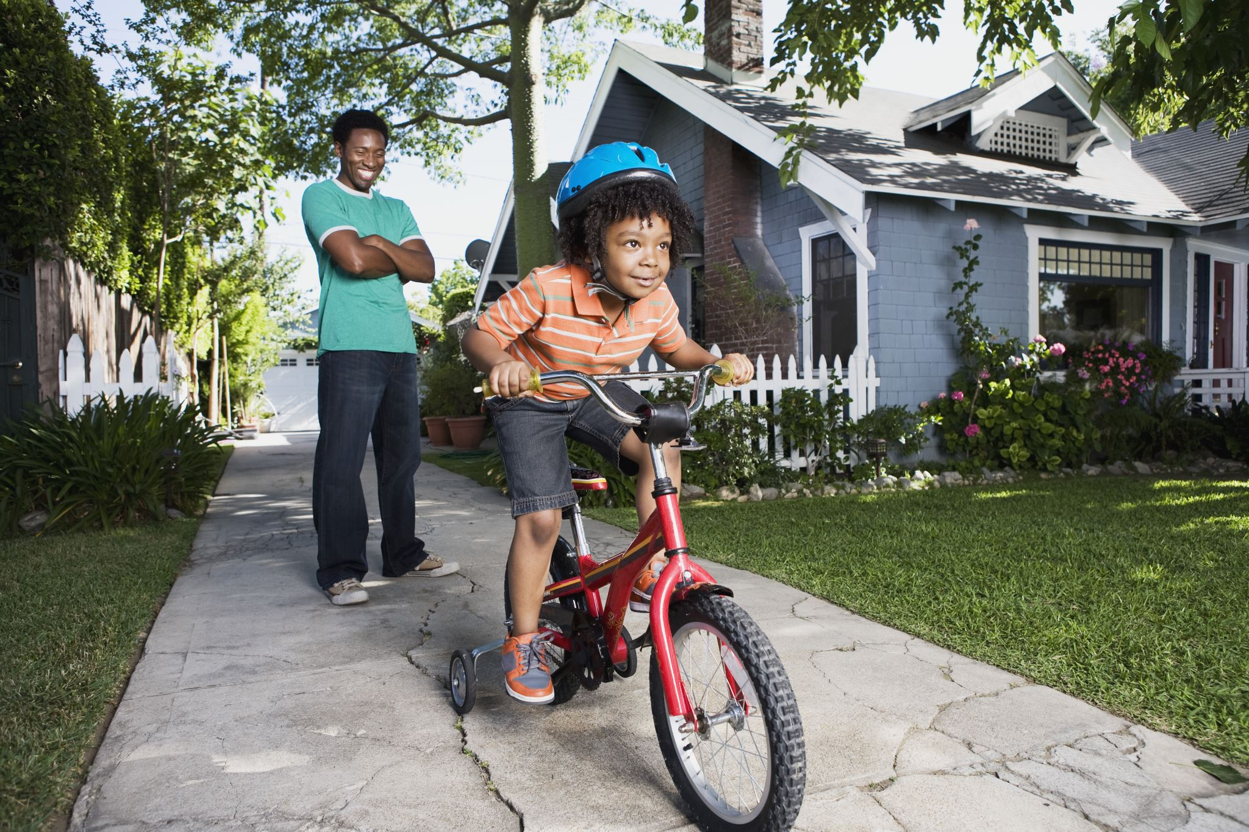
Responsibilities in Training
Skill Development
Technique Instruction
Physical Conditioning
Motivation and Inspiration
Individualised Coaching
Team Building

Slide 23

Responsibilities in Competition
Game Preparation
In-game decision making
Support, Encouragement and Motivation
Sportsmanship
Managing Emotions
Post Game Analysis
Post Competition Debriefings

Slide 24

Limitations to the coaching role
Injury Management – Can you handle emergencies?
Providing Sport Science Advice – Are you equipped to offer guidance?
Also –
Time
Resources
Admin obligations
Emotional Strain
Unclear Roles

Slide 25
Model Behaviours as a Coach
Being prepared and organised
Promoting cooperation and good relationships
Using acceptable language
Dressing and presenting in a professional manner
Arriving on time
Using self-reflection to identify areas for improvement
Complete Inquiry task 2G on page 29

Slide 26

Characteristics of a Good Coach
Interpersonal Skills – Good communication, empathy, conflict resolution, flexibility etc
Knowledge of Sport – Personal experience, Formal education, Studying, networking etc
Demonstrated skills and abilities – technical and tactical.

Slide 27




What does a skilled coach look like?
Technical Skills – Fundamental movements and actions for the sport
Tactical Skills – Knowledge of strategy
Sport Specific Skills – Know rules, regulations and equipment and can analyse performance

Slide 28
Work in line with the organisational expectations
Code of Conduct
Health and Safety Guidelines
Uniform and equipment standards
Communication protocols
Reporting and Documenting rules
Complaint procedures
Certification and training requirements
Complete Inquiry task 2H on page 34

Slide 29
Identify and Deal with Problems

Slide 30
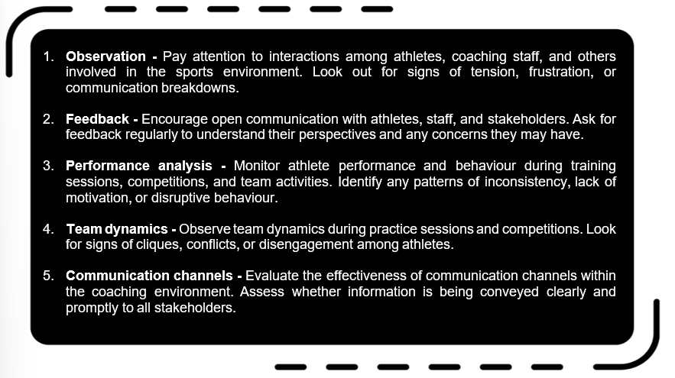
Identify Problems

Slide 31




Resolve Problems
Talk openly with all involved
Actively Listen
Consider different viewpoints
Be clear about expectations
Agree as a team
Support all involved
Don’t be afraid to ask for help

Slide 32
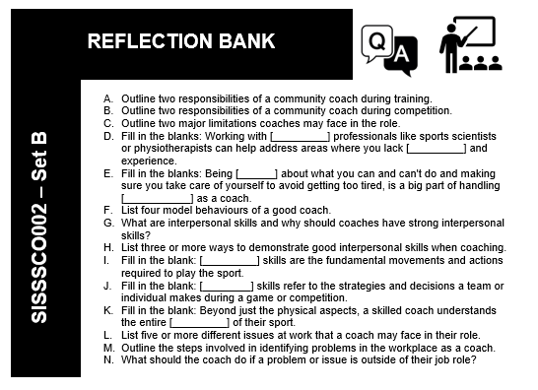


Slide 33
Different ways to Communicate
Tone and Language
Use simple language, avoid jargon, know your Audience
Questioning Techniques
Open and closed questions
Clarifying questions
Reflective questions
Future orientated questions
Solution focused questions
Impact questions
Priority questions
Complete Inquiry task 2I and 2J on page 39-41

Slide 34





Active Listening
Giving full attention
Using verbal and non verbal cues
Paraphrasing
Reflecting feelings
Avoiding interruptions
Asking clarifying questions
Responding appropriately
Summarising
Empathising

Slide 35





Constructive Feedback
Choose the right time and place
Be specific and objective
Use "I" Statements
Express emotions appropriately
Offer solutions and alternatives
Encourage two-way communication
Maintain a positive tone
Follow up

Slide 36



The feedback “sandwich”
Start with positive feedback: "Alex, I've noticed that you've been making some great strides in your swimming technique lately. Your dedication to improving your strokes and turns is really paying off, and I can see that you're putting in a lot of effort during our training sessions."
Constructive feedback: "However, I've also noticed that you've been missing some of our scheduled practice sessions recently. Consistency is key to reaching your full potential as a swimmer, and when you miss practices, it not only affects your own progress but also disrupts the rhythm of the team."
End with positive reinforcement: "That being said, I have full confidence in your ability to turn things around. I know that you're capable of showing up to practice consistently and giving it your all. Let's work together to come up with a plan to help you stay on track and continue making progress towards your goals."

Slide 37
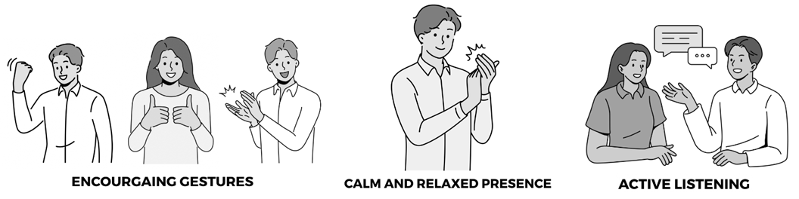
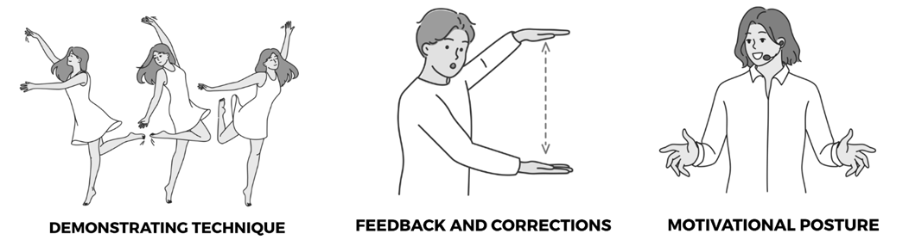
Body Language

Slide 38
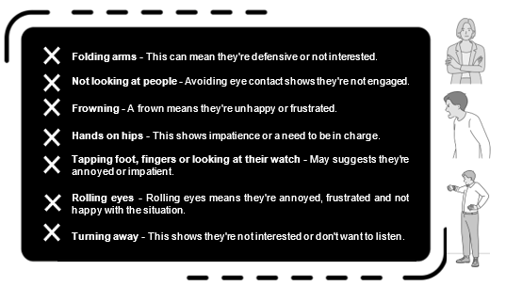
Avoid Negative Body Language

Slide 39



Gestures and Mannerisms
Hand signals: Coaches use signals with their hands, like thumbs-up or pointing, to show approval or direct athletes.
Clapping: Clapping can show support or motivate athletes during games or practice.
Pointing: Coaches point to areas on the field or court to guide athletes where to go or what to do.
Facial expressions: Smiling or nodding can show coaches are happy or agree with what athletes are doing.
Body language: How coaches stand or move can show they're confident and involved.
Demonstrations: Coaches might physically show athletes how to do something to help them understand better.
Encouraging gestures: High-fives or pats on the back boost athletes' confidence and show support.

Slide 40
Personal Presentation

Slide 41

Language – Use clear, concise inclusive language. Be positive. Avoid Jargon.
Tone – A warm, supportive tone promotes positivity. A harsh negative tone can be demotivating
Volume – Loud enough to hear, but not overwhelming or intimidating
Consider how you are using the available space to your advantage!

Slide 42



Using Written Communication
Newsletters – Keeps everyone in the loop
Social Media Posts – Connect with the wider community
Emails – For important, direct info
Texts – for quick little notes and urgent matters
Remember to always follow workplace communication policies!
Complete Inquiry task 2k on page 54

Slide 43


Slide 44

Cultural Awareness in Communications
Learn about different cultures
Respect Individual differences
Use inclusive language
Be open minded
Adapt communication styles
Show empathy and understanding

Slide 45
Further Enhance Communication
Use Simple Language
Learn Basic Phrases
Be Mindful of Non-Verbal Communication
Provide Written Information in Multiple Languages
Respect Cultural Norms
Use Feedback
Consider how you are greeting, and farewelling people
Consider your body language
How formal should you be?
What should you wear?

Slide 46
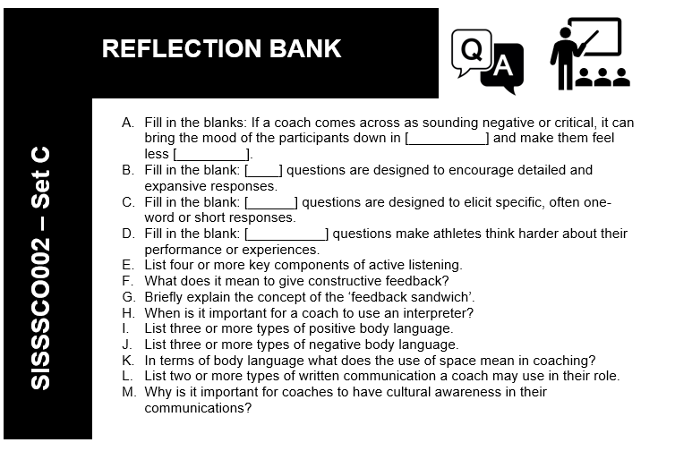

Slide 47
Building Rapport
Rapport is a key element in delivering quality coaching programs
Build Rapport through effective communication
To build a lasting relationship, consider the individuals
Preferences
Expectations
Needs
Complete Inquiry task 2L on page 64

Slide 48

Trust and Respect
Keep promises
Be honest, professional and dependable
Be clear
Respect privacy
Effective Communication
Talk open and honestly
Minimising Challenges and Conflict
Listen
Understand viewpoints
Be flexible

Slide 49


Communication Challenges

Slide 50
