Slide 1



Slide 2
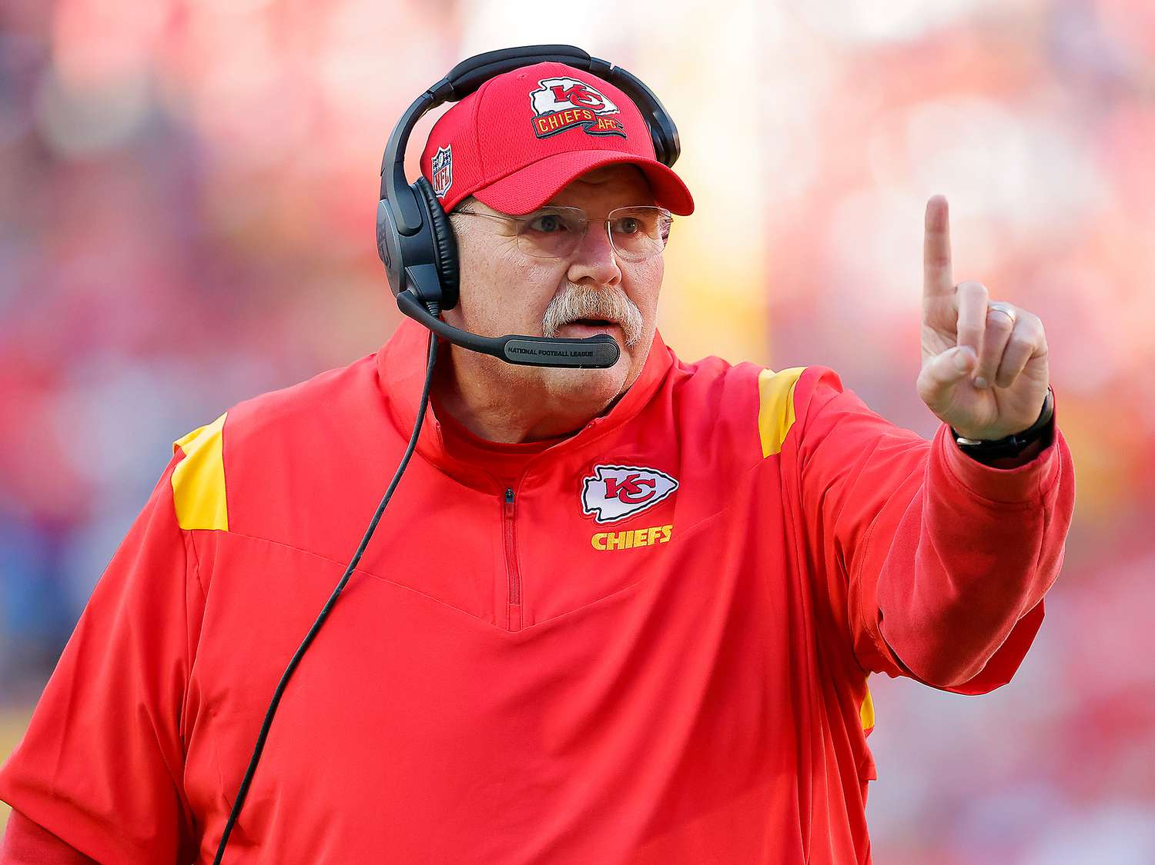
Sports coaches must follow WHS/OHS laws
Their duty is to ensure a safe environment by:
Protecting Physical Health
Teach safe practices on & off the field
Prevent injuries & worsening conditions
Support Mental Health
Recognise participant stress, anxiety, or personal challenges
Provide reassurance & solutions

Slide 3

Workplace Health and Safety Laws
National framework (2011):
1. WHS Act
2. WHS Regulations
3. Codes of Practice
Most states adopted model laws (as of July 2025)
Victoria uses its own OHS laws
Occupational Health & Safety Act 2004
OHS Regulations 2017
Guidance: WorkSafe Victoria
Compliance = follow Victorian standards

Slide 4

Key Safety Responsibilities of Coaches
Provide safe environments
Manage risks
Maintain equipment
Give information & supervision
Prevent discrimination/harassment
Understand OHS procedures
Consult with Health & Safety Reps (HSRs)
Report incidents & hazards

Slide 5
Additional Setting-Specific Requirements
Working with children - WWCC
Schools - First Aid training
Swimming coaches - CPR qualification
Horse riding - helmets, vests, safe saddling
Other: proper briefing and protective equipment
When you start a coaching role, learn the dangers, regulations and procedures!

Slide 6


Consequences of Non-Compliance
Failing OHS obligations = serious consequences:
1. Legal consequences
2. Professional & organisational impact
3. Harm to participants
Legal Consequences
Fines between $360 - $1.7 Million
Improvement/Prohibition notices
Prosecution: criminal charges, enforceable undertakings

Slide 7

Professional & Organisational Impact
Negligence claims (civil lawsuits)
Loss of accreditation/licensing
Disciplinary action (suspension, dismissal)
Reputational damage
Higher insurance premiums
Difficulty gaining future employment

Slide 8



Impacts on Participants
Injury, illness, or death
Psychological trauma
Reduced participation (unsafe reputation)

Slide 9









Following Procedures
Workplace procedures keep everyone safe
Policies must be up-to-date & compliant
Coaches must: read safe work codes, sign duty of care statement, follow procedures always

Slide 10

Final Note OHS isn’t just about preventing accidents Positive conduct & behaviour = mental health support Coaches have dual responsibility: physical & mental health
Mental health is equally important as Physical health
Complete Inquiry task 1A on page 12

Slide 11

Importance of OHS Policies in Sport
Align with legislation
Minimise/prevent accidents, injuries, fatalities
Ensure regulatory compliance through workplace policies
Developing Policies and Procedures
Consultation with experts, stakeholders, safety advisors
Policies guide procedure development
Consider: environments, risks, protective measures

Slide 12

Example Policies & Procedures by Sport
Ball sports: Sun safe, Heat, Air quality - First Aid, Evacuation
Team Sports: Fair play, Infectious diseases - Code of conduct, Grievances
Aquatic Sports: Water safety, Chemical awareness - CPR, Chemical handling
Snow Sports: Snow safe, Adverse weather - First Aid, Stop play
Motorsport: PPE, Safe handling - Driving conduct, Accident/fire procedures
Horse Riding: Safe riding, Concussion - Animal handling, CPR
Common Work/Sport Hazards
Equipment use
PPE requirements
Hazardous substances
Manual handling
Bullying/harassment
Communication & reporting

Slide 13

Working Safely with Equipment
Inspection & maintenance policy - checks before each session
Safe use & storage policy - instructions, supervision, correct storage
Risk assessment policy - pre-session checks, dynamic assessment, documentation
Lithium-ion Batteries
Risks: fire, explosion, toxic fumes
Reference: WorkSafe Victoria guidance

Slide 14

PPE Policies & Procedures
Mandatory PPE requirements – Know what is needed, checks, rules
PPE fit, condition, maintenance – Education and inspections
PPE for coaches/support staff – Not just for players
Training & instruction for PPE use - briefings
Incident reporting on PPE failures – report all problems

Slide 15

Hazardous Substances in Sport
Cleaning agents, pool/spa treatments, equipment maintenance
Sports equipment materials
Medications & performance-enhancing substances
Body fluids & airborne pathogens
Policies for Hazardous Substances
Education & awareness
Safety Data Sheets (SDS)
PPE use
First aid response
Complete Inquiry task 1B on page 21

Slide 16
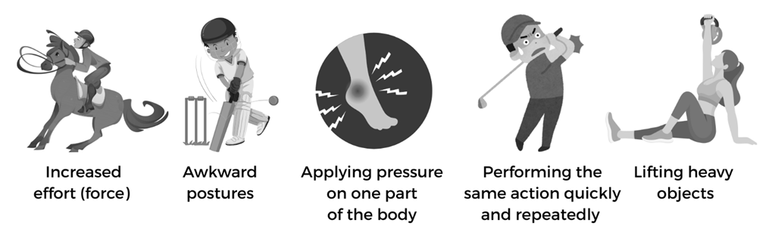
Safe Manual Handling
Tasks like: lifting, lowering, pushing, pulling, carrying, moving, restraining
Risks: musculoskeletal injuries
Examples: sprains, strains, joint injuries, disc issues, nerve compression
Why Injuries Occur

Slide 17

Manual Handling Risk Assessment Policy
Identify hazardous tasks
Assess risks (force, posture, repetition, distance, environment, capability)
Document risks and controls
Hierarchy of Controls Policy
Eliminate: avoid manual handling entirely
Substitute: lighter/safer equipment
Engineering: trolleys, carts, better storage design
Administrative: SOPs, safe lifting techniques, signage, training, task rotation, breaks
PPE: gloves, footwear, protective clothing
Safe Operating Procedures (SOPs)
Team lifting requirements
Clear communication protocols
Proper lifting technique (bend knees, back straight, load close, avoid twisting)
Team Lifting & Assistance Policy
Assess load before lifting
Ask for help – never force it
Use designated leader & clear commands
Lift and move smoothly as a team
Reporting & Incident Management Policy
Report injuries and near misses promptly
Participate in investigations
Help improve procedures through feedback
1000kgs

Slide 18

Bullying and Harassment
OHS Act (Vic) requires eliminating risks to mental health to provide a safe, healthy environment
Equal Opportunity Act 2010 (Vic) - protects against discrimination
Racial & Religious Tolerance Act 2001 (Vic) - promotes respect
Guidance for Sporting Organisations
WorkSafe Victoria – psychological health support
Vic Equal Opportunity & Human Rights Commission – obligations for sporting clubs
eSafety Australia – online safety in sport
Sport Integrity Australia – safeguarding children
Play by the Rules – training & resources

Slide 19
Recommended Policies
Zero tolerance policy on bullying and harassment – Model behaviour, prevent and intervene
Clear reporting and complaints procedure – Know the reporting process
Investigation and resolution policy – Cooperate, Discipline, Restore, Monitor
Review and improvement Policy – Provide feedback, Stay Informed
Education and Training Policy – Train and be aware
Complete Inquiry task 1C on page 29

Slide 20






Communication and Reporting
OHS policies and procedures for a sporting coach regarding communication and reporting.
Open Communication and consultation policy
-Regular, brief discussions with all involved
-Allow concerns and questions
-Participate and Communicate
Hazard Identification and Reporting Policy
-Contain hazards and warn others
-Report hazards clearly
-Allow for inspections
-Follow up
Incident, Injury and Near Miss Reporting Policy
-Ensure Safety of Injured persons
-Notify the right people
-Ensure Privacy
-Assist with investigations

Slide 21
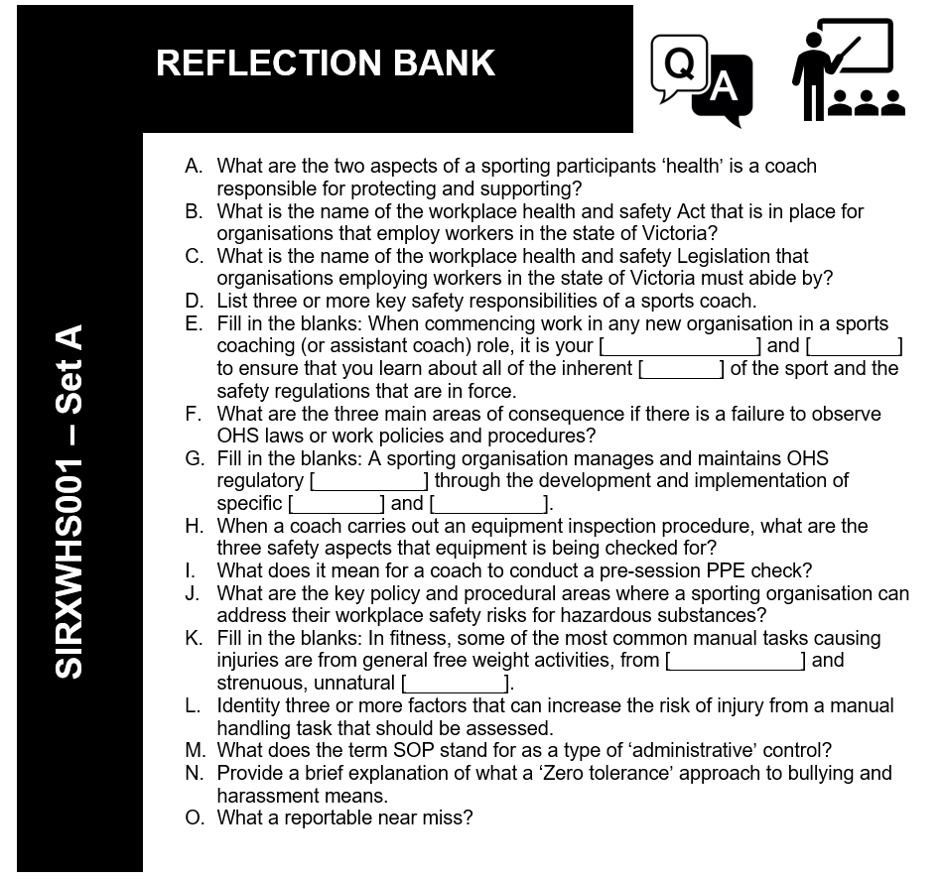

Slide 22



Recognising potential emergency situations
When it comes to ‘potential’ emergencies, a coach should have an in-depth understanding for their specific sport which shall incorporate:
a clear understanding of the risks
the preventative measures to take (controls)
the organisation's emergency response plan, including first aid protocols
communication procedures.

Slide 23
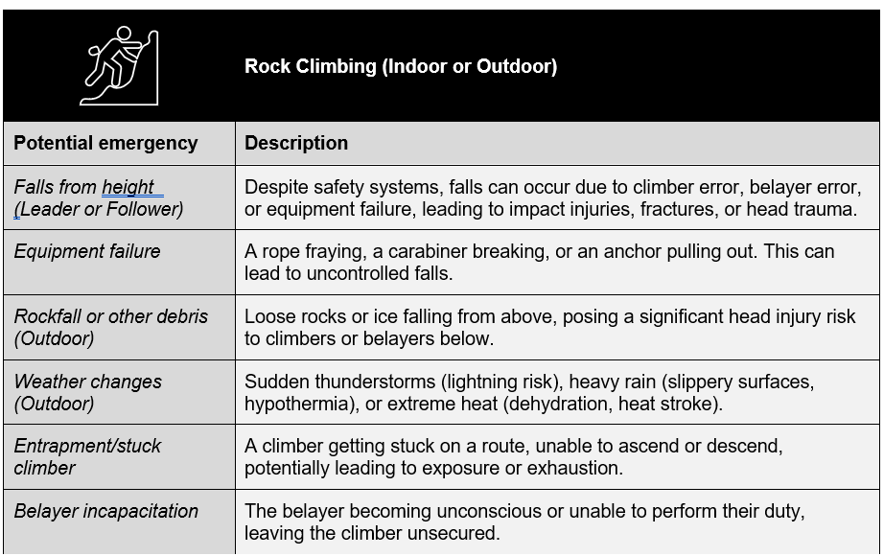
Example risk assessment

Slide 24
What Happens when a sport fails to identify the potential for an emergency?
Inadequate Pre-Event Communication of Risks to Participants = FAIL
Adequate Consultation with External Emergency Services and Authorities = FAIL
Effective Internal Communication System During the Event = FAIL
Sufficient Monitoring and Reporting of Changing Conditions = FAIL
Clear Incident Reporting and Escalation Protocols for Staff/Volunteers = FAIL

Slide 25





Emergency Preparedness
 | Emergency Action Plan (EAP) Having a comprehensive emergency action plan is crucial for effective response. This includes communication protocols, evacuation routes, assembly points and designated first aid areas.
 | Communication Clear and concise communication with attendees about potential hazards, safety procedures, and emergency instructions is vital.
 | Weather monitoring Regularly monitoring weather forecasts and utilising weather alerts is essential to anticipate and prepare for potential hazards.
 | Training and drills Regular training for staff and volunteers on emergency procedures and first aid can improve response time and effectiveness.
 | Medical support On-site medical personnel and ambulances should be readily available to handle medical emergencies.
Complete Inquiry task 1D on page 40

Slide 26

Policies and procedures designed for emergency response
Key areas of emergency response:
Responding to an emergency.
Emergency evacuations.
Communication.
Reporting emergency incidents

Slide 27


What’s an appropriate response?
Ensure Safety
Assess the situation and any casualties
Call 000 for emergency services
Delegate Roles
Secure and Preserve the Scene
DO NOT ATTEMPT PROCEDURES YOU ARE NOT TRAINED FOR

Slide 28

Emergency Evacuations
Triggered By:
Fire
Gas Leaks/Chemical spill
Structural Damage
Severe Weather
Security Threat
Widespread Medical Emergency
Evacuate immediately
Do Not Leave Anyone Behind
Alert others / Raise the alarm
Assemble at designated point

Slide 29



During Evacuation
Sweeping and leading – Do not re-enter building!
Liaison with Emergency Services
Control and reassurance
Post Evacuation
Remain at assembly point
Await Further instructions
Communicate Emergency Info
Debrief

Slide 30

Reporting emergency incidents
Formal Incident Reporting procedure
Documentation
Include all factual details
WorkSafe Victoria Notification
Investigation
Review and update OHS Policies and Procedures
Complete Inquiry task 1E on page 47 and 1F on page 49

Slide 31
