Slide 1
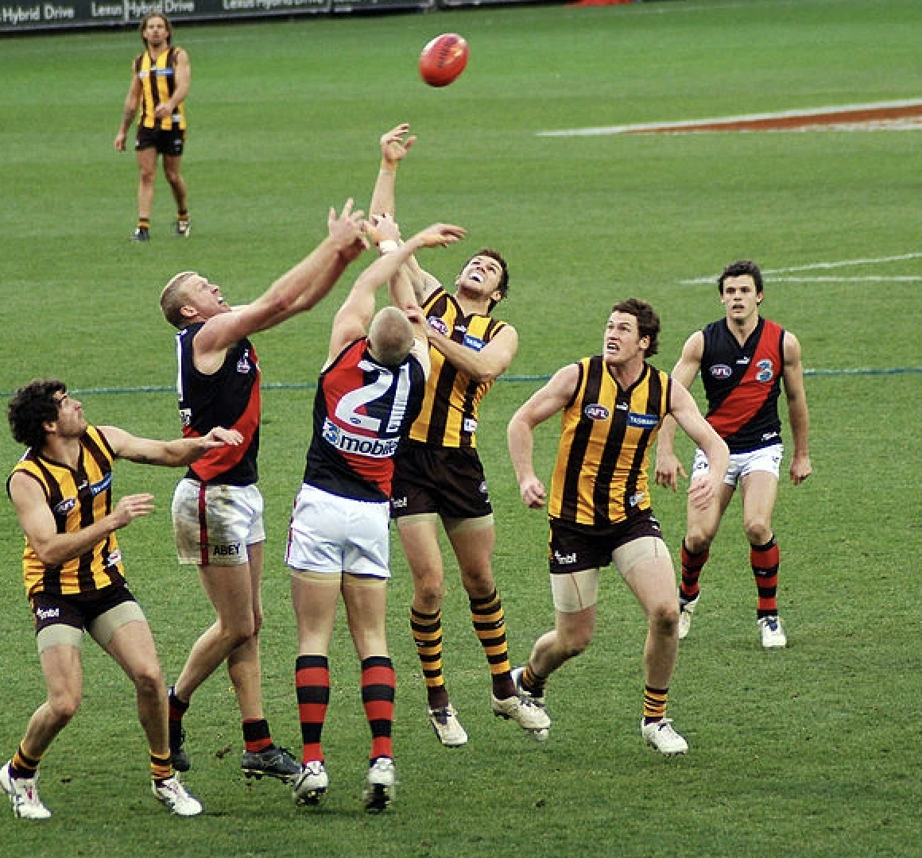

SISSSPT001 IMPLEMENT SPORTS INJURY PREVENTION AND MANAGMENT STRATEGIES

Slide 2
The athletes you will be working and dealing with may be a beginner at local level through to high performance level competitors in a more elite setting.
SISSSPT001

Slide 3
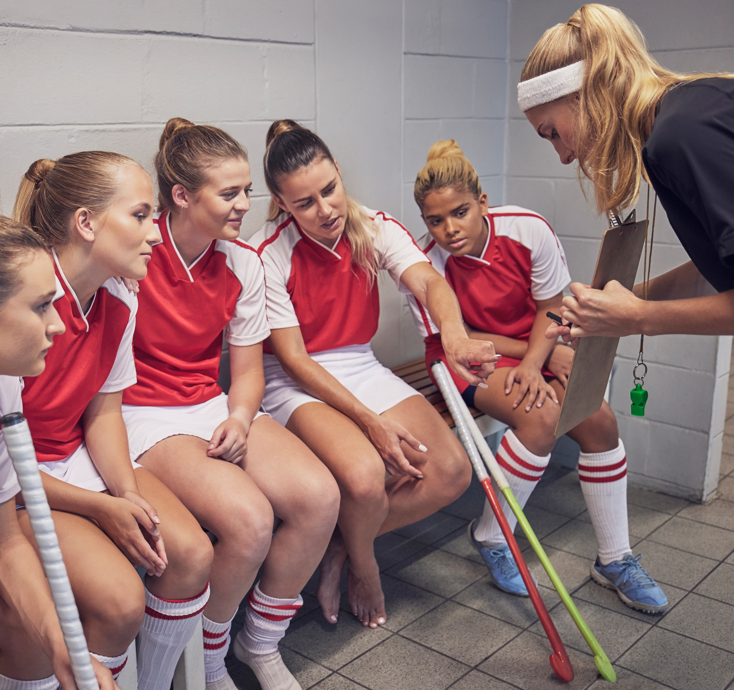
Injury surveillance
What are the costs?
In order to effectively implement and manage sports injury prevention, you need to monitor participants and contribute to injury surveillance.
Impact on healthcare system
Personal medical costs
Loss of income
Anxiety and depression
Psychological problems
Body image
Illness
Abuse from players, coaches and staff
Disordered eating
SISSSPT001

Slide 4
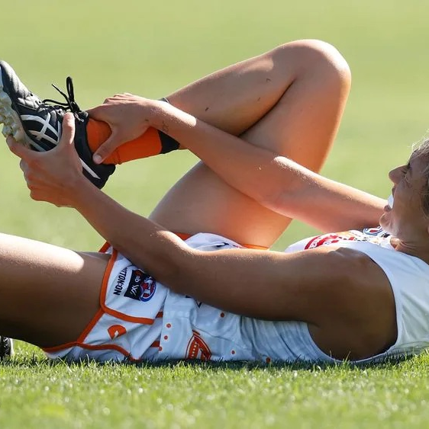
What are the effects of injury?
If you are injured, you may be unable to exercise and be active on a regular basis. This may contribute to a loss of physical fitness, weight gain, inability to sleep, loss of muscle mass and strength as well as flexibility.
You may also experience feelings of irritability, stress, and depression, as your body is not getting its usual dose of endorphins.
A lack of exercise due to injury can also affect a persons’ social life.
People who don't exercise may feel more isolated. The effect is particularly pronounced in children.
Read page 83 to 85 and create a diagram with injury in the centre and 5 potential issues that can come from injury.
For each issue provide 2 dot points.
SISSSPT001

Slide 5
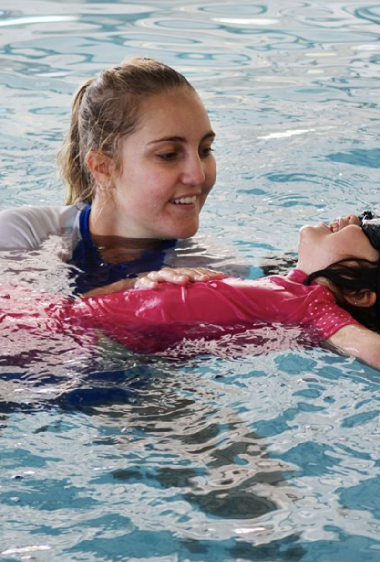
Duty of care is about taking reasonable measures to protect the health and safety of an individual within your care. There is no legality that exists which requires an individual to provide first aid unless a duty of care connection exists In this instance you are bound by law to do “everything within your abilities” to meet the duty of care. Occupational health and safety dictate that you must ensure the safety and health or yourself and others; this means not placing yourself in a dangerous situation in order to assist someone else. List 5 common injuries that you may come across in your role in sport?
Organisational policies and procedures
SISSSPT001

Slide 6
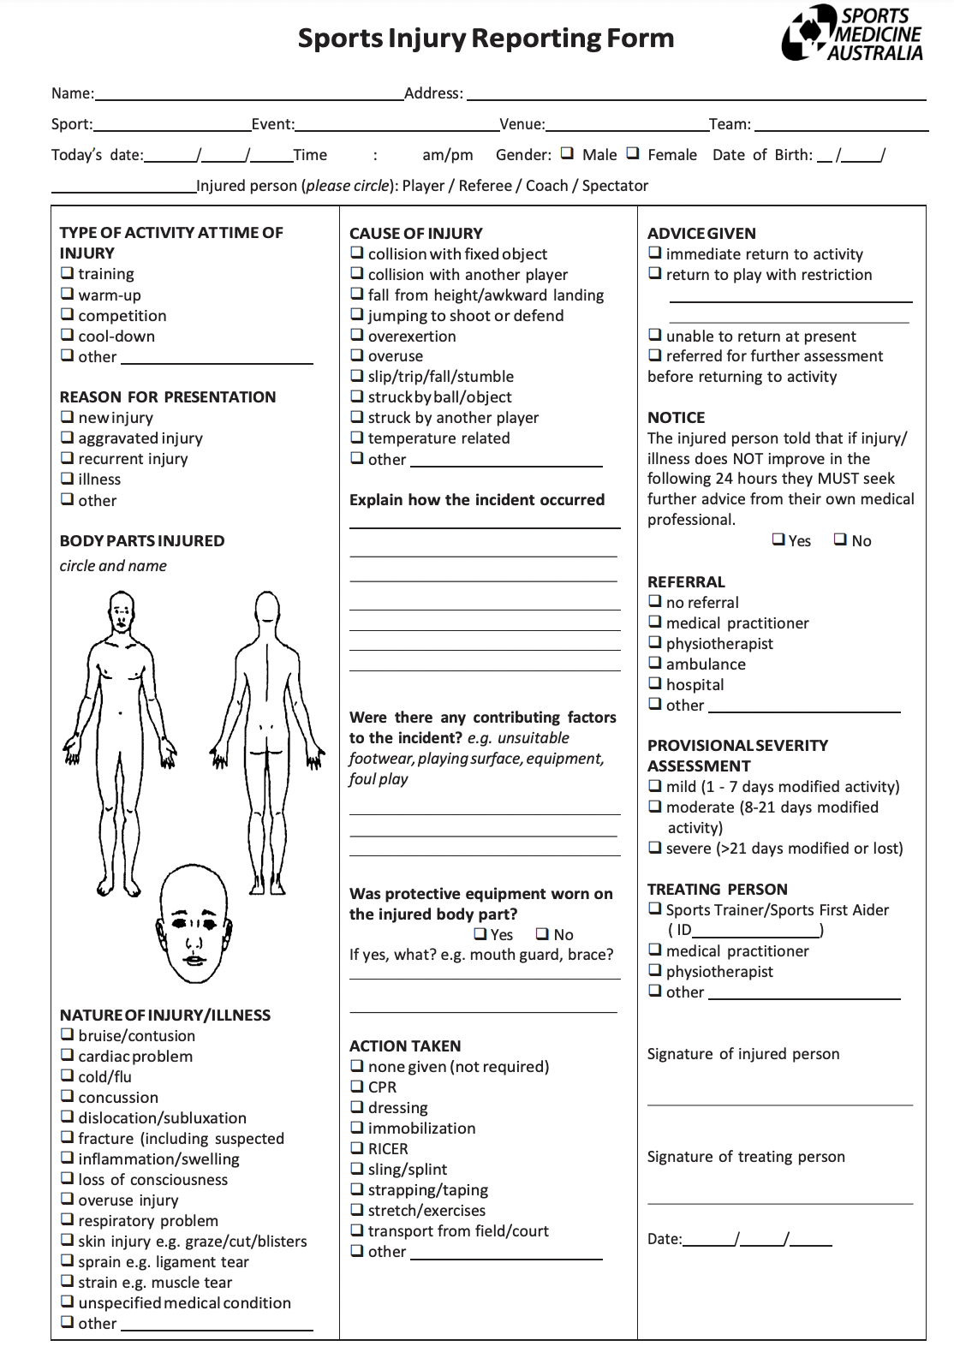
Reporting and Documentation
Incident reports
SISSSPT001

Slide 7
When do I have to report?
The Act requires organisations/sporting clubs and workplaces to report serious incidents or accidents, keep up to date and comprehensive reports of equipment servicing, as well as obtaining specific licenses based on the nature and role of the workplace.
There are serious penalties and consequences for workplaces that fail to comply with all legislative requirements for their industry. These penalties may include hefty fines and suspension of license for a period of time.
Do you know how long you have to report an incident that requires hospitalization to work safe?
48 hours
Complete Activity 2A
SISSSCO001

Slide 8

In sports organisations, a number of key stakeholders play crucial roles in the prevention and management of injuries.
As part of injury surveillance, you will need to keep track of injury incidence and analyse injury patterns in your particular sport in cooperation with the authorised parties.
Athletes, coaches, support workers, and medical experts are a few of these.
When it comes to the execution of sports injury management and preventive measures, each has very significant duties and obligations.
Read page 90 – 94 and provide a summary of each.
SISSSCO001

Slide 9
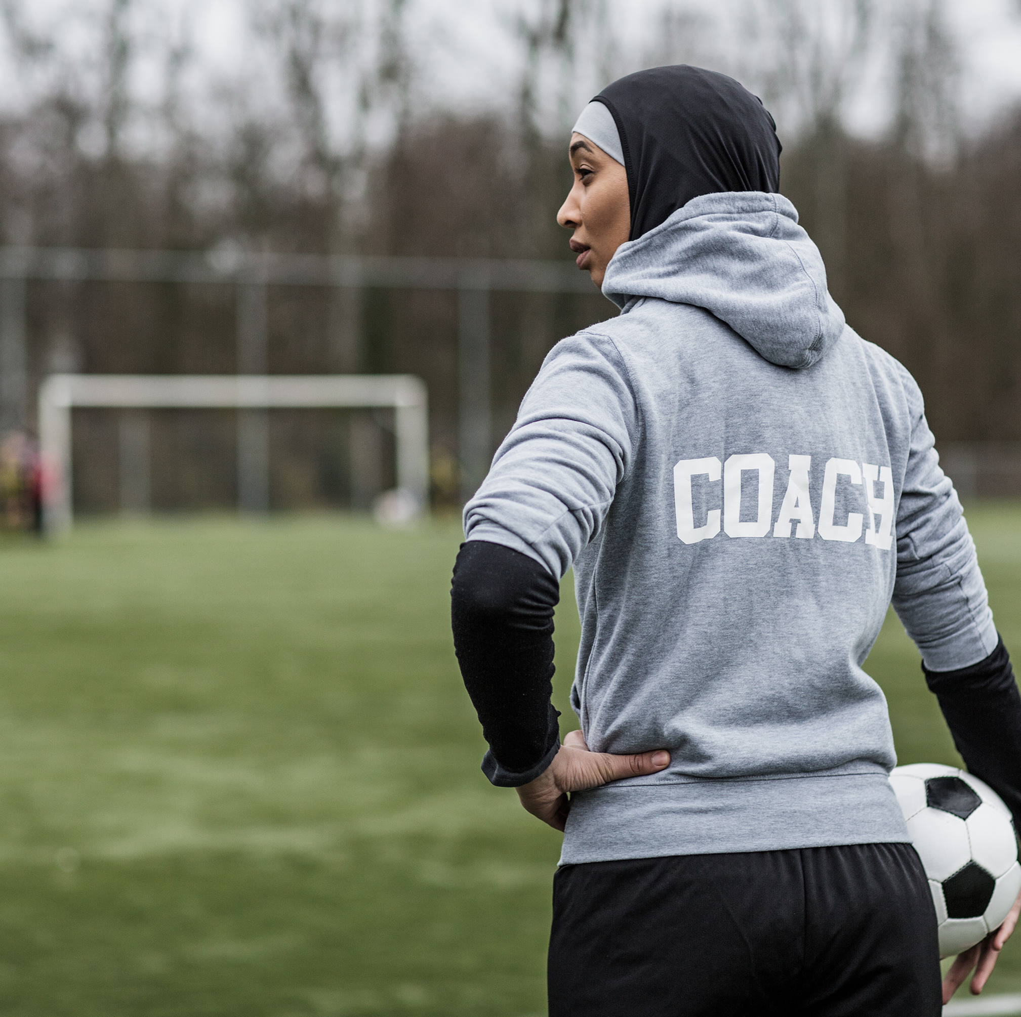
LIMITATIONS OF YOUR ROLE
As a sports trainer, you are a professional who is trained to provided care and support to athletes. While sports trainers play an important role in the care and treatment of athletes, there are many limitations to their ability to advise on injuries, illnesses, medical conditions, medications, injury prevention and management, nutrition, and hydration.
SISSSCO001

Slide 10
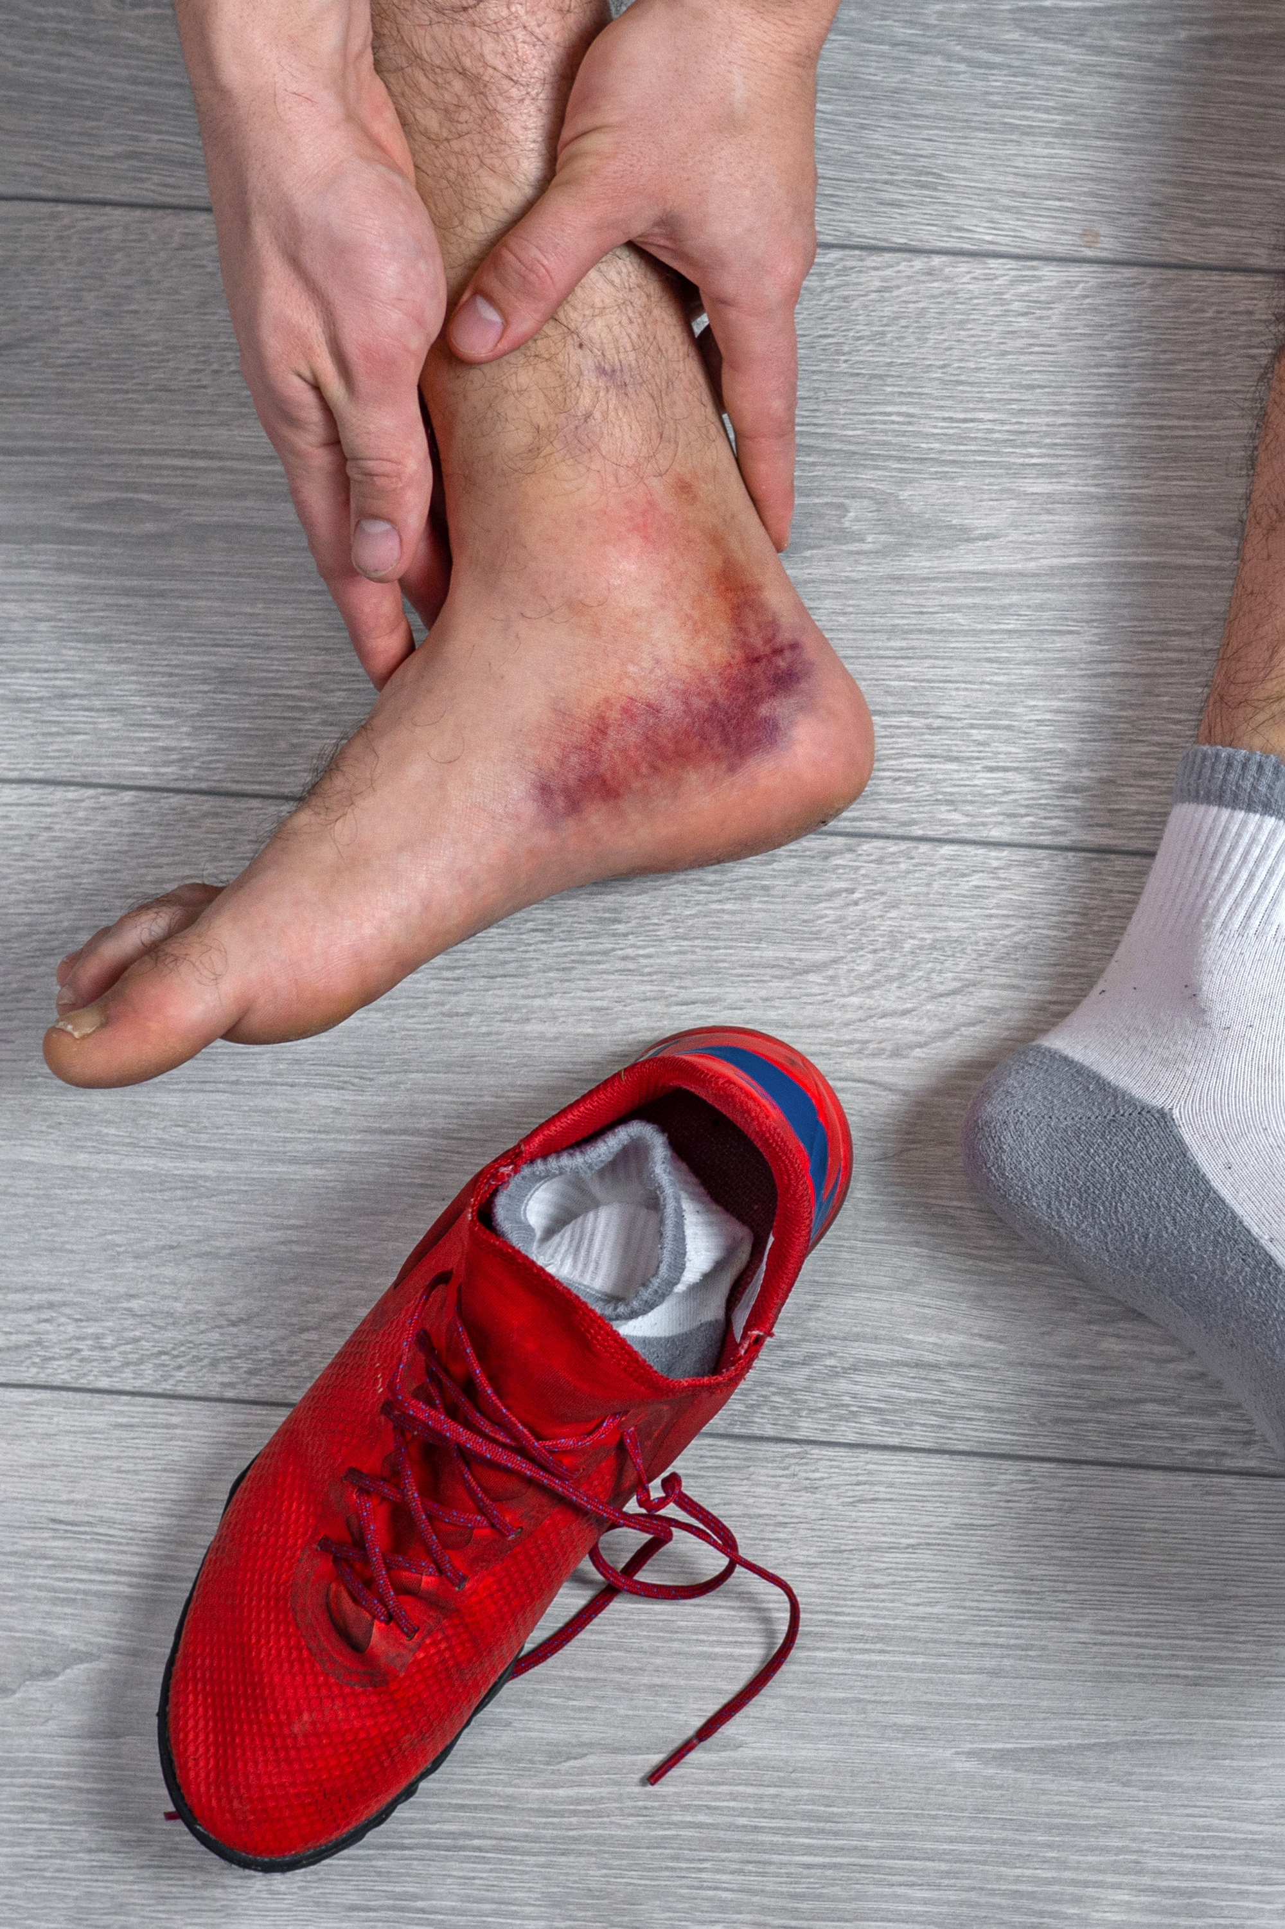
Types of sports injuries
There are many different types of sports injuries that can occur. Some common types of sports injuries include:
Sprains: A sprain is an injury to a ligament, which is a tough, fibrous tissue that connects bones together at a joint. Sprains can occur when a joint is stretched or twisted beyond its normal range of motion.
Strains: A strain is an injury to a muscle or tendon, which is a tough, fibrous tissue that connects muscles to bones. Strains can occur when a muscle is stretched or torn due to overuse or overexertion.
Fractures: A fracture is a break in a bone. Fractures can be caused by a direct blow or impact, or by excessive twisting or bending forces.
Dislocations: A dislocation is an injury in which a bone is displaced from its normal position at a joint. Dislocations can be caused by a direct blow or impact, or by excessive twisting or bending forces.
Concussions: A concussion is a type of traumatic brain injury that occurs when the brain is jarred or shaken inside the skull. Concussions can be caused by a direct blow to the head or by the head and neck being violently shaken.
Overuse injuries: Overuse injuries are injuries that occur due to repetitive stress or strain on a specific part of the body. Overuse injuries can be caused by repeating the same motion or activity too often, or by training at too high an intensity or volume.
Can you see these in the next video? Watch the video and try to list each injury.
SISSSCO001

Slide 11


Slide 12
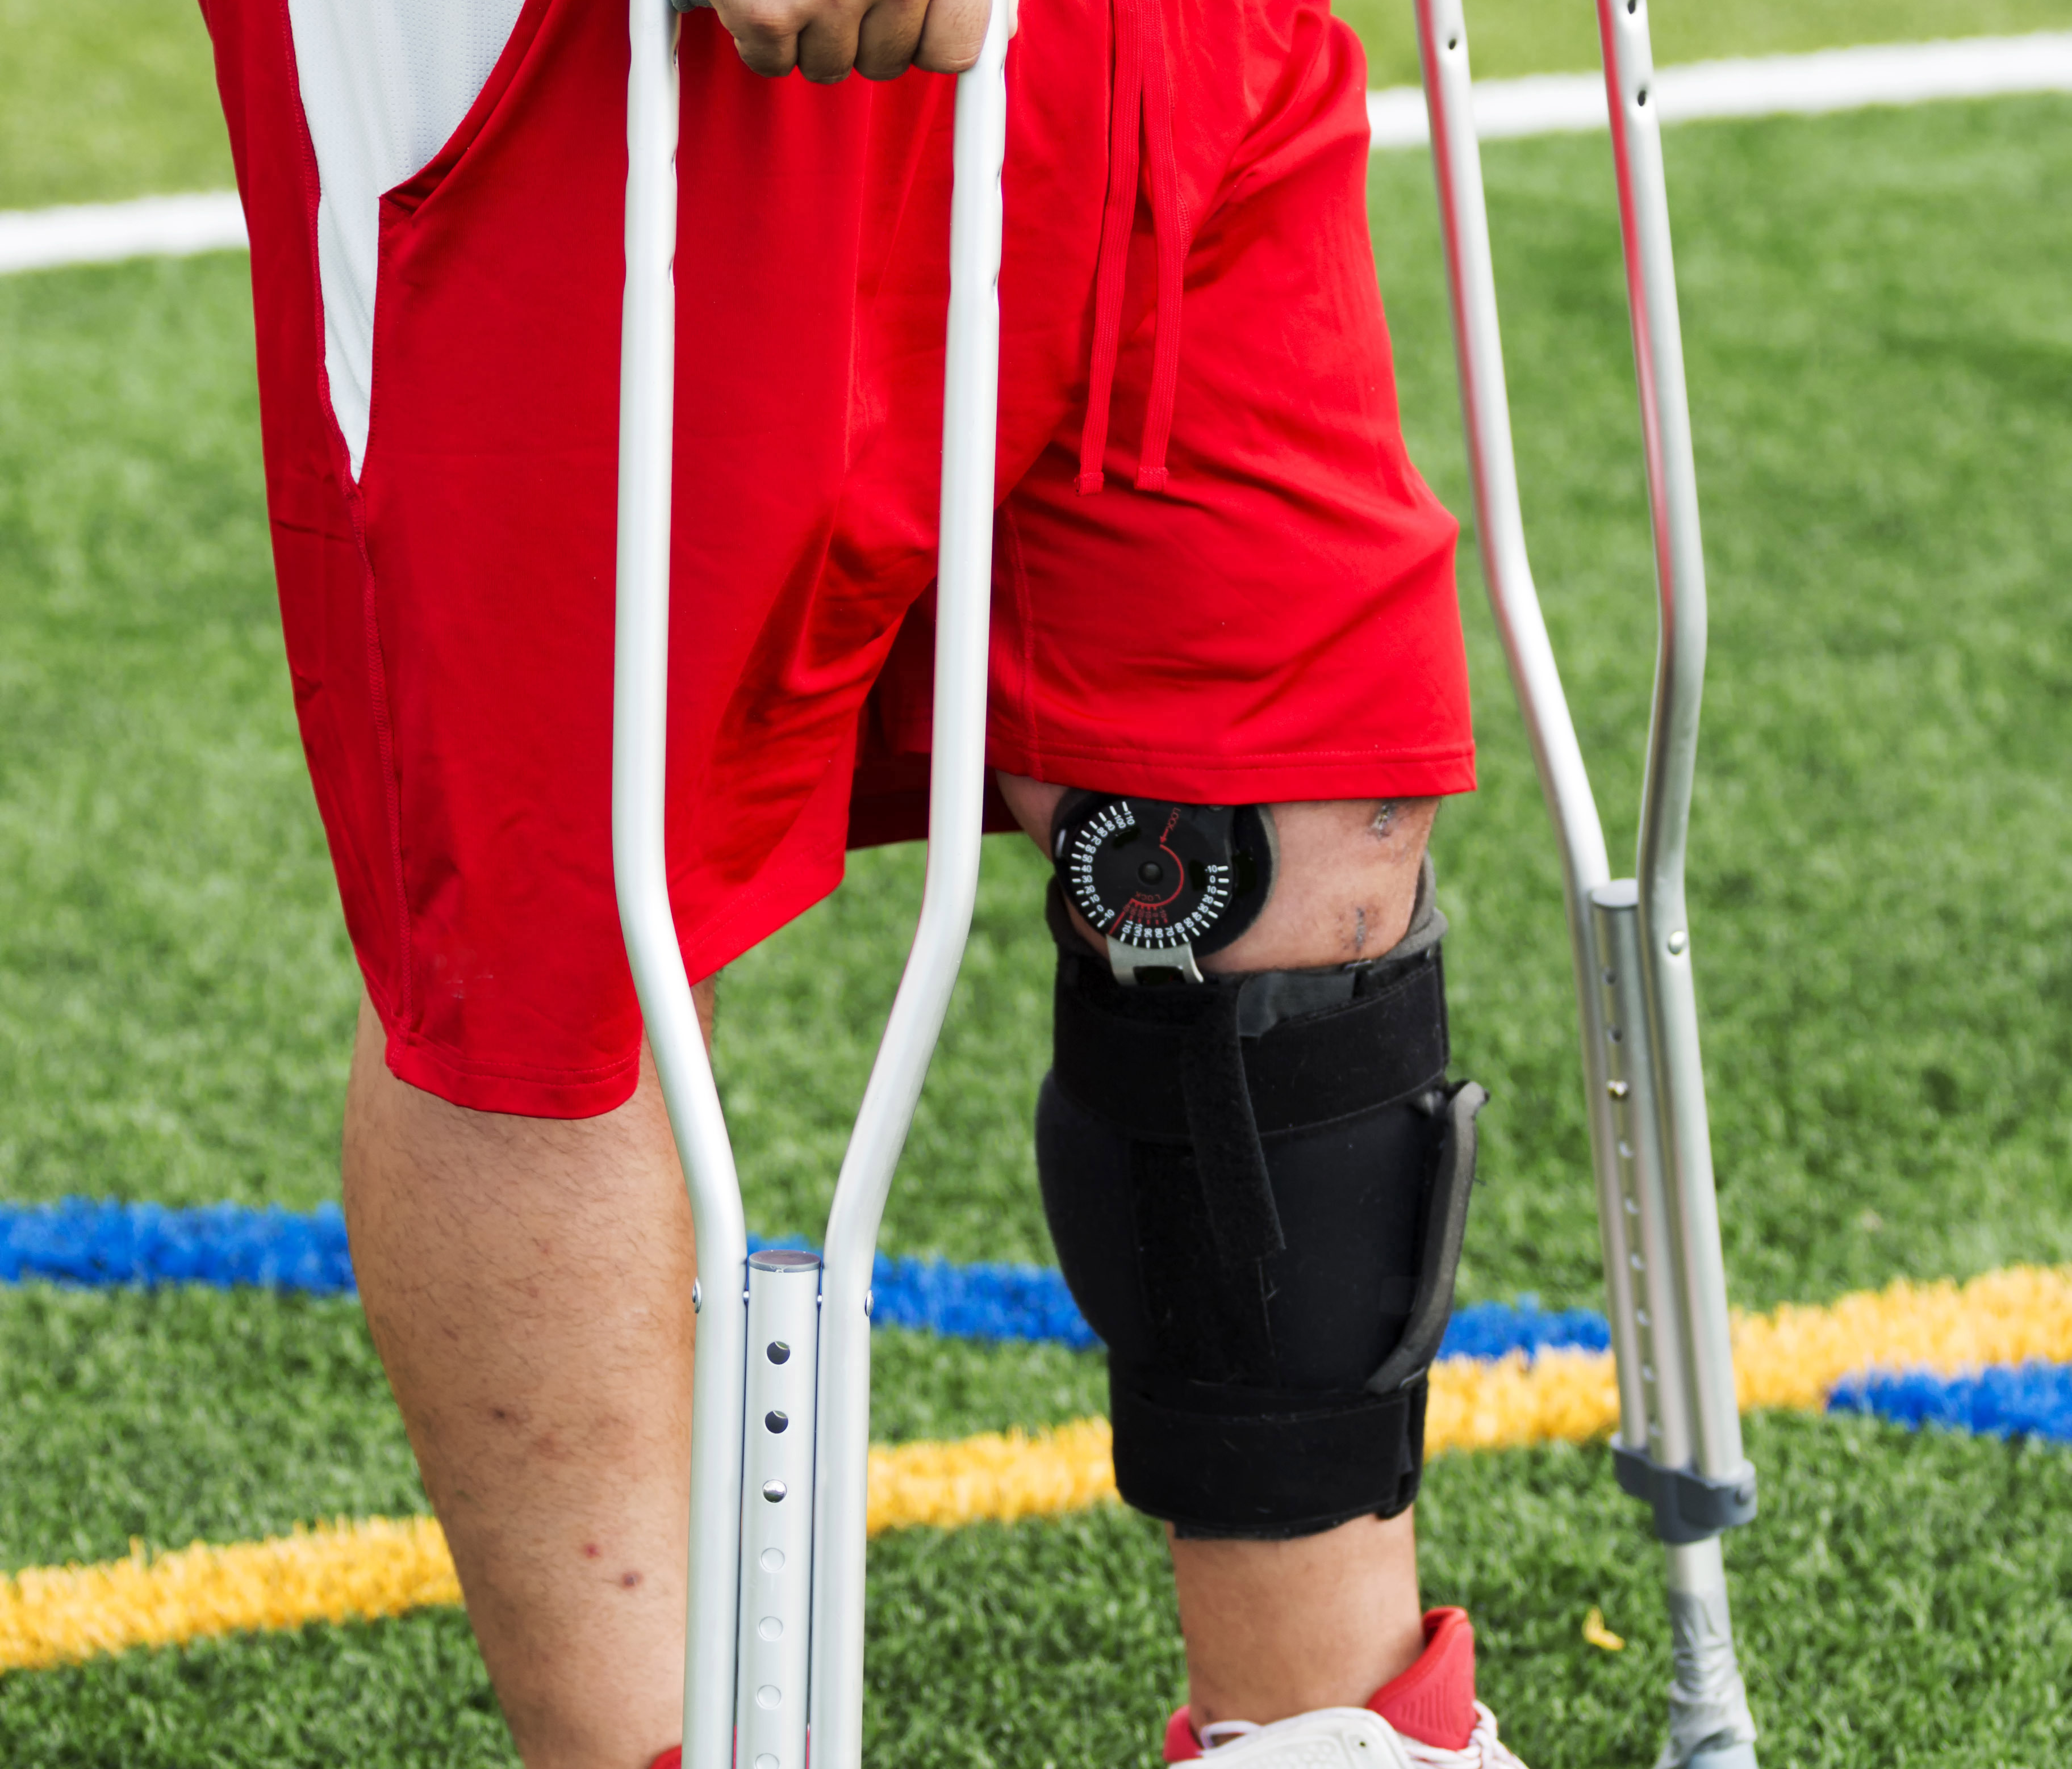
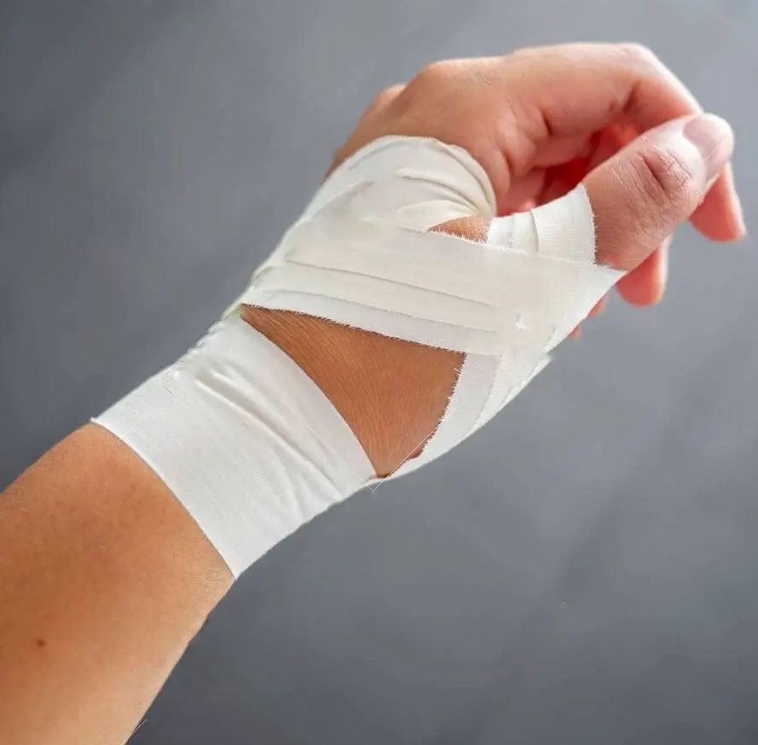
INFORMATION ON SPORTS INJURIES
Read page 95 -97 and summarise the information in a table format.
Complete Activity 2B
SISSSCO001

Slide 13

Provide a summary of key points on 1. Screening 2. Training and physical conditioning 3. Protective equipment 4. Hydration and nutrition s Injuries risk
Medical conditions can have a significant impact on an athlete's ability to participate in sports or physical activity.
By effectively managing medical conditions, athletes can reduce the risk of injury and improve their overall performance and well-being.
Read page 100 – 105
SISSSCO001

Slide 14
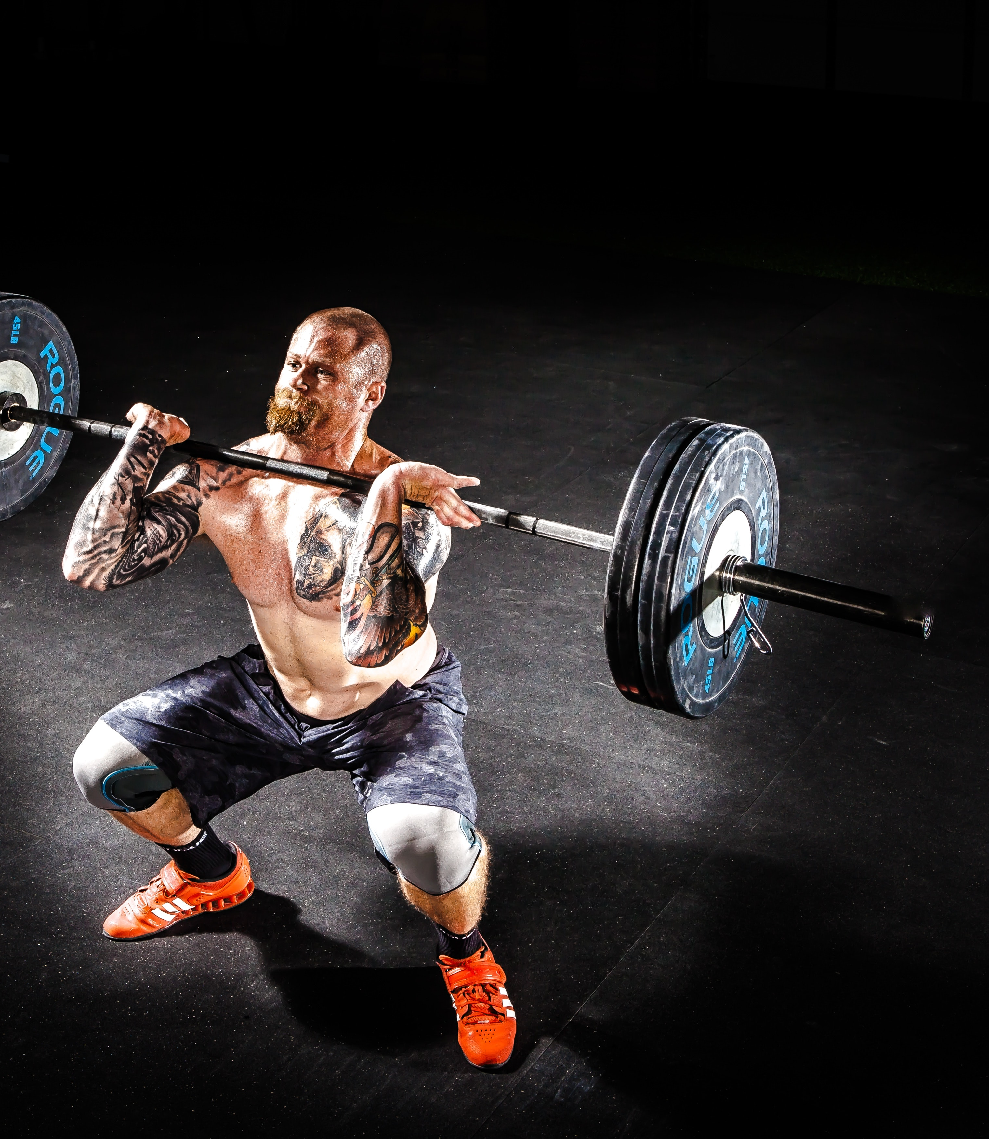
Injury prevention strategies
As part of your role, you will need to assess the effectiveness of a range of injury prevention programs relevant to your own sporting area in consultation with the coach and relevant health professionals. It is important that you contribute to the development of a sport injury prevention program according to organisational policies and procedures.
Injury prevention programs may include:
Musculoskeletal
Neuromuscular
Running exercises
Balance and body control exercises
Plyometrics
Strengthening exercises
Stretching exercises
For each of the above, partner up and come up with 5 dot points for each.
Complete Activity 2C
SISSSPT001

Slide 15
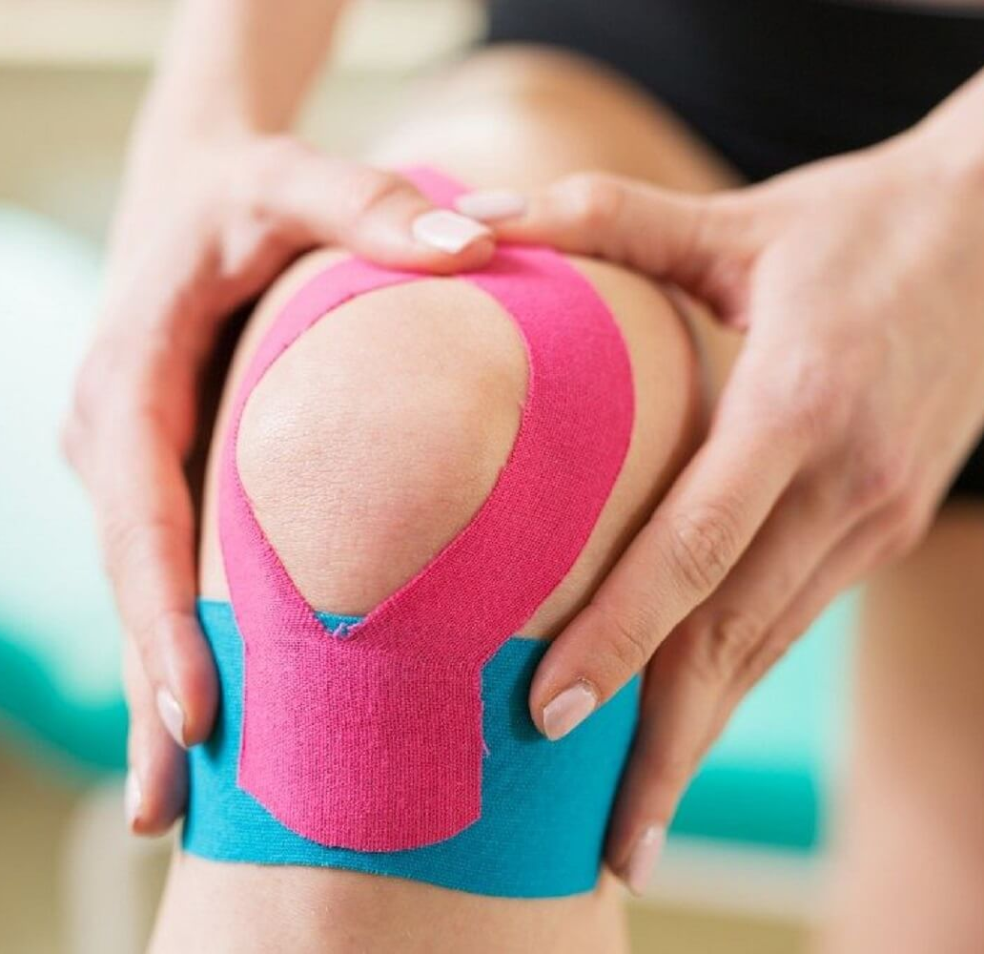
Taping
The main purpose of sports taping is to provide support and stability to injured joints, muscles, and other tissues, and to reduce the risk of further injury.
Read pages 112 – 118
After watching each of the taping tutorials practice taping each part of the body outlined in the chapter.
SISSSPT001

Slide 16
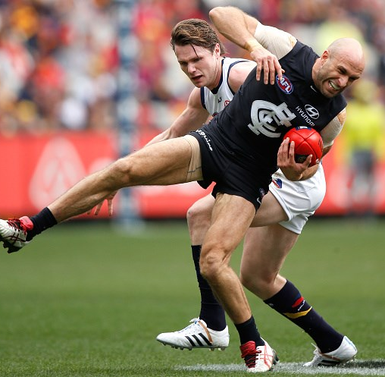
WHAT DO I DO?
Medical management and assessment
Your first response to an injury is the most important in order to prevent further injury from occurring. As a sports trainer you need to be able to make decisions on whether a player is able to continue to play or if they need to be taken from the field. In some sports those decisions need to be made very quickly and under a lot of pressure.
SISSSPT001

Slide 17
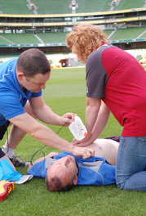
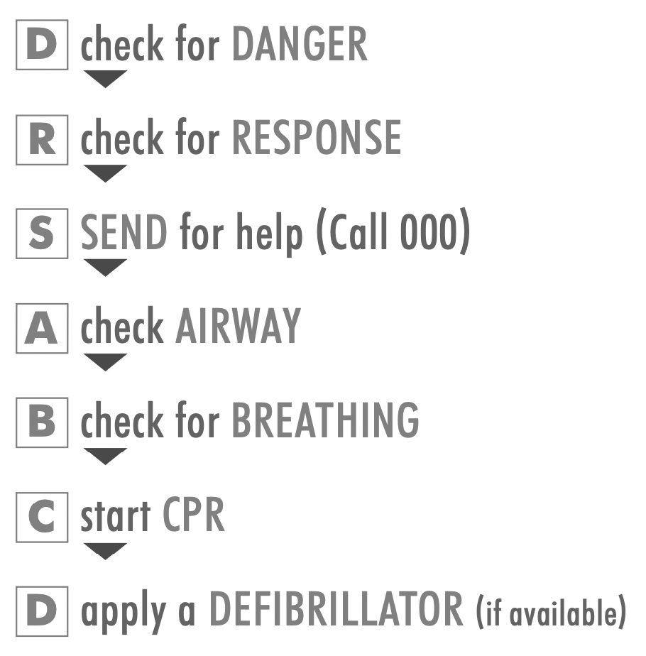
Read pages 119 -123
Create a summary of the medical management and assessment process when dealing with a sports injury
Complete SET A of reflection bank questions
SISSSPT001

