Slide 1
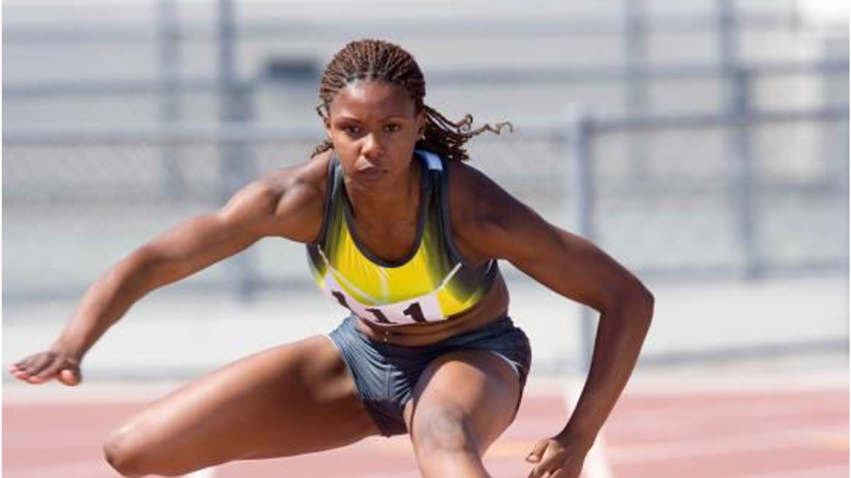

SISSSCO015
PREPARE PARTICIPANTS FOR SPORT COMPETITION

Slide 2
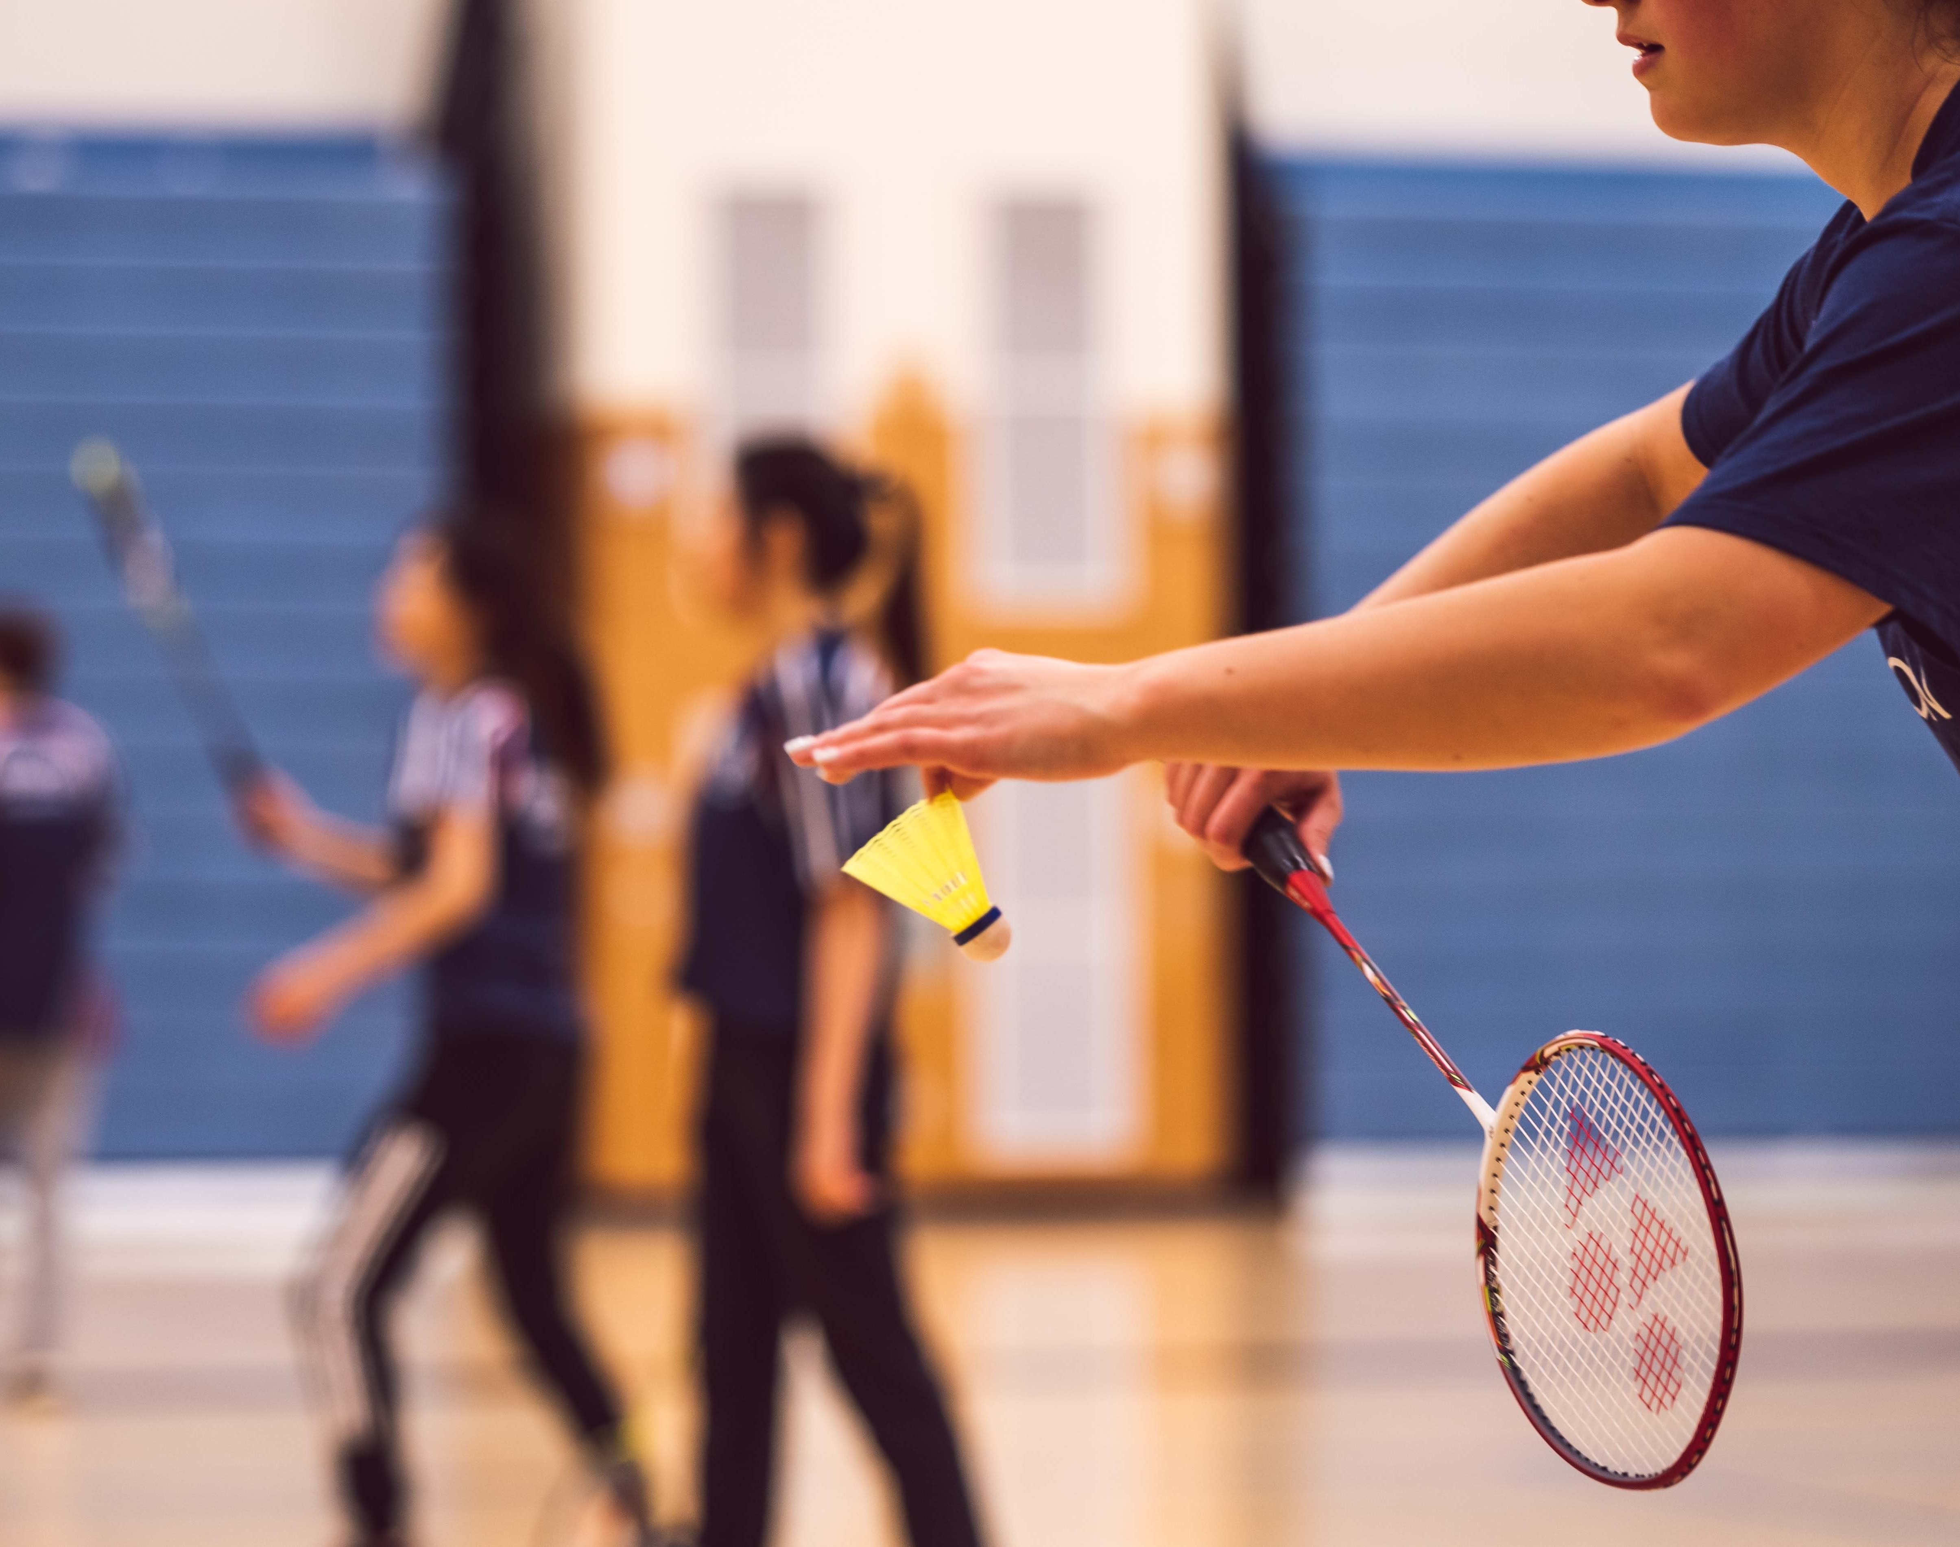
As a coach or trainer, it is your responsibility to ensure that your participants are planned, organised, and properly prepared for the appropriate level of competition.
SISSSCO015

Slide 3
Mental Readiness: Being a competitor in the event or competition, showing confidence, managing anxiety and nerves, and understanding strategy.
Physical Readiness: Being physically conditioned and trained in the skills required for a level of competition.
How do we know when a participant is ready for competition?
How can we choose the right level of competition to match the developmental standard of your participants?
Can I be a source of motivation for my participants?
There are ways in which you can determine the mental and physical readiness of your participants. They may include:
Fitness tests (e.g., beep test, agility runs, time trials, strength, and endurance tests)
Observations of physical performance, skills, and behaviour
Meetings and discussions with individual participants
Discussions with specialist support staff such as doctors, physiotherapists, and psychologists
Your behaviours as a coach/trainer, can influence motivation in your participants and help them feel like they control their own behaviour even with the presence of external or material rewards.
SISSSCO015

Slide 4
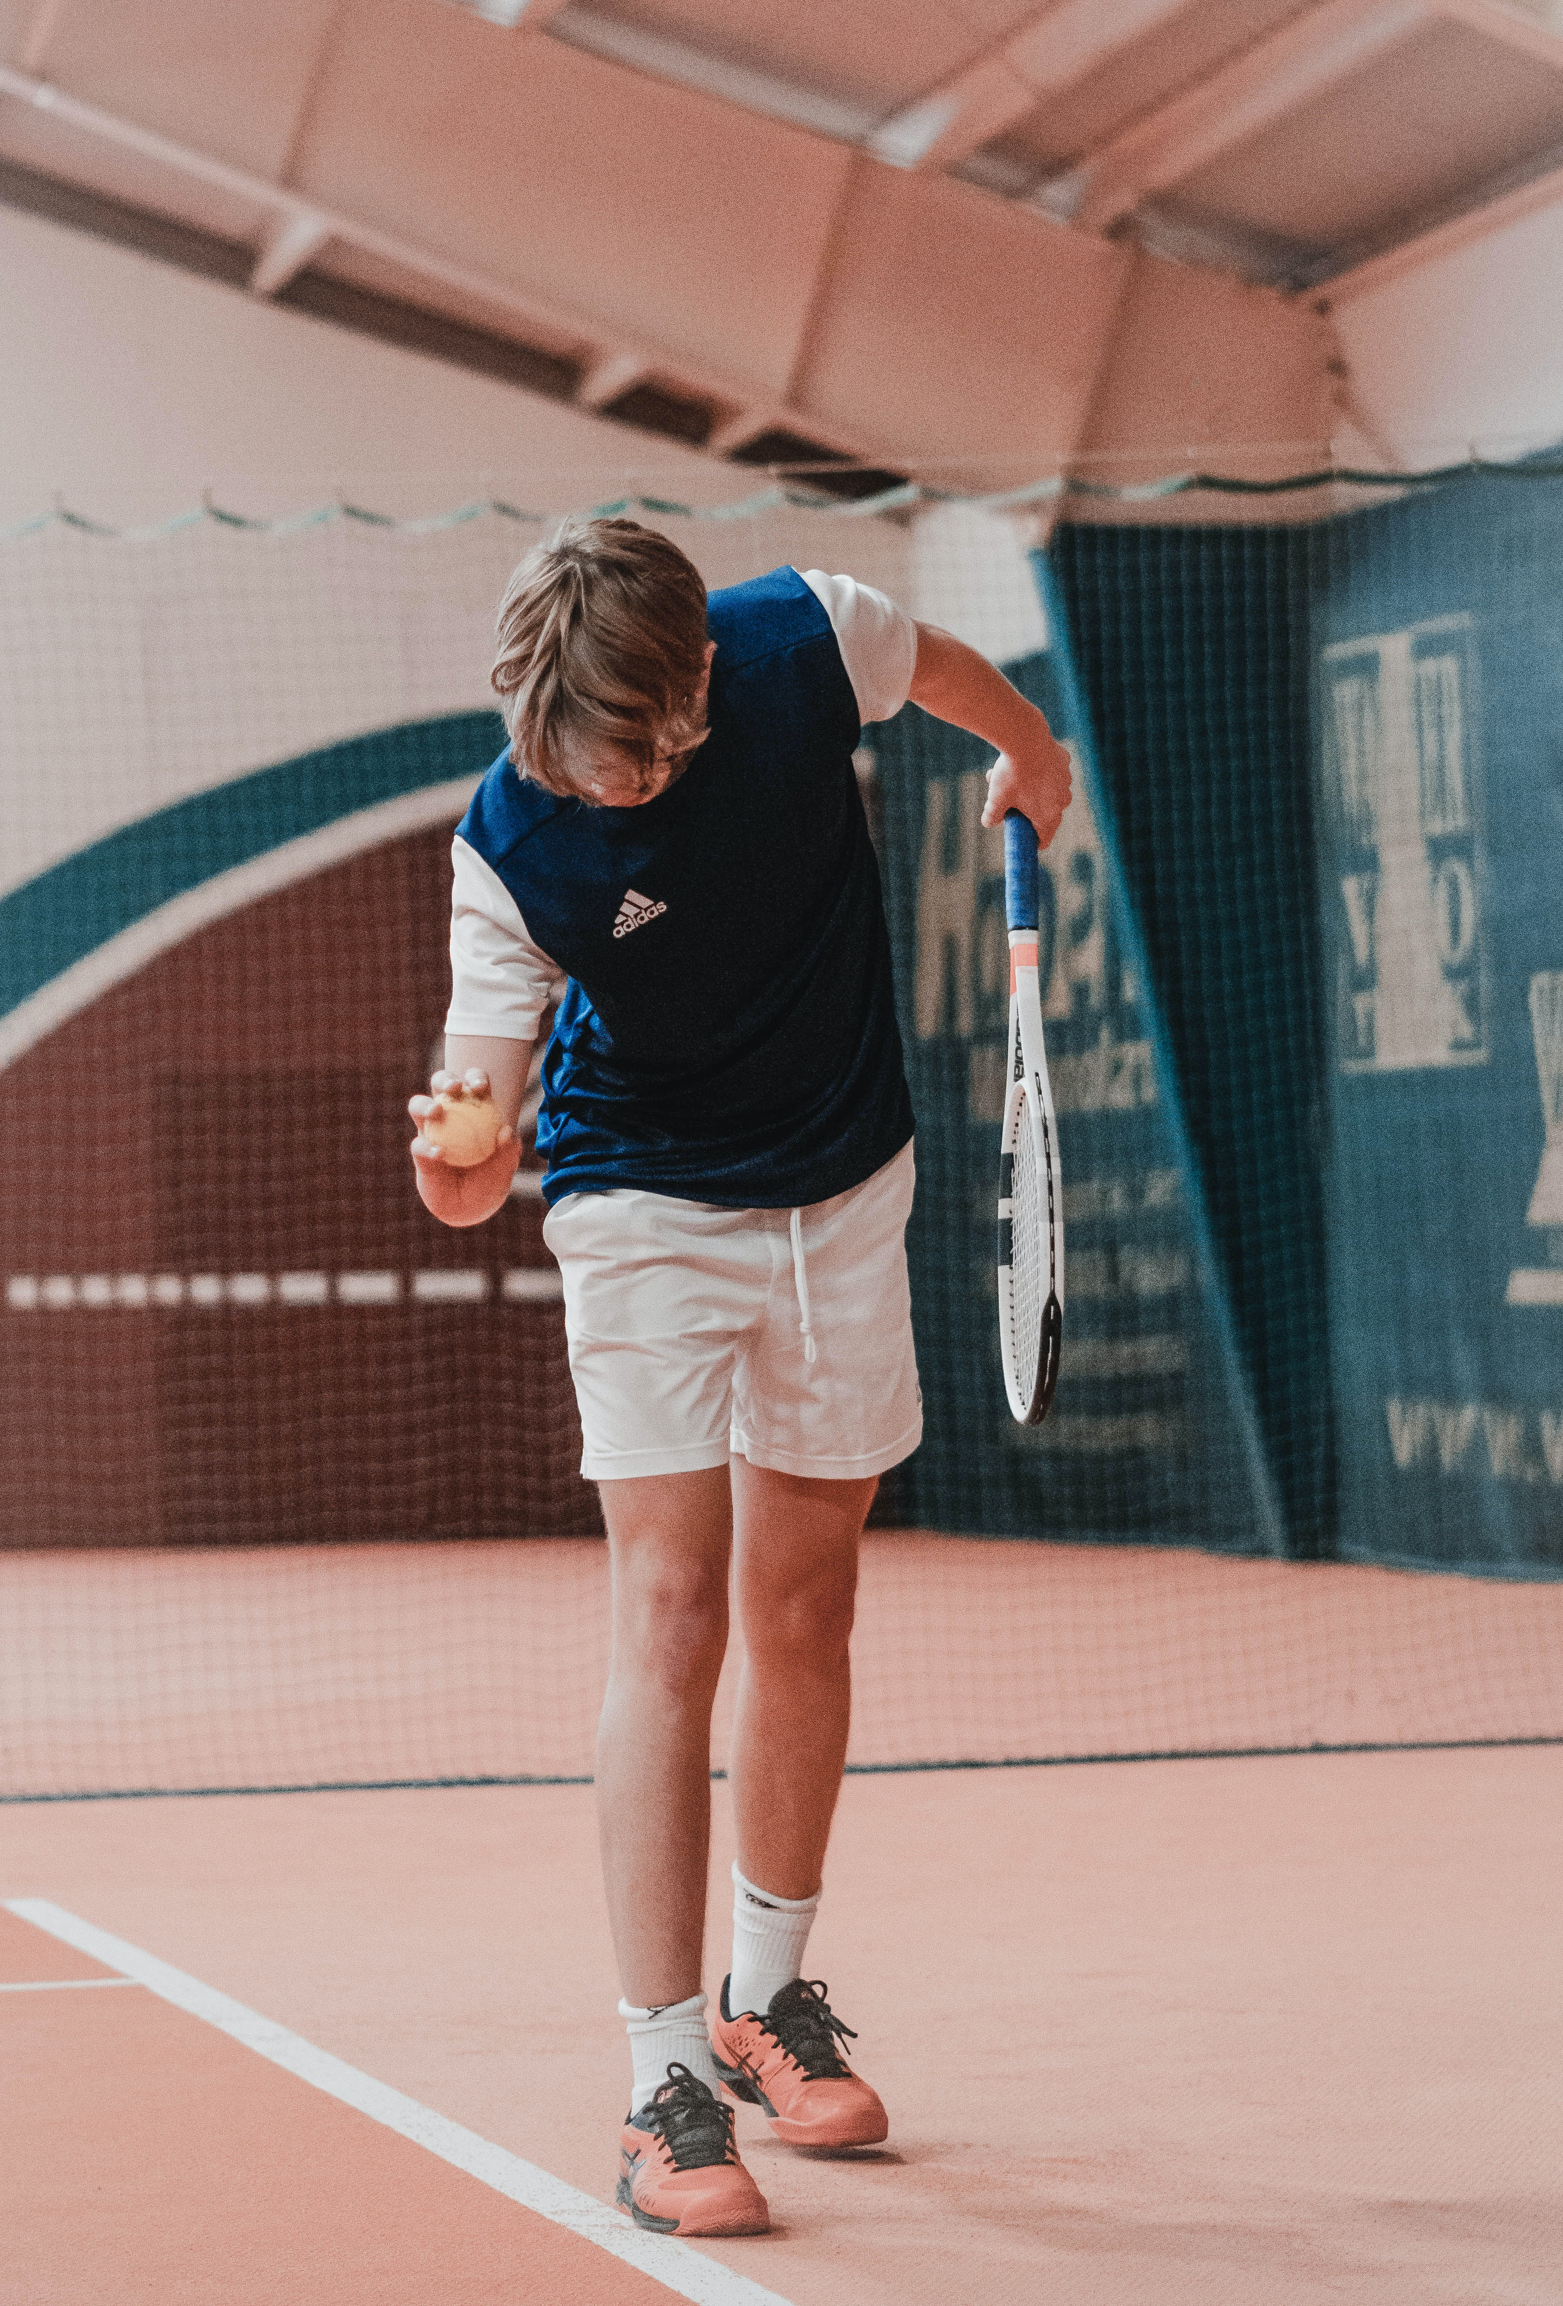
Read pages 132 – 133 and provide a summary your role as a coach.
Create a brief guide on matching participant standards to competition based on the information on page 134
Complete Activity 3A
SISSSCO015

Slide 5
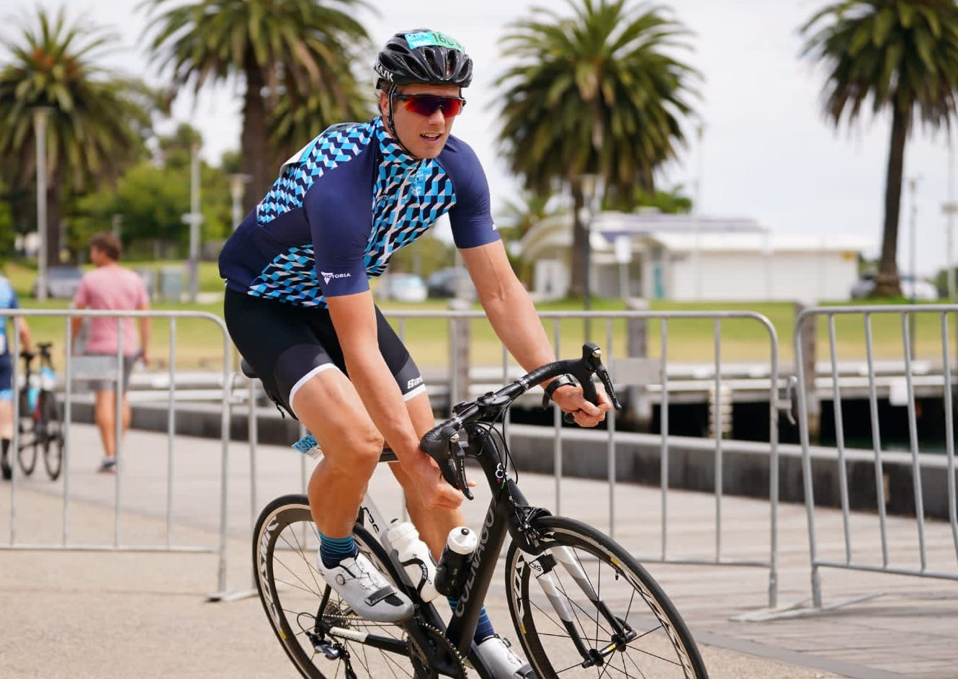
What should a competition schedule look like?
Should they be the same for every athlete?
Discuss and list the important elements that should be included when creating a competition schedule
SISSSCO015

Slide 6
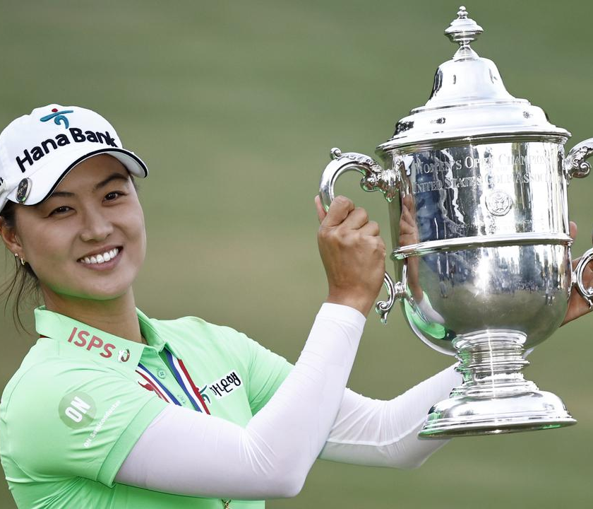
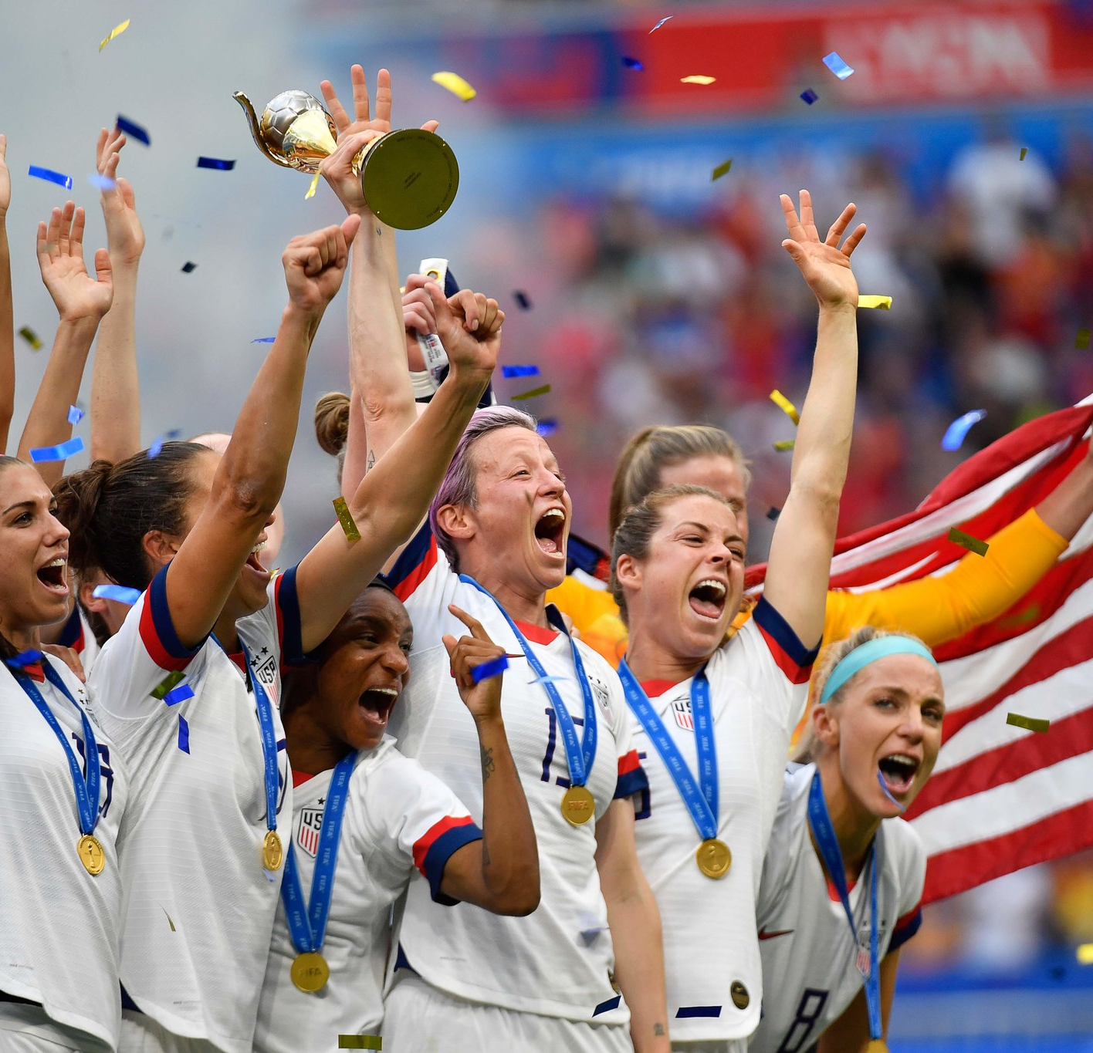
GOAL SETTING
Goal setting is invaluable. It allows athletes to focus on success by creating both short and long-term goals.
Performance goals
Process goals
Outcome goals
SMART goals
For each of the above, partner up and explain each type of goal. You can find the information on pages 137-139
Complete Activity 3B
SISSSCO015

Slide 7
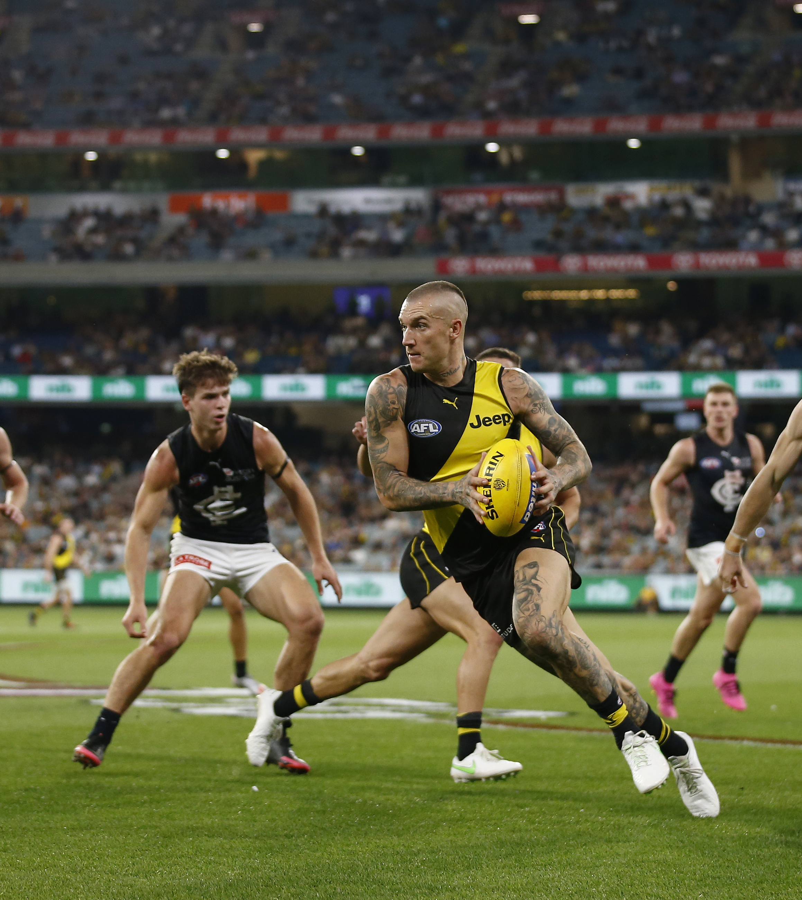
Training for competition is extremely important and should form a central part of an athlete’s daily routines.
It is recommended that all training is varied and tailored to meet the needs of both the individual athlete and team. This helps to keep athletes motivated, establishes individual and team goals, and can help to improve team cohesiveness. Training should also include sport-specific competition context drills, games and exercises, which means practicing techniques and skills at training under conditions and circumstances which simulate and even exceed the demands of competition.
With a partner discuss the importance of a game plan in training and in competition.
SISSSCO015

Slide 8
Provide a summary of key points of each of the following environmental conditions:
Temperature
Humidity
Wind
Rain
Altitude
SISSSCO015

Slide 9
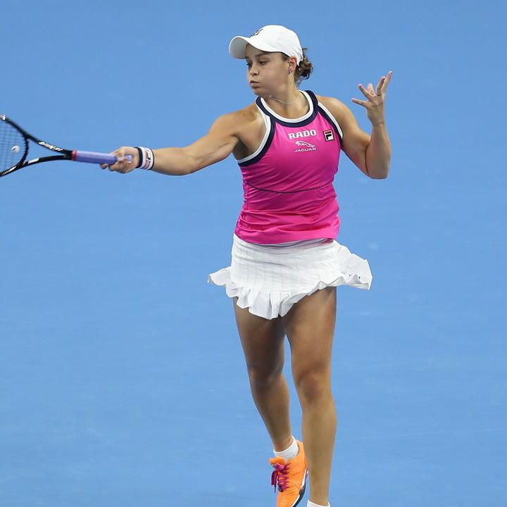
- Complete Set A of your reflection bank questions
SISSSCO015

Slide 10
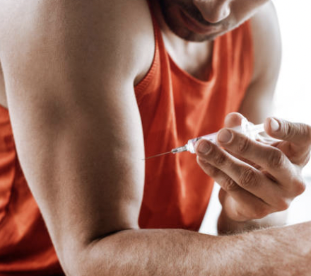
Anti-doping
Read page 145 -147
As a class, discuss why anti-doping is an important part of world sport.
SISSSCO015

Slide 11

What should an athlete eat and drink before competition?
As a guide the choice of meal, snack and fluids should:
• Be easy to digest
• Be rich in carbohydrates for fuel
• Be low in fat
• Provide adequate amounts of fluids
• Include foods and fluids that are familiar and enjoyable
Complete Activity 3C
SISSSCO015

Slide 12
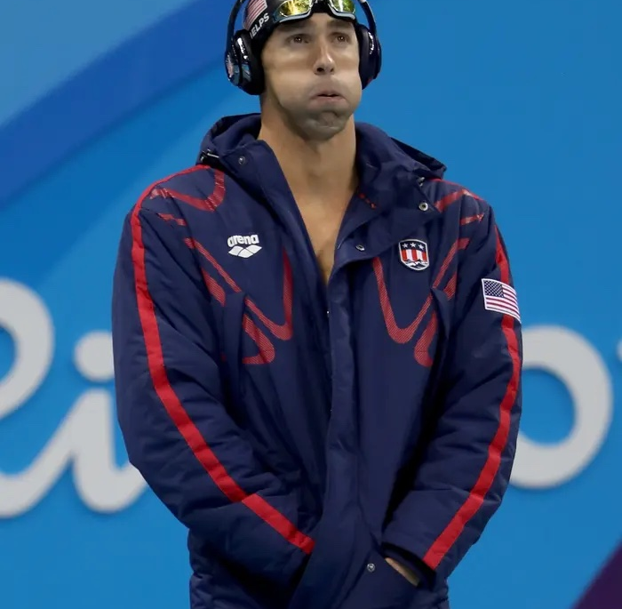
Psychological preparation
Proper psychological preparation before competition is often overlooked and undervalued by athletes and their coaches. As a result, a lack of psychological preparation can make some athletes so nervous and tense before competition that they literally feel weak and tired before stepping onto the field, court, running track or arena.
Provide a summary of key points on
1. Pre-competition routines
2. Post-competition routine
3. Managing performance anxiety
3. Developing sport self-confidence
Complete Activity 3D
SISSSCO015

Slide 13
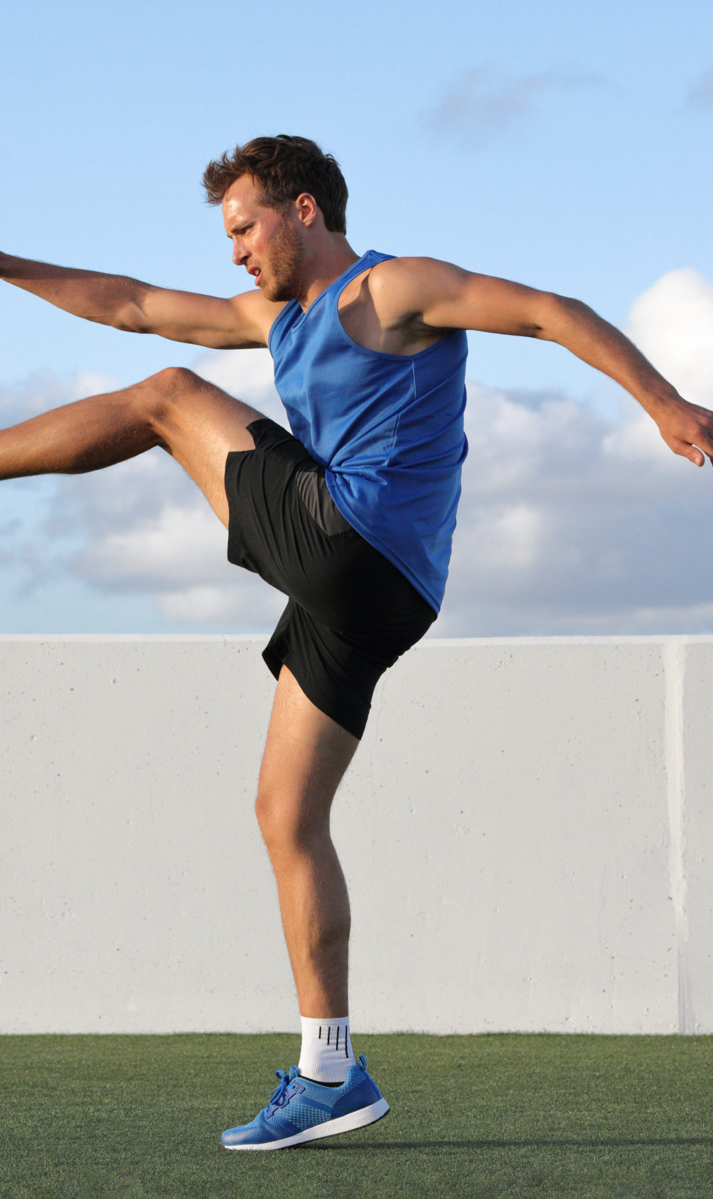
WARM – UP
Most athletes use a warm-up to prepare their body for intense exercise and to help prevent injury. As a coach it is vital to provide sport-specific pre- competition physical warm-up information to athletes to ensure that they are prepared for the high physical demands of competition
The benefits of a physical warm-up
Include:
Gradually increase body and muscle temperature
Increased blood and oxygen supply
Increased flexibility generally or in specific muscle groups
Increased excitement levels
Increased proprioception
For each of the above, partner up and briefly describe the mechanisms behind each dot point above.
SISSSCO015

Slide 14

Components of a physical warm-up
1. Low intensity rhythmic activity
2. Stretching
Static, dynamic & PNF
3. Sports specific activities
Watch the next video and note the sequence and types of stretches
SISSSCO015

Slide 15
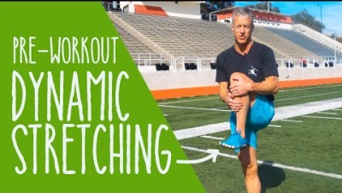

Slide 16
Complete Practical Activity 3E
SISSSCO015

Slide 17
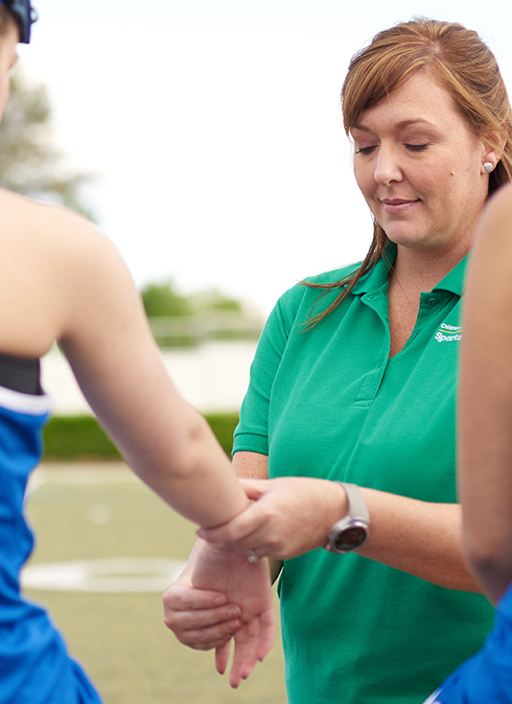
WHO IS THERE FOR SUPPORT?
Coaches, parents, and specialist support staff such as doctors, dieticians and physiotherapists play a vital role in an athlete’s sporting circle and can make a significant impact on their sporting performance. They have a special responsibility to support all participants and athletes to achieve sporting success through specialist advice, support, and care. A critical part of your role as a coach and trainer is to assist participants to identify and access support staff and resources for specialist advice and support to enhance sport specific performance.
Read page 162 – 164 and provide a summary of the role of each support staff member.
Complete Activity 3F
SISSSCO015

Slide 18
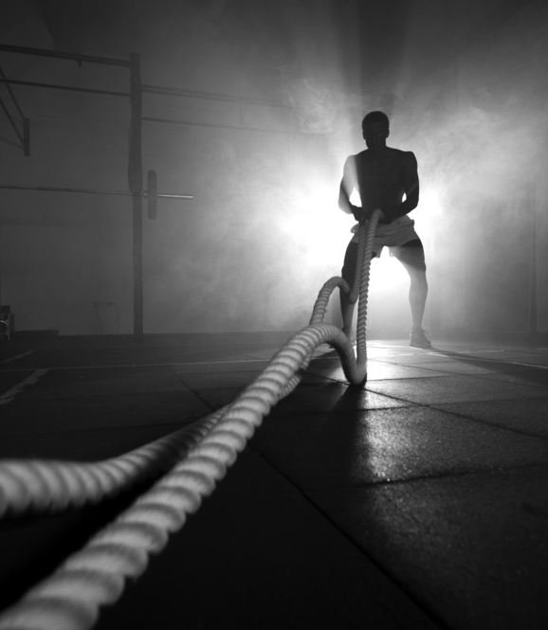
Self reflection
As a coach, it is important to constantly reflect on your own practice of preparing participants for competition and to identify any areas of improvement so you can continue to provide the best possible guidance for your athletes.
Self-reflection helps you to:
Grow and develop as a coach
Learn from the past
Not repeat mistakes
Find ways to tweak and tune your delivery and your sessions
Better understand yourself
Consistently improve
Talk with the person next to you and discuss the what self-reflection method you would use as a coach or trainer.
SISSSCO015

Slide 19
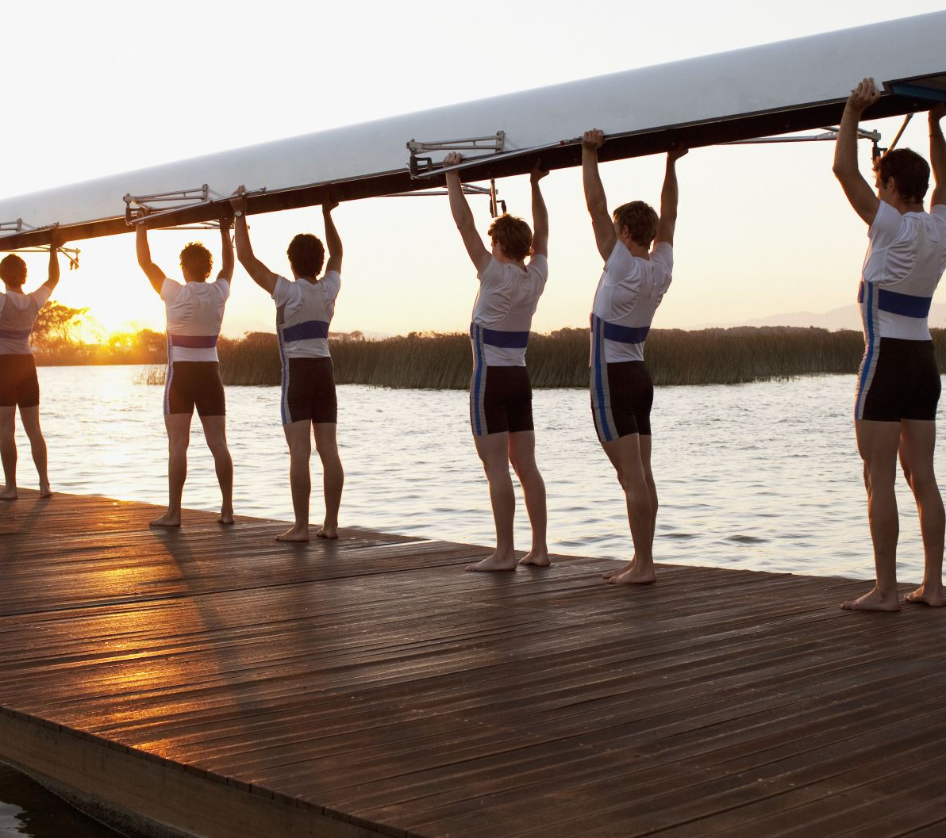


Read pages 165-167 and complete Activity 3G
Complete Set B of your reflection bank questions
SISSSCO015

