Slide 1


HLTWHS001 PARTICIPATE IN WORKPLACE HEALTH AND SAFETY

Slide 2
WHS laws
Workplace health and safety legislation and regulations set out the health and safety requirements affecting all Australian workplaces and work activities.
Acts
Regulations
Regulation
Codes of practice (or compliance codes)
HLTWHS001

Slide 3
Acts – This is the law (legislation) that outlines a workplace’s responsibilities and duties to ensure that the workplace they are providing is safe. The Act to be followed is different in each state/territory.
Regulations – These are the standards that need to be met for specific risks and hazards that exist in the workplace. These may include manual handling and noise related risks. Regulations also set out the licenses needed for specific activities and any records or reports that must be documented.
Regulator – This is the organisation responsible for ensuring that workplaces uphold the Act and any regulations required. They are responsible for workplace inspections and providing advice and information relating to workplace health and safety. They also administer penalties when required. The regulator is different in every state/territory.
Codes of practice (or compliance codes) – These provide guidance and advice for specific elements of workplace health and safety. These codes are easy to read and provide practical advice for employers on how to implement and act in accordance with required legislation and regulations. If the codes of practice are implemented and applied correctly a workplace will have complied with their workplace health and safety obligations. Once again these are state and territory specific.
HLTWHS001

Slide 4
The rights and responsibilities of employers and employees
Workplace Health and Safety legislation contains obligations to exercise a ‘duty of care’ in relation to health and safety in the workplace.
Duty of care places into a legal form a moral duty to anticipate possible causes of injury and illness and to do everything reasonably practicable to remove or minimise these possible causes of harm.
HLTWHS001

Slide 5
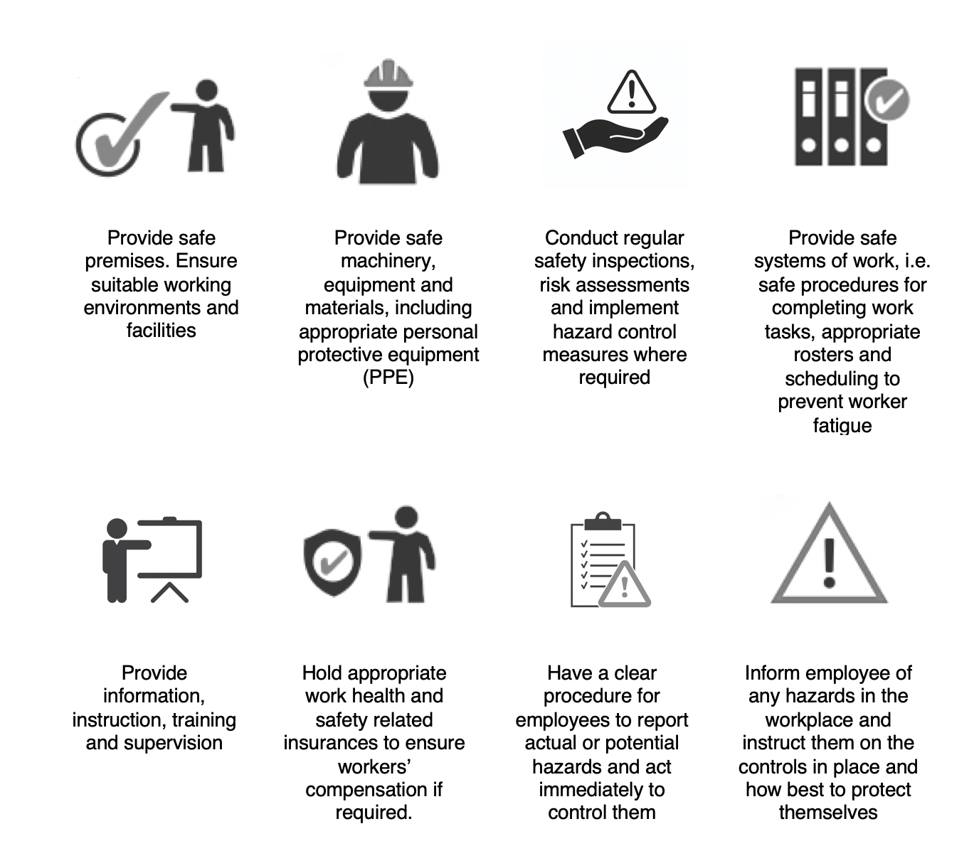
Under WHS legislation a workplace (the employer) is required to:
HLTWHS001

Slide 6
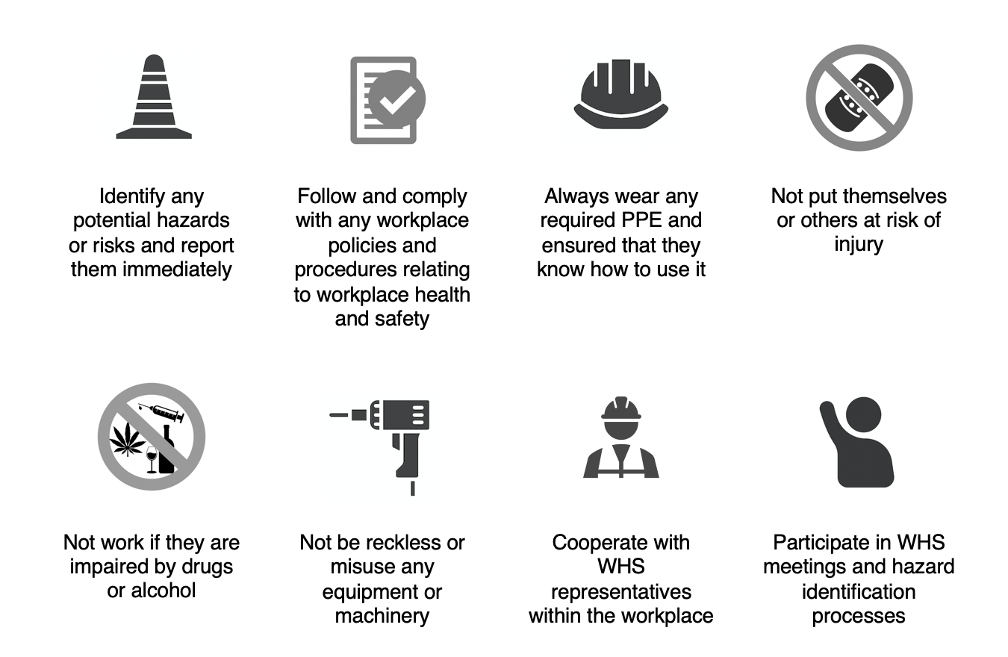
Within a workplace employees also have responsibilities to ensure workplace health and safety to prevent injuries to themselves and others in the workplace.
They are required to:
HLTWHS001

Slide 7
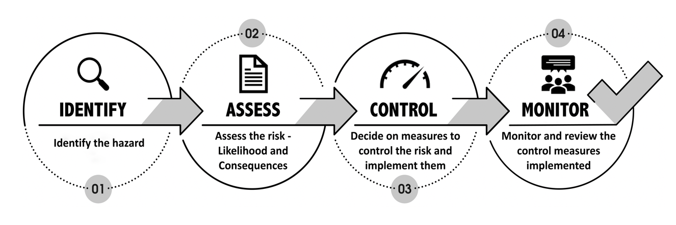
Risk management and assessment
Risk management is an organisational issue, and a successful program requires the commitment and cooperation of all.
HLTWHS001

Slide 8

Hazards can be:
Physical
Biological
Chemical
Ergonomic
Psychosocial

Slide 9
Identifying Hazards
Conduct site safety audit
Physical inspection of the premises and equipment
Observing employees performing tasks
Investigating accidents and past incidents
Investigating near misses
Reviewing available documentation
Environmental monitoring of fumes
Reviewing employee complaints
Communicating with employees
Having an external safety consultant conduct a safety audit

Slide 10
Hazard identification
Should be conducted when:
An organisation is new
New forms of work is being implemented
Changes to process or practice is made
A hazard has been identified
After a near miss incident or accident
Concerns are voiced by staff
New knowledge or information about hazards becomes available
Changes to equipment are made
At regular intervals during normal operations

Slide 11
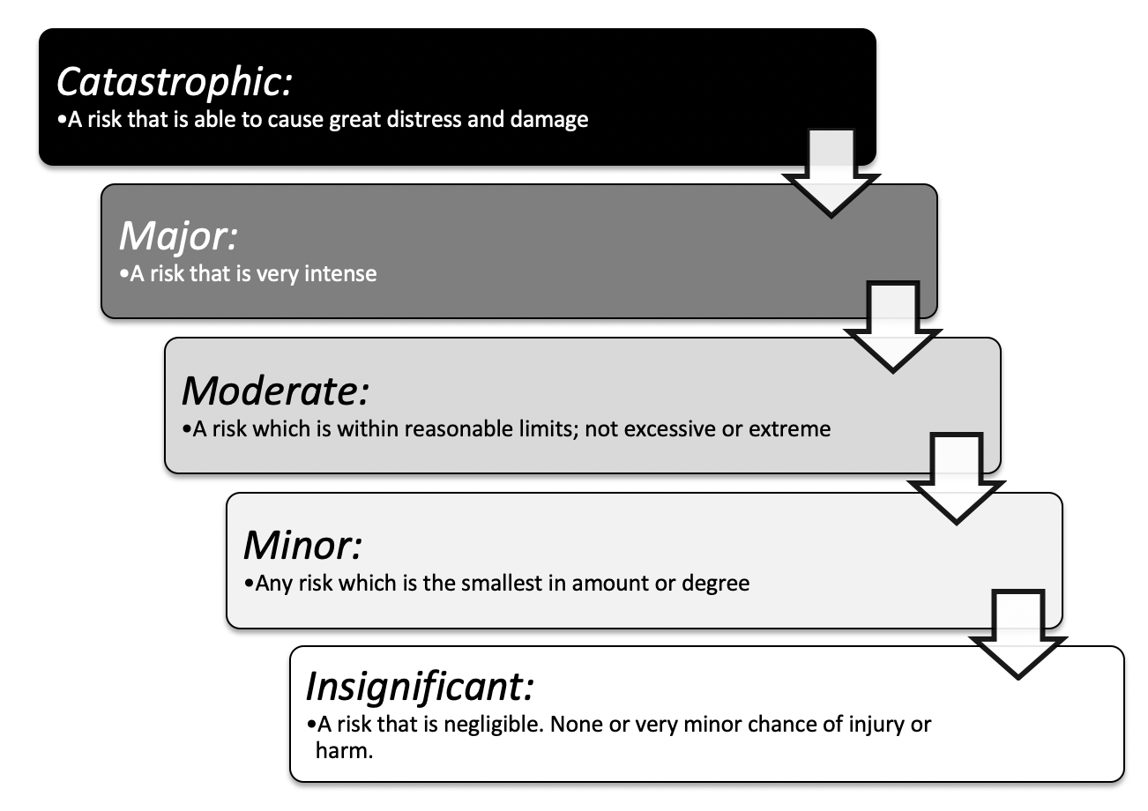
You will need to rank each risk based on the severity of the consequences if it was to occur.
You will need a list that identifies and describes the significance of outcomes if the risk occurs.
For example:
HLTWHS001

Slide 12
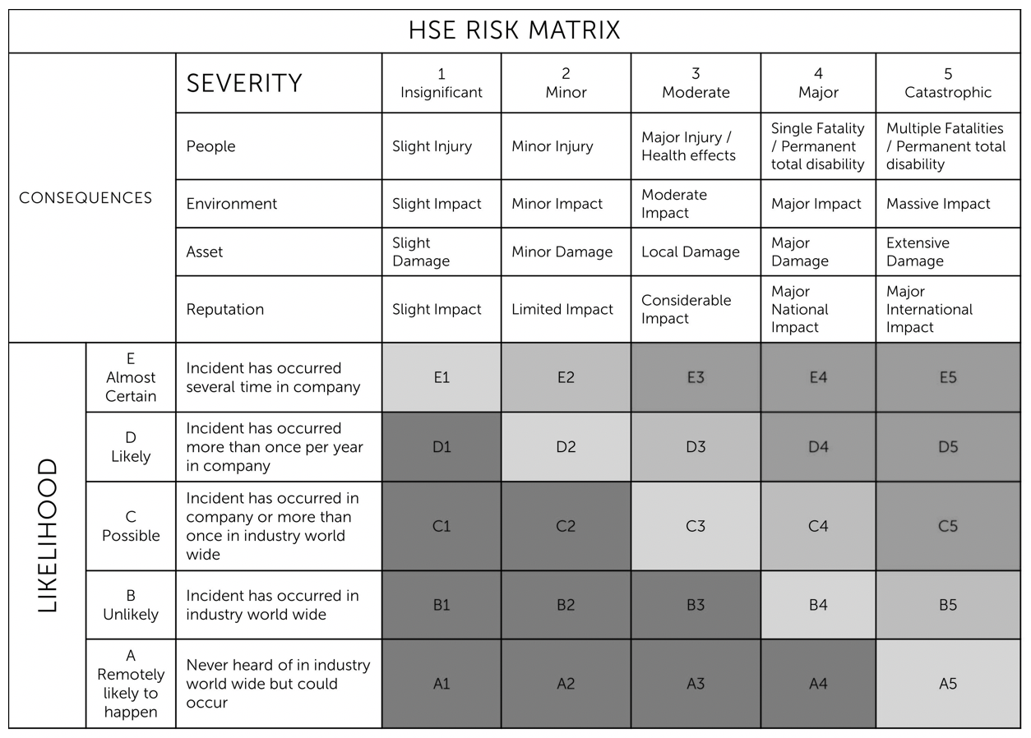
Risk Matrix
HLTWHS001

Slide 13
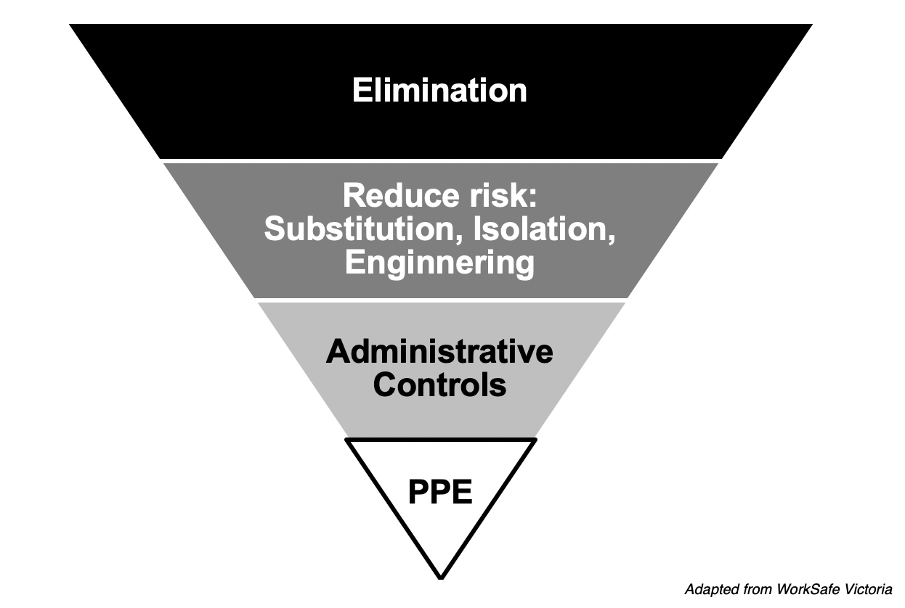
The Hierarchy of control
HLTWHS001

Slide 14
Reduce the risk
Substitution
Replace the hazard. Substitute the risk with a lesser risk
Isolation
Isolate the risk by separating people from the risk
Engineering Controls
Make physical changes to reduce the risk. Reduce the risks through engineering changes or changes to systems of work
HLTWHS001

Slide 15

Personal Protective Equipment (PPE) Complete Inquiry task 4C pg 149
HLTWHS001

Slide 16
What is a risk register?
A risk register is tool for documenting risks, actioning and managing them. Each risk is logged on the register and actions taken to respond to them.
There is no set format for a risk register.
HLTWHS001

Slide 17
Workplace emergency procedure
A workplace emergency can be defined as an unforeseeable situation that threatens people within the organisation including employees, customers or the public.
It is often a sudden event or situation that requires an immediate response which can be really scary. In emergencies, people can panic or become confused.
The best way to make sure emergency situations are handled as well as possible, is to plan, prepare and practise for them.
HLTWHS001

Slide 18
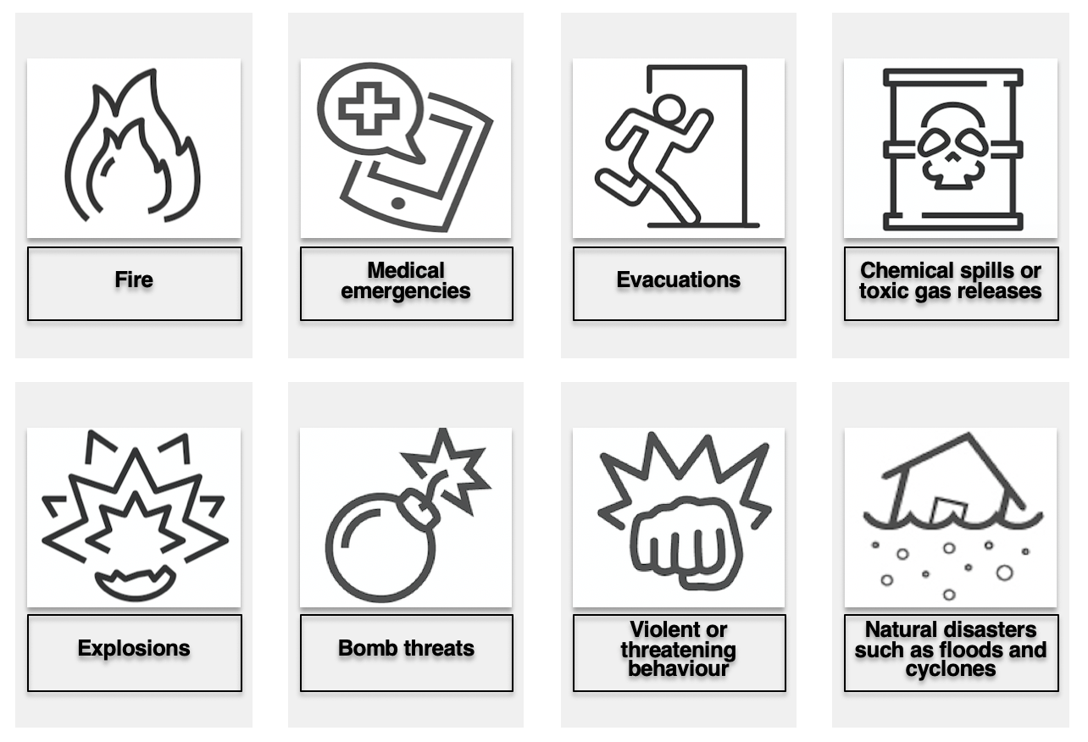
HLTWHS001

Slide 19
What to do in an emergency
Take care of self
Understand the situation
Follow your organization’s policies and procedures for acting in an emergency
After the emergency

Slide 20
IMPLEMENT SAFE WORK PRACTICES
Every employee within an organisation should know how to adhere to safe work practices.
Some examples of safe work practices from a variety of workplaces include:
Correctly wearing the required PPE equipment ensuring that it is clean, in good condition and functional.
Ensuring that you are not fatigued at work or under the influence of alcohol or other drugs.
Ensure that you take designated breaks
Handle chemicals, poisons and other dangerous materials carefully as in accordance with workplace procedures.
Safely use any machinery in accordance with workplace procedures.
Ensuring safe posture and movements.
Working ergonomically and setting up safe workstations
HLTWHS001

Slide 21

Safety signs
HLTWHS001

Slide 22
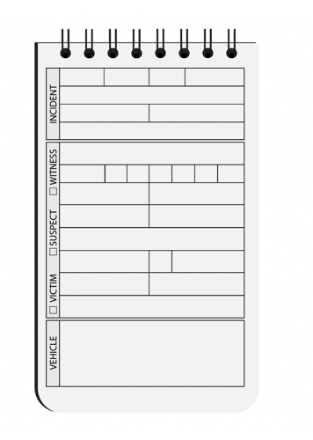
Reporting incidents
Where an incident or injury occurs in the workplace it is important to report it to the designated person in accordance with workplace procedures.
WHS legislation mandates that workplaces report and keep records of serious accidents, emergencies or health incidents that occur.
HLTWHS001

Slide 23
What is a notifiable incident
The following must be reported to WorkSafe:
Death
Person needing treatment within 48 hours of being exposed to a substance
Person needing immediate treatment as an in-patient in hospital
Amputation, head injury, eye injury, degloving, electric shock, spinal injury, loss of bodily function, serious lacerations

Slide 24
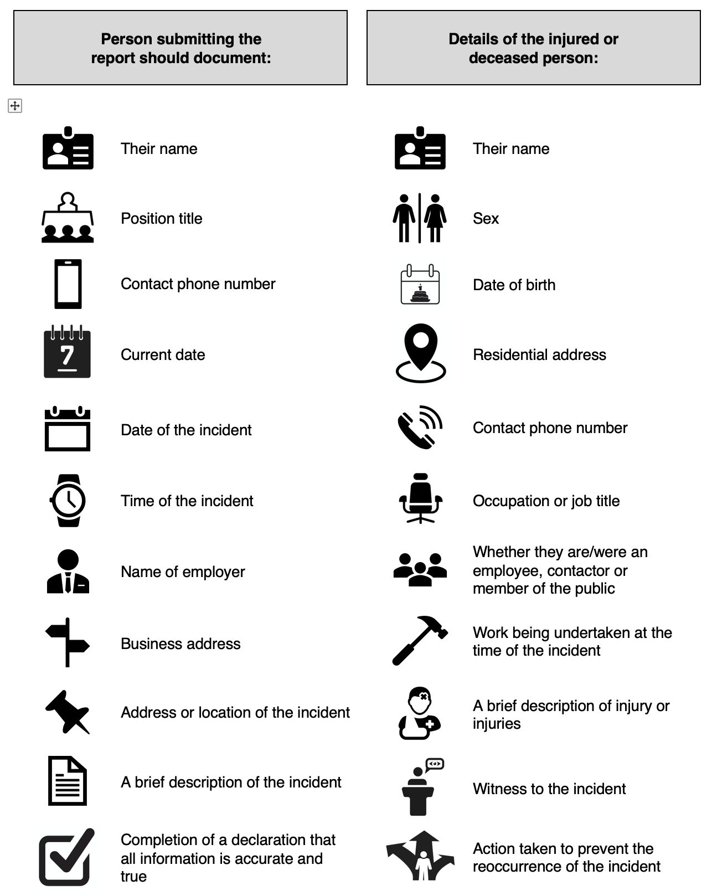
Incident report
HLTWHS001

Slide 25
Housekeeping Practice
Clean up spills as soon as they are identified
Regular floor cleaning, vacuuming, sweeping, and mopping
Regular floor checks looking for damage
Not leaving items lying around the floor
Create a checklist

Slide 26
CONTRIBUTE TO SAFE WORK PRACTICES IN THE WORKPLACE
Everyone has a responsibility to identify hazards as they arise, report and act to control them within the scope of their job role.
It is important that all staff are trained and led to understand that it is in their best interest to work safely and always be on the lookout for safety concerns.
Workplaces should have regular staff meeting that focus on work health and safety, where staff are encouraged to contribute to the development and implementation of safe work policies and procedures within their own work area.
HLTWHS001

Slide 27
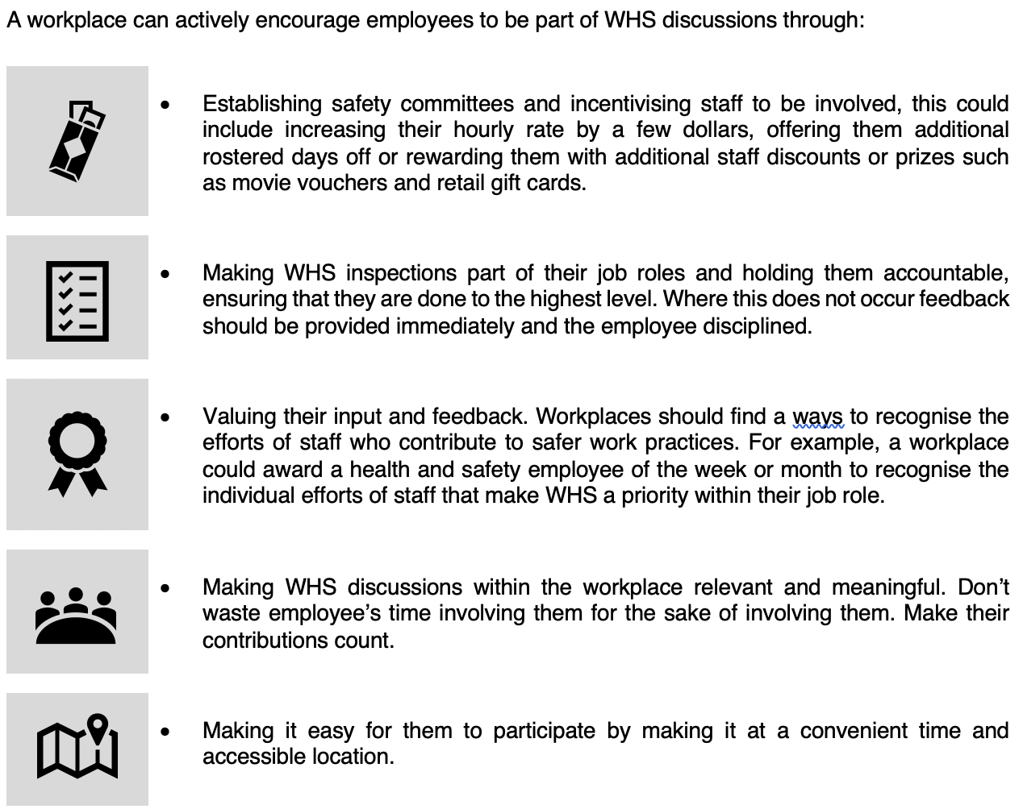
HLTWHS001

Slide 28
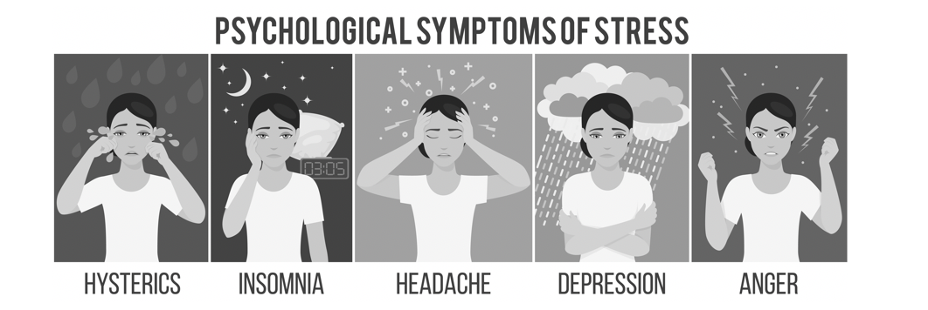
REFLECT ON OWN SAFE WORK PRACTICES
As an employee it is important that you take the time to reflect on your own work practices to ensure that you are being safe at all times.
When a person has been doing a job for a long time it is easy to become complacent and this is when accidents occur.
It is important that employees are encouraged and given the time needed to maintain their currency of safe work practices.
HLTWHS001

Slide 29
Stress Prevention
To prevent stress in the workplace you should always:
Take your rest times and breaks when they're allocated
Always take the time to sit back and relax, to clear your mind and rest your body
Get enough fresh air; take your breaks outside
Do not go to work when you are sick
Let your supervisor know if you are feeling stressed by events or issues at work. Remember, the problem can't be resolved unless someone knows about it. Your supervisor will treat your concerns with respect and confidentiality
Be clear about your job responsibilities. Don't perform duties for which you are not trained and focus firstly on your own duties and areas of responsibility before helping others.
HLTWHS001

