Slide 1


CHCCOM005 Communicate and work in health or community services

Slide 2

Unit Overview
Housekeeping
Emergency procedures
Unit outline and structure
Assessment requirements and submission dates

Slide 3
Section 1- Working in the Health or Community Services Sector
By the end of the first Section, you will understand:
Working in the sector
Day to day tasks
Roles, duties and responsibilities
Organisational policies and procedures

Slide 4

1.1 Your Role and Duties
There are multiple roles within the health and community services sector including:
Personal care assistant
Support worker
Personal care giver
Health support worker

Slide 5
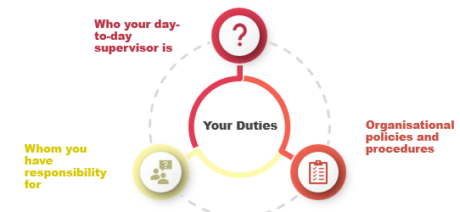
1.2 Your role and duties
Your duties
A position description, also known as a job description, is a document that outlines the day-to-day responsibilities of a role.
When you start any new role, always make sure you have a copy of the job description as this will guide you in the expectations of the workplace.

Slide 6

What it’s like to work in the Community Services industry?
Notes:
Key points:
Watch and discuss: ‘What it's like to work in Community Services – Part 1’
https://www.youtube.com/watch?v=HF1gzVWlRHk 5:05 mins

Slide 7

Role Boundaries
From time to time, you may be asked by a client or someone other than your supervisor to do something that you would not normally do.
In these situations, it's important you remember the limitations and boundaries of your role.
You must always have clear instructions from your supervisor to carry out additional tasks if they are outside your normal duties.
DISCUSS: What does a position description include?
Notes:
Position summary
Position responsibilities
Role requirements

Slide 8

1.3 Collaborating with others as part of a team
Community services and health workplaces
TEAM BASED
Members of the team
Different skill sets and backgrounds, collaborate to provide a wide range of services and supports
Multi-disciplinary teams
Such as workers, youth workers, mental health practitioners and allied health professionals.

Slide 9

1.4 Listening to instructions
What are some situations for receiving instructions:
In team meetings: formal such as with meeting minutes or informal discussion
Within a project or group: for building networks and skills across a wider area
In daily tasks: specific such as details of tasks you need to do
During a handover: such as verbally or in writing

Slide 10





Complete 1A Inquiry Task page 11

Slide 11
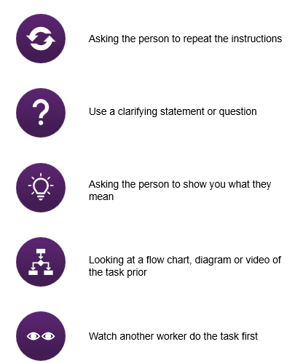

1.5 Clarifying Instructions
You may not always understand the work instructions you have been given or understand what is required of you at work. If this happens, it is always better to seek clarification.
Clarifying information can be achieved by the following strategies:

Slide 12

Discussion
Discuss types of clarifying safety instructions that you may need to be aware of and follow as a community services worker.

Slide 13

Clarifying Specific Instructions
Clarifying Client Specific Instructions
Some clients have specific needs and requests that should be met.
These instructions could be included in part of an individual planning and support document, or within a client file or case notes.
Accessing and sharing these instructions can assist in providing appropriate support to a client, particularly when there is more than one worker involved.
Clarifying Duty of Care Instructions
In some situations, you will have a duty of care responsibility to a client.
As part of your duty of care, you may need to clarify the instructions you receive in order to fulfil your obligations.

Slide 14

1.6 Agreeing on Timeframes
Workplace instructions give you information about what tasks need to be completed as part of your work role, and they usually include information about the timeframe which applies to the instruction.
Your own timeframe for tasks will be influenced by:
Your own skills and experiences
Your other duties and responsibilities
Ability to delegate other tasks
Skills at time and task management

Slide 15
Complete 1B Inquiry Task page 15

Slide 16
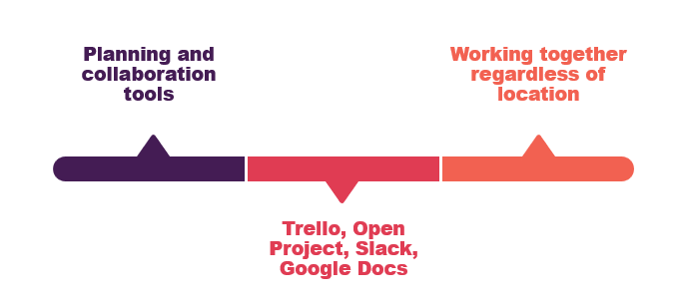
Using digital tools
Some organisations use a planning and collaboration tool such as Trello, Open Project or Slack to help them organise tasks, timeframes and collaborative approaches to work.
Individual workers and small work teams may also use tools such as Google Docs to allow them to share input into a single document, edit the document and agree on comments and changes as they work towards a final piece of communication.
Digital tools can be an effective way of helping workers who may not all be in the same physical location to work together on tasks and to set and check timeframes for projects and activities.

Slide 17

Research and Explore
Choose a digital tool such as those mentioned in the previous slide, or another, and outline the advantages and features regarding communication and collaboration

Slide 18
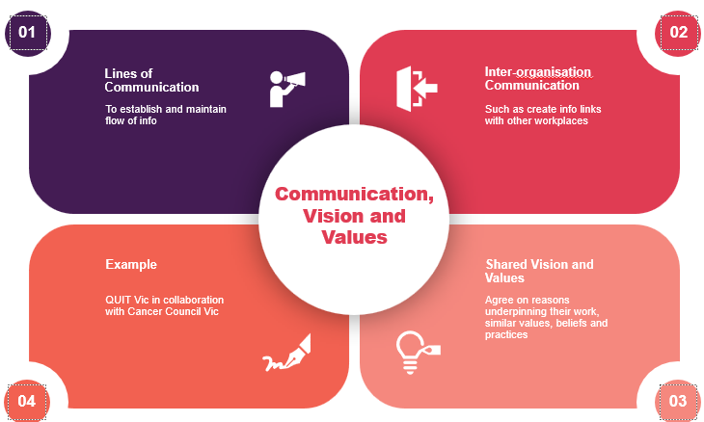
1.7 Determining Reason for Contact & 1.8 Inter-Organisation Communication
1.9 Shared Vision and Values
Notes:
Key points:
Lines of Communication
Some health and community services workplaces are very large, other workplaces are quite small, employing only a few people who provide services in specific areas and programs.
Within both large and small organisations, there will be clear lines of communication which help establish and maintain the flow of information.
Inter-Organisation Communication
In some organisations, there is capacity to communicate beyond the workplace itself and to create information links with other workplaces.
This is an effective and commonly used approach to communication and operations which fits well with capacity building and empowerment models of support.
Shared Vision and Values
Many organisations have very similar reasons for doing the sort of work they do.
They may agree on the reasons underpinning their work, hold similar values and beliefs and practice their support services in similar ways.
Learner Guide: Ch1.7, 1.8 and 1.9, pg 12

Slide 19
Complete 1C Inquiry Task page 16

Slide 20
Complete 1D Inquiry Task page 17

Slide 21
1.10 Utilising expertise
Complex and changing needs: Such as those in poverty or affected by a disability
People who are ageing: Have changing physical and mental health care needs
Strategies: Such as identifying people who hold specific skills and knowledge such as mental health practitioners, AOD (Alcohol and Drugs) and youth workers
Notes:
Key points:
Complex and Changing Needs
We know that many of the people who utilise community services are impacted by more than one issue, and many of these issues relate each other. For example, people who are experiencing homelessness may also live in poverty and have reduced physical health and higher incidence of mental illness.
We also know that some people are affected by more than one disability or have a disability which has multiple impacts upon their activities of daily living. For example, a person who has cerebral palsy may also have epilepsy, experience vision loss and communication needs.
People who are Aging
In Australia, one in seven people are aged over 65 years.
People who are older may have changing physical and mental health care needs, and these needs can become more complex and challenging as they increase in age.
Here are some strategies you can use to access expertise to meet the needs and goals of people with complex, changing or higher-level needs…
Reference: Learner Guide Ch1.10, pg 13

Slide 22

1.11 Using the Correct Terminology
Like most sectors, there is a specific ‘language’ associated with the health and community services area of work.
This language can seem unfamiliar and strange at first, and it can take a while before you can use and understand the terms which are used as part of your daily work practices.
It is important to remember that, even when you do master the terminology of the community services and health sector, it will probably be unfamiliar to people who are outside the sector.
Notes:
Key points:
Using the Correct Terminology
Like most sectors, there is a specific ‘language’ associated with the health and community services area of work.
This language can seem unfamiliar and strange at first, and it can take a while before you can use and understand the terms which are used as part of your daily work practices.
It is important to remember that, even when you do master the terminology of the community services and health sector, it will probably be unfamiliar to people who are outside the sector.
Reference: Learner Guide Ch1.11, pg 14

Slide 23
Complete 1E Inquiry Task page 19

Slide 24

Glossary
Start a glossary of terms for working in health and or community services.
The learner guide and websites will assist.
https://www.aihw.gov.au/getmedia/a9ab60a1-8ae3-4811-b68f-c6190b198a9f/dda-mnc-c04.pdf.aspx
https://www.myagedcare.gov.au/glossary

Slide 25
1.12 Digital Communication
Type | What is it? | How can it be used effectively as a communication tool?
Web | Allows for a wide range of apps such as sharing of files | Use appropriate privacy protection
Email | Internet based to communicate messages | Use professional language
Social Media | Internet based to post images, audio, share text, etc. | Check for privacy limits
Podcasts | Audio tools to present info and news | Record audio professionally using HQ microphone
Written communication is used frequently in most workplaces, so it is important to refine your skills and ensure you can share information effectively in your work role.
Each of these situations requires you to use industry terminology correctly and appropriately. You should think about the audience needs for your communication, the language which matches the audience and whether there are any privacy or confidentiality requirements you should follow.
Notes:
Key points:
Written Communication
Written communication is used frequently in most workplaces, so it is important to refine your skills and ensure you can share information effectively in your work role.
Each of these situations requires you to use industry terminology correctly and appropriately. You should think about the audience needs for your communication, the language which matches the audience and whether there are any privacy or confidentiality requirements you should follow.
Reference: Learner Guide Ch1.13, pg 16

Slide 26
1.13 Written Communication
Communication factor | What to consider
Audience | Age, gender, disability and cultural features
Communication tools | Literacy and numeracy skills of target audience
Privacy and confidentiality requirements | Check what organisation policies and procedures may apply

Slide 27
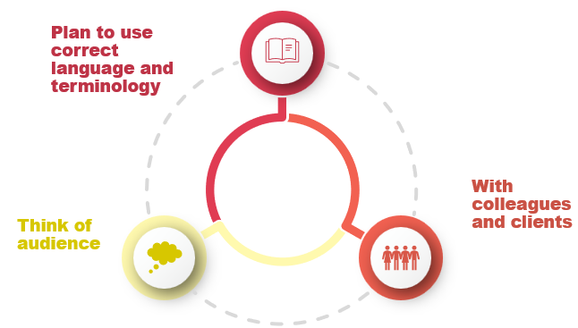
1.14 Verbal Communication
There are many situations when you will need to communicate verbally with your colleagues at work and you will need to be able to do this effectively to ensure the best care for your clients.
Just as with written communication, you should think about the audience with whom you are communicating.
Plan your communication so that you are using language and terminology that will be easily understood.
Notes:
Key points:
Verbal Communication
There are many situations when you will need to communicate verbally with your colleagues at work and you will need to be able to do this effectively to ensure the best care for your clients.
Just as with written communication, you should think about the audience with whom you are communicating.
Plan your communication so that you are using language and terminology that will be easily understood.
Reference: Learner Guide Ch1.14, pg 17

Slide 28
1D Inquiry Task page 23

Slide 29
1.15 Communication Protocols in the workplace
With the organisation | Communicating appropriately
Such as CC or BCC in an email | Maintain a professional and appropriate method
The way you communicate with people within your organisation is important. Just like any interaction, you do not communicate with every person in the same way.
You need to manage and modify your communication to suit the needs and requirements of your audience so that you are maintaining a professional and appropriate manner that suits the situation.
Notes:
The way you communicate with people within your organisation is important. Just like any interaction, you do not communicate with every person in the same way.
You need to manage and modify your communication to suit the needs and requirements of your audience so that you are maintaining a professional and appropriate manner that suits the situation.
Reference: Learner Guide Ch1.15, pg 17 and 1.16, pg 18

Slide 30
1E Inquiry Task page 25

Slide 31
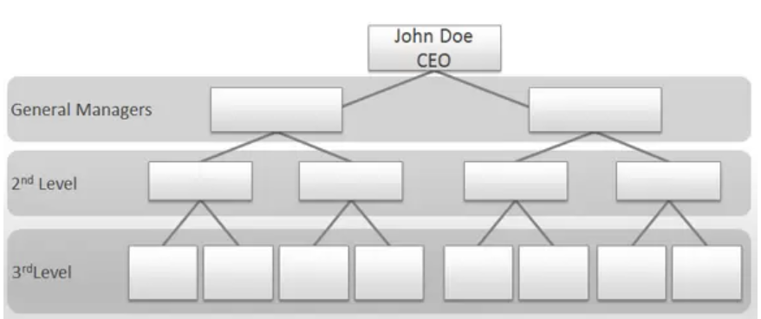
1.16- Understanding Your Organisation Research and Explore
Each workplace will have a different organisation structure.
Refer to the organisational chart in section 1.16 of your learner guide.
Research (or choose a workplace you are familiar with in the health or community services) and then create an organisational chart to identify the various positions.

Slide 32

1.17 Understanding Other Organisations: Who are they?
Family Support Services
AOD Support
Mental Health
Child Protection
5. Youth Work
6. Home Based Support
7. Homelessness Support
Often teams within an organisation will collaborate and refer clients to other organisations so that they offer the most appropriate support to meet specific needs.
To do this, there needs to be capacity to communicate between different members of the health and community services workforces.
This capacity is based on a relationship where there is mutual trust, understanding and shared agreement on outcomes, goals and directions. It is also based on a sound knowledge of the various roles provided by support services, such as…
Notes:
Often teams within an organisation will collaborate and refer clients to other organisations so that they offer the most appropriate support to meet specific needs.
To do this, there needs to be capacity to communicate between different members of the health and community services workforces.
This capacity is based on a relationship where there is mutual trust, understanding and shared agreement on outcomes, goals and directions. It is also based on a sound knowledge of the various roles provided by support services, such as…
Learner Guide Ch1.17, pg 19

Slide 33
Complete Chapter Review Questions page 28

Slide 34

2.1 Understanding Person-Centred Support
Evidence-based approach
Person receiving care and support at centre of planning and decision-making activities
How to individualise and focus specific needs and requirements
Notes:
Key points:
Understanding Person Centred Support
Person-centred support is a fundamental aspect of health and community services work.
It is a highly effective, evidence-based approach that places the person receiving care and support at the centre of all the planning and decision-making activities that surround them.
Person-centred support means thinking about how to individualise and focus on specific needs and requirements, as well as meeting the interests, preferences and desires of the person in the most effective way possible.
Learner Guide Ch2.1, pg 23

Slide 35

2.2 Rights Based Approach
Focus on needs, deficits and remediation or rehabilitation.
Fundamental human rights.
Empowered to make decisions.

Slide 36

2.3 Verbal and Non-Verbal Communication
Verbal and Non-Verbal Communication are essential components of:
Motivational Interviewing
Communicating with clients
Providing health and community services information
Providing individualised support and care
Making ethical decisions and judgments
Collaborative planning with clients as part of person-centred support

Slide 37
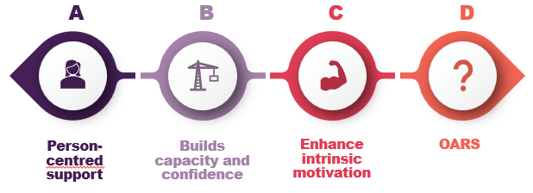
Motivational Interviewing
Motivational interviewing is a technique based on the principles of person-centred support, which aims to build capacity and confidence, and enhance intrinsic motivation for the client.
Motivational interviewing uses four key strategies which can be remembered by the acronym OARS:
Open Questions – these encourage the person to begin talking and sharing their story, without being guided in one direction.
Affirmation – statements or gestures which recognise and affirm achievements or positive elements in a genuine manner.
Reflective Listening – this can include paraphrasing, repeating and confirming or reflecting on what the other person has just told you.
Summary Reflections – these allow the listener to reflect on a section or component of the discussion before moving on to the next part of the conversation.

Slide 38
Go into your portal and watch the Video: ‘What is Communication Access – Information in Auslan’
Notes:
Key points:
Watch and discuss: ‘What is Communication Access – Information in Auslan’
https://www.youtube.com/watch?v=UYXD5QtlE7Q 2:23 mins

Slide 39
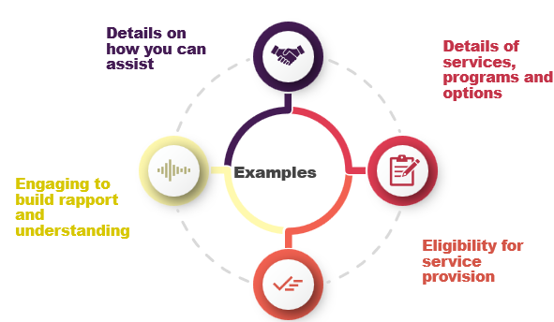
2.4 Providing Information
In a health or community services workplace, you may need to provide information to people in many different situations. This could include…
Notes:
Key points:
Providing Information
In a health or community services workplace, you may need to provide information to people in many different situations. This could include…
Learner Guide Ch2.3, pg 27

Slide 40

2.5 Strategies to Communicate Information
People from culturally and linguistically diverse backgrounds | Elderly people | People with literacy, numeracy or cognitive needs
Providing info which is culturally appropriate | Provide info that is relevant to age group and experience | Use plain English writing styles
Written info translated into community languages | Consider large font size | Add meaning with captions, pictures, etc.
What are some ways to communicate information to different individuals?
Reference Learner Guide Ch 2.4 pg 28

Slide 41
2.6 Enhancing Information
Assume limited prior knowledge: Clients may encounter the information for the first time, so avoid assuming they understand it fully or can retain all details easily.
Chunk information: People process and remember information better when it is presented in manageable chunks rather than overwhelming amounts.
Use practical examples: Case studies or stories illustrating the information in real-life scenarios can make it more relevant and memorable.
Incorporate visuals and captions: Pictures can help convey key points effectively, and captions are an excellent tool to highlight critical details.
Keep it concise: Avoid overloading with unnecessary details, as simplicity aids retention.
Reinforce with reminders: Periodically recap or emphasize key points to help reinforce understanding and retention.

Slide 42

2.7 Checking For Understanding
Once you have provided information to a person, it is important to check they have understood what you meant.
This is not as simple as asking ‘Did you understand?’ because most people will generally respond ‘Yes’, and you will never be sure if they have understood what you intended from your communication.
People may not completely understand the information you have provided for reasons related to their own needs and characteristics, as well as to the situation and your own communication approach.
Notes:
Key points:
Checking For Understanding
Once you have provided information to a person, it is important to check they have understood what you meant.
This is not as simple as asking ‘Did you understand?’ because most people will generally respond ‘Yes’, and you will never be sure if they have understood what you intended from your communication.
People may not completely understand the information you have provided for reasons related to their own needs and characteristics, as well as to the situation and your own communication approach.
Learner Guide Ch2.6, pg 29

Slide 43

2.8 Reasons people may not understand
There are many reasons people may be reluctant to tell you they have not understood information you have provided to them. This could include:
→Being embarrassed
→Not wanting to waste your time
→Feeling like you are in a rush
→Having other important commitments of their own
→Thinking they have understood the information
→Not wanting to ask silly questions
→Feeling there is a power imbalance between the parties who are communicating.

Slide 44
Complete 2A Inquiry Task page 40

Slide 45

2.9 Speech Mechanisms
Varied speech styles: People have different speech rates, sentence structures, and expressions, which add meaning and make language engaging.
Punctuation in speech: Like written language, punctuation in speech includes pauses, breaks, silences, and changes in pitch to clarify ideas and emphasize points.
Role of grammar: Grammar organizes words into sentences and phrases, shaping how ideas are communicated.
Cultural and linguistic influences: Spoken grammar and sentence structures can vary based on cultural, linguistic, and familial backgrounds.
Impact of language learning: People speaking an additional language may construct sentences differently while adapting to its grammar rules.

Slide 46
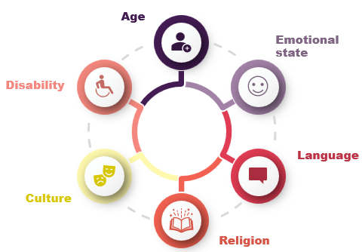
2.10 Influences on Communication
There are many factors which can influence the way an individual responds to and participates in a communication exchange:
Notes:
Key points:
Influences On Communication
There are many factors which can influence the way an individual responds to and participates in a communication exchange.
Learner Guide Ch2.9, pg 31

Slide 47
Complete 2B Inquiry Task page 43

Slide 48

2.11 Checking for Understanding
Reasons for checking for understanding:
Doing your job well
Making sure you are being effective
Vital for the health and wellbeing of the person that you check they are completely aware of important details

Slide 49

2.12 Ways of checking for and enhancing understanding
Ask questions: Use questions to check how well the person has understood and interpreted the information and how they plan to apply it.
Retelling: Ask the person to repeat key details to identify any gaps in understanding, especially for complex or detailed information.
Repeat key points: Summarise the most important information at the end of a conversation or document to reinforce understanding and retention.
Provide written materials: Share written or digital copies of the information to help people recall details later.
Focus on critical points: Highlight and reiterate the essential information for better retention and clarity.

Slide 50
Complete 2C Inquiry Task page 45

Slide 51

2.13 Two-Way Communication Process
Based on the giving and receiving of information. The transmission of information back and forth between each party that is involved in the communication.
As part of the process each party is required to:
Listen
Hear
Decipher
Respond

Slide 52
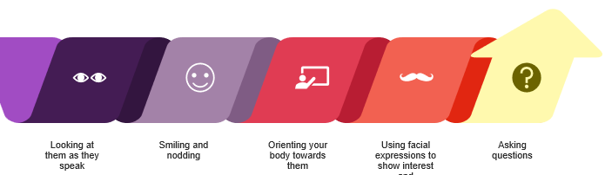
Clarifying Information Through Feedback
You may not always be sure you have understood the person with whom you are communicating.
In this case, you might need to clarify the information using a technique such as feedback.
Here are some ways you can provide feedback to and clarify information with the other person:
Notes:
Key points:
Clarifying Information Through Feedback
You may not always be sure you have understood the person with whom you are communicating.
In this case, you might need to clarify the information using a technique such as feedback.
Here are some ways you can provide feedback to and clarify information with the other person…
Learner Guide Ch2.12, pg 34

Slide 53
Negative Feedback
This type of feedback gives the other person the message that you do not agree with their ideas, that you are concerned about what they are saying or that you are not interested.
Some examples of negative feedback include:
Frowning and turning your face away from the individual
Appearing distracted or lacking interest
Orienting your body in a different direction
Completing other tasks at the same time
Asking a question which is unrelated to the topic.

Slide 54
Complete 2D Inquiry Task page 48

Slide 55

2.14 Confirming understanding
Once you have clarified the message, it is important to confirm you have understood. Confirming lets the other person know that their communication with you has been understood, so the conversation or discussion can continue.
Here are some ways you can confirm you have understood the message:
→Using a statement such as ‘I understand’ or ‘I get what you are saying’
→Nodding and smiling
→Writing down the information, showing the person what you have written and asking them to check it is correct.

Slide 56
Complete 2E Inquiry Task page 49

Slide 57

2.15 Exchanging information
Information can be in formats such as:
Handwriting
Printed text
Digital texts
Verbal communication

Slide 58

2.16 Attention to detail
Use written and spoken communication skills to exchange information effectively.
Pay close attention to detail to avoid errors that could negatively impact clients or the workplace.
Carefully review written work to identify and correct mistakes.
Reflect on spoken conversations to accurately record shared details.

Slide 59

2.17 Confidentiality
Your supervisor will explain how your workplace ensures information privacy and confidentiality, covering:
Legislation: Laws like the Australian Privacy Act (1988) and Australian Privacy Principles guide how information is collected, managed, and accessed.
Policies: Written documents detailing how to comply with legal requirements.
Procedures: Step-by-step guides for implementing policies in daily tasks.
Requirements: Regularly check workplace rules to ensure appropriate and compliant communication.
Notes:
Your supervisor will explain the ways your workplace protects the rights of clients and others in the workplace in relation to information privacy and confidentiality. They will tell you about:
Legislation – These are the laws which relate to information that you might collect or use in your daily work tasks. One of the most important laws is The Australian Privacy Act (1988) and the associated Australian Privacy Principles. These principles set out how you should manage information that you collect, and who can access the information.
Policies – These are written documents which explain how information should be managed at work and tell you about how your workplace acts to ensure it complies with legal requirements such as the Australian Privacy Act.
Procedures – These are the step-by-step guides to help you implement a policy. Procedures give you more detail than policies and you can think of them as the ‘how to’ guide to your daily activities at work.
Checking the Requirements – It is important to check the requirements of your workplace to make sure you are communicating correctly and appropriately. Always think about how information should be shared with others and what rules might apply.
Reference: Learner Guide Ch2.16, pg 37

Slide 60
Complete 2F Inquiry Task page 53

Slide 61
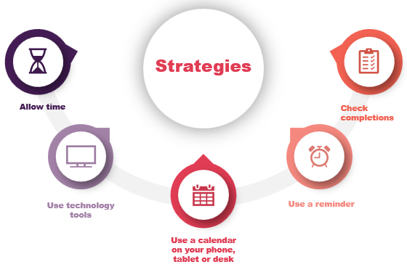
2.18 Strategies for communicating in a timely manner
There are many strategies which can help you organise your work and tasks so that information you need to share with others is completed in a timely manner
Notes:
Key points:
Strategies for communicating in a timely manner
There are many strategies which can help you organise your work and tasks so that information you need to share with others is completed in a timely manner.
Here are some strategies you could try to help you communicate in a timely manner in your workplace…
Learner Guide Ch2.17, pg 38

Slide 62

Section 2 Recap
Key Areas Covered:
Communication in the workplace- the different types that can be utilised in the health and community services industry
Considerations when communicating to audience
Communication protocols
The support services available in the health and community services industry
The various approaches when working with clients
Providing information to assist clients on services and supports available
Strategies to communicate information
Clarifying information
Legislation on keeping information private
Notes:
Key points: Conclude Session
Share key learnings
Homework: Outline homework tasks to complete before next session
Thank you and close

Slide 63
Complete Chapter 2 Review Questions page 56

Slide 64

3.1 Recognising challenging situations
Challenging situations can occur in community services and health workplaces. To handle them effectively:
- Recognise the situation.
- Plan an appropriate response.
- Take action to address the issue.
- Seek help: Engage the skills of others when needed rather than attempting to resolve it alone.
- Prioritise safety and effectiveness over independent problem-solving.

Slide 65



3.2 Situations Which Challenge Us
- Support to someone experiencing trauma or grief
- Managing a critical incident
- Dealing with threats of violence or harm
- Child abuse, harm or neglect
Notes:
Key points:
Situations Which Challenge Us
Here are some examples of situations which can be challenging to manage…
Learner Guide Ch3.2, pg 41

Slide 66
Complete 3A Inquiry Task page 59

Slide 67
3.3 Situations that challenge us
Some early signs and their descriptions are shown in the table below:
Sign | Description
Behaviour triggers | Known triggers that have been identified in a person’s support plan or case notes that have previously triggered behaviours of concern
Changes in response | Differences which occur in the way a person responds to your communication or interaction with them, such as a difference in mood, language, tone of voice or body movements
Language | Words or phrases which are threatening, aggressive, confused or difficult to comprehend
Presence of dangers in the environment | Objects, equipment or environmental factors which could contribute to a situation becoming more challenging or higher risk

Slide 68

Identifying Challenges Through Early Signs
Behavioural triggers
Identified in a support plan or
case notes
Changes in response
Such as difference in mood, language and tone
Presence of dangers in the environment
Objects, equipment or environmental factors
Language
Words or phrases that are threatening
Notes:
Key points:
Identifying Challenges Through Early Signs
Sometimes there are early signs that indicate a situation might become more complex and challenging.
It is useful to recognise these early signs, so you can respond appropriately to them.
Some early signs and their descriptions…

Slide 69
3.4 Indicators of Risk
You need to be alert to indicators of risk which can suggest that a child, young person or adult may be experiencing abuse, harm or neglect. Some of these indicators are:
Areas of abuse | Indicators
Physical | Bruises, lacerations, swelling, fractures, etc.
Sexual | Bruising, pain around genitals or torso
Emotional | Delayed development, failure to achieve milestones
Financial | Not having enough money for daily tasks and activities
Neglect | Frequently tired, unprepared
Notes:
Key points:
Indicators of Risk
You need to be alert to indicators of risk which can suggest that a child, young person or adult may be experiencing abuse, harm or neglect. Some of these indicators are…

Slide 70

3.5 Following Organisational Procedures
Organisational procedures guide how to respond to early indicators of risk. Key steps include:
Seek guidance: Consult others for direction or assistance in responding to the situation.
Take action: Respond appropriately and report the situation to relevant parties.
Inform supervisors: Notify your supervisor or team leader when managing complex or challenging situations.
Supervisor support: Supervisors may provide additional support or intervene as needed.

Slide 71

3.6 Duty of care
You should consider all aspects of duty of care in your work role:
Legal – what the law says you must do.
Ethical – what is morally the best course of action to take.
Organisational – what the policies, procedures and directions of your organisation require you to do.
Professional – what the expectations are for a person holding your qualifications and position.
Notes:
Key points:
You should consider all aspects of duty of care in your work role:
Legal – what the law says you must do.
Ethical – what is morally the best course of action to take.
Organisational – what the policies, procedures and directions of your organisation require you to do.
Professional – what the expectations are for a person holding your qualifications and position.

Slide 72

3.7 Mandatory Reporting
Mandatory reporting is a very specific type of communication that is sometimes required in a community services or health workplace.
It is a process of making a notification to the relevant authorities that you know or suspect that a child or young person has been harmed or is at risk of harm. This risk can relate to physical, emotional and sexual abuse and neglect.
Notes:
Activities/Discussions:
Mandatory reporting is a very specific type of communication that is sometimes required in a community services or health workplace.
Each state and territory have their own legislation which relates to child protection.
Research mandatory reporting requirements for your state or territory.

Slide 73
Mandatory Reporting- Legislation and How to Report
Each state and territory have their own legislation which relates to child protection. These laws apply the principle of acting in the best interests of the child as the primary consideration.
In Victoria the legislation followed is the Children, Youth and Families Act 2005.
When choosing what and how to report:
Report concerns to your supervisor or directly to an authority, depending on the situation.
Consider your job role and its responsibilities when deciding how to report.
Evaluate if you have a duty of care or if harm or neglect has occurred.
Check if mandatory reporting laws apply to the situation.

Slide 74

3.8 Communication Constraints
Environmental Constraint | Strategy to Resolve
Distractions | Look for options to remove them such as closing a window to reduce effect of wind
Temperature | Ask if the person is comfortable
Threats | Remove immediate threat if safe to do so
Comfort and familiarity | Think about what might help the person feel comfortable
Notes:
Key points:
Resolving Communication Constraints
Once you have identified the factors which affect communication, you can take steps to resolve them.
In some cases, your response can be quite simple, while in other cases you may need to think carefully about how to respond.

Slide 75
3.9 Factors that affect communication
Factor | How
Environmental | Distractions (eg noise, weather, movement), temperature, safety threats, and unfamiliar or uncomfortable environments can affect communication
Person-specific | Medication effects, mental illness, trauma triggers, disabilities, or sensory impairments can impact communication
External responsibilities | Tasks like caring duties, work, or study may limit focus on communication
Observation skills | Use observations and knowledge of the person to identify environmental and personal factors affecting communication
Action steps | Address identified factors to improve communication effectiveness and clarity

Slide 76
3.10 Resolving Communication Constraints
Once you have identified the factors which affect communication, you can take steps to resolve them. In some cases, your response can be quite simple, while in other cases you may need to think carefully about how to respond.
See below examples for Resolving Environmental Constraints:
Environmental Constraint | Strategy to resolve
Distractions | Look for options to remove the distraction or change the location of the communication so the distraction is further away
Temperature | Ask if the person is comfortable, then adjust the temperature as required by turning on/off an air conditioner or fan, turning on/off a heater, etc
Threats | Remove the immediate threat if safe to do so or move the person and yourself away from the threat
Comfort and Familiarity | Think about what might help the person to feel comfortable and at ease.

Slide 77
Complete 3B Inquiry Task page 68

Slide 78
3.11 Managing Conflict
Conflict can arise in community services and healthcare settings and requires careful management.
Prioritise safety for everyone involved and aim for positive outcomes for clients.
Use communication skills to reduce the likelihood of conflict.
Act quickly and efficiently to defuse conflict when it occurs.
Focus on finding an acceptable and appropriate resolution

Slide 79
3.12 Understanding Conflict
Before you begin to manage conflict, it is important to understand what conflict means, and what it can look and feel like for different people.
When can Conflict Occur?
Conflict can occur between individuals, workers, or the general public, and is experienced differently by children, adolescents, and adults.
It can have emotional and mental effects, negatively impacting a person's wellbeing.
Conflict can lead to physical effects, such as stress, burnout, and even violence or harm.
How Conflict affects individuals:
Their age can determine how they react
Their previous experiences can dictate how they respond
Any disabilities or mental illness which they may have
Their cultural and linguistic background

Slide 80

3.13 Avoiding Conflict
Conflict situations can sometimes be avoided with careful planning.
Assess the situation and consider factors that may increase or decrease the likelihood of conflict.
Encourage factors that reduce the chance of conflict and remove those that make it more likely.
Delaying a conversation until a better time can help avoid conflict.
Asking the person if they are ready to discuss the situation can promote a more productive interaction.
Observing signs of stress or agitation and choosing a neutral, non-threatening environment can reduce conflict.

Slide 81

3.14 Defusing Conflict
Communication skills are fundamental to defusing a potential conflict before it escalates.
Here are some steps to consider:
Identify potential for conflict to escalate
Monitor your own safety and that of others around you
Consider a safer option for removing yourself and others from a situation if needed
Discuss options that are based on a win-win approach where there are benefits for both parties
Offer the option of coming back to the discussion later
Notes:
Key points:
Defusing Conflict
Communication skills are fundamental to defusing a potential conflict before it escalates.
Here are steps to consider…
Reference: Learner Guide Ch3.14, pg 49

Slide 82

Defusing Conflict
6. Use neutral vocabulary and a calm, relaxed but confident approach
7. Keep number of words to a minimum
8. Provide clear, direct information
9. Focus on what you would like the person to do first, then next
10. Work towards a safe, mutually beneficial resolution
Notes:
Key points:
Defusing Conflict
6. Use neutral vocabulary and a calm, relaxed but confident approach
7. Keep number of words to a minimum
8. Provide clear, direct information
9. Focus on what you would like the person to do first, then next
10. Work towards a safe, mutually beneficial resolution

Slide 83
Complete 3C Inquiry Task page 72

Slide 84
3.15 Resolving Conflict
There are a number of Conflict Resolution Approaches you can use depending on the situation.

Slide 85
Conflict Resolution Styles
Competing Style: One party prioritizes their own goals over the other’s, suitable for time-sensitive situations. It requires assertiveness, clear instructions, and confidence (e.g., emergency care situations).
Accommodating Style: One party gives in to the other’s needs, which can empower the other but may lead to a false sense of control. It is a "win-lose" approach, where one party concedes.
Collaborating Style: A win-win approach where both parties work together to find mutually beneficial solutions, requiring strong communication, goal setting, and understanding of body language.
Avoiding Style: The conflict is ignored or avoided, leading to no resolution. It has low concern for both the goal and relationship, often resulting in unresolved issues.

Slide 86
Complete 3D Inquiry Task page 74

Slide 87
Complete Chapter 3 Review Questions page 75

Slide 88

4.1 Legal Responsibilities
There are many acts and sets of regulation which can apply to community services and health care work. Here are some of the laws which can apply to your work:
Racial Discrimination Act 1975
Disability Discrimination Act 1992
Equal Opportunity Act 2010
Health Records Act 2001
Child Wellbeing and Safety Act 2005

Slide 89

4.2 Ethical Requirements
As well as legal requirements, your work in community services and health care will also involve ethical requirements and decision making.
Ethical decision-making means considering the following:
Is there a conflict of interest to the situation
Rights of people with whom you are working
Model of support under which you are working
Your own views and values
Views and values of your organisation
Notes:
Key points:
Ethical Requirements
As well as legal requirements, your work in community services and health care will also involve ethical requirements and decision making. Ethical decision-making means considering…

Slide 90
Complete 4A Inquiry Task page 80

Slide 91

4.3 Making Links Across the Sector
Legal and ethical requirements can be challenging and can sometimes prompt a response in a situation where the solution is not clear cut.
In these situations, it may be important to refer to, and link with, other parts of the community services and health care sector.
You may need to access specialist information and guidance to help you resolve a legal or ethical challenge, or to find out how an aspect of the law applies to a client’s situation.
Over time, you will establish links with others who work in different areas of the sector, so that you are easily able to access their expertise when it is required.
Notes:
Key points:
Making Links Across the Sector
Legal and ethical requirements can be challenging and can sometimes prompt a response in a situation where the solution is not clear cut.
In these situations, it may be important to refer to, and link with, other parts of the community services and health care sector.
You may need to access specialist information and guidance to help you resolve a legal or ethical challenge, or to find out how an aspect of the law applies to a client’s situation.
Over time, you will establish links with others who work in different areas of the sector, so that you are easily able to access their expertise when it is required.
Learner Guide Ch4.3, pg 55

Slide 92
4.4 Referring to Appropriate People
Workplace Procedures: Most workplaces have standard procedures outlining how tasks should be performed, and employees should understand and follow them.
Breaches of Procedure: Breaches may occur due to workers not understanding the procedure, thinking it is unimportant, finding quicker methods, or postponing parts of tasks.
Need for Review: Some breaches indicate that procedures may need to be updated to better suit workers’ needs.
Consequences of Breaches: Some breaches can have significant consequences, requiring quick and appropriate action to address them.
Importance of Following Procedures: Even if a procedure seems unimportant, it must still be followed unless formally changed through a continuous improvement process.
Reporting Breaches: If a breach occurs, it should be reported to the supervisor or another relevant person in the workplace.

Slide 93



4.5 Adverse Events
Adverse events are situations where there is an outcome that was not desired or planned for, often involving a client.
Examples of adverse events include:
Illness or health condition which deteriorates
Client harmed or injured
Conflict situation that escalates
Medication error which occurs
Worker injured or becomes sick due to work
Notes:
Key points:
Adverse Events
Adverse events are situations where there is an outcome that was not desired or planned for, often involving a client. Examples of adverse events include:
-Illness or health condition which deteriorates
-Client harmed or injured
-Conflict situation that escalates
-Medication error which occurs
-Worker injured or becomes sick due to work

Slide 94
4.6 Rights and Responsibilities
Rights and Responsibilities: Workers, employers, and clients all have rights and responsibilities in the workplace, which should be understood by all parties.
Examples of Rights: Clients have the right to be informed about care options, workers have the right to a safe work environment, and employers have the right to expect workers to fulfill their duties.
Legislation and Expectations: Some rights and responsibilities are defined by legislation, while others are based on sector-specific or organisational expectations.
Areas of Rights and Responsibilities: These can relate to work health and safety, work roles, services provided, infection control, responses to incidents, and professional development.
Clear Communication: Rights and responsibilities should be communicated openly and clearly to ensure everyone understands their roles.
Strategies for Sharing Information: Strategies include regular meetings, clear policies, client service guidelines, visual displays, and embedding sector standards in organisational procedures.

Slide 95
Complete 4B Inquiry Task page 85

Slide 96
4.7 Unresolved Conflict
Conflict in the Workplace: Conflict may arise at work, and while conflict resolution strategies can be used, some situations may require external assistance if the conflict escalates or cannot be resolved.
Examples of Conflict: Conflicts can include disagreements about best practices, unresolved duty disputes, unrealistic client expectations, or differing willingness to participate in conflict resolution discussions.
Collaborative Approach: The best approach to conflict resolution is often collaborative, focusing on mutual agreement and the intent to resolve the issue positively.
Seeking Assistance: If the conflict cannot be resolved, it should be referred to a supervisor for further action.
Communication Methods: Conflicts can be reported to a supervisor via email, phone, or direct conversation, depending on the workplace’s communication practices.
Supervisor’s Role: A supervisor may offer suggestions, directions, or act as a mediator to help facilitate the resolution of the conflict.

Slide 97
Chapter 4 Review Questions page 87

Slide 98

5.1 Documentation
Recordkeeping: Completing timesheets, making case notes, appointments and bookings
Role-related documents: Case notes, team meeting agendas, emails from supervisor
Organisational standards: Expected standards for written and electronic documents, following brand, logo, etc.
Notes:
Workplace Documentation
Workplace documentation must be completed regularly, in line with the policies and procedures of your organisation.
Recordkeeping
Your organisation will have specific policies and procedures which guide the way you must complete workplace documents and records. This can apply to areas of work such as…
Role-related documents
When you begin in a community services or health workplace, you will mainly focus your attention on documents and information which relate specifically to your own job. Although there are likely to be other documents within your workplace, it makes sense to think first about the documents which are most relevant to you. These could include…
Organisational standards
Your organisation will have an expected standard for written and electronic documents. These are often included in the policies and procedures of your workplace, but you can also ask your supervisor for guidance if needed.
Reference: Learner Guide Ch5.1–5.5 (pg 61–65)

Slide 99

5.2 Role-Related Documents
Focus you attention on documents and information which relate directly to your own job.
This can also include other documentation such as:
Case notes for your own clients
Team meeting agendas and minutes
Emails from your supervisor and co-workers
Your position description
Policies and procedures which relate to your job
But take your time when reading workplace documents, you don’t want to miss key details!

Slide 100
5.3 Asking your Supervisor for Assistance
- If there is something you don’t understand- always ask your supervisor for assistance!
- Some workplace documents are complex and details or could contain critical instructions which must be followed precisely.

Slide 101
5.4 Asking your Supervisor for Assistance
Organisational Standards: Written and electronic documents must meet organisational standards, often outlined in workplace policies and procedures. Guidance can also be sought from supervisors.
Implied Standards: Standards may not always be explicitly stated but can be observed by comparing the work of colleagues in similar roles.
Electronic Document Standards: These include using specific fonts, avoiding colored backgrounds, limiting animations, ensuring intuitive navigation, and offering accessibility options like text-to-speech or Plain English versions.
Audience-Specific Design: Document standards should align with the audience's needs, e.g., larger fonts for elderly users or more multimedia for younger audiences.
Written Document Standards: Requirements might include version control, branding, print and electronic availability, and intended purpose (internal or external use).
Confidentiality: Some documents are for internal use only and should not be shared with the general public due to their sensitive nature.

Slide 102



5.5 Brand Features
Many organisations have a brand or identity that they maintain through their documents.
Brand features can relate to:
Logo
Slogan or key phrase
Colours
Font size
Font style
Headers and footers
Many workplaces will use a template system for letters, flyers and publicity documents to help workers maintain the branding which is required by the organisation.

Slide 103
Complete 5B Inquiry Task page 97

Slide 104

5.6 Digital Media
Digital Media Challenges: Digital and social media offer benefits for promotion and communication but present challenges, including appropriateness, readability, cultural relevance, and image use (e.g., images of children).
Evolving Landscape: The digital media environment changes rapidly, requiring careful thought, planning, and attention when creating or using digital content.
Worker Familiarity: Some workers are skilled and experienced with digital media but may lack caution when transitioning from personal to professional use.
Workplace vs. Personal Use: Digital content created for the workplace must adhere to stricter rules and maintain boundaries distinct from personal digital media practices.
Importance of Boundaries: Clear boundaries between personal and professional digital media use must be upheld to align with workplace standards and expectations.

Slide 105
5.7 Documenting Events
Documentation in Community Services: Recording actions, outcomes, goals, and progress is a critical part of many tasks in community services and healthcare.
Purpose of Documentation: Information helps track client progress, support continuity of care, and assist other professionals who may work with the client.
Shared Use: Documentation is often accessed by others, such as referral recipients, to provide informed and effective services.
Required Format: Documentation should follow a standard format commonly used in workplaces to ensure consistency and clarity.
Organisational Rules: Each organisation may have specific documentation guidelines that must be adhered to alongside general formatting practices.

Slide 106
5.8 Conventions for Recording Information
Here are some of the conventions for completing documentation for case notes, client records, referrals and individual plans and assessments:
Convention | What to do
Name | Include your own name so people know who has made the document or note
Date | Include the complete date so it is easy to check when a record has been made and records can be maintained in a sequential order
Signature | Some documents or notes require a signature, which should be made in blue or black pen
Past tense | Documents such as case notes are often written in the past tense
Objective | Keep your writing objective rather than including your own opinions and values

Slide 107
Conventions for Recording Information
Convention | What to do
Details | Include details relevant to the situation and the task or work you are doing and leave out non-relevant details
Accuracy | Check your work for accuracy, so that you are confident the details are correct, and you have not included anything which is incorrect
Courtesy copies and referrals | Check if the document needs to be copied and sent to another worker or organisation as a courtesy, or if you should attach a referral form or letter.

Slide 108
5.9 Making Summaries
Summaries provide a concise outline of a situation, activity, or task, focusing on main points rather than all details.
When to Use: Summaries are useful when full details are unnecessary, a brief reminder is needed, or only a small amount of information is helpful.
Practical Applications: They can assist in preparing for meetings, outlining incidents or near misses, and prompting discussion points with supervisors or colleagues.
Purpose: Summaries serve as quick references or prompts for specific situations or tasks.
Focus: The emphasis is on brevity and relevance to the context in which they are used.

Slide 109
Complete 5A Inquiry Task p91

Slide 110

5.10 Funding Body Requirements
Writing a summary of outcomes for period the funding is provided
Stating how much money has been spent during time period
Providing details of staffing, hours and resources used
Confirming your program has met objectives
Giving detailed info about achievements
Notes:
Key points:
Funding Body Requirements
If you are involved in working on a program which is funded by the government, you may need to complete documentation in relation to the program.
Reporting may include…

Slide 111
Complete Chapter 5 Review Questions page 101

Slide 112
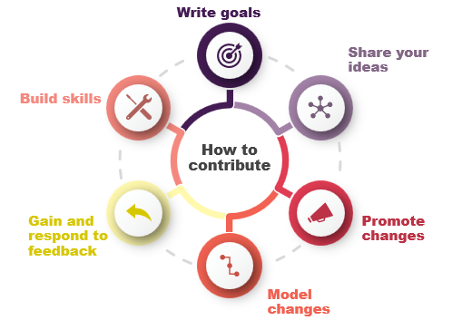
6.1 Workplace Improvements
Notes:
Key points:
Workplace Improvements
Many workplaces participate in formal continuous improvement processes and use these processes to inform and drive positive change across the organisation.
Reference: Learner Guide Ch6, pg 70

Slide 113

6.2 Individual Contributions
Contributing to Continuous Improvement: Workers can participate by attending meetings, suggesting changes, collecting client feedback, and implementing new practices.
Benefits of Participation: Involvement in continuous improvement is satisfying and helps achieve best practice outcomes for the organisation.
Value of New Perspectives: New workers bring fresh insights, noticing inefficiencies others may overlook, which can be highly valuable.
Ways to Share Ideas: Suggestions can be shared through feedback forms, team meetings, committees, one-on-one discussions with supervisors, emails, staff newsletter contributions, or discussions with colleagues.
Support for Ideas: All workplace ideas should be valued and considered, and workers should feel confident their contributions are important to organisational growth.

Slide 114
Complete 6A Inquiry Task page 104

Slide 115
6.3 Improving Work Practices and Procedures
Improving Work Practices: Work practices can improve through small changes and addressing inefficiencies, supported by proactive discussions and planning within the organisation.
Collaborative Approach: Positive change involves team participation, not ignoring established systems, but contributing to discussions and planning to advance goals.
Setting Goals: Work teams often set measurable, clear goals to guide improvements and align with organizational objectives.
Promoting Change: Workers can promote change by discussing improvements, actively listening, giving and receiving constructive feedback, and participating in both formal and informal initiatives.
Leadership Role: Even early-career workers can take leadership roles in promoting changes, helping their organization achieve goals and drive continuous improvement.

Slide 116

6.4 Modelling Changes
Role of Modelling: Modelling involves demonstrating changes to work systems rather than explaining them verbally, making it a powerful teaching tool.
Importance in Teams: It helps team members learn new skills and adapt to changes effectively, especially for complex tasks or significant system changes.
Use in Communication: Modelling is especially useful when language barriers exist, enabling clear communication through action.
Steps in Modelling: Key steps include identifying the change, focusing on its essential aspects, inviting participation, and emphasizing demonstration over explanation.
Practical Impact: This approach fosters learning and supports smooth transitions during organisational or procedural changes.

Slide 117
Complete 6B Inquiry Task page 107

Slide 118
6.4/6.5 Feedback
Purpose of Feedback: Feedback helps improve skills, knowledge, and performance, supporting organisational goals and continuous improvement.
Types of Feedback:
- Knowledge of Performance: Focuses on the process and efforts involved in achieving a goal, aiding specific skill and knowledge development.
- Knowledge of Results: Focuses on the outcome, allowing for measurement against goals and understanding overall achievements.
Requesting Feedback: Workers can seek feedback from colleagues or supervisors by asking them to observe tasks or provide constructive input. Permission from clients may be needed when their involvement is required.
Constructive Feedback: Effective feedback highlights strengths and areas for improvement, avoiding criticism and promoting learning and growth.
Responding to Feedback: Reflect on feedback, document it for reference, and plan how to apply it for skill and knowledge enhancement over time.

Slide 119

6.6 Building Skills
Continuous Learning: Learning continues beyond starting a role in health and community services, as building skills and knowledge is a lifelong process.
Methods to Build Skills:
- Attend formal training such as workshops, conferences, or webinars.
- Work with a mentor regularly.
- Observe experienced colleagues at work.
- Network with professionals in similar roles.
- Participate in industry information sessions or webinars.
Tracking Professional Development: Keep a record of professional development activities, such as in a diary or by taking notes on key learnings.
Seeking Skill Development Opportunities: Consult your supervisor or HR Manager for guidance on training options, workshops, or seminars, and follow your organization's process for applying for professional development.
Setting Work Performance Goals: Write clear, specific goals to guide your learning and professional development (e.g., mastering infection control, improving manual handling techniques, or learning Auslan for communication).

Slide 120
Complete 6A Inquiry Task page 110

Slide 121
Complete Chapter 6 Review Questions page 111

Slide 122

Assessment Tasks
Assessment Task 1: Written Questions
Assessment Task 2: Case Studies
Assessment Task 3: Communicate with a Client (Parts A and B)
Assessment Task 4: Communicate with Co-workers (Parts A and B)
Assessment Task 5: Communicate with Coordinator (Parts A and B)

