Slide 1

CHCCOM001:
PROVIDE FIRST POINT OF CONTACT
POWERPOINT PRESENTATION 2
CHCCOM001

Slide 2
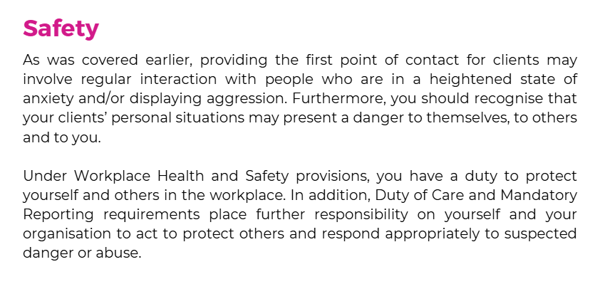
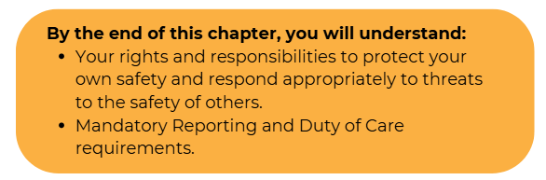
SECTION 3:
Safety
CHCCOM001

Slide 3
3.1 Recognising Danger to Yourself and Others
In some situations, the danger presented to yourself and/or your colleagues may be immediately apparent
Overt aggression and threats of violence may be easy to spot, but many dangers are less obvious
These may include threats presented by: -
Living circumstances
Non-obvious medical conditions
Mental health concerns
Violence from third parties
CHCCOM001

Slide 4
What to do?
Aggression or threats
Seek to ensure you and others are safe
Practices
Act to policies and procedures
Distance yourself and others
CHCCOM001

Slide 5
3.2 Duty of Care and Mandatory Reporting
DUTY OF CARE
MANDATORY REPORTING
Legal obligation that requires organisations and practitioners to ensure the safety and wellbeing of those in their care and of those who access their services
Require that suspected child abuse and neglect be reported immediately.
Requirements vary by state, so you need to be aware of your State or Territories requirement and your organisations policies and procedures
Read case study on page 25
CHCCOM001

Slide 6


Complete 3A Inquiry Task
on page 25
COMPLETE CHAPTER REVIEW QUESTIONS ON PAGE 26
CHCCOM001

Slide 7
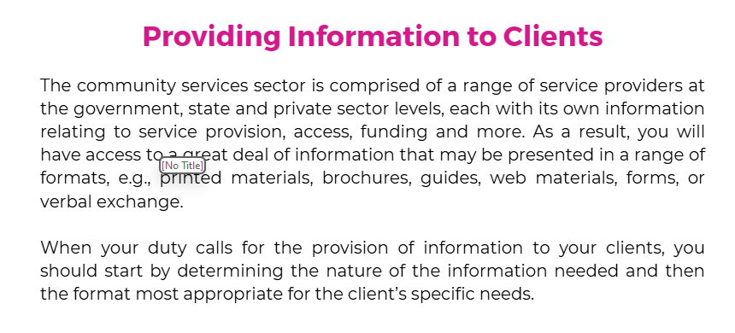
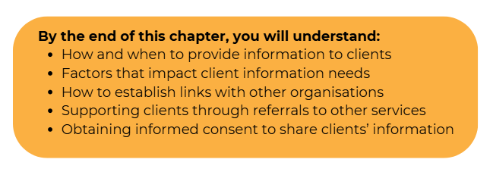
SECTION 4:
Providing Information to Clients
CHCCOM001

Slide 8
4.1 Types of Information to be Provided
Depends on the type of information, your organisations policies and procedures and the needs of the client.
Common information that may be required as part of your first point of contact duties include: -
This is all determined in your
Application forms
Brochures about your service
Timetables
Flyers about specific events or services
Contact details
User guides
CHCCOM001

Slide 9
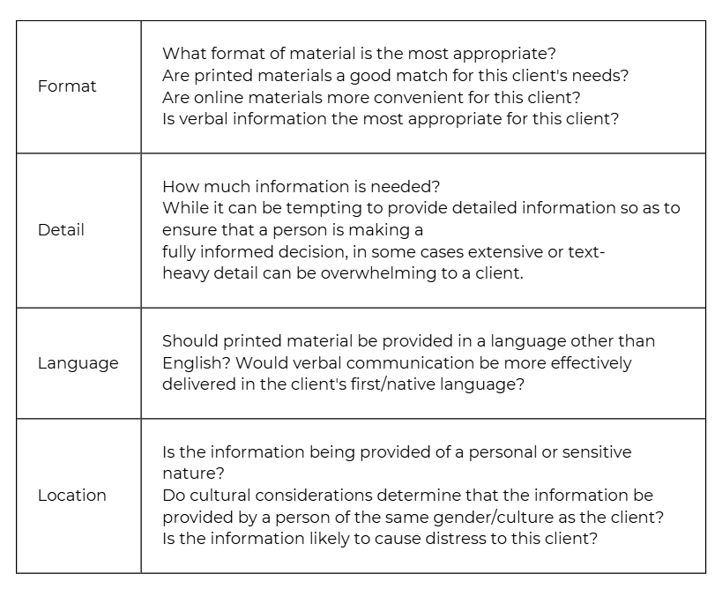
Considerations to communication
CHCCOM001

Slide 10
Role of Organisation and Service Features
Information that you provide to others may include details relating to the nature of your organisation and its service features including: -
  Who your organisation serves (i.e., specific needs and/ or groups and/or within certain geographical areas)
  Your organisation’s principles and philosophies
  Activities/events/services provided by the organisation
  How its services are funded
CHCCOM001

Slide 11
To provide this information accurately and in line with the scope of your role it is essential that you have a full understanding of your organisation’s policies and procedures relating to service delivery and the provision of information
Policies and procedures may include: -
  Determining the extent to which you can provide information — some information may only be provided by more senior staff members or once people have enrolled/engaged with the service
  Determining what information is to be provided at the first point of contact
  Types of information and the formats in which they are to be provided
  Specific language or terminology to be used while talking about the organisation and its services
CHCCOM001

Slide 12
Service Transition and Exit
As well as being the first point of contact, you may be required to assist in transitioning a client out of the service.
Reasons for this include: -
  A client no longer requiring the services of your organisation
  A client’s needs progresses beyond the capabilities of your particular service
This will be determined by your organisations policies and procedures. You may need to complete specific forms, conduct and exit activity and then a process of how follow up and reporting are to be managed
CHCCOM001

Slide 13
4.2 Assisting with Referral to Other Agencies
Referral to other agencies may be required where specialist advice or services become necessary, either in conjunction with or in place of your organisation and may include: -
  For communication or cultural needs – translators, etc.
  Specialist medical professionals
  Advocacy and representation professionals
  Organisations or service providers that assist clients with multifaceted needs
  Employment or education-service providers
  Community outreach representatives
CHCCOM001

Slide 14
You may be required to assist a client who is unable to complete this task due to disability or language barriers.
Tasks you may complete include: -
  Filling out forms
  Making contact via email or the internet
  Making a telephone call
Consent must be obtained prior to passing on personal details or information, even when acting on another’s behalf
Explain to the client why this information is required and how it will help them to access the service they need.
CHCCOM001

Slide 15
4.3 Links with Other Service Providers
By cultivating links with other service providers, it offers multiple benefits to both the worker as an individual and to the organisation that they represent.
Developing strong networks
Professional Development
Benefits
Enables smoother service delivery
Broadens understanding
CHCCOM001

Slide 16
4.4 Providing Further Assistance and Follow-Up as Required
Once you have provided initial support to those engaging with your service, you should check to see if any further assistance is required
If an individual’s enquiry is not fully resolved during the first point of contact, you should confirm and communicate how follow-up will occur and an appropriate timeline
In more complex settings, gather information from multiple sources including those within and/or external to your organisation.
You also need to ensure that your client is aware and involved, so they feel valued.
Read case study on page 33
CHCCOM001

Slide 17
Complete 4A Inquiry Task
on page 33
COMPLETE CHAPTER REVIEW QUESTIONS ON PAGE 34
CHCCOM001

