Slide 1


CHCCOM001 PROVIDE FIRST POINT OF CONTACT
POWERPOINT PRESENTATION 1
CHCCOM001

Slide 2
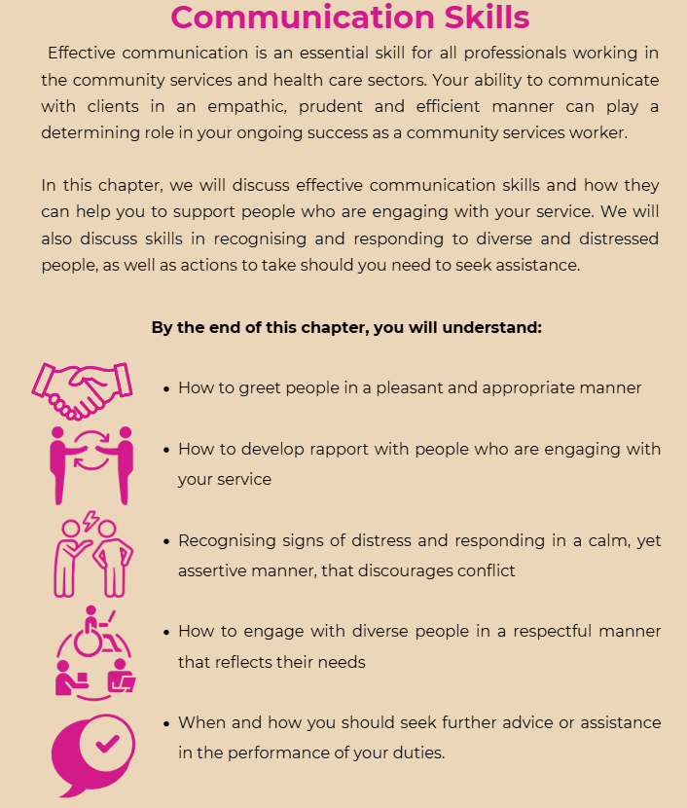
SECTION 1:
Communication skills
CHCCOM001

Slide 3
1.1 What is Effective Communication?
Who will I communicate with in the community services sector?
  Clients
  Client families
  Members of the community
  Colleagues
  Service providers
Effective communication is imperative as people will have diverse needs including cultural and social backgrounds, complex medical and disability-related and social support needs
These all need to be considered among other factors as they will influence the individual needs of every one of your clients
CHCCOM001

Slide 4
Tips
Your ability to recognise the specific communication needs of each individual and to, in accordance, modify your approach in providing services to that client is essential
When acting as the first point of contact with your organisation or service, how you communicate will help to determine first impressions for the client — not only of yourself but of your service as a whole. It is therefore essential that your communication skills help to set a positive tone for all those who come into contact with your organisation and/or service.
CHCCOM001

Slide 5

Effective Listening Skills
Listening and showing that you are giving your full attention is a key element of effective communication
Reduces your chances of misunderstanding what is said
Helps to build trust and rapport with whoever you are communicating with
Listen closely and avoid making assumptions or judgements about them or what they need
Be patient and allow them to talk without interruption offering your opinion
CHCCOM001

Slide 6
Active Listening
Is a skill that can be learned and practiced just as any other skill
Refers to using all of your senses combined in order to focus on what is being said while showing the other person that they have your undivided attention
CHCCOM001

Slide 7


DO’s and DON’Ts of Active Listening
Use body language like smiling and nodding
Give people your full attention
Ask clarifying and follow up questions
Paraphrase what has been said, to confirm understanding
Avoid negative body language like crossing arms and yawning
Don’t fidget or get distracted
Ignore their conversation
Repeat the whole conversation
CHCCOM001

Slide 8
Verbal Communication Skills
Effective verbal communication comprises three primary elements
1. | Words chosen | Consider what you are going to say. Appropriate words for the audience.
2. | Voice and tone | Speak clearly and with confidence. Appropriate volume.
3. | Body language | Consider facial expressions.
CHCCOM001

Slide 9

Complete 1A Inquiry Task
on page 6
CHCCOM001

Slide 10
1.2 Communicating with Distressed People
Clients will most likely need to interact and communicate with you and engage your services when they are physically, mentally and emotionally distressed
The way you greet these clients can set the stage for future interactions
Be friendly, calm and professional to ease their distress
Building rapport can help you to demonstrate to the distressed person that you are there to support them and to facilitate them in addressing the issue that is causing their discomfort.
CHCCOM001

Slide 11
LEAN IN SLIGHTLYWHEN THEY ARE TALKING
DON’T STAND OR SIT DIRECTLY FRONT-ON
ASK THEM A FRIENDLY LIGHT-HEARTED QUESTION
ASK QUESTIONS TO DETERMINE HELP REQUIRED
LISTEN TO THEIR CONCERNS
TIPS FOR DEVELOPING RAPPORT
BE MINDFUL OF YOUR BODY LANGUAGE
ASK EARLY ON IF THERE IS SOMEONE THERE WHO CAN SUPPORT THEM
SMILE
CHCCOM001

Slide 12
Remain calm
Listen to their concerns
Tips for communicating with distressed and/or aggressive individuals
Avoid arguing the point
Establish boundaries
Tell them what you are going to do
Negotiate a resolution
Notes:
Key points:
Apply the following tips while dealing with a person who is aggressive:
Remain calm – don’t respond to aggression with aggression. A calm demeanour can help to diffuse another person’s anger.
Listen to their concerns – as with distressed people, showing people that their concerns are being heard will serve to diffuse anger.
Avoid arguing the point – anger and logic rarely coexist, so trying to reason with them or to show them that their argument is not logical will only serve to inflame the situation.
Establish boundaries – tell them that abuse and aggression are neither called-for nor acceptable. Explain that you want to help them but cannot do so if they continue to yell, swear, threaten violence, etc.
Tell them what you are going to do before you do it – if you are going to seek help from another person, ensure that you communicate this before the time.
Negotiate a resolution – explain that you can help on condition that they communicate in a more appropriate and subdued manner.
Learner Guide: Ch 1

Slide 13
Actions to follow when working with upset people
Listen to their concerns, without judgement
Allow the person to voice their distress
Demonstrate through your actions, body language and speech that they are being heard and taken seriously
When talking to a distressed person on the phone, ask them early on whether there is someone there who can support them
Ask them questions to determine what sort of help they need.
Let them know you can help them or, if you can’t, that you will find someone who can
CHCCOM001

Slide 14
Often people who are in distress can become aggressive.
If this situation arises or looks like it could arise, you should start by ensuring your safety and the safety of those around you.
This may require assistance from colleagues, emergency services, etc.
Carefully move away from the aggressive person
WARNING
CHCCOM001

Slide 15
1.2 Communicating with Diverse People
Is a day-by-day reality for professionals who work in the community services sector
Your clients, colleagues and other service providers will represent a variety of diverse factors as a broad representation of the community
You need to be able to recognise and respond to the needs of individuals in a manner that reflects and respects their individuality.
We will discuss some general guidelines but it’s imperative to not stereotype and you seek to understand the specific needs of each individual
CHCCOM001

Slide 16
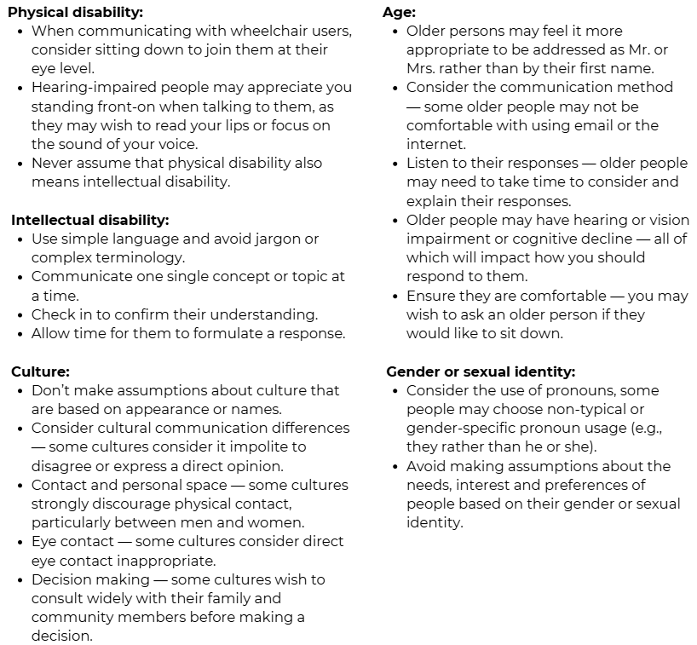
CHCCOM001

Slide 17
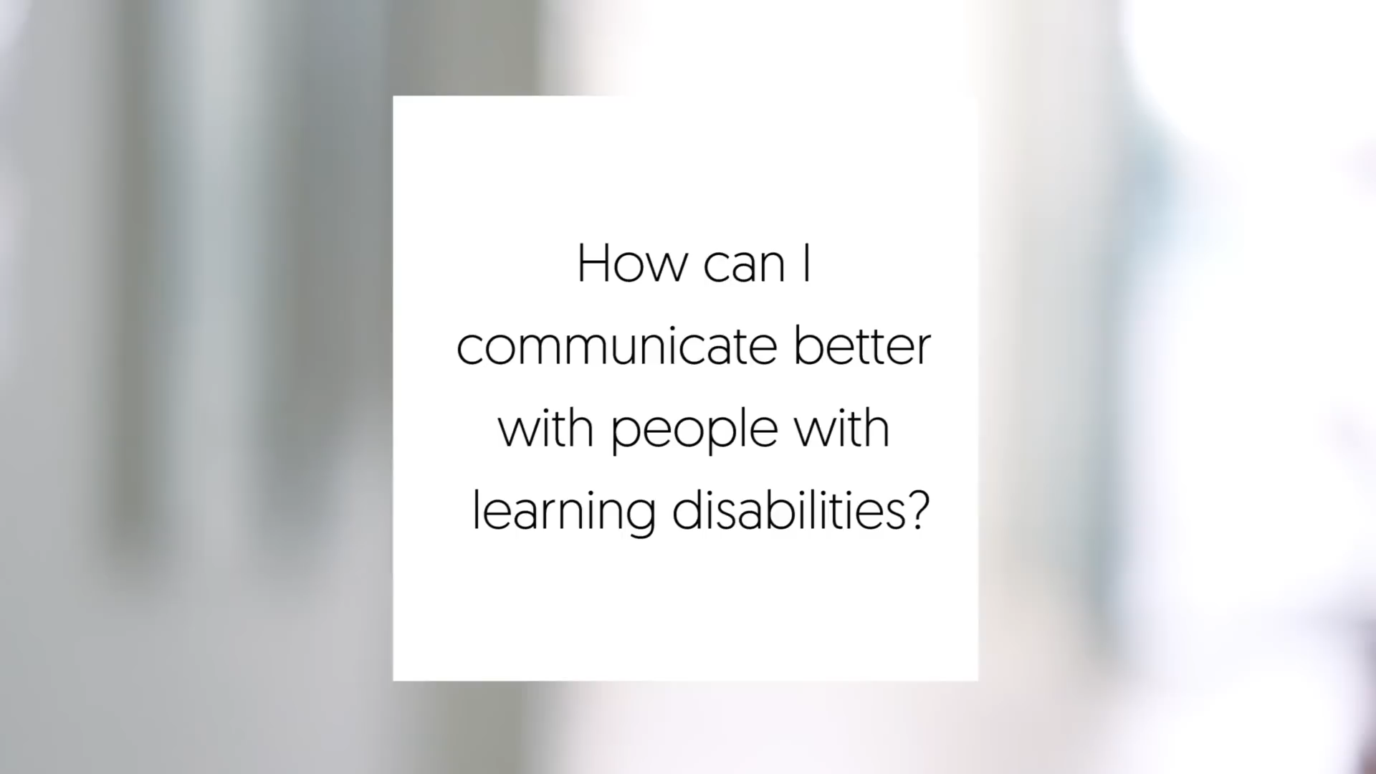

Slide 18
Language and Literacy
Considerations regarding language and literacy should be made within your role as a community services worker:
  Literature prepared in various languages spoken in the community
  Accessing interpreters
If you are having problems communicating, seek the assistance of someone with the skills and means to help
CHCCOM001

Slide 19
Jargon and idioms
The use of terminology and language that you use everyday can be unfamiliar to outsiders, recruits and clients
Be careful using acronyms
When dealing with people from different cultures, Australian idioms may cause unnecessary confusion (or even offence) to some
Read the Case Study on Page 11
CHCCOM001

Slide 20

Complete 1B Inquiry Task on page 11
COMPLETE CHAPTER REVIEW QUESTIONS ON PAGE 12
BSBWOR202

Slide 21
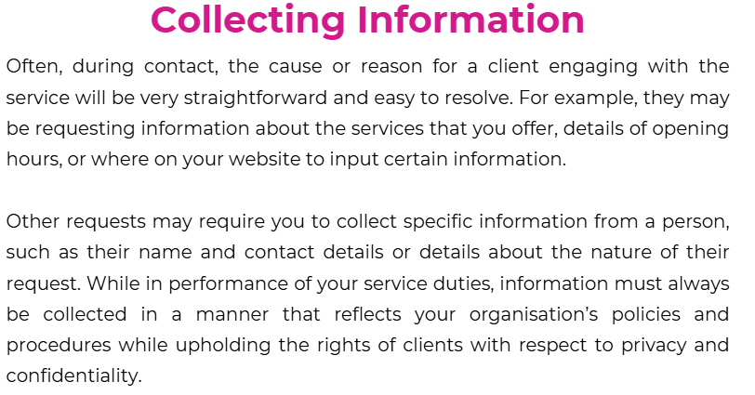
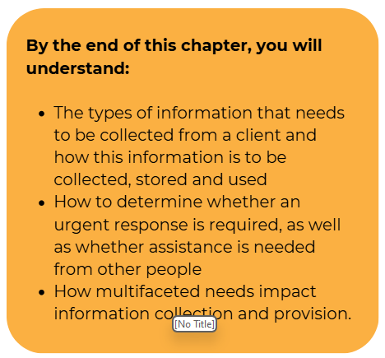
SECTION 2:
Collecting Information
CHCCOM001

Slide 22
2.1 Determine the Information Required
Information you may be required to collect as the first point of contact, to meet the needs of your client includes:
  Name
  Date of Birth
  Address
  The nature of their enquiry or of the support they seek
As a community services worker you: -
  Must respect the position of privilege and trust that you hold
  Will be in a position to collect and access a client’s personal and private information (Maintain client privacy)
Some information may also be collected via observation
CHCCOM001

Slide 23
Organisational Policies and Procedures for Recording and Storing Information
It is up to you to be aware of your organisations policies and procedures relating to how information is collected, used and stored.
If unsure… ASK
CHCCOM001

Slide 24

Recording and Storing Information
What information is to be collected under specific circumstances.
Use of specific recording formats, e.g., progress notes, handover reports and client files.
Timeframes for storing or logging of client information and/or requests.
How and when information is to be shared with other organisations.
Notes:
Key points:
Your organisation will have policies and procedures in place that determine how information is to be collected, used and stored by workers. It is essential that you be aware of these policies and procedures and, if at all unsure, that you check with your supervisor before you proceed.
Organisational policies may address the following:
what information is to be collected under specific circumstances
use of specific recording formats, e.g., progress notes, handover reports and client files
timeframes for storing or logging of client information and/or requests
how and when information is to be shared with other organisations.
Learner Guide: Ch2

Slide 25

Recording and Storing Information
Ensure a private or quiet space before collecting person information.
Be discrete when talking on the phone.
Collect only necessary information.
Ensure writing is clear.
Notes:
Key points:
The following principles must be observed while collecting and storing personal information:
If you are in a public space, e.g., the reception area, move to a private or quiet space before collecting personal information.
Be discrete when talking on the telephone so as to avoid incidents of others overhearing your discussion. Move to a private space if necessary.
Collect only the information that is necessary for you to provide effective service to your client.
If handwriting notes, ensure that your writing is clear and most likely to be understandable to anyone who may access the notes.
Learner Guide: Ch2

Slide 26

Recording and Storing Information
Follow policies and procedures.
Do not leave information lying around.
Double check spelling and numbers.
Be mindful of who you discuss this information with.
Notes:
Key points:
Once collected, promptly follow your organisation’s procedures for storing such information. Do not leave personal information laying in places where it can be seen. Do not leave computer windows that contain client information open in places where they can be seen.
While taking down names, email addresses, phone numbers and street addresses, double check spelling and numbers to avoid any mistakes.
Be mindful of how, with whom, when and where you discuss the information collected .
Learner Guide: Ch2

Slide 27
Client Rights and Responsibilities
Clients expect that their personal information will be respected by you and that confidentiality is maintained
This relates to: -
  How and why the information is collected
  Who it is to be disclosed to
  How it will be stored
  How and when it will be destroyed
CHCCOM001

Slide 28
Before collecting information from clients, you should seek their approval to collect and record that information
You should make the client aware of their rights and responsibilities with respect to disclosure and storage
If you are working with children, this should be discussed with their parent/s or guardian/s
You must advise clients of their right to access any information collected that relates to them
You need to follow your organisations policies regarding access to this information, or clients may be directed to access the information under the Freedom of Information Act
CHCCOM001

Slide 29
Legislation
Freedom of Information Act
Privacy Act 1988
My Health Records Act 2018
Read the case study on page 17
CHCCOM001
Notes:
Key points:
Your clients must be advised of their right to access any information collected about them. Your organisation may have specific policies regarding access to this information, or clients may be directed to access the information under the Freedom of Information Act.
The collection, storage and disclosure of personal information is subject to a number of pieces of legislation.
Learner Guide: Ch2

Slide 30
Complete 2A Inquiry Task on page 17
BSBWOR202

Slide 31
2.1 Determining Reason for Contact
On most occasions, people will have a clear reason for contacting your service and will involve a simple process including: -
Asking basic questions
Determining how you are able to meet the client needs
Ensure effective communication skills
Exploratory questions
Unpacking individual's needs
Empathic approach
Read the case study on page 18
CHCCOM001

Slide 32
Complete 2B Inquiry Task on page 18
BSBWOR202

Slide 33
2.3 Establishing Needs and Urgency
Part of your role as a first point of contact for clients is to promptly assess the needs and urgency level attached to the reason for conduct.
If a client’s health, wellbeing or safety is of concern then they may take precedence over other enquiries.
You need to learn how to recognise and respond to specific situations in a timely manner
In physical situations the appearance, demeanour and apparent state of health of the client may determine the need
If this is the case, assistance should be immediately sought
CHCCOM001

Slide 34
Needs and
Urgency
Person is in danger
Client contact
Person is unwell
Can you resolve issue?
Person is
aggressive
Yes
No
Is request or situation urgent?
Response
is timebound
No
Yes
Investigate further
Seek advice
Request assistance
Seek advice
CHCCOM001
Notes:
Key points:
A flow chart or process can be useful in establishing urgency and the necessary responses. An example is provided.
Learner Guide: Ch2

Slide 35
The Impact of Multifaceted Needs
EXAMPLE OF A MULTIFACETED NEEDS APPROACH
Terri has physical disabilities and cognitive impairment because of a car accident. In addition, she suffers from depression and aggressive mood swings.
Arthur is an elderly man with advancing dementia and diabetes. As his dementia progresses, he regularly forgets to take his diabetes medication, resulting in hypoglycaemic episodes.
Janelle is a 16-year-old with an eating disorder. She has two younger brothers with Autism, which has resulted in a stressful and disordered family life.
In some instances, observation and communication at the initial point of contact or as part of a referral from other agencies may indicate that an individual has multifaceted needs.
This may mean that clients need support by and are engaged with services from multiple organisations
To ensure consistency, the involvement of other services should be established and considered upon determining needs
CHCCOM001

Slide 36
2.4 Seeking Advice and Discussing Concerns
Some situations will require you to seek the advice of colleagues and/or to discuss the concerns that you may have including: -
Body language that does not match with what the person is saying.
Observations of physical state.
Cognition and awareness issues.
Signs of abuses, injury or neglect.
CHCCOM001

Slide 37
To respect the privacy of your client’s personal affairs, when discussing you need to: -
Be discreet
Use respectful language and tonality
Ensure you include your client in the discussion
Ensure it cannot be overheard by those not involved
CHCCOM001

Slide 38
COMPLETE CHAPTER REVIEW QUESTIONS ON PAGE 22
CHCCOM001

