Slide 1
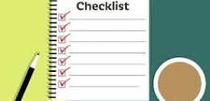
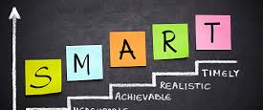

BSBWOR202 ORGANISE & COMPLETE DAILY WORK ACTIVITIES
POWERPOINT PRESENTATION 3
BSBWOR202

Slide 2
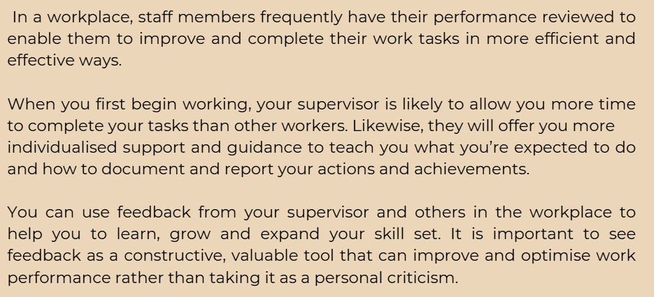
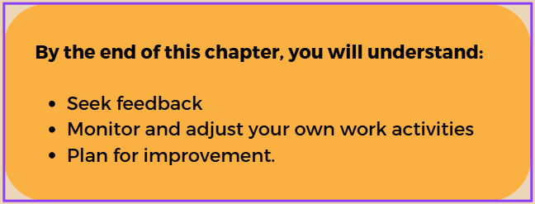
SECTION 3: Reviewing Work Performance
BSBWOR202

Slide 3
3.1 Seeking Feedback on Work Performance
Feedback is an important way of learning about the quality of your work performance
Feedback can be used in relation to many different types of tasks including
Techniques used when interacting with and providing support to clients
Communication that you engage with others
Leadership roles that you undertake
Reporting and documentation that you complete
Approaches that you use for resolving confict
Interaction, collaboration and support amongst your work team
BSBWOR202

Slide 4
How to Seek Feedback
Ask the following for feedback regarding your performance
Other people
Colleagues
Superiors
You can obtain feedback from another person in an informal way or receive feedback via formal methods.
We will discuss these on the next few slides
BSBWOR202

Slide 5

BSBWOR202

Slide 6
Informal Feedback
Things to consider:
Is the time of the meeting suitable?
What do you want to specifically know about your performance?
Is there something you are worried about that you do regularly?
Do you have an issue and are unsure how to resolve it?
Plan your questions in advance to get the best feedback
You could ask to meet or just have a discussion while working on a task together
Do you want them to observe you completing a task?
Do you want them to take notes or are you going to write down the feedback points?
BSBWOR202

Slide 7
Formal Feedback
Provided through processes at the team or organisational level and is known as a PERFORMANCE REVIEW
Performance Reviews provide valuable and detailed information to workers about their performance
Generally conducted yearly or on a half-yearly basis and customised to suit the worker
Reviews are the ideal means of learning more about your work performance
BSBWOR202

Slide 8

Complete 3A Inquiry Task on page 52
BSBWOR202

Slide 9
Areas covered in a performance review
Areas of performance where you may receive feedback include:
completion of work tasks
engagement with clients
collaboration with co-workers
decision-making and problem-solving
managing change
reliability
working safely
making client referrals
knowing and understanding your job
working within role boundaries
networking with other agencies and workers outside the organisation
commitment to your role
dependability and reliability
time management.
It is unlikely you will receive feedback on every aspect of your work performance.
Generally, a focus on specific areas that may change over time
BSBWOR202

Slide 10
Complete 3B Inquiry Task on page 54
BSBWOR202

Slide 11
3.2 Monitoring and Adjusting Work Activities
Based on feedback, you may need to make adjustments to the way you carry out your work tasks
It might be: -
To improve your work performance
To make certain changes
Align your own performance with others doing similar roles and have a similar level of skill and experience to you
BSBWOR202

Slide 12
Written Standards
Specify exactly how tasks should be completed in many workplaces
Include details regarding allocated tasks:
The amount of time
The resources required
May apply to both team-based expectations and to the organisation as a whole
BSBWOR202

Slide 13
Written standards might apply to areas of work performance such as:
Conducting intake assessments
Completing phone interviews
Providing remote support
Writing individual plans
Updating client files
Completing summary reports
Writing and submitting referrals
Writing and distributing meeting agendas and organising meetings
All tasks above require different resources and time allocations; different types of work performance and outputs; and some are face-to-face with clients and others administrative or document-based tasks.
BSBWOR202

Slide 14
Complete 3C Inquiry Task on page 56
BSBWOR202

Slide 15
Comply with Legislation Requirements
Many work tasks must be completed in compliance with state/territory and federal legislation
This applies to:
Records management
Privacy
Record keeping
Data Management
BSBWOR202

Slide 16
3.3 Planning for Improvement
Members of work teams often combine their skills and knowledge to allow them to collaborate in achieving goals and the overall team performance
Helps teams to contribute to organisation goals and strategic direction
As a member of a work team, it is likely you will be involved in planning ways to improve the team’s performance over time
BSBWOR202

Slide 17
Strategic Team Plans
May be developed by a work team that details of how the team members will work together to achieve their goals
Could form part of a continuous improvement cycle that links with organisational strategies
Can include:
Long-term goals for performance
Short-term goals for performance
Performance indicators to determine how the team will recognise success
The names of whomever is responsible for each area of performance and improvement
Great way of developing your skills for the future
This is how several people become leaders and managers in the community services and health industry
BSBWOR202

Slide 18


Slide 19
Planning Opportunities to Improve
You may notice opportunities to improve your performance in collaboration with your colleagues
This could be as it may not be as effective or efficient as it could be
You may notice how things could be done more efficiently or more effectively through changes or improving systems at work
If you do notice this, it is important to share your ideas with your team
BSBWOR202

Slide 20
Formal Opportunities
Formal opportunities through Professional Development or additional training
In an ever-changing industry accessing formal opportunities for Professional Development and Training can help you and your work team to improve your combined and individual performance
Read the case study on page 58
BSBWOR202

Slide 21
Complete 3D Inquiry Task on page 59
BSBWOR202

Slide 22
Key Points
Feedback should be considered as a positive, helpful feature of working in community services and health and not as personal criticism.
Feedback from your supervisor and others in the workplace can help you to improve your work performance.
Many organisations have written standards that set out how a task should be completed.
You should aim to align your work performance and outputs with the requirements and expectations of your supervisor and organisation.
There are many opportunities that you can access, both individually and as a work team, to help to improve your performance and achieve goals.
BSBWOR202

