Slide 1
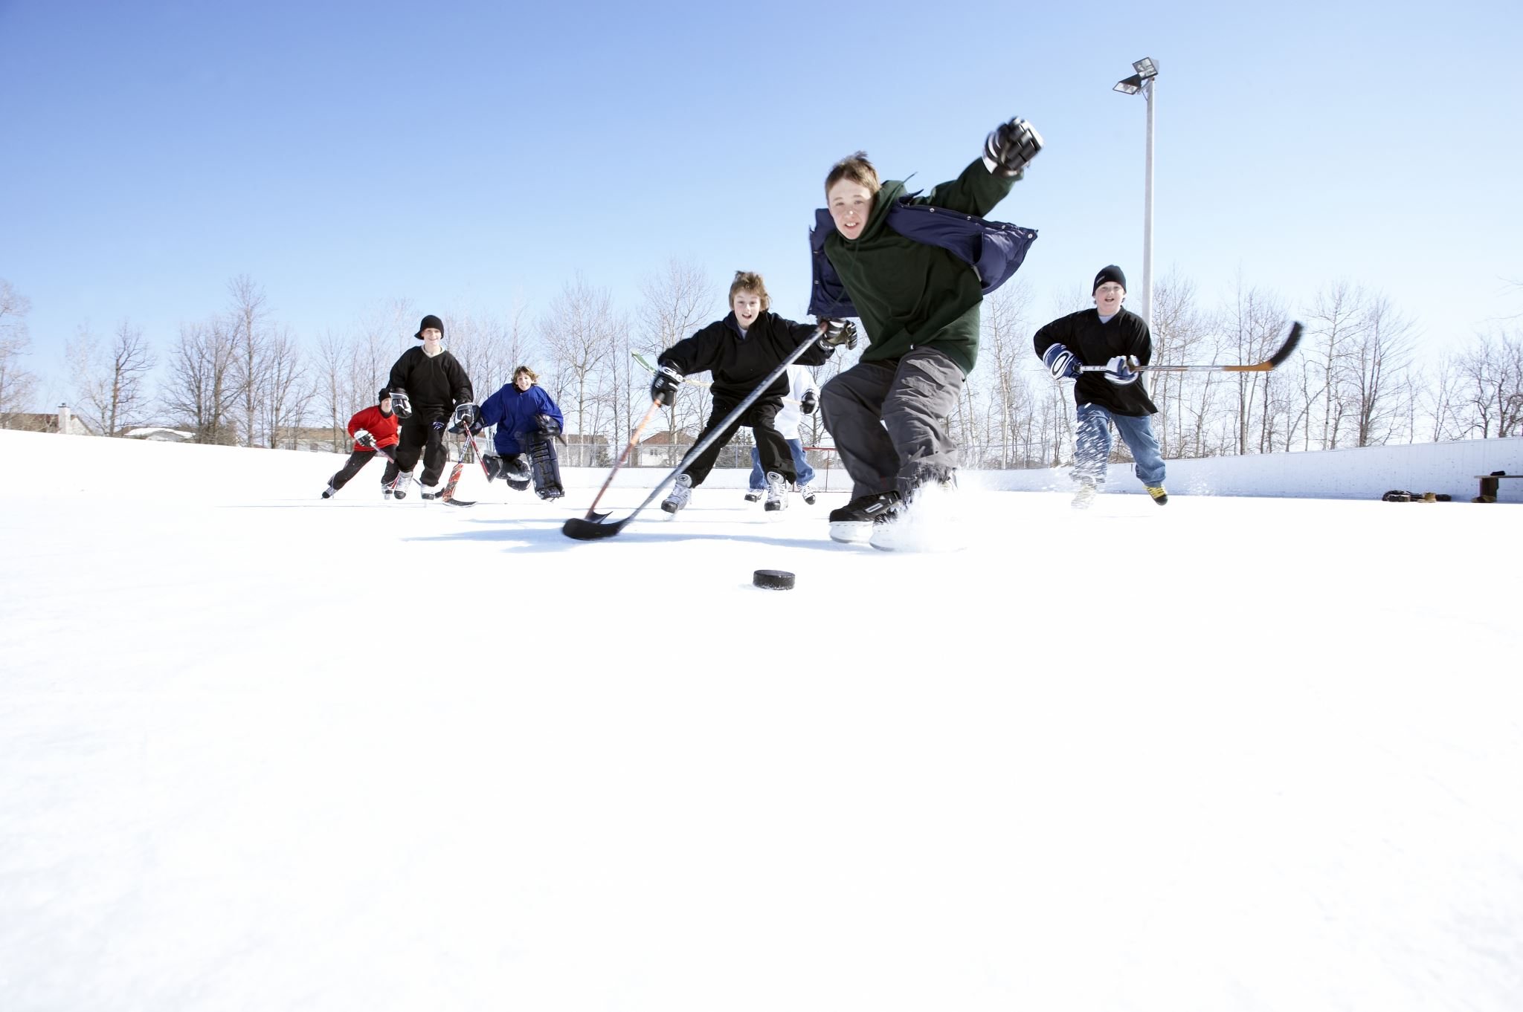


Slide 2

Your role as an assistant in a sport and recreation activity, will provide you with invaluable experience, equipping you with the necessary skills and knowledge to confidently lead your own session one day.

Slide 3

To ensure a smooth sport and recreation session, it is essential to have a clear understanding of the session activities and your role.
Activity logistics: When planning to assist in conducting a sport and recreation session it is important to double-check all details and logistics before you start
Objectives: When getting ready to assist with a sport and recreation session one of the first things to do is understand the objectives of the session and what the session aims to achieve.

Slide 4
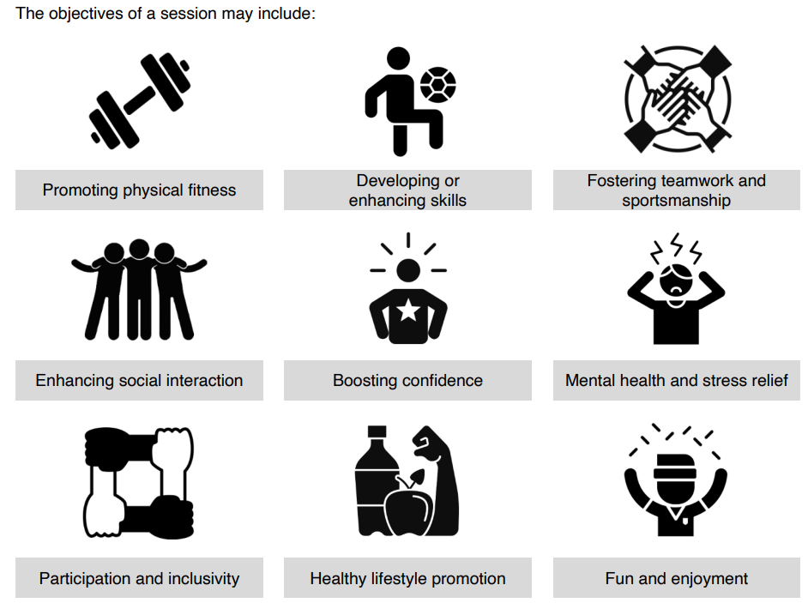

Complete Inquiry task 1A on page 6

Slide 5
Participant characteristics and abilities
Find out who will be participating in the sport and recreation session you are assisting with.
These may include, children, adults, older adults, tourists, those with disabilities and school groups.
Knowing who they are will enable you to tailor your approach, ensuring a safe, enjoyable and fun experience for everyone involved.
Complete Inquiry task 2 on page 7

Slide 6
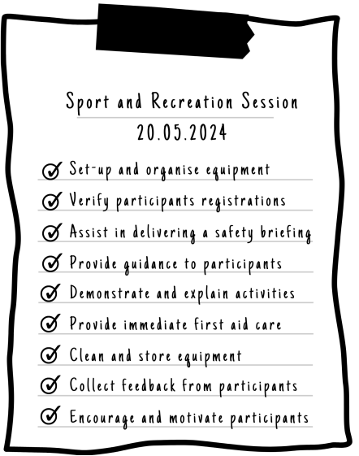
What’s your role?
Before any sport and recreation session it is important to determine what your individual role is and what tasks that you are responsible for
Here is an example of some of the roles and responsibilities

Slide 7

Equipment
Select equipment to suit each participant according to their:
• Age, size and weight
• current experience in the recreational activity and skill level
• fitness level and physical capabilities
• injuries and medical conditions
Check the equipment for
Functionality
Safety
Durability
Compliance
Complete Inquiry task 3 on page 11

Slide 8

Identify potential hazards and risks
Conduct a risk assessment or analysis
Make note of potential hazards – i.e. equipment, uneven surfaces, weather
Evaluate the hazards
Take steps to reduce risks
Plan for emergencies

Slide 9

Clothing and Footwear
Before starting any activity, you must ensure that all participants are wearing clothes and footwear that is appropriate for the planned activities
Check that what they are wearing is
Comfortable
Fits properly
Appropriate
Safe
Complete Inquiry task 4 on page 13

Slide 10

Clothes Requirements Remove all jewellery Do the clothes allow a full range of movement? Are clothes weather appropriate Do they comply with uniform standards?

Slide 11
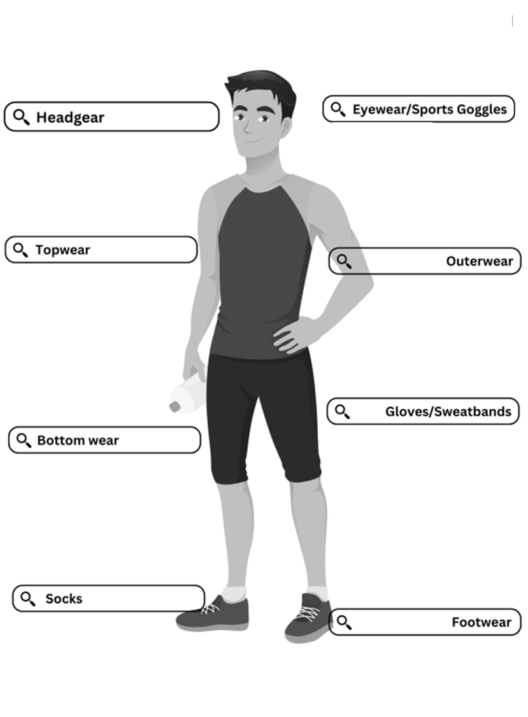
Helmets, Hats, Beanies
Sunglasses, Goggles
Jersey, Uniform
Jacket, Rain Coat
Compression garment, Swimwear
Gloves for warmth or grip, sweatband
Suitable socks
Appropriate footwear
Complete Inquiry task 5 on page 16

Slide 12
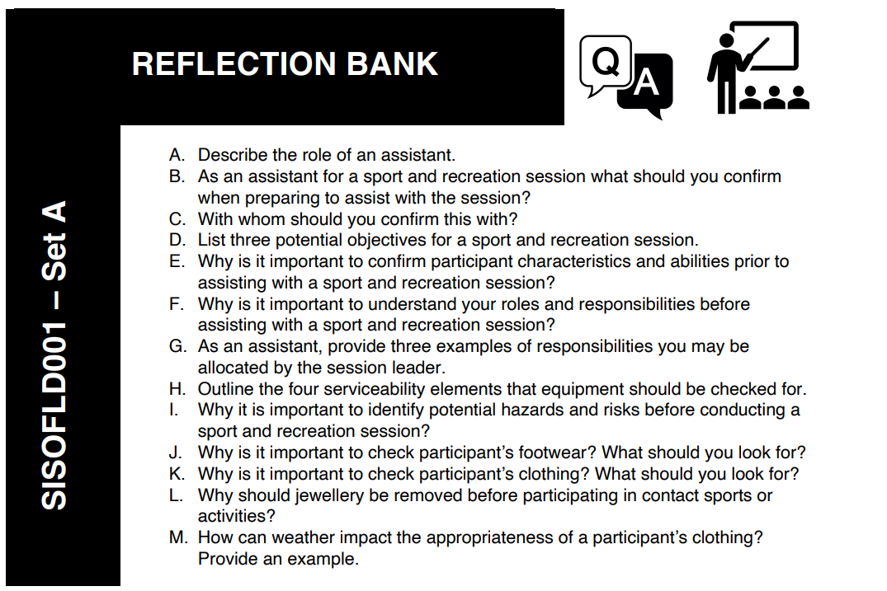

Slide 13

Fitting Equipment
When fitting equipment
Measure participants for size and have them try items on
Assist them in wearing items properly
Ensure it fits correctly and they are comfortable

Slide 14

Activity rules, safety procedures and communication protocols
To keep activities Safe
Be aware of rules
Know and practice safety procedures
Emphasise importance of safety
Emphasise clear communication
Complete Inquiry task 6 on page 19

Slide 15

Assist with session activities
To assist a participant with their technique and use of equipment, you could:
Provide demonstration
Break steps down
Encourage questions
Offer hands on assistance
Provide feedback
Complete Inquiry task 7 on page 24

Slide 16



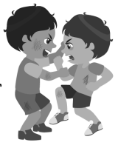
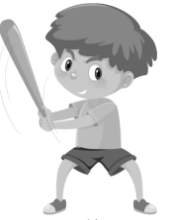

Assist with monitoring participant behaviour
Common poor behaviors include:
Disruptive behaviour
Not participating
Aggressive behaviour
Cheating / Bad Sport
Ignoring safety
Negative attitude / refusal

Slide 17






Depending on the situation, there are several techniques that you could use. You could:
Ignore the behaviour
Interact with the participant
Use feedback
Involve them more
Speak to them
Sit them out

Slide 18

Monitor Equipment
Ask participants to point out faulty equipment
Set aside broken items immediately
Mark/tag the defect
Report
Repair or Replace

Slide 19
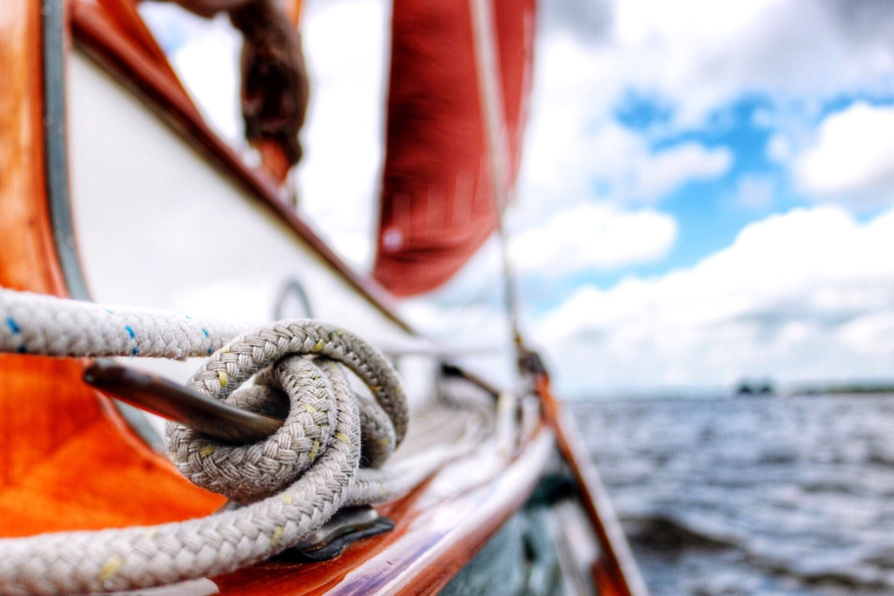


When the session is complete
Retrieve all equipment
Check for any damage
Organise equipment
Store securely and safely
Complete Inquiry task 8 on page 29

Slide 20
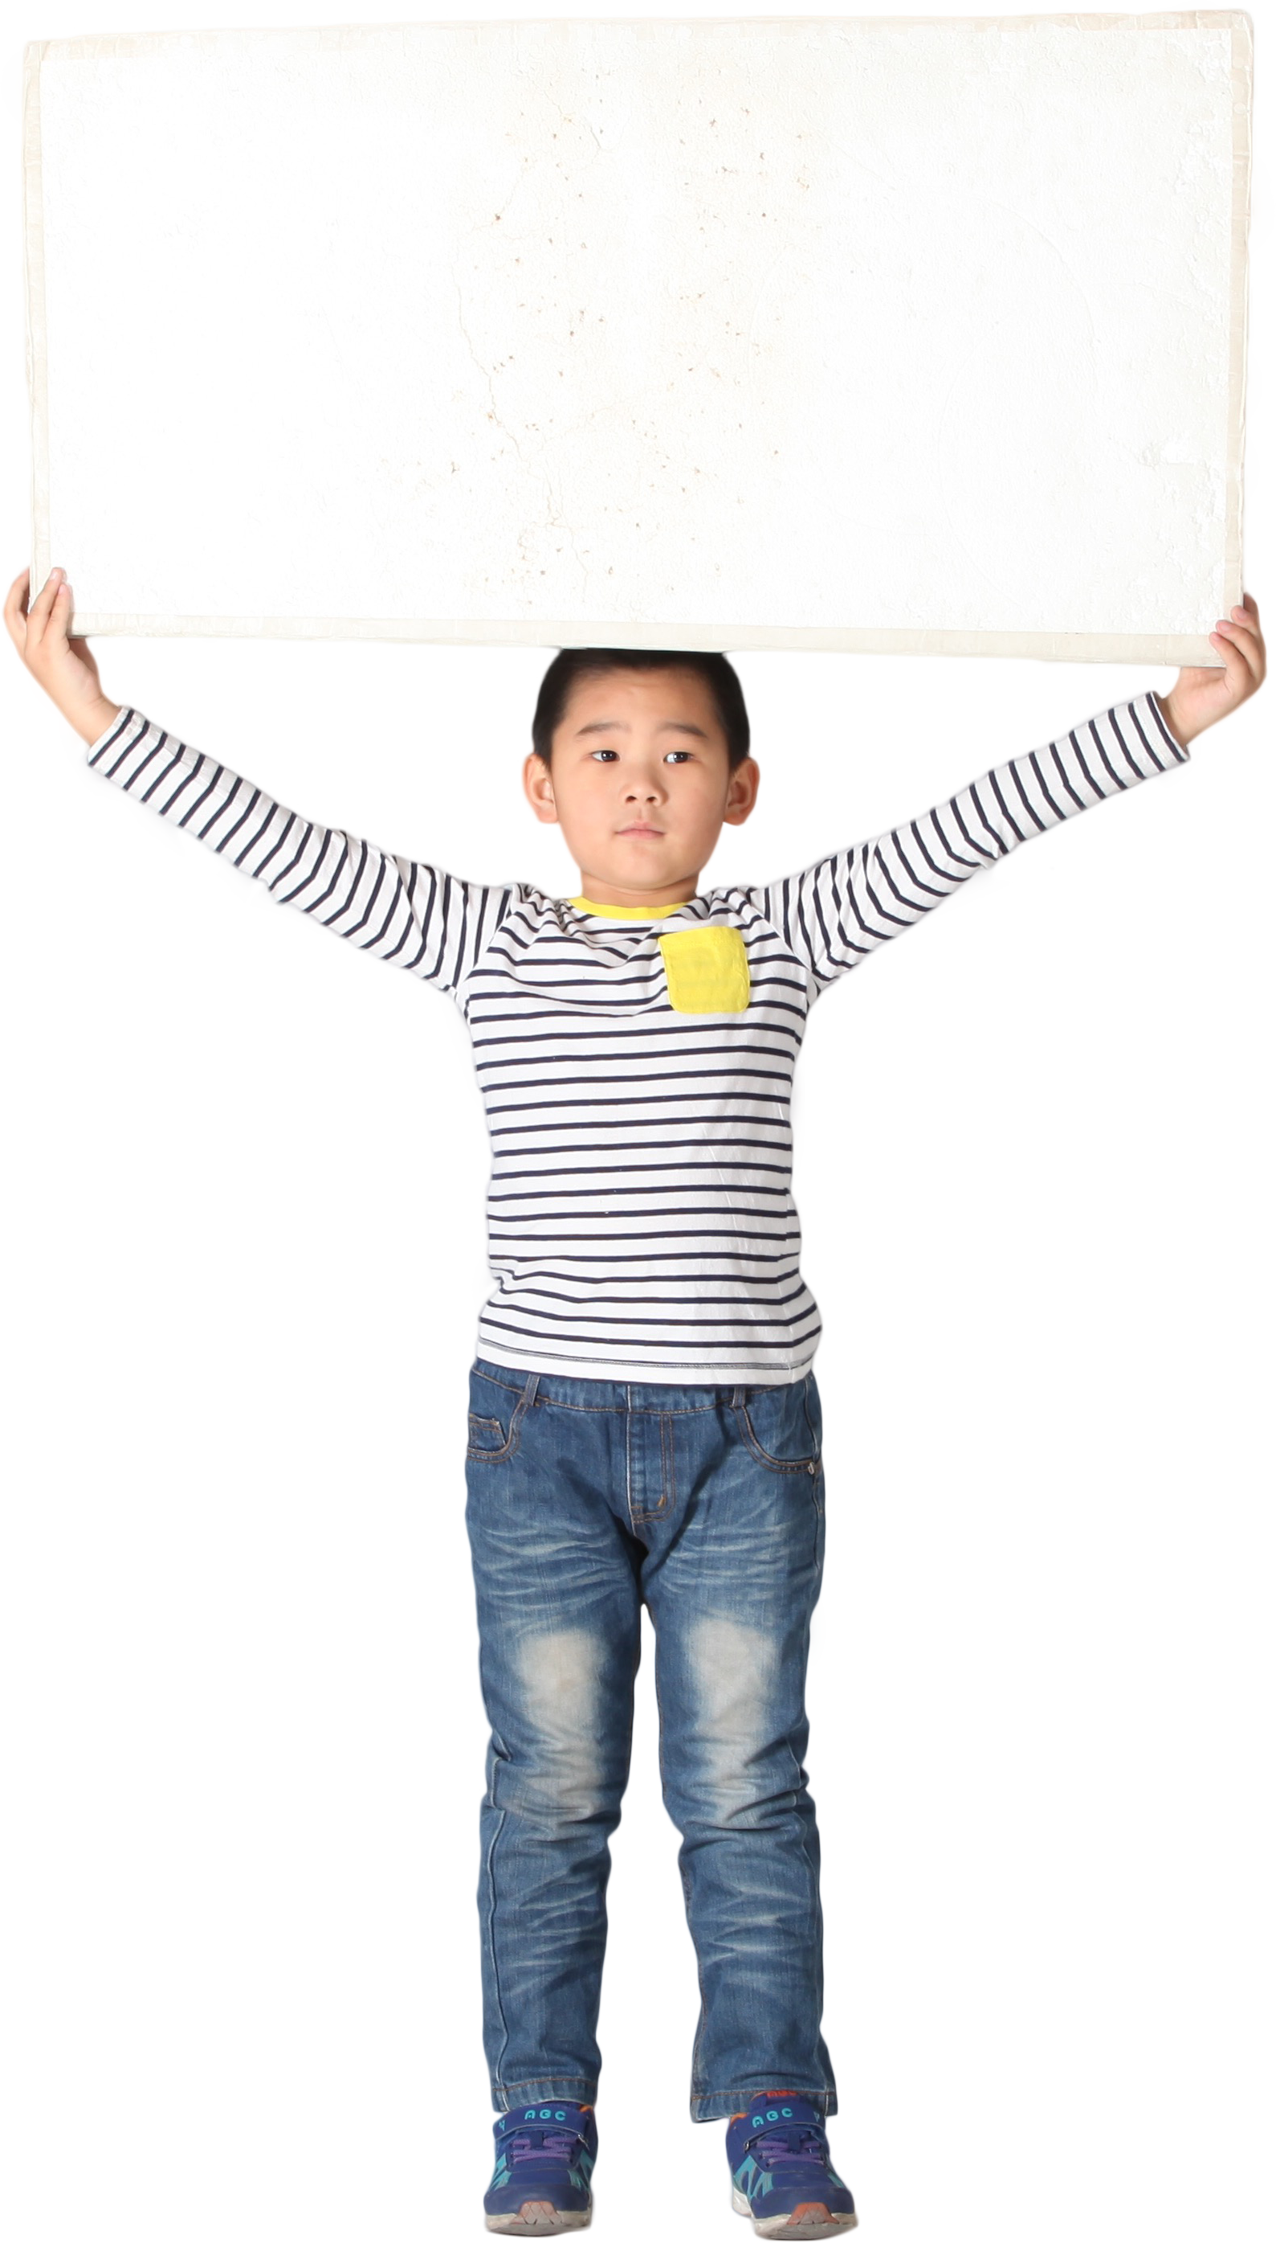
Debriefing
Debriefing is an opportunity to gain valuable feedback that can be used to improve future activities.
Can be formal or informal
Encourage feedback
Ask open ended questions to assist feedback
Actively listen to participants
Constructively discuss necessary improvements
Good Job
Complete Inquiry task 2E on page 81

Slide 21

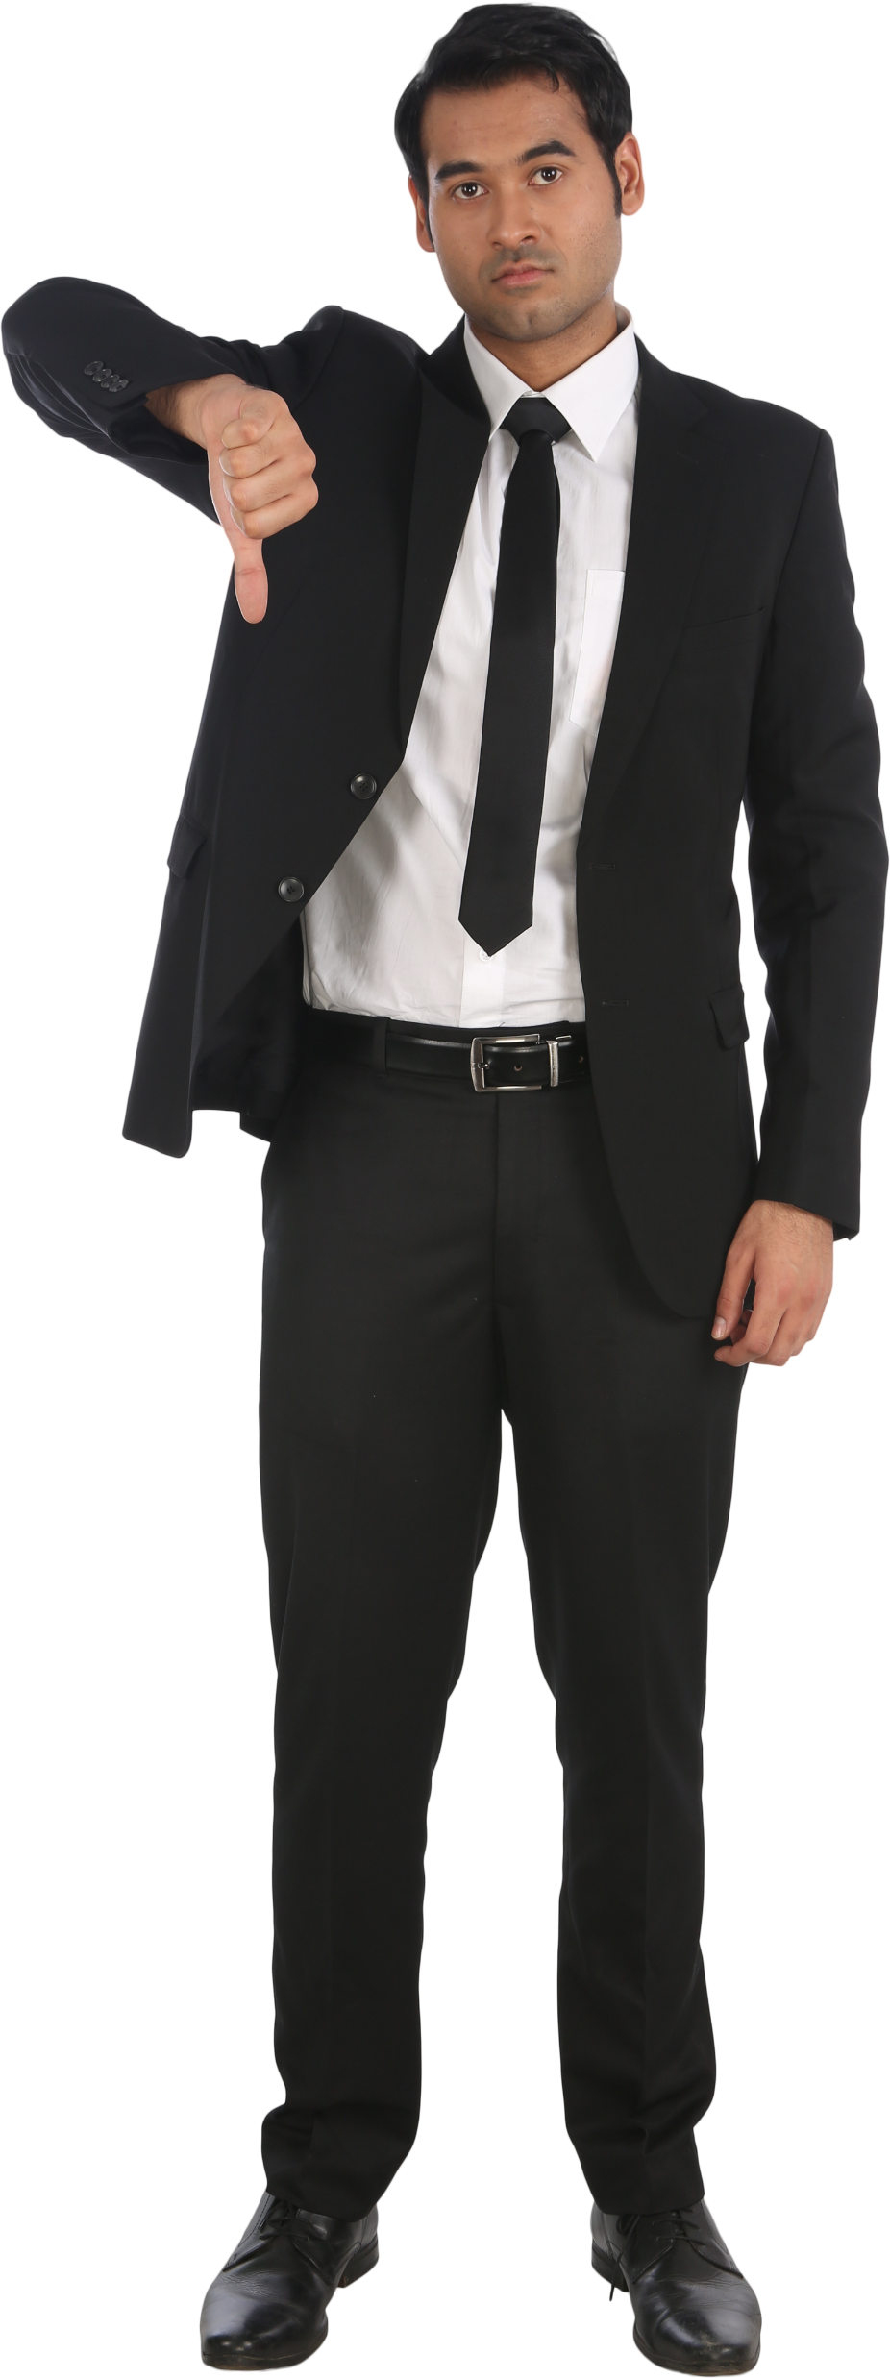
Review your own performance
Self assessment encourages improvement.
After debrief, take a moment to think about how you went.
Did you handle any challenges that arose?
Set realistic goals based on feedback for later sessions

Slide 22
